Slide 1


Generating Traffic Profiles and dealing with Deviations from Profile
Alvaro Cabrejas Egea
Supervisor: Colm Connaughton

Slide 2
Forecasting Traffic: Profiles
Current profiles: Some form of EWMA
Black Box
Sensitive to extreme events that can create distortions
Updating profiles causes discontinuities in data (profile shifting)
Solution based on the assumption that most weeks can be described as an average version of their neighbors

Slide 3
Forecasting Traffic: Profiles
Proposed profiles: Frequency filter and Seasonal analysis
White Box
Resilient to extreme values and short term oscillations
No profile shifting, no discontinuities
Solution based on the assumption that there is an underlying minimal profile per link that characterises it. Measurements fluctuate randomly around the profile.
Accounts for different kinds of seasonality

Slide 4
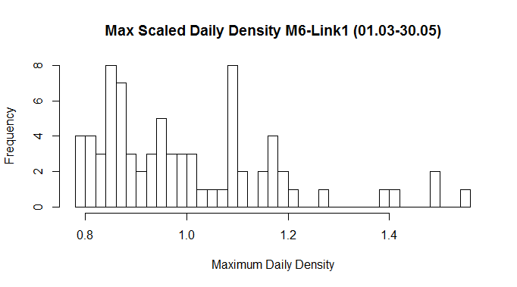
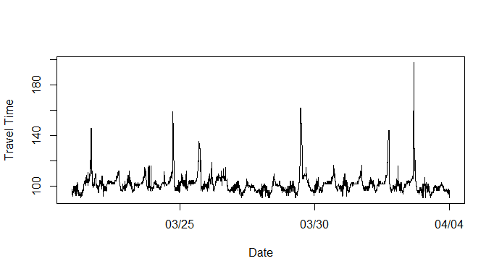
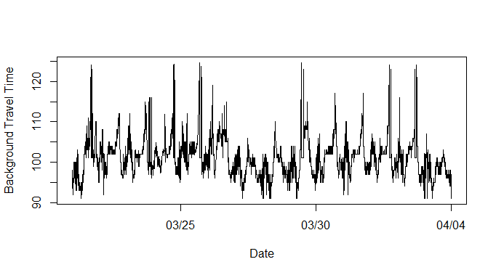
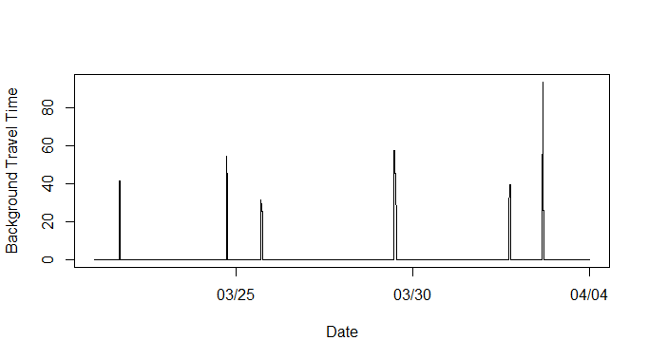
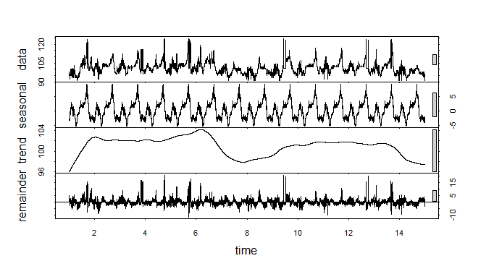
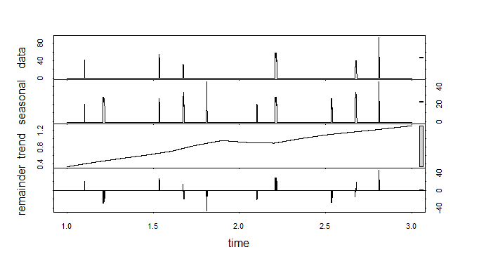
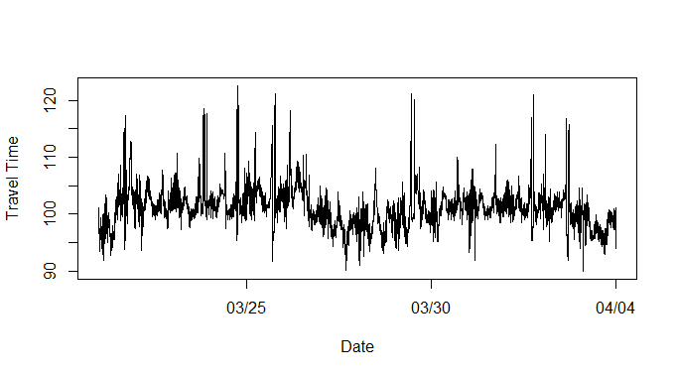
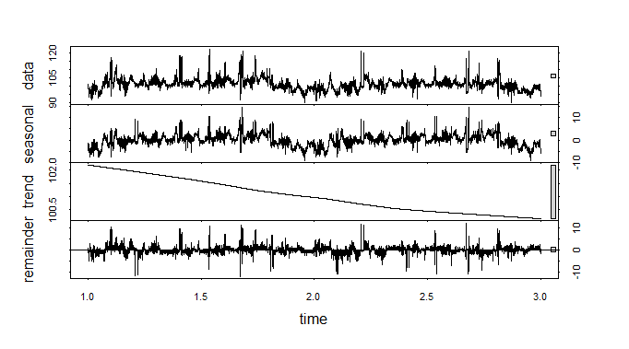
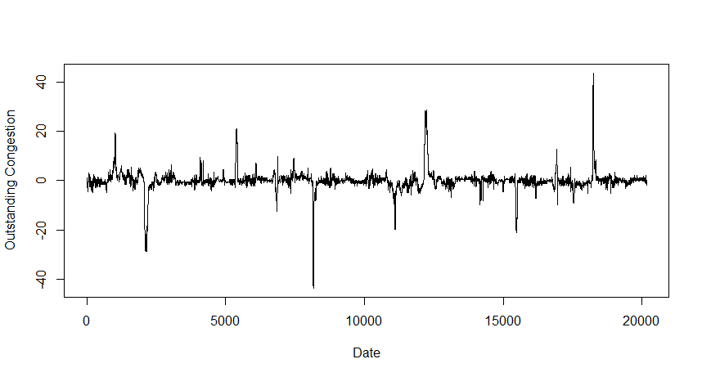
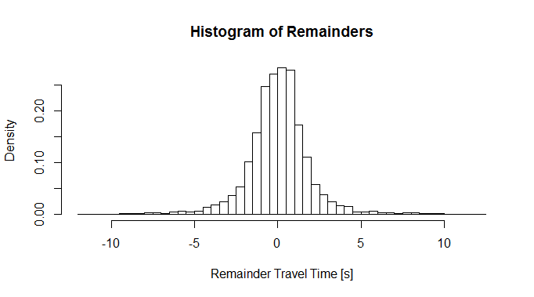
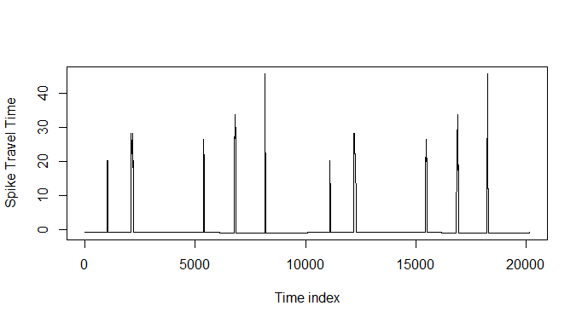
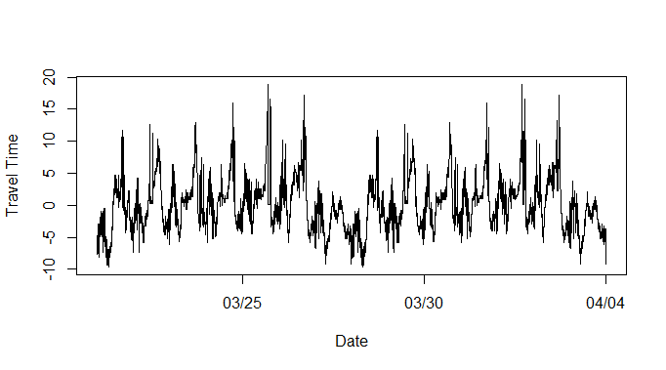
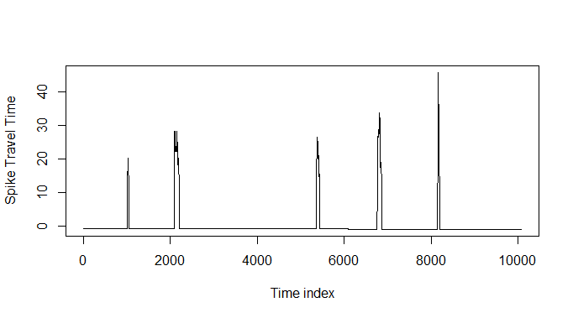
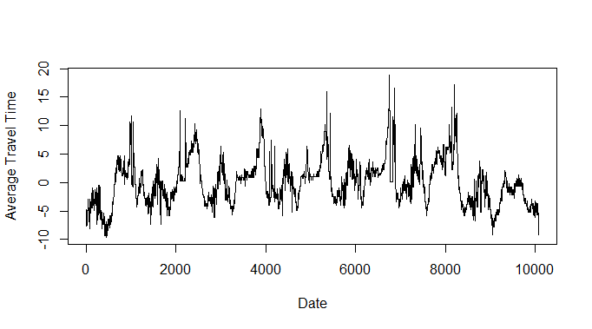
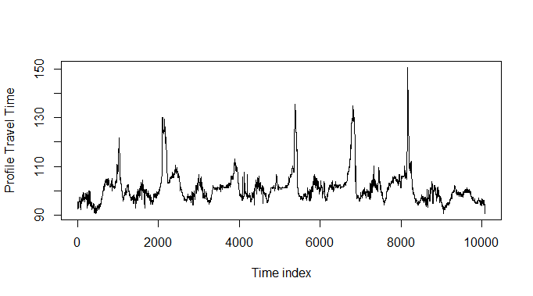
Time Travel
Clean Data
Average Max Daily
Threshold Filter
Background
Spikes
STL
Daily period
STL
Weekly period
Seasonal
Day
Trend
Background
Remainder
Background
Trend
Spikes
Remainder
Spikes
+
+
Deseasonalised data
(Day)
Outstanding Congestion
STL
Weekly period
Seasonal
Week
Trend
Remainder
Seasonal
Spikes
Substitution by median
Distribution check
Average over weeks
+
Seasonal Background
Seasonal Spike Weekly Basis
Average over weeks
Seasonal Background Weekly Basis
+
Profile

Slide 5
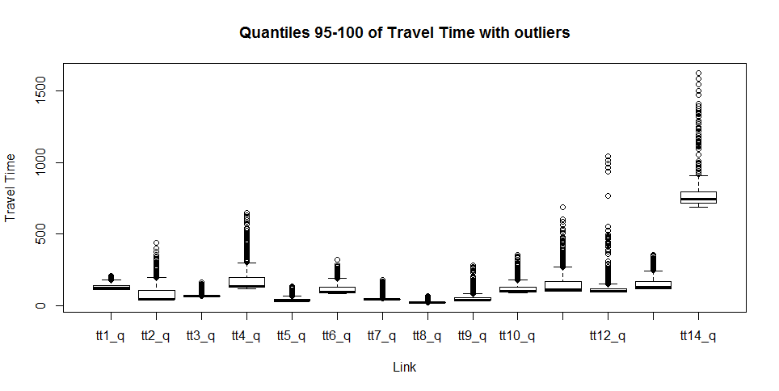

Slide 6
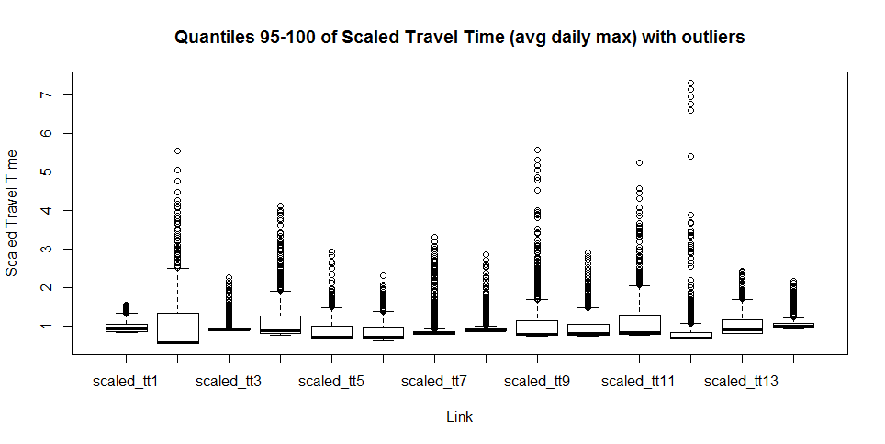

Slide 7
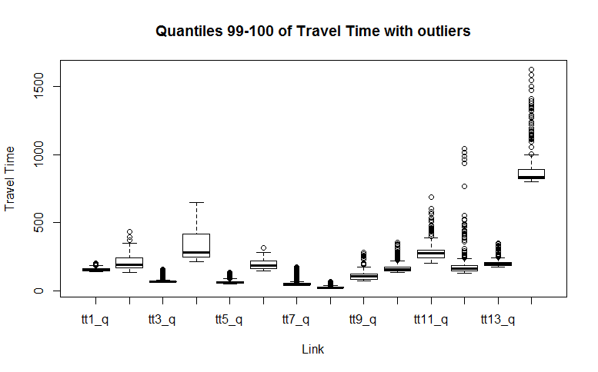

Slide 8
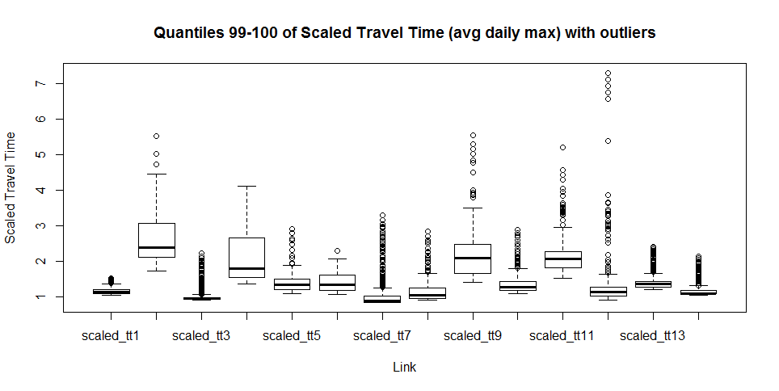

Slide 9
Profiles: Figures
Q1-100
Q95-100
Q99-100
Daytime
Daytime negative errors

Slide 10
Deviations from Profile
RSG Project 2016: Forecasting Return to Normal time during Deviations from Profile
Null Model
Published Method
Linear Model
Midpoint prediction
Dynamic Trapezoid
These can benefit from more adequate profiles: more accurate DPEs

Slide 11
Results Summary
Standard Deviation Scaling methods proven valid
OSA shows better and faster convergence than WH
OSA performs better for all run lengths
Solution proposal strategy in WH does not seem to play on its favour. Lack of data for stronger statement
Common Random Numbers has negative effect in the Rosenbrock problem
OSA’s resampling approach discourages fix sample size
Notes:
For reducing noise in the test, not inherent to system in real life.
Yes
Idem
3 behaviors don’t seem to add benefit
It has a positive one in Fourier, but the implementation is probably missing details about WH which were not obvious. No way to test.
Because OSA is by definition variable sample size. These adaptations play directly against it.

Slide 12
DPEs: Figures
Min 5 minute DPE, long jam
Min 6 second DPE, all jams

Slide 13
Further Work
Individualised thresholding for each link
Longer timeseries
Sensitivity analysis (variable training/prediction ratio)
NEW : Shockwave absorption for self-driving cars
NEW: Fluid-Dynamic models for Motorways and Ramps
NEW: Traffic Prediction with Data Assimilation

Slide 14

Thank you!
Any questions?

