Slide 1



A speed memory game for forgetful fishies
Terminal Application Assignment – Work in Progress
Annabelle Caspersz

Slide 2
General Design of Application
The general plan for the game is:
The player has 45 seconds - 1 minute to correctly match as many symbols as possible.
The symbol must match the symbol immediately previous to it.
If the symbol matches, the user needs to press 1 to be correct
If the symbol doesn’t match, the user needs to press 0.
All correct and incorrect guesses will be stored and user given a score.

Slide 3
Purpose of Application
A flash card based matching game that tests user’s informational processing (IP) ability.
Informational processing is important because:
Directly correlates with reading and math ability in children
Can be affected in executive dysfunction conditions
This ability can decrease with age: cognitive decline & frailty
Game is designed to help the user test and improve IP/short term memory, as brain training games have been shown to improve many areas of cognitive function.

Slide 4
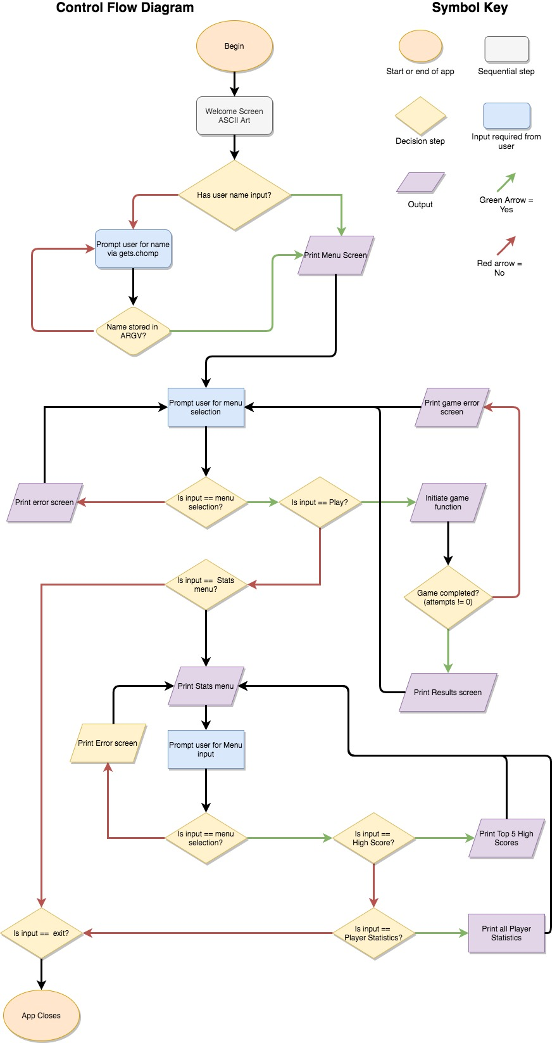

Slide 5
Features
Username collected and stored in ARGV
Begin/end /rescue
If/else statements
Menu: Play Game, Stats and Exit.
Uses loops, hashes, tty-prompt
Game initiation (flash card game)
Uses many (MANY!) loop arguments, classes, modules

Slide 6
Development Process & Challenges
Positives: TTY Prompt
Negatives: Not fully functional yet!
Not DRY!!
Struggling to bug fix and refactor my code to MVC
Want to incorporate many more features and ’sprinkles’!
Collect stats
Timer countdown
Remove the need for pressing enter during game
Track response time so can give average response stats

