Slide 1


Analysis of user behavior with the device and marketing recommendations for the company Bellabeat
Google project
by Eng. Andrea Cendón Durán

Slide 2

Business Task
Analyze the data from the company to identify user behavior patterns and factors influencing their engagement. The goal is to present the analysis results and the recommendations to the stakeholders to strengthen the marketing strategies.

Slide 3


Objectives of the analysis
Identify trends among users.
Determine features or sections that promote participation.
Provide data-driven recommendations for marketing strategies.

Slide 4
Methodology
Eight analyses were performed:
Number of records per ID
Records per day of week and type of day (Weekday or Weekend)
Adherence analysis based on minutes of use
Compare Adherence vs. Number of Records
Mobility Profile of the Users
Relationship between Total Steps and Calories Burned Daily
Comparison between average steps on weekends vs weekdays
Classification by type of day and activity profile

Slide 5
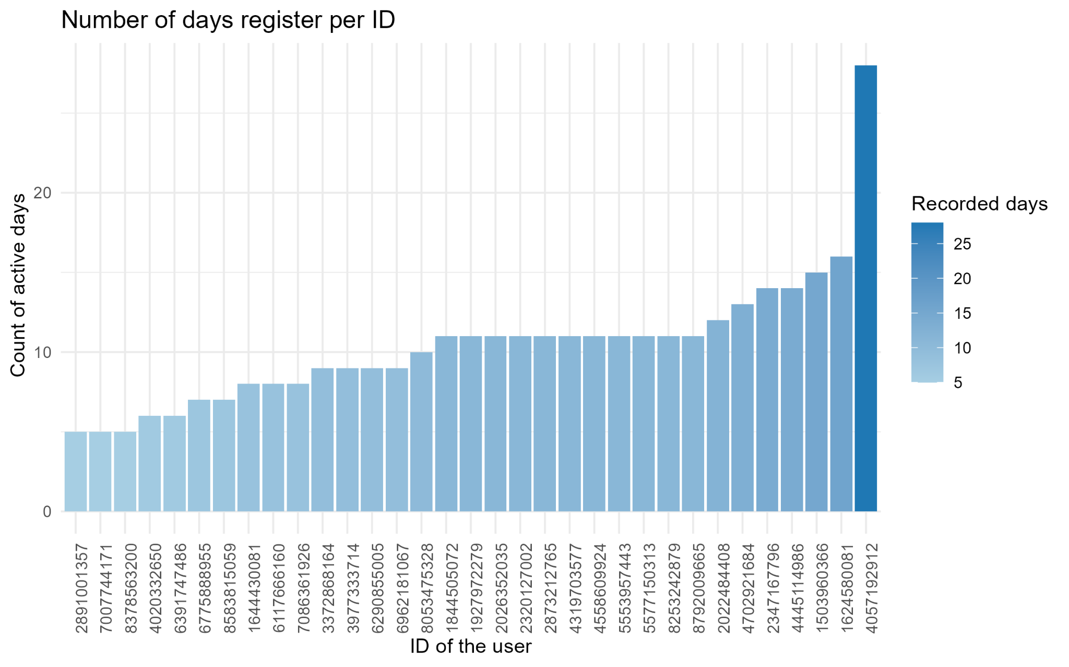
Analysis 1: Number of record per ID
Findings:
Half of the users have between 8 and 11 records.
Five users have less day 8 records meaning a low usage or possible abandonment of the device.
Only one user have 28 records.
Recommend strategies:
Gently personalized reminders aimed at low-activity users
Rewards for daily use
Social integration and competitions
Education on benefits and results
Programas de seguimiento proactivo
Figure 1.- The bar chart shows the number of days each ID has been registered. Each bar represents an ID; the intensity of the blue color increases with the number of records for that user.

Slide 6
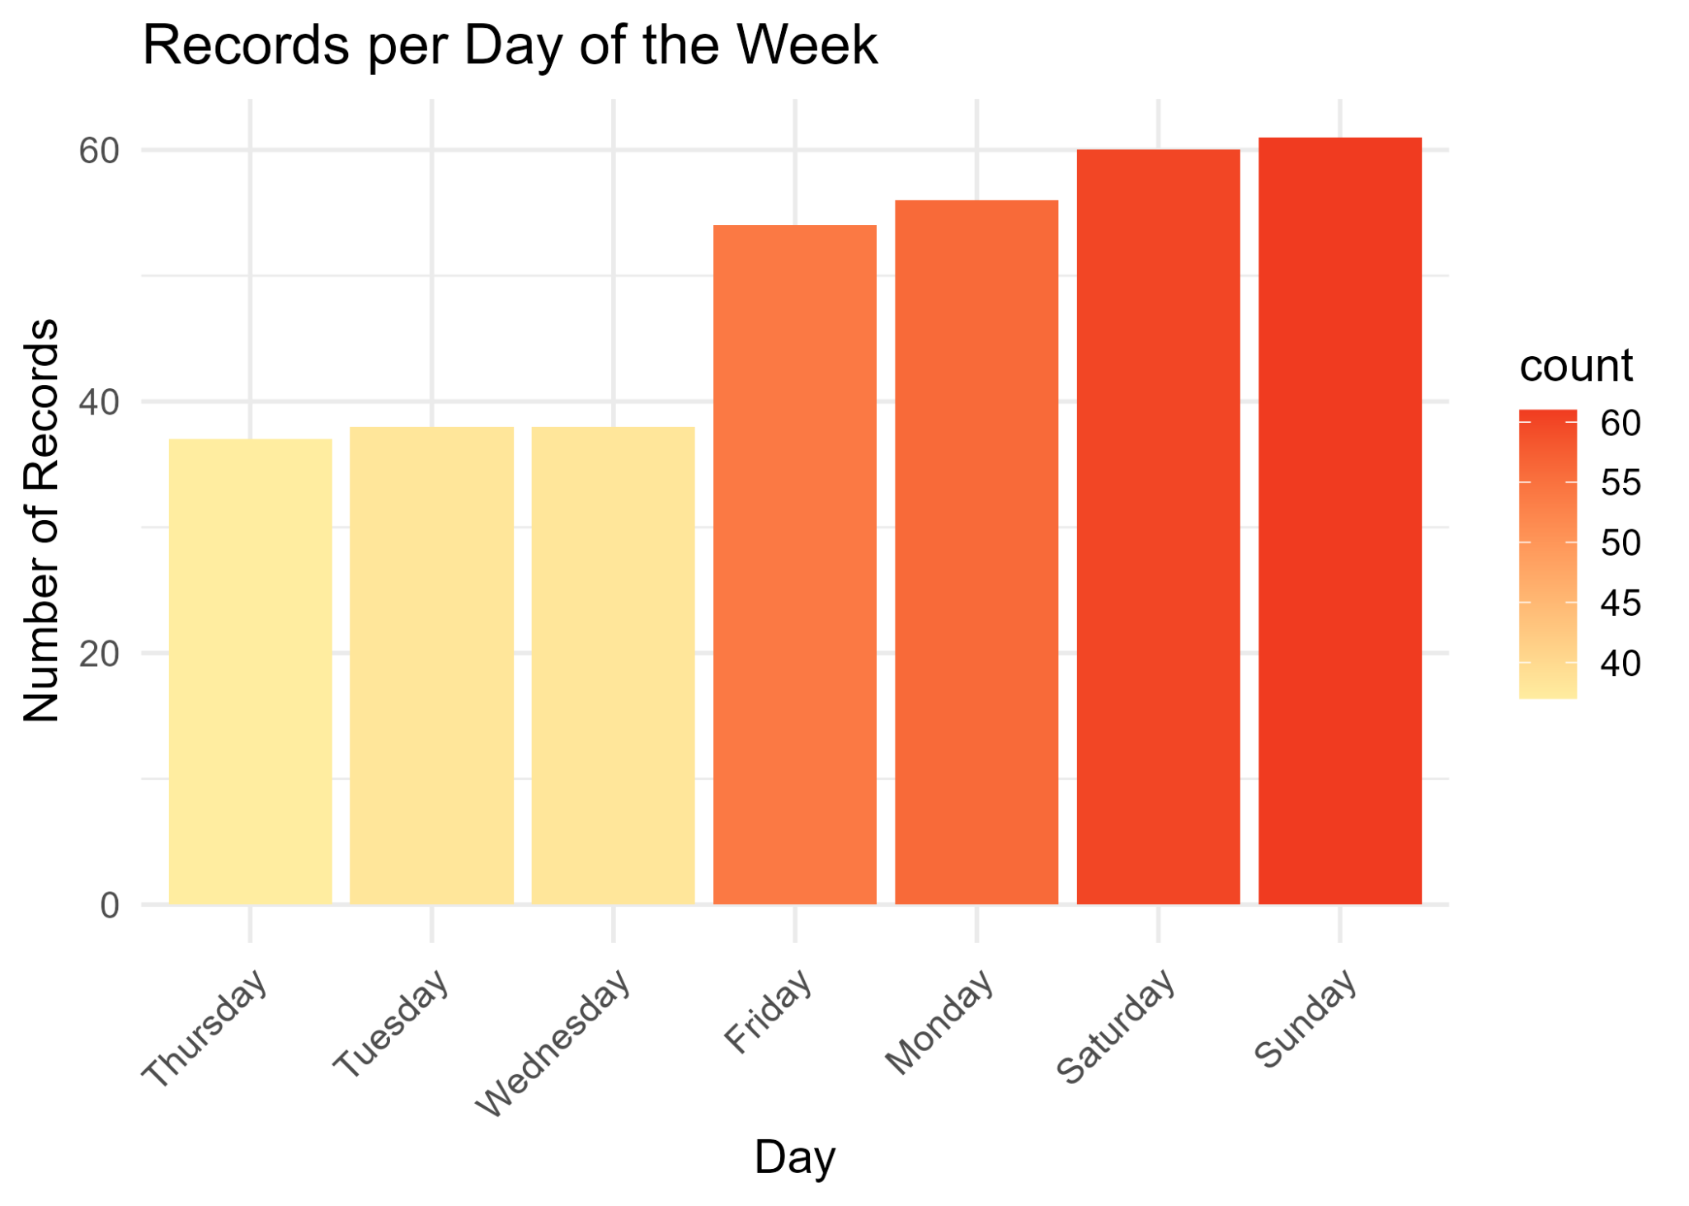
Analysis 2: Records per day of week and type of day (Weekday or Weekend).
Findings:
Total records are higher on weekdays (223) than weekends (121), but this is due to more weekdays in the dataset.
Average activity is higher on weekends (60.5 records/day) than weekdays (44.6 records/day).
Sunday has the highest number of records (61), followed closely by Saturday (60).
Recommend strategies:
Send reminders or tips during weekdays
Highlight weekday benefits
Weekday mini-challenges
Progress insights & streaks
Figure 2.- The bar chart represents the number of records per day of the week. The yellow bars show low user activity, the orange bars show medium activity, and the red bars show high activity.

Slide 7
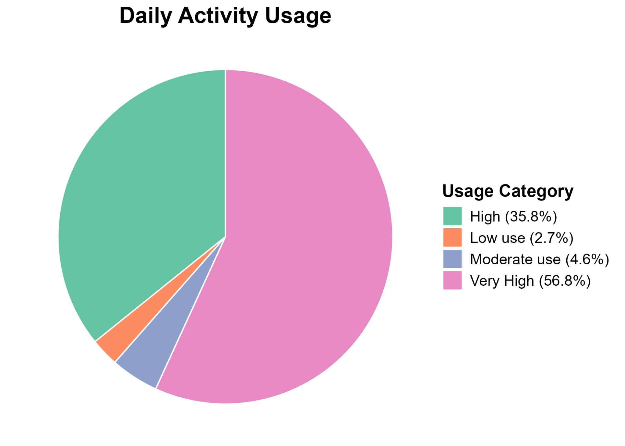
Analysis 3: Adherence analysis based on minutes of use
Findings:
92.6% of days show high or very high usage.
56% of days are very high usage.
Only 7.3% of days have moderate or low usage.
Users consistently exceeded 12 hours/day, ensuring reliable data.
Recommend strategies:
Loyalty rewards
Personalized summaries highlighting progress and trends
Reward consistent users with access to premium functions or analytics.
Figure 3.- The pie chart shows the results in percentage of the daily usage of the device, classified into four categories: very high, high, moderate, and low.

Slide 8
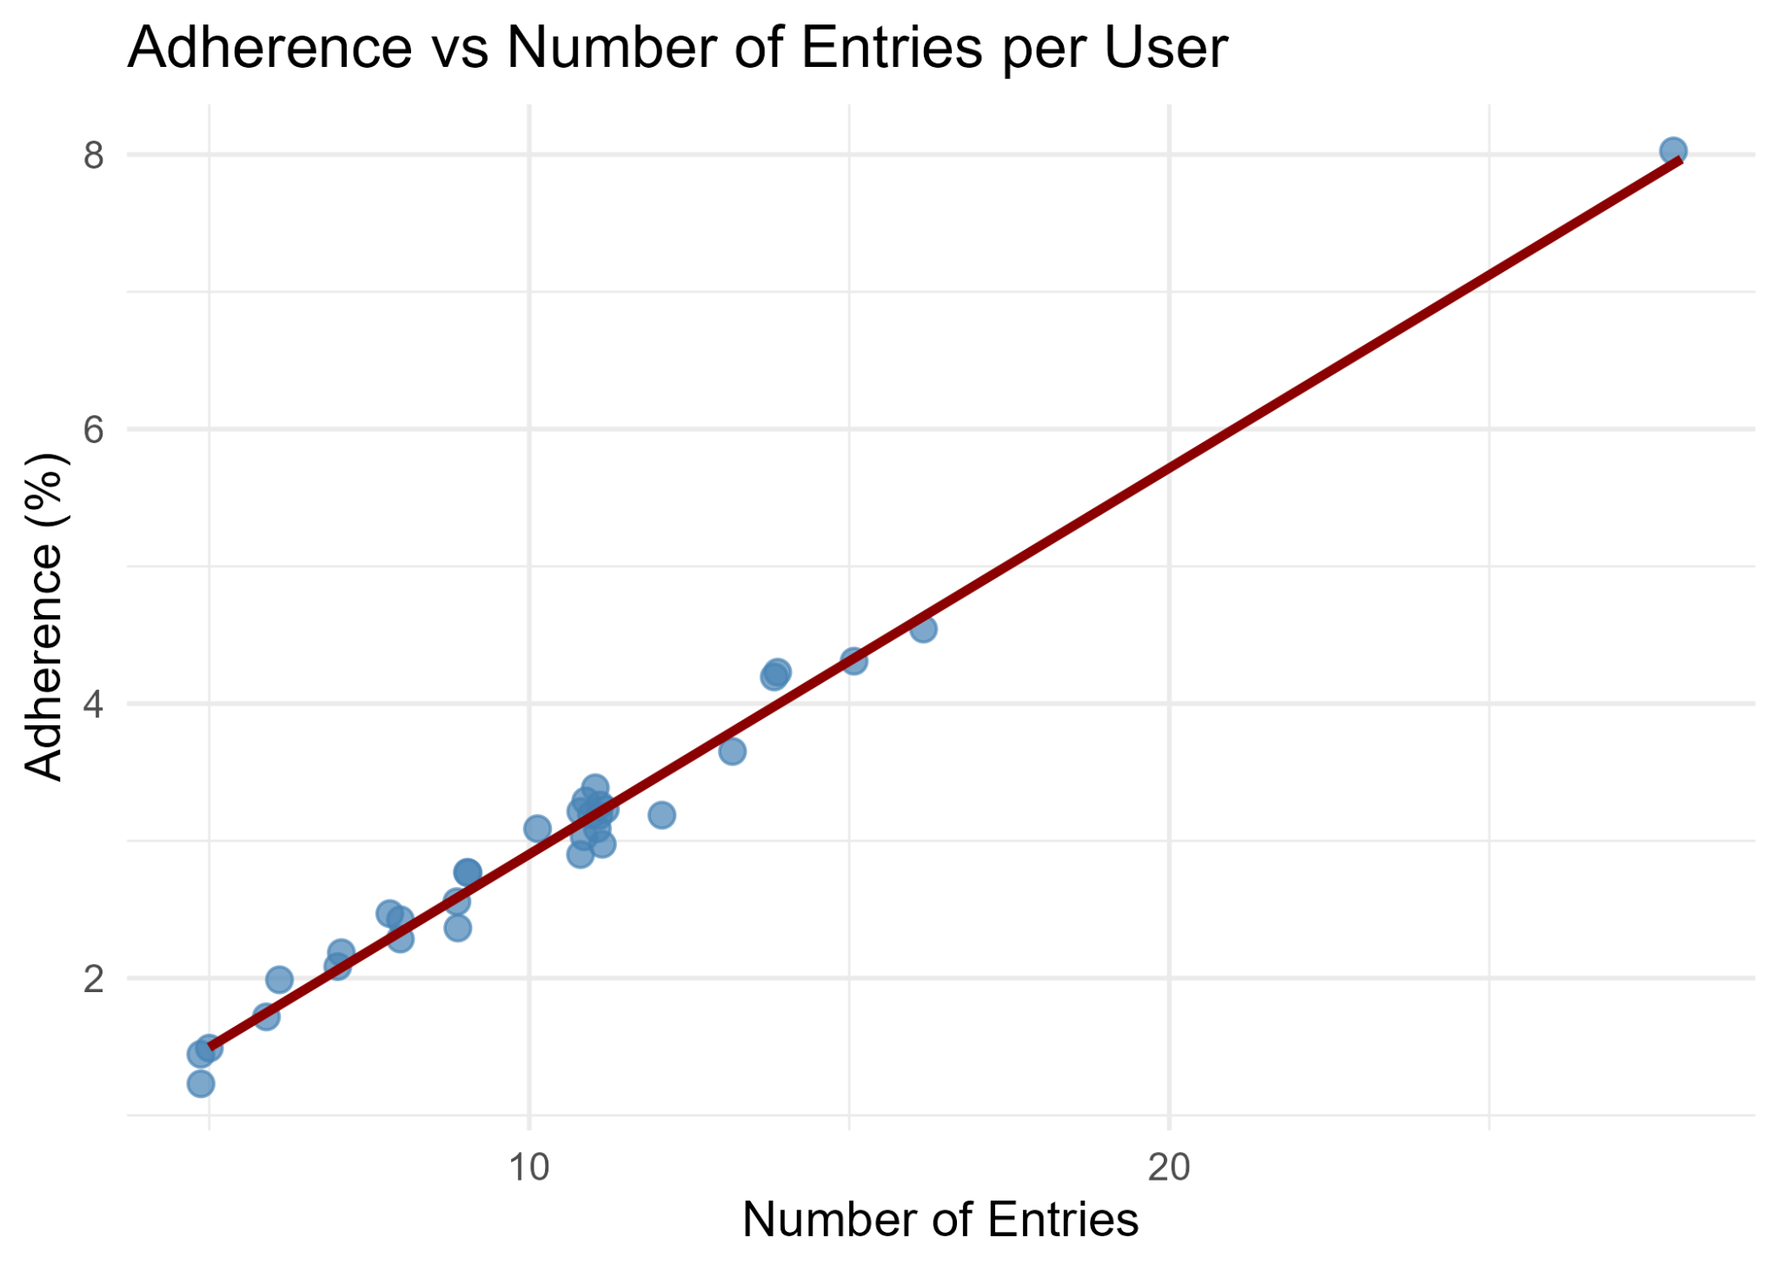
Analysis 4: Compare Adherence vs. Number of Records
Findings:
Only 33 users met minimum quality standards.
Most users have 5–16 records.
Majority of users show 0–5% adherence; one user reaches ~8%.
Strong positive correlation.
Pearson correlation: 0.994 Near-perfect relationship between variables.
Recommend strategies:
Motivate users to record data daily to boost adherence
Progress tracking & feedback
Showcase users with high records and adherence as motivation for others.
Figure 4.- Scatter plot showing the relationship between the percentage of time each ID uses the device and the number of records per user. Different IDs are represented by the blue dots, while the trend line is shown in red. The darker blue dots represent an overlap of IDs that have the same values on both axes.

Slide 9
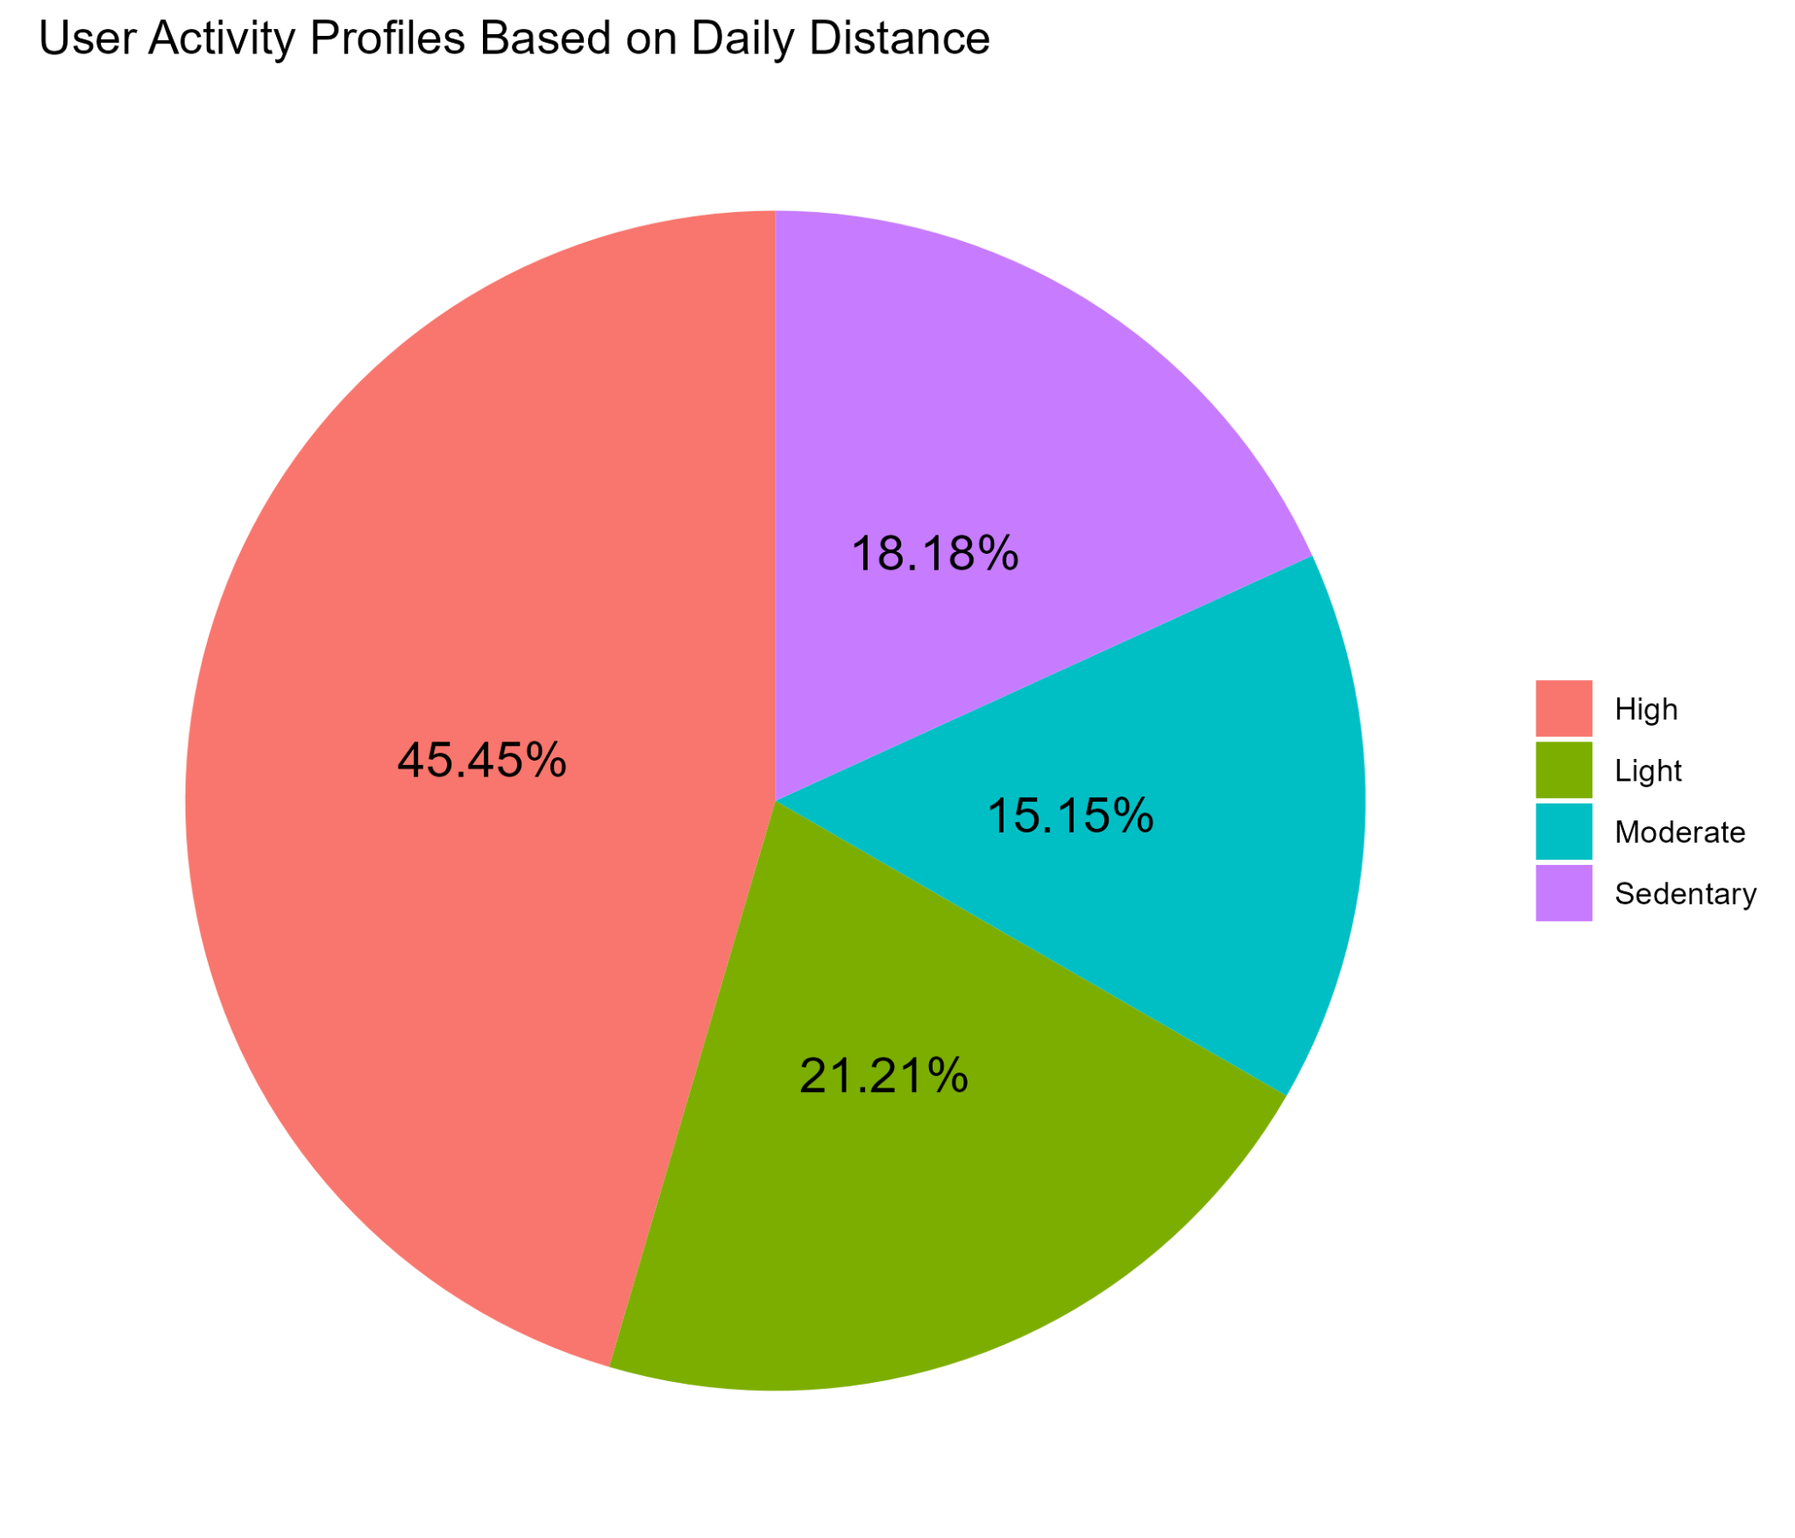
Analysis 5: Mobility Profile of the Users
Findings:
45.4% of users fall into the high mobility profile (>4.7 miles/day).
18.2% are sedentary (<0.9 miles/day), 21.2% have light activity (0.9–3 miles/day).
Only 15.2% of users fall into the moderate profile (3–4.7 miles/day).
Profiles determined per day, then the predominant profile assigned per user.
Results may have bias due to only 33 users analyzed.
Recommend strategies:
Targeted content by activity level.
Send reminders or encouragement to increase daily movement
Reward users for meeting personal distance goals, not just high activity.
Progress tracking & insights.
Figure 5.- Shows the percentages of users for each type of mobility profile.

Slide 10
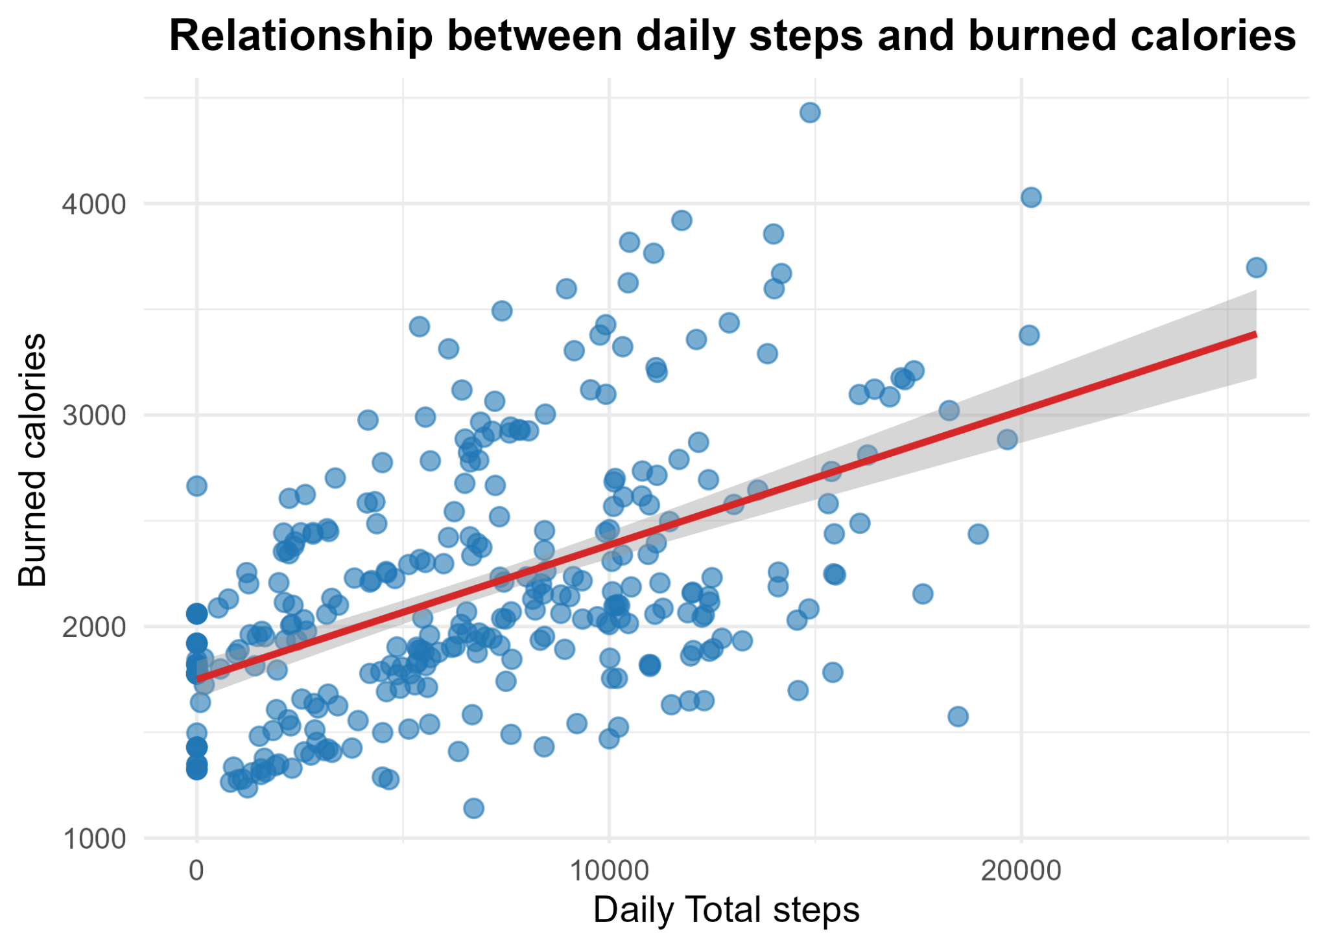
Analysis 6: Relationship between Total Steps and Calories Burned Daily
Findings:
More steps generally lead to higher daily calories burned.
Most records fall between 0–17,000 steps per day
Daily calories burned mostly between 1,000–4,000 kcal.
Pearson’s r = 0.54, indicating a moderate positive relationship.
Other factors matter: Exercise type, intensity, and individual metabolism
Recommend:
Step-based challenges
Recommend exercises (like yoga or weightlifting) for low-step days to maintain calorie burn.
Figure 6.- The scatter plot shows the relationship between the total daily steps and the burned calories. The blue dots represent the registers for each user, the red line represents the linear model, and the grey shadow represents the confidence interval of the linear model.

Slide 11
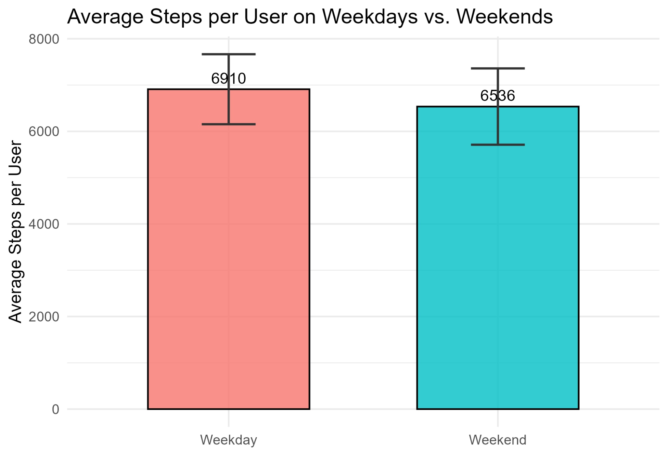
Analysis 7: Comparison between average steps on weekends vs weekdays
Findings:
Slightly higher weekday steps.
374 steps difference, not statistically significant.
Variation between users explains the minor difference.
Differences are mainly due to personal activity habits.
Recommend strategies:
Suggest personalized step targets considering small differences between weekdays and weekends.
Weekend motivation tips.
Progress tracking & comparison.
Figure 7.- The graph shows the total average of steps per user during weekdays and weekends. The bars represent the daily average of days per type of day, and the black lines represent the standard error.

Slide 12
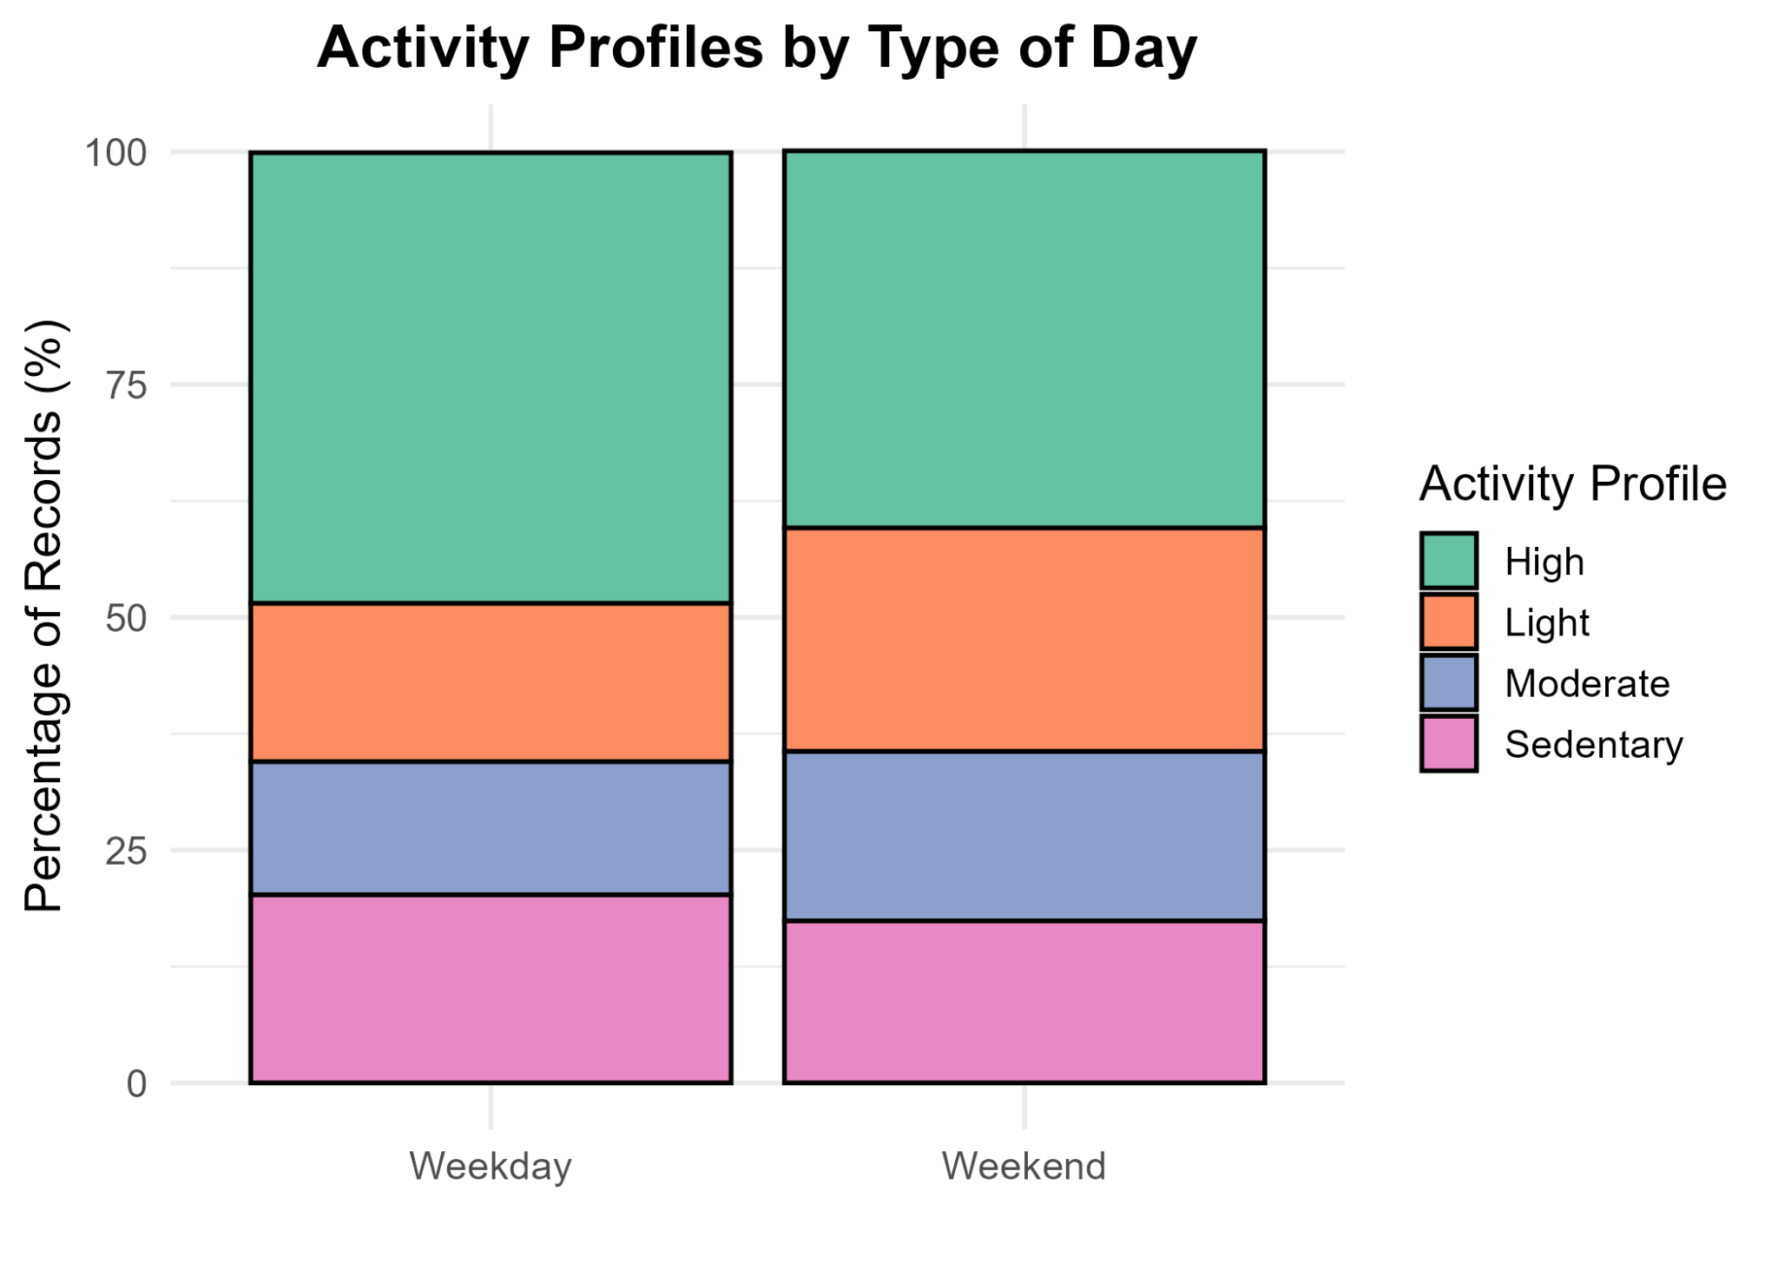
Analysis 8: Classification by type of day and activity profile
Findings:
Highest percentage of users are in high active distance profile (48.4% weekdays, 40.5% weekends).
Sedentary profile is higher on weekdays.
Structured weekday schedules increase sedentary time; weekends show more variability in movement.
Recommend strategies:
Encourage movement breaks or short walks for sedentary users during workdays.
Reward users who maintain or improve activity levels across both weekdays and weekends.
Routine-based reminders
Figure 8.- The percentage distribution of the mobility categories in distance based on the type of day (weekday and weekend).

Slide 13

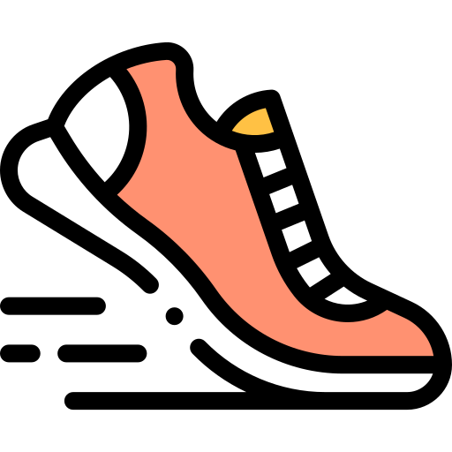



Key Insights from the Dataset
Consistent usage: Most users log 8–11 days; few dropouts.
Stable activity: Steps similar on weekdays vs weekends; more variability on weekends.
Highly adherent users: 93% of days show high or very high usage.
Predominantly high mobility: ≈45% of users have a high activity profile.
More records → higher adherence: Daily logging improves consistency.

Slide 14
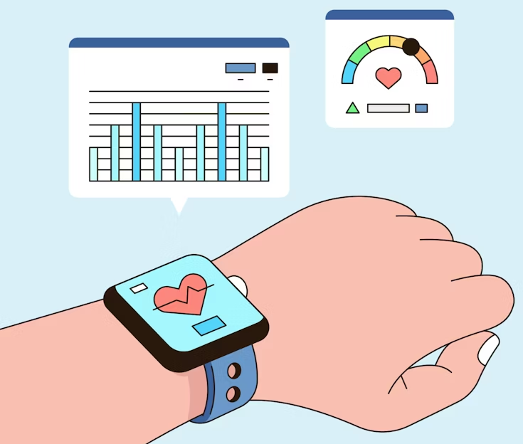

¡Thanks for your attention!

