Slide 1
Azure PaaS PCI Reference Architecture
- An integrated end-to-end solution stack
A Microsoft Azure Partner

Slide 2
Azure PaaS – PCI Reference Architecture for Enterprise Web Application

Slide 3
WHY WE BUILT THIS QUICKSTART?
01
Simplify Azure Adoption
Showcase ease of standing up secure and compliant infrastructure
02
Showcase a commonly used Reference Architecture
Azure PaaS LOB Web Apps
03
Teach how to deploy a secure and compliant Azure PaaS solution
Open sourcing allows us to learn from the larger community
04
Showcase Microsoft Partner Relationship
Microsoft and Avyan Consulting

Slide 4





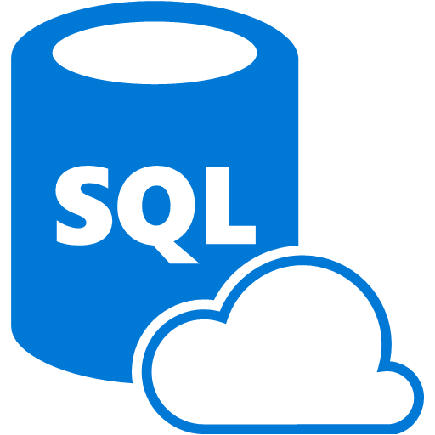








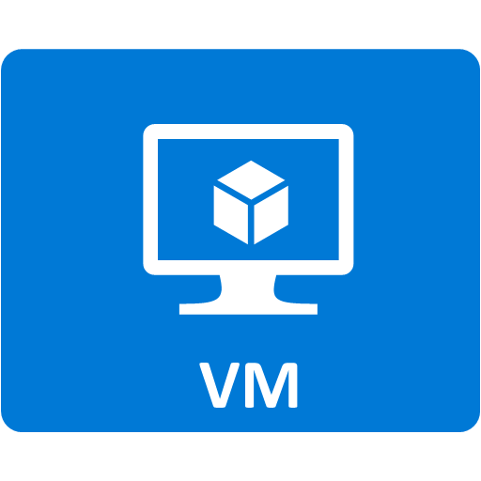



TECHNOLOGIES USED
Application Gateway
Azure Active Directory
App Service Environment
OMS Log Analytics
Azure Key Vault
Network Security Groups
Azure SQL DB
Azure Load Balancer
Application Insights
Azure Security Center
Azure Web App
Azure Automation
Azure Automation Runbooks
Azure DNS
Azure Virtual Network
Azure Virtual Machine
Azure Resource Group and Policies
Azure Blob Storage
Azure Active Directory access control (RBAC)

Slide 5
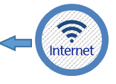
High Level PCI and HIPAA Blueprint design
4 tier (3 tier + DMZ) design overview
Middle Tier
Front End
DMZ
Azure Virtual Machine
Backend
Azure Active Directory access control (RBAC)
Azure Blob Storage
Application Insights
Azure Automation
Application Gateway
Azure Virtual Network
Azure Web App
OMS Log Analytics
Azure Automation Runbooks
App Service Environment
Azure Resource Group and Policies
Azure DNS
Azure SQL DB
Azure Active Directory
Azure Load Balancer
Azure Security Center
Azure Key Vault
Network Security Groups

Slide 6





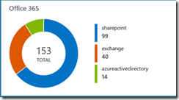






AZURE PAAS – PCI REFERENCE ARCHITECTURE FOR ENTERPRISE WEB APPLICATION
A record:
azurepcisamples.com
To
App Gateway hostname
DNS lookup
Customer / Cardholder
DevOps Releases/ Management
Custom Domain:
https://www.azurepcisamples.com
Resource Group
vNet-pci-paas
DMZ
OMS Workspace
External Public IP:
Mapped to
App Gateway hostname
subnet-WAF-appGateway
OMS Solutions
Activity Log Analytics
Azure Networking Analytics
Azure SQL Analytics
Change Tracking
Key Vault Analytics
Service Map
nsg-appGateway
subnet-bastionhost
Bastion Host
(RDP)
nsg-Bastion
Diag Logs:
N/W,
KeyVault,
App Gateway,
ASE, Subnets
Custom probe
Log Analytics
Access for management
Antimalware extension
Dashboards
subnet-ASE
nsg-ASE
OMS extension
App Service Environment
Ingest metrics
Ops Logs
ILB
Automation +
Pool 1
Pool 2
Pull metrics
Runbooks
SQL DB
Secured by AD
Webapp
extension
Web App
App Insights
Encrypted
SSL Certificate for custom domain
RBAC
Staff AAD
Azure Security Center

Slide 7
Configurations
Management and Operations
Application Gateway
SSL Offload Custom Healthprobes Prevention mode Diagnostics Logging Web Application Firewall Disable TLS v1.0 and v1.1
VM Bastion Host
Antimalware Extension OMS Monitoring VM Diagnostics Extension Encrypted Disk AutoShutDown Policy
OMS Log Analytics
Data Retention: 365 days Dashboards for WebApp and SQL OMS SQL DB Auditing View App Insights Extension Activity Log Analytics Azure Networking Analytics Azure SQL Analytics Change Tracking Key Vault Analytics Service Map Security And Audit Solution
Azure Monitor
Monitoring Activity Logging
subnet-Bastion
subnet-WAF-appGateway
PowerBI
Analyze Audit logs
10.0.1.0/24
10.0.2.0/24
Automation
Azure automation SQL and Web metrics Ingestion Runbooks
App Service Environment
Disable TLS 1.0 Change TLS cipher Control inbound traffic N/W ports WAF – Restrict Data(Third party) Allow SQL DB traffic
Web App Configuration
Custom Domain Extension: Vulnerability Scanner: Tinfoil Security WebApp Extension Enable Diagnostics Logging
subnet-ASE
Databases
Application Insights
Server Requests, Failures, Exceptions, Availability WebTests
SQL DB
Auditing Enabled Transparent Data Encryption Enabled Firewall rules (ASE worker pools) Enable Diagnostics Logging Threat Detection Enable Always Encrypted Columns(Permission issue) Dynamic Data masking(Powershell) Connection string encrypted AD Authentication and Authorization
10.0.3.0/24
NSG
Enable Diagnostics Logging Inbound outbound Traffic rules
Resource Group
RBAC – Access Policies
Infrastructure
Azure Security Center
Policies Recommendations
Key Vault
Store Certificate Enable Diagnostics Logging

Slide 8
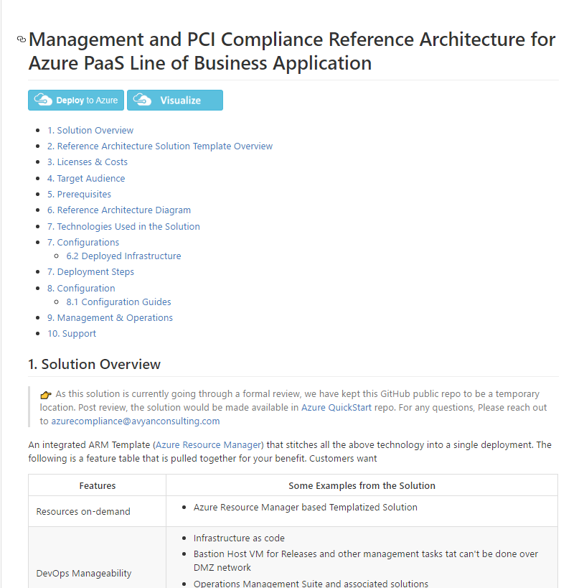

CALL TO ACTION
❶
Deploy and Play with Azure PCI PaaS QuickStart Solution
Refer to URL
https://github.com/AvyanConsultingCorp/azure-quickstart-templates/tree/master/pci-paas-webapp-ase-sqldb-appgateway-keyvault-oms
❷
Contact us for any questions on this Azure QuickStart Solution
azurecompliance@avyanconsulting.com
All other enquiries
contactus@avyanconsulting.com
Visit us
www.avyanconsulting.com
Notes:
We want to leave you with a few tidbits
On the screen you'll find the links to the solution deployment Github page.
Any questions on solution, please do not hesitate to contact us on azuremarketplace@avyanconsulting.com
thanks for watching the video.

Slide 9
A record:
azurepcisamples.com
To
App Gateway hostname
DNS lookup
Customer / Cardholder
DevOps Releases/ Management
Custom Domain:
https://www.azurepcisamples.com
Resource Group
vNet-pci-paas
DMZ
OMS Workspace
OMS Solutions
Activity Log Analytics
Azure Networking Analytics
Azure SQL Analytics
Change Tracking
Key Vault Analytics
Service Map
External Public IP:
Mapped to
App Gateway hostname
subnet-WAF-appGateway
nsg-appGateway
subnet-bastionhost
Bastion Host
(RDP)
nsg-Bastion
Diag Logs:
N/W,
KeyVault,
App Gateway,
ASE, Subnets
Custom probe
Access for management
Log Analytics
Antimalware extension
Dashboards
subnet-ASE
nsg-ASE
OMS extension
App Service Environment
Ingest metrics
Ops Logs
ILB
Automation +
Pool 1
Pool 2
Pull metrics
Runbooks
Collect metrics
SQL DB
Secured by AD
Webapp
extension
Collect metrics
Web App
App Insights
Encrypted
Keys and Secrets
RBAC
Staff AAD
Azure Security Center

