Slide 1
Project 2

Slide 2

Introduction
Who am I?
My name is Alex, I have little coding experience due to spending a career in the care industry. I had been working with children both as a youth worker and then later as a carer, working my way up to management level.
I have always had a interest and passion for computers and technology and so here we are today, my first presentation for my first project, building an application and documenting it all.
How I approached the specification.
I was no strangers to specifications, having been to uni before and completing other qualifications however the shock for me was the level of experience I had compared to the specifications needs. I approached it by going through the specification and first splitting the tasks into coding and documentation. Naturally my instinct was to complete the documentation however I realised that if I was stuck on some code I could take a breather by completing some of the documentation.
I then was able to with the coding systematically go down and try to complete each point.

Slide 3
Consultant Journey
What technologies have you learned for this project?
This project enabled me to develop my understanding of coding in general. It enabled me to utilise what I had learned in class and previous projects and further that knowledge by putting it into practice to create my API.
I also developed my knowledge on testing and was able to get a 90% coverage.

Slide 4
CI
How did you approach version control?
My initial feeling about Git was more optimism than pessimism as I feel like I had a better understanding of how to use Git.
I was able to keep up with my commits and push's but I did run into a few problems, mainly that I would push to one branch and when I would checkout into another all my work on the local machine would be gone, so I had to go onto GitHub and do a pull and merge to make sure I have the correct code on my local device.

Slide 5
Testing
What was tested?
The testing process for me was a challenge and I strived to reach the industry standard of 80% and I was managed to get a coverage of 94%.
My last project I struggled and it was very challenging to complete testing. This time round I had more knowledge of testing and took what I learned in class and implemented it into practice. Im very happy with my testing this time around.

Slide 6
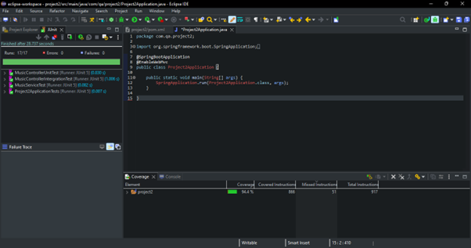

Slide 7
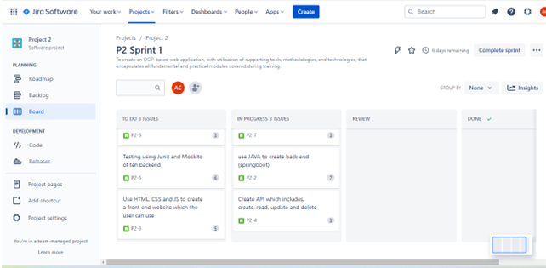
Jira.
This time around I was able to plan more effectively and was able to break down the points in my board and I was able to check them off with more efficiency this time around. I have learned this time that the sprint was so valuable to keep referring too

Slide 8
Sprint review
What got left behind?
Unfortunately there were a few things that I didn't quite get completed or I didn't finish Simply because of timing :
I'm not fully aware with how to complete the UML
I need to develop knowledge with .gitignore files.

Slide 9
Sprint retrospective
What could be improved?
What went well?
I feel that overall the project went well and I was able to complete the coding and tougher part of the project within reasonable time. O feel this project was more achievable for me to complete.
I feel I need to develop my confidence and ensure that I am able to put my learning into practice, I am aware I need to brush up on Git so I don’t run into the problems I faced and that I need to take more screenshots of my progress.

Slide 10
Conclusion
Reflections on the project, future steps, any other relevant info
In conclusion first and foremost I would like to thank all of my trainers because if it wasn't for them and their continued support I would not have been able to create the application.
I feel this project has enabled me to feel a sense of accomplishment with my working back and front end. I feel that this project has allowed me to put what I learned into practice and explore different avenues and creativity.
Thank you

Slide 11
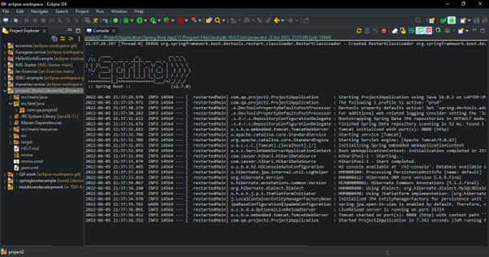
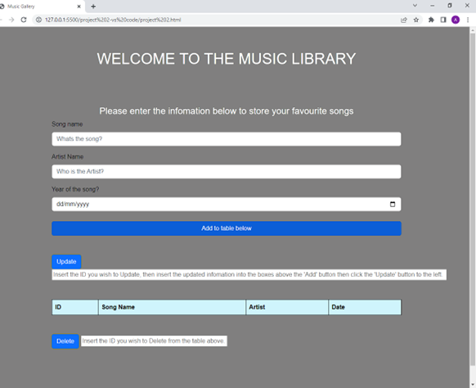
Diagrams and/or screenshots used where appropriate

