Slide 1
IMS- Project 1

Slide 2
Introduction
Who am I?
My name is Alex, and this is currently the 5th week I have coding experience wise. I had been working with children both as a youth worker and then later as a carer, working my way up to management level.
I have always had a interest and passion for computers and technology and so here we are today, my first presentation for my first project, building an application and documenting it all.
How I approached the specification.
I was no strangers to specifications, having been to uni before and completing other qualifications however the shock for me was the level of experience I had compared to the specification. I approached it by going through the specification and first splitting the tasks into coding and documentation. Naturally my instinct was to complete the documentation however I realised that if I was stuck on some code I could take a breather by completing some of the documentation.
I then was able to with the coding systematically go down and try to complete each point.

Slide 3
Consultant Journey
What technologies have you learned for this project?
This project enabled me to develop my understanding of coding in general. It enabled me to utilise what I had learned in class and further that knowledge by putting it into practice, for loops, while loops, if statements and that’s just java.
I have got a better understanding and grips with Github, and with draw.io. However what I am taking from the project is the holes in my ‘game’ the awareness that certain things I thought was less complex or easier to do tripped me up and also shown me just how important that planning and preparation is.
I also learned testing and Jira, although I know these are things I want to focus on developing further.

Slide 4
CI
How did you approach version control?
My initial feeling about Git was more optimism than pessimism as I feel like I had a better understanding of how to use Git however I felt the start although I use the main dev feature branches I may have created too many branches . it also became very clear at the end of the day because I was working on so many different codes that I would end up pushing code to a feature which didn't necessarily correlate to the name. however when I got into github I could use the features there to pull and merge to the correct branches. Again only having two weeks knowledge slash experience of it I'm sure overtime with experience I'll learn to work on something and only push it too the branch it correlates to.
I feel a big bonus for me is that it didn't go wrong on the side (touchwood).

Slide 5
Testing
What was tested?
The testing process for me was a challenge and I strived to reach the industry standard of 80% and again when it comes to experience and knowledge I know overtime that I will be able to reach industry standard however unfortunately I was only managed to get a coverage of 70.2%.
now that was some error codes that I would get that I was getting that I've just never experienced before hadn't no amount of research was helping me. I tested all of the Java test file and then I started to test all of the customer side of things so the customer controller the customerDAO on the customer.Java. The issue I had a some of them weren‘t passing the tests however I got the customer controller and the customerDAO to pass so I moved onto items I then tested the items controller and also the items DAO and then finally the items .Java which again for me didn't pass. the last ones to be tested were the more difficult ones which were the ordercontroller orderDAO and order.Java. these definitely give me the most challenge but I researched until I was able to get a percentage which what's the best I could get.

Slide 6
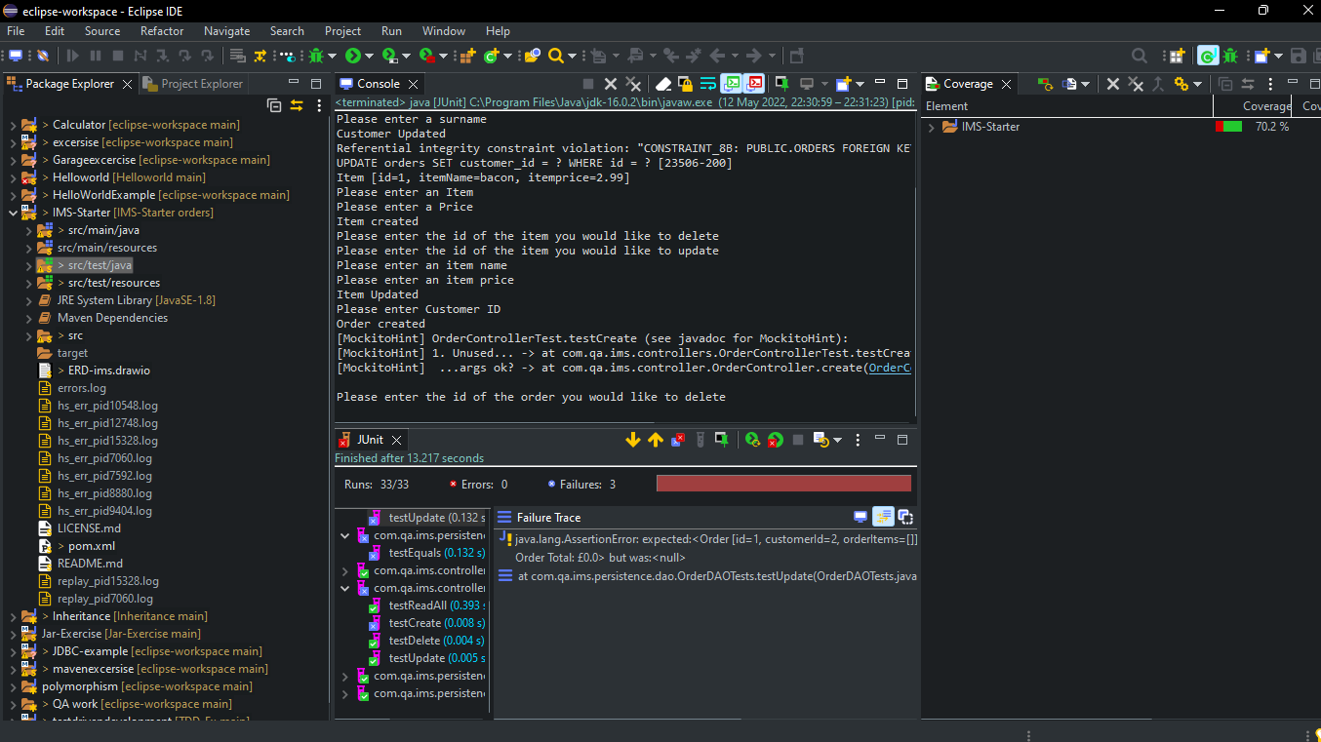

Slide 7
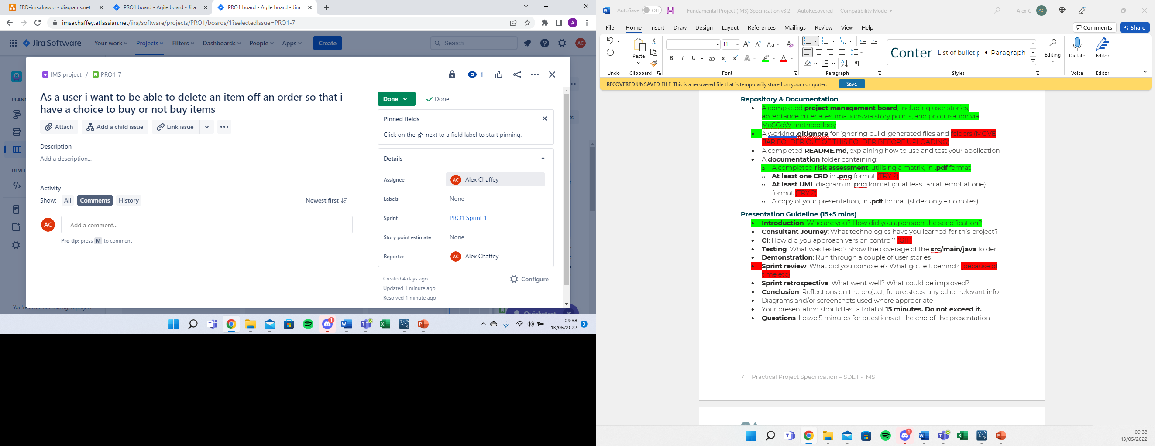
Demonstration:
So this is the part where we run through some of the user stories from Jira.

Slide 8
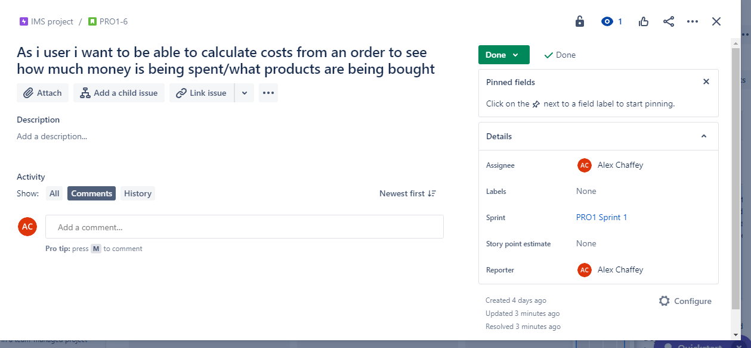
Demonstration continued

Slide 9
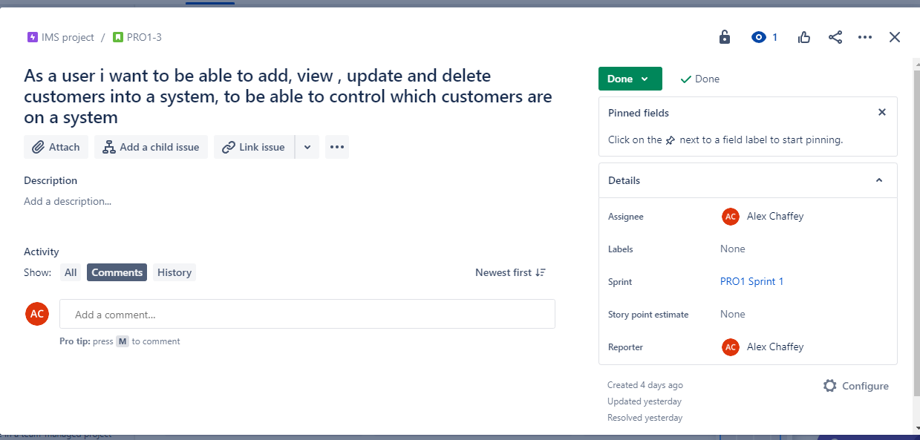
Demonstration continued

Slide 10
Sprint review
What did you complete?
As of now I have currently completed the complete code for the application which was working fully last night. which means that:
I could add view update and delete a customer .
Add view update and delete an item .
Create an order view the order and delete an order.
Add an item to my order, calculate the cost for an order and then delete an item in an order.
I was able to create my MySQL database and link it with my Java.
I was able to integrate my version onto GitHub using main dev and multiple branches.
I was able to make a basic Kanban board with user stories
I was able to create a risk assessment.

Slide 11
Sprint review continued
What got left behind?
Unfortunately there were a few things that I didn't quite get completed or I didn't finish Simply because of timing :
unfortunately I couldn't get my testing to 80% and only managed to get 70.2%
I started a read.me file but unfortunately I haven't finished that yet either.
I was unable to mvn package my file due to an unknown error in my customer.test file.

Slide 12
Sprint retrospective
What went well?
I feel that overall the project went well I feel that I was able to develop my skills and knowledge over the week and I was able to create something which works. it's not perfect yet but it works. I was able to utilise my past experience and knowledge of paperwork and documentation to create a decent trail of screenshots and a risk assessment.
What could be improved
for me what could have been improved is more knowledge on testing and on Jira. I only learn about Jira on Monday and testing was a very small segment which in hindsight needed to be longer as testing was a struggle. I can improve the application a bit further I would like to change a few little things with regards to how things are worded or adding in a few things to make it a bit more user friendly. but I feel for the time and I had given that I'm five weeks in and we've had a quite a few bank holidays to have missed some training days I've done a reasonably good job

Slide 13
Conclusion
Reflections on the project, future steps, any other relevant info
In conclusion first and foremost I would like to thank all of my trainers over the past five weeks because if it wasn't for them and their continued support I would not have been able to create the application. I feel it is given me a understanding of what's to come with regards to the workspace which I'm also thankful for. I’m also glad that it's over is there have been very many late nights working on the project but I can sit here and tell you with confidence that I'm happy with my performance over the week. I would like to thank you for your time, I would like to take questions After I've shown you some of my screenshots from the project.
Thank you

Slide 14
Diagrams and/or screenshots used where appropriate
C:\Users\ajpch\PROJECT 1\Documentation\Screen shots.docx

