Slide 1
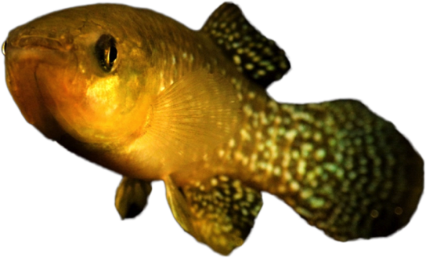


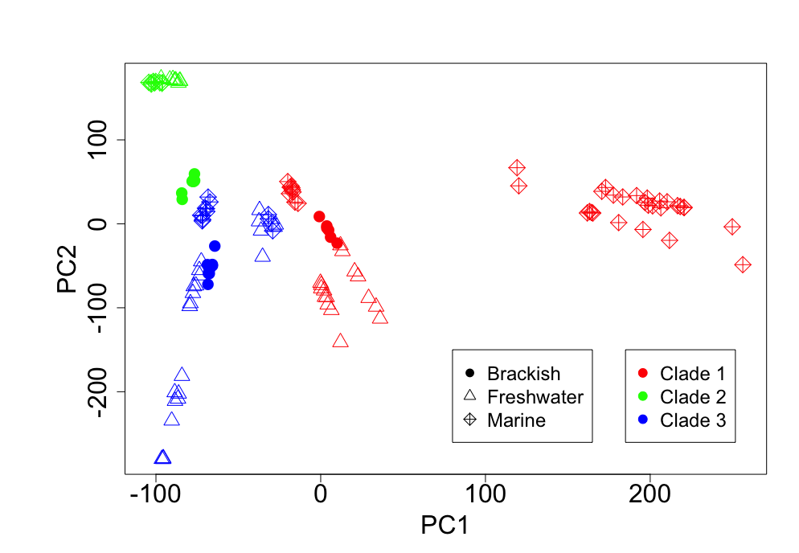
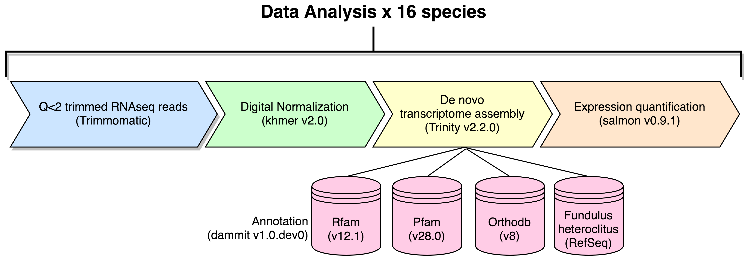
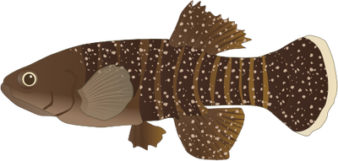
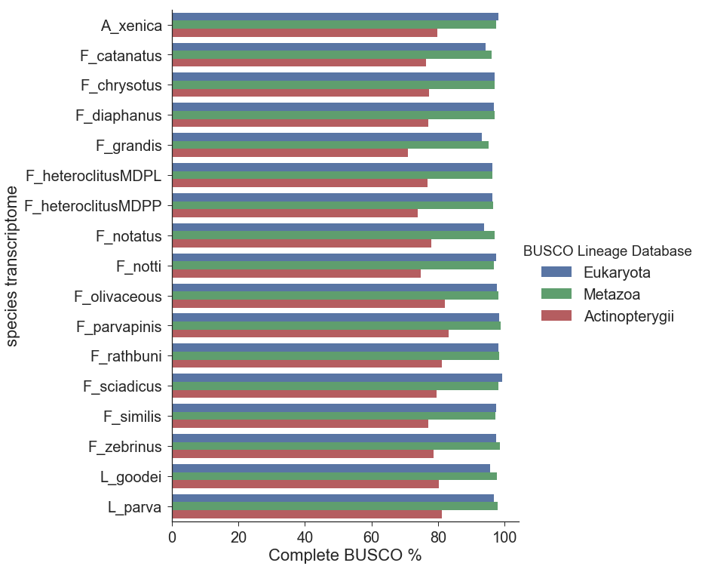
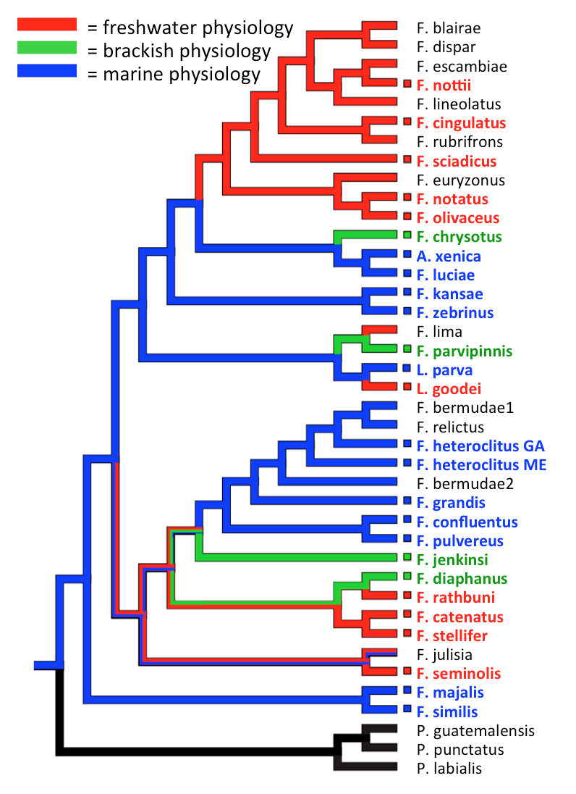
De novo assemblies, annotations, and gene expression profiling of gill epithelium from
16 species of Fundulus killifish in response to salinity change.
Lisa K. Johnson^{1,2,3*} and Andrew Whitehead³
¹School of Veterinary Medicine, ² Molecular, Cellular, Integrative Physiology Graduate Group, ³ Department of Environmental Toxicology, University of California Davis
* Email: ljcohen@ucdavis.edu @monsterbashseq
ABSTRACT:
METHODS:
Estuaries are characterized by periodic fluxes in salinity. Many species of North American killifish (Fundulus) are estuarine specialists and harbor euryhaline phenotypes. Three clades within Fundulus independently radiated into freshwater environments and have lost their abilities to tolerate high salinity. We use Fundulus as a comparative model system for studying the physiological and genetic mechanisms that diverge between euryhaline and freshwater species. We examined 16 estuarine and freshwater species with representation from each of three clades. Fish from all species were acclimated to either brackish or fresh water then exposed to an acute brackish water challenge. Gill transcriptome data were collected. To enable multi-species comparisons, reference transcriptome assemblies were generated de novo for each species then used to analyze transcriptional responses to salinity change by clade and physiology. We find differences in the gene expression between euryhaline and freshwater species, some of which are shared across clades, implicating molecular mechanisms that contribute to divergent osmoregulatory physiologies.
Osmotic Challenge Experiment
PCA of expression in 53K genes x 16 species indicate trends across clades
0.2 ppt
Individuals from each species were randomly divided and acclimated to either 0.2 ppt or 15 ppt
Gill epithelium was preserved
polyA+ libraries were prepared
Illumina HiSeq 2000 PE x 100 RNA sequencing
Native
Physiology
x 16 species
15 ppt
Quantification by contig (salmon v0.9.1)
Expression summary by Trinity ‘gene’ (tximport 1.6.0)
One annotation per contig, lowest E-value
Representative contig per gene, longest annotation
Filtered by expression, at least one sample > 5 counts
TRANSCRIPTOME ASSEMBLIES:
Species | Native Physiology BW = Brackish Water FW = Freshwater M = Marine | Clade | N | Quality Trimmed (Q>2) Reads | % Kept After Diginorm | Trinity contigs | Annotated contigs | Unique gene Names | Fundulus heteroclitus (RefSeq) gene names
Adenia xenica | M | 3 | 9 | 250,627,759 | 24.8 | 362,783 | 148,980 | 50,123 | 21,806
Fundulus catanatus | FW | 1 | 7 | 328,807,408 | 21.6 | 405,866 | 164,596 | 47,298 | 22,435
Fundulus chrysotus | BW | 3 | 8 | 258,850,289 | 25.6 | 396,400 | 155,206 | 46,327 | 22,455
Fundulus diaphanus | BW | 1 | 7 | 137,246,213 | 34 | 384,218 | 128,323 | 42,877 | 21,624
Fundulus grandis | M | 1 | 9 | 467,432,867 | 23.2 | 809,060 | 234,074 | 63,741 | 24,275
Fundulus heteroclitus 1 | M | 1 | 9 | 319,925,008 | 24.8 | 592,419 | 188,268 | 54,653 | 22,849
Fundulus heteroclitus 2 | M | 1 | 9 | 275,951,932 | 28.2 | 668,487 | 186,798 | 54,253 | 22,994
Fundulus notatus | FW | 3 | 9 | 349,630,701 | 21.6 | 416,299 | 167,061 | 46,884 | 22,530
Fundulus nottii | FW | 3 | 2 | 46,463,472 | 47 | 159,771 | 69,247 | 30,427 | 18,280
Fundulus olivaceus | FW | 3 | 8 | 202,133,952 | 27.8 | 350,265 | 134,207 | 42,194 | 21,600
Fundulus parvapinis | BW | 2 | 8 | 184,254,591 | 27.5 | 352,346 | 126,200 | 46,368 | 20,647
Fundulus rathbuni | FW | 1 | 9 | 348,759,075 | 22.7 | 501,222 | 176,367 | 48,801 | 22,718
Fundulus sciadicus | FW | 3 | 5 | 101,937,160 | 37.2 | 241,279 | 98,332 | 36,027 | 20,382
Fundulus similis | M | 1 | 9 | 207,444,577 | 30.5 | 520,319 | 154,675 | 48,509 | 22,338
Fundulus zebrinus | M | 3 | 4 | 98,327,251 | 36.6 | 266,978 | 102,046 | 37,405 | 20,439
Lucania goodei | FW | 2 | 9 | 219,175,639 | 28 | 385,476 | 138,485 | 46,599 | 22,631
Lucania parva | M | 2 | 9 | 255,219,214 | 25 | 409,543 | 145,529 | 46,914 | 22,601
v3.0 used to evaluate the completeness of transcriptomes, indicated similar results across assemblies.
OBJECTIVES:
To address comparative physiology questions across species using transcriptomics, specifically:
Is there evidence of parallel or divergent osmoregulatory evolution in this system?
Build reference transcriptomes and reproducible infrastructure for analyzing RNAseq data across multiple species
What are the “apples-to-apples” orthologous comparisons?
Test hypotheses for gene expression patterns across clades
Phylogenetic relationships and osmotic physiologies in the genus Fundulus:
Three independent radiations into freshwater are highlighted with red clade branches.
Whitehead, A. 2010. The evolutionary radiation of diverse osmotolerant physiologies in killifish (Fundulus SP.). Evolution. 64, 2070–2085.
3
2
Marine physiology
SUMMARY:
DATA:
% Complete BUSCO
(Benchmarking Universal Single Copy Ortholog)
Freshwater physiology
Parallel evolution
Expression Gene A
Reference de novo transcriptome assemblies and annotations for gill from 16 species of Fundulus killifish were generated and are available.
53K genes x 16 species expression quantification table will be used for analysis of patterns across clades for the osmotic challenge experiment.
Reproducible, automated scripts are available to generate de novo transcriptome assemblies, annotations, and merge gene expression tables across species.
Fundulus Multispecies Osmotic Transcriptome Sequencing Project (FMOTSP): http://doi.org/10.17605/OSF.IO/M4XEG
Analysis scripts: https://github.com/ljcohen/RNAseq_15killifish
Raw data: https://www.ncbi.nlm.nih.gov/bioproject/473009
0.2ppt
15 ppt
0.2ppt
15 ppt
0.2ppt
15 ppt
1
Divergence is unique,
not repeated
Divergent evolution
ACKNOWLEDGEMENTS:
Expression Gene A
Reid Brennan performed the osmotic challenge experiment. Jen Roach prepared the RNAseq libraries. Thank you to Noah Reid and Titus Brown for guidance and assistance with data analysis. Thanks to the DIB lab and Whitehead lab members at UC Davis for helpful discussions.
0.2ppt
15 ppt
0.2ppt
15 ppt
0.2ppt
15 ppt
Clade 1
Clade 2
Clade 3

