Slide 1
Mapping short reads

Slide 2
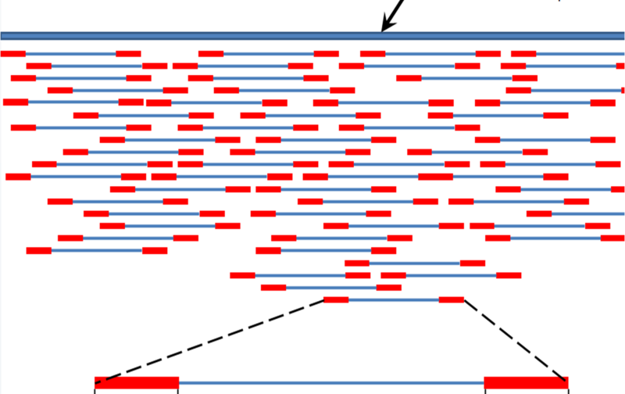
Locate reads in ref genome
http://en.wikipedia.org/wiki/File:Mapping_Reads.png

Slide 3
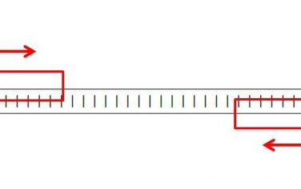
http://www.cureffi.org/2012/12/19/forward-and-reverse-reads-in-paired-end-sequencing/

Slide 4
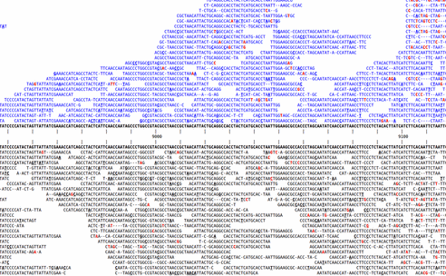
SNP calling – which variants are “real”?
http://www.kenkraaijeveld.nl/genomics/bioinformatics/

Slide 5
Note: long v short
Mapping long reads is a different problem from mapping short reads.
This is for two reasons, both of them pragmatic/practical:
The volume of data has traditionally been much less: 1m 454 reads vs 200m Illumina
Long reads are much more likely to have insertions or deletions in them

Slide 6
Long reads: BLAST vs ‘blat’
BLAST is not the right tool.
BLAST requires that a query sequence contains the same 11-mer as a database sequence before it attempts further alignment.
Any given 11-mer occurs only once in 2m sequences, so this filters out many database sequences quickly.
You can also store the list of all possible 11-mers in memory easily (~2mb), making it possible to keep track of everything quickly.
‘blat’ does the same thing as BLAST, but is faster because it uses longer k-mers.

Slide 7
How alignment works, and why indels are the devil
There are many alignment strategies, but most work like this:
GCGGAGatggac GCGGAGatggac
||||||...... => ||||||x.....
GCGGAGgcggac GCGGAGgcggac
At each base, try extending alignment; is total score still above threshold?

Slide 8
How alignment works, and why indels are the devil
There are many alignment strategies, but most work like this:
GCGGAGatggac GCGGAGatggac
||||||...... => ||||||xx....
GCGGAGgcggac GCGGAGgcggac
Each mismatch costs.

Slide 9
How alignment works, and why indels are the devil
Insertions/deletions introduce lots more ambiguity:
GCGGAGagaccaacc GCGGAGag-accaacc
|||||| => ||||||
GCGGAGggaaccacc GCGGAGggaacc-acc
GCGGAGagaccaacc GCGGAGaga-ccaacc
|||||| => ||||||
GCGGAGggaaccacc GCGGAGggaacca-cc

Slide 10
Mapping short reads, again
What’s hard about mapping
Some mapping programs
Decisions to be made
Color space issues

Slide 11
Mapping, defined
Exhibit A: 20m+ reads from genome/transcriptome.
Exhibit B: related genome/transcriptome, aka “the reference”
Goal: assign all reads to location(s) within reference.
Req’d for resequencing, ChIP-seq, and mRNAseq

Slide 12
Want global, not local, alignment
You do not want matches within the read, like BLAST would produce.
Do not use BLAST!

Slide 13
Mapping is “pleasantly parallel”
Goal is to assign each individual read to location(s) within the genome.
So, you can map each read separately.

Slide 14
What makes mapping challenging?
Volume of data
Garbage reads
Errors in reads, and quality scores
Repeat elements and multicopy sequence
SNPs/SNVs
Indels
Splicing (transcriptome)

Slide 15
Volume of data
Size of reference genome is not a problem: you can load essentially any genome into memory (~3 gb).
However, doing any complicated process 20m times is generally going to require optimization!

Slide 16
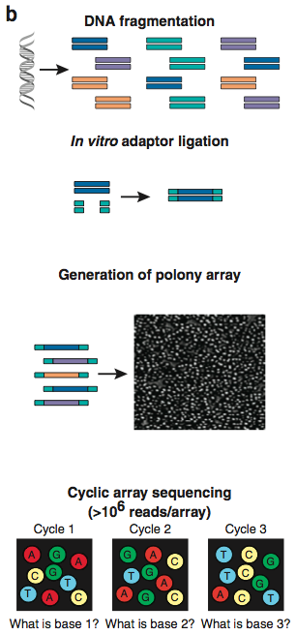
Garbage reads
Overlapping polonies result in mixed signals.
These reads will not map to anything!
Used to be ~40% of data.
Increasingly, filtered out by sequencing software.
Shendure and Ji, Nat Biotech, 2008

Slide 17
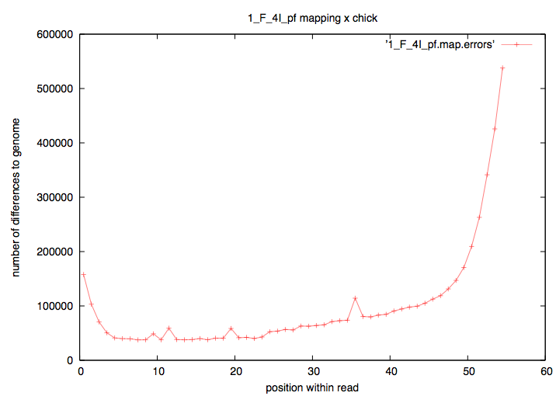
Errors in reads
When mapping, a mismatch is not necessarily “real”.
Rule of thumb: anything that varies by position within read is NOT REAL!

Slide 18
Errors in reads
Quality scores are based on Sanger sequencing-style quality scores: per base.
But 454 & Ion/Proton data are subject to different biases than Illumina, and the biases are not necessarily base-by-base (think: homopolymer runs)

Slide 19
Repeat/multi-copy elements
Multi-copy sequence makes it impossible to map all reads uniquely.
Repeats are particularly bad, because there are (a) lots of them and (b) they vary in sequence. They therefore may “attract” reads depending on what optimizations/heuristics you use.

Slide 20
SNP/SNVs
Genuine mismatches between reference and sequence do exist, of course.
Polymorphism
Diploidy
Population studies
You want to map these reads!
Fast heuristic approaches exist, based on fuzzy matching.
However, they are still biased towards mapping exact matches.
This can be a problem for allelotyping and population studies.
Likit will discuss next week.

Slide 21
Indels
Remember, they are the devil:
Complicate mapping heuristics
Complicate statistics

Slide 22
Indels: ambiguity & decisions…
TGACGATATGGCGATGGACTGGACG
|x|||||||||||x||x|x||||||
TcACGATATGGCGgTGaA-TGGACG
TGACGATATGGCGATGGACTGGACG
|x|||||||||||x|x||x||||||
TcACGATATGGCGgT-GAaTGGACG

Slide 23
Splice sites
If you are mapping transcriptome reads to the genome, your reference sequence is different from your source sequence!
This is a problem if you don’t have a really good annotation!
Main technique: try to map across splice sites, build new exon models.
Another technique: assembly.

Slide 24
Two specific mapping programs
Bowtie
BWA
Both open source.
BWA is widely used now, so we’ll use that for examples.
(There are many more, too.)

Slide 25
Bowtie1
Not indel-capable.
Designed for:
Many reads have one good, valid alignment
Many reads are high quality
Small number of alignments/read
a.k.a. “sweet spot” :)

Slide 26
BWA
Uses similar strategy to Bowtie, but does gapped alignment.
Newest, hottest tool.
Written by the Mapping God, Heng Li
(Istvan Albert’s scientific crush)

Slide 27
Decisions to be made by you
How many mismatches to allow?
Vary depending on biology & completeness of reference genome
Report how many matches?
Are you interested in multiple matches?
Require best match, or first/any that fit criteria?
It can be much faster to find first match that fits your criteria.
All of these decisions affect your results and how you treat your data.

Slide 28
Mapping best done on entire reference
May be tempted to optimize by doing mapping to one chr, etc. “just to see what happens”
Don’t.
Simple reason: if you allow mismatches, then many of your reads will match erroneously to what’s in the chr you chose.

Slide 29
Look at your mapping
Just like statistics, always look at your “raw data” ☺
We’ll do some of that today.

Slide 30
Two considerations in mapping
Building an index
Prepares your “reference”
(Not really a big deal for single microbial genomes)

Slide 31
Indexing – e.g. BLAST
BLASTN filters sequences for exact matches between “words” of length 11:
GAGGGTATGACGATATGGCGATGGAC
||x|||||x|||||||||||x|x||x
GAcGGTATcACGATATGGCGgT-Gag
What the ‘formatdb’ command does (see Tuesday’s first tutorial) is build an index (“index”) sequences by their 11-base word content – a “reverse index” of sorts.

Slide 32
Indexing – e.g. BLAST
What the ‘formatdb’ command does (see Tuesday’s BLAST tutorial) is build an index (“index”) sequences by their 11-base word content – a “reverse index” of sorts.
Since this index only needs to be built once for each reference, it can be slower to build – what matters to most people is mapping speed.
All short-read mappers have an indexing step.

Slide 33
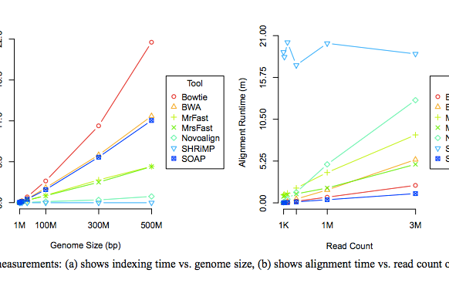
Speed of indexing & mapping.
Fig 5 of Ruffalo et al. PMID 21856737, Bioinformatics 2011.

Slide 34
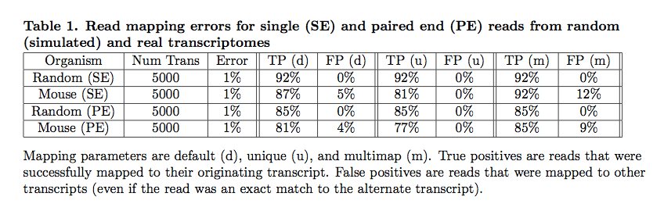
Simulations => understanding mappers
Mappers will ignore some fraction of reads due to errors.
Pyrkosz et al., unpub.; http://arxiv.org/abs/1303.2411

Slide 35
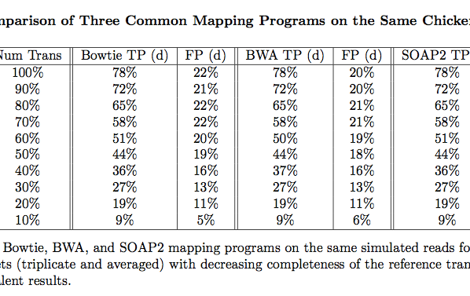
Does choice of mapper matter? Not in our experience.
Reference completeness/quality matters more!
Pyrkosz et al., unpub.; http://arxiv.org/abs/1303.2411

Slide 36
Misc points
Transcriptomes and bacterial genomes have very few repeats…
…but for transcriptomes, you need to think about shared exons.
For genotyping/association studies/ASE, you may not care about indels too much.
Variant calling is less sensitive to coverage than assembly (20x vs 100x)

Slide 37
Using quality scores?
Bowtie uses quality scores; bwa does not.
This means that bowtie can align some things in FASTQ that cannot be aligned in FASTA.
See: http://www.homolog.us/blogs/blog/2012/02/28/bowtie-alignment-with-and-without-quality-score/

Slide 38
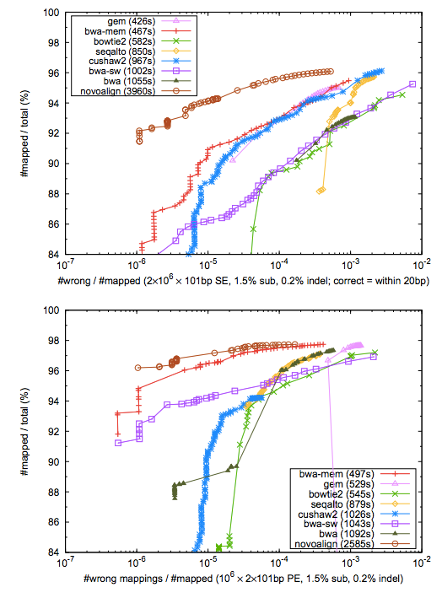
Comparative performance/SE
Heng Li, BWA-MEM: http://arxiv.org/pdf/1303.3997v2.pdf

Slide 39
Comparative performance/PE
Heng Li, BWA-MEM: http://arxiv.org/pdf/1303.3997v2.pdf

Slide 40
Part II: De novo Assembly

Slide 41
Assembly vs mapping
No reference needed, for assembly!
De novo genomes, transcriptomes…
But:
Scales poorly; need a much bigger computer.
Biology gets in the way (repeats!)
Need higher coverage
But but:
Often your reference isn’t that great, so assembly may actually be the best way to go.

Slide 42
Assembly
It was the best of times, it was the wor
, it was the worst of times, it was the
isdom, it was the age of foolishness
mes, it was the age of wisdom, it was th
It was the best of times, it was the worst of times, it was the age of wisdom, it was the age of foolishness
…but for lots and lots of fragments!

Slide 43
Assemble based on word overlaps:
the quick brown fox jumped
jumped over the lazy dog
the quick brown fox jumped over the lazy dog
Repeats do cause problems:
my chemical romance: na na na
na na na, batman!

Slide 44
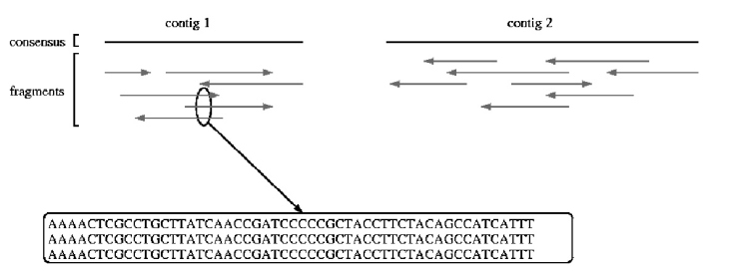
Shotgun sequencing & assembly
Randomly fragment & sequence from DNA;
reassemble computationally.
UMD assembly primer (cbcb.umd.edu)

Slide 45
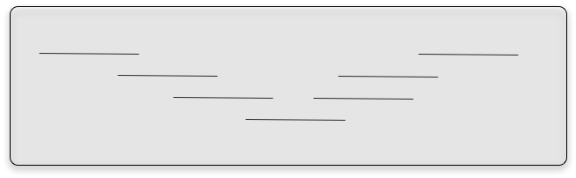
Assembly – no subdivision!
Assembly is inherently an all by all process. There is no good way to subdivide the reads without potentially missing a key connection

Slide 46
Short-read assembly
Short-read assembly is problematic
Relies on very deep coverage, ruthless read trimming, paired ends.
UMD assembly primer (cbcb.umd.edu)

Slide 47
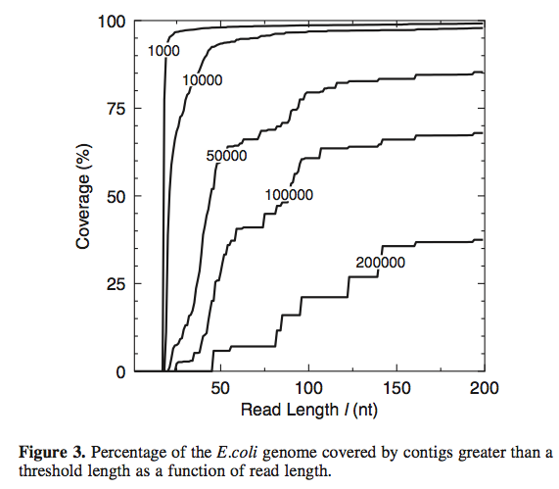
Short read lengths are hard.
Whiteford et al., Nuc. Acid Res, 2005

Slide 48
Four main challenges for de novo sequencing.
Repeats.
Low coverage.
Errors
These introduce breaks in the
construction of contigs.
Variation in coverage – transcriptomes and metagenomes, as well as amplified genomic.
This challenges the assembler to distinguish between erroneous connections (e.g. repeats) and real connections.

Slide 49
Repeats
Overlaps don’t place sequences uniquely when there are repeats present.
UMD assembly primer (cbcb.umd.edu)

Slide 50
Coverage
Easy calculation:
(# reads x avg read length) / genome size
So, for haploid human genome:
30m reads x 100 bp = 3 bn

Slide 51
Coverage
“1x” doesn’t mean every DNA sequence is read once.
It means that, if sampling were systematic, it would be.
Sampling isn’t systematic, it’s random!

Slide 52
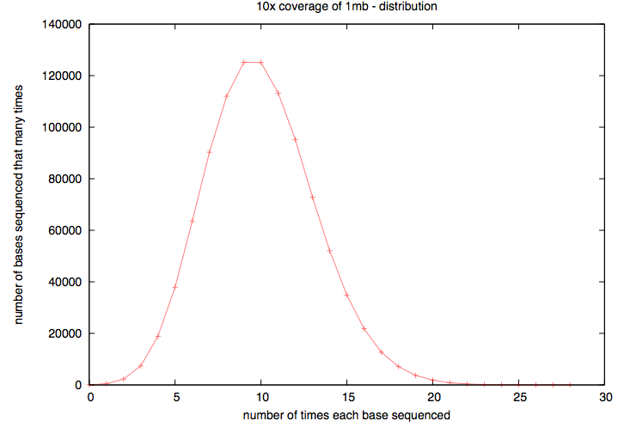
Actual coverage varies widely from the average, for low avg coverage
Notes:
High coverage is essential.

Slide 53
Two basic assembly approaches
Overlap/layout/consensus
De Bruijn k-mer graphs
The former is used for long reads, esp all Sanger-based assemblies. The latter is used because of memory efficiency.

Slide 54
Overlap/layout/consensus
Essentially,
Calculate all overlaps
Cluster based on overlap.
Do a multiple sequence alignment
UMD assembly primer (cbcb.umd.edu)

Slide 55
K-mers
Break reads (of any length) down into multiple overlapping words of fixed length k.
ATGGACCAGATGACAC (k=12) =>
ATGGACCAGATG
TGGACCAGATGA
GGACCAGATGAC
GACCAGATGACA
ACCAGATGACAC
Notes:
Note, no tolerance for indels

Slide 56
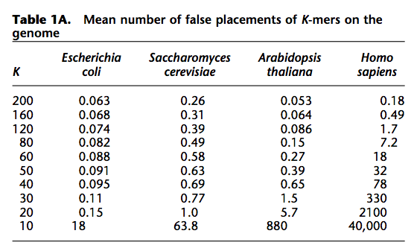
K-mers – what k to use?
Butler et al., Genome Res, 2009

Slide 57
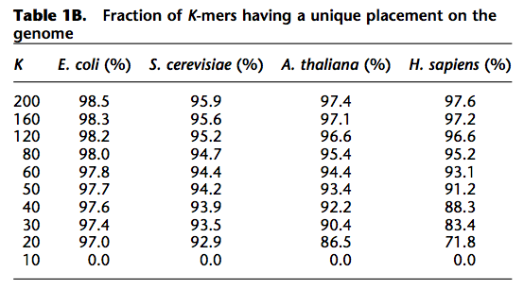
K-mers – what k to use?
Butler et al., Genome Res, 2009

Slide 58
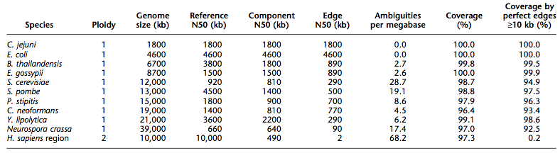
Big genomes are problematic
Butler et al., Genome Res, 2009

Slide 59
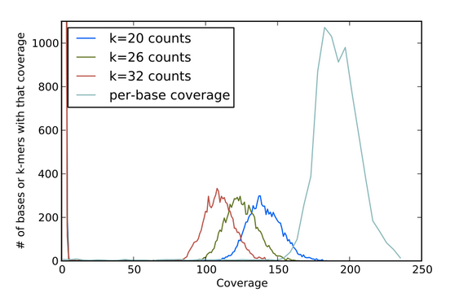
Choice of k affects apparent coverage

Slide 60
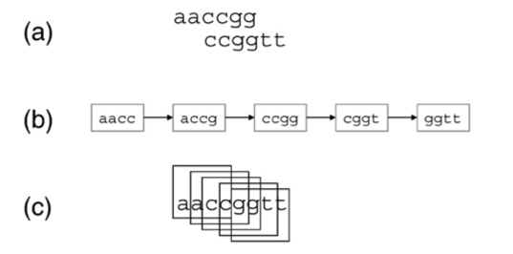
K-mer graphs - overlaps
J.R. Miller et al. / Genomics (2010)

Slide 61
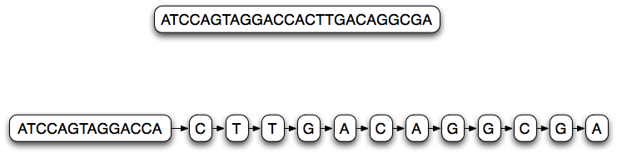
K-mer graph (k=14)
Each node represents a 14-mer;
Links between each node are 13-mer overlaps

Slide 62
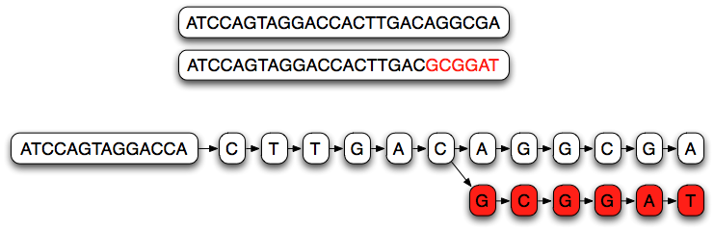
K-mer graph (k=14)
Branches in the graph represent partially overlapping sequences.

Slide 63
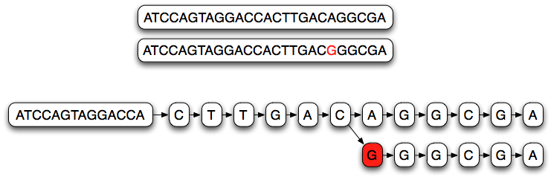
K-mer graph (k=14)
Single nucleotide variations cause long branches

Slide 64
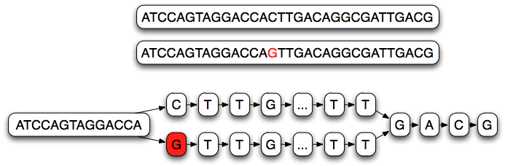
K-mer graph (k=14)
Single nucleotide variations cause long branches;
They don’t rejoin quickly.

Slide 65
Choice of k affects apparent coverage

Slide 66
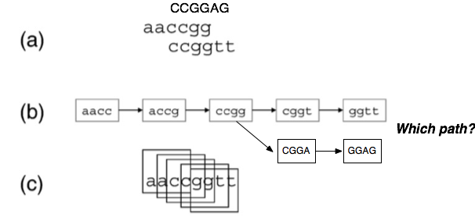
K-mer graphs - branching
For decisions about which paths etc, biology-based heuristics come into play as well.

Slide 67
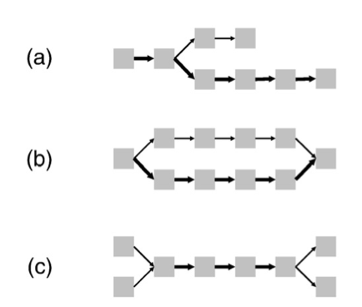
K-mer graph complexity - spur
(Short) dead-end in graph.
Can be caused by error at the end of some overlapping reads, or low coverage
J.R. Miller et al. / Genomics (2010)

Slide 68
K-mer graph complexity - bubble
Multiple parallel paths that diverge and join.
Caused by sequencing error and true polymorphism / polyploidy in sample.
J.R. Miller et al. / Genomics (2010)

Slide 69
K-mer graph complexity – “frayed rope”
Converging, then diverging paths.
Caused by repetitive sequences.
J.R. Miller et al. / Genomics (2010)

Slide 70
Resolving graph complexity
Primarily heuristic (approximate) approaches.
Detecting complex graph structures can generally not be done efficiently.
Much of the divergence in functionality of new assemblers comes from this.
Three examples:

Slide 71
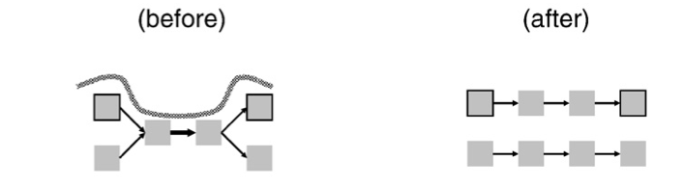
Read threading
Single read spans k-mer graph => extract the single-read path.
J.R. Miller et al. / Genomics (2010)

Slide 72
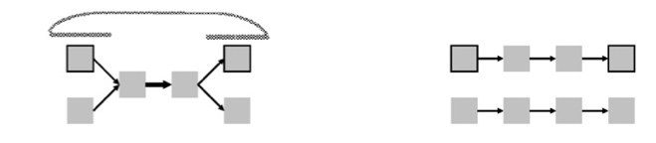
Mate threading
Resolve “frayed-rope” pattern caused by repeats, by separating paths based on mate-pair reads.
J.R. Miller et al. / Genomics (2010)

Slide 73
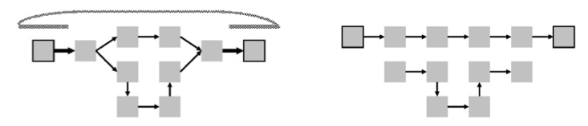
Path following
Reject inconsistent paths based on mate-pair reads and insert size.
J.R. Miller et al. / Genomics (2010)

Slide 74
More assembly issues
Many parameters to optimize!
RNAseq has variation in copy number; naïve assemblers can treat this as repetitive and eliminate it.
Some assemblers require gobs of memory (4 lanes, 60m reads => ~ 150gb RAM)
How do we evaluate assemblies?
What’s the best assembler?

Slide 75
K-mer based assemblers scale poorly
Why do big data sets require big machines??
Memory usage ~ “real” variation + number of errors
Number of errors ~ size of data set

Slide 76
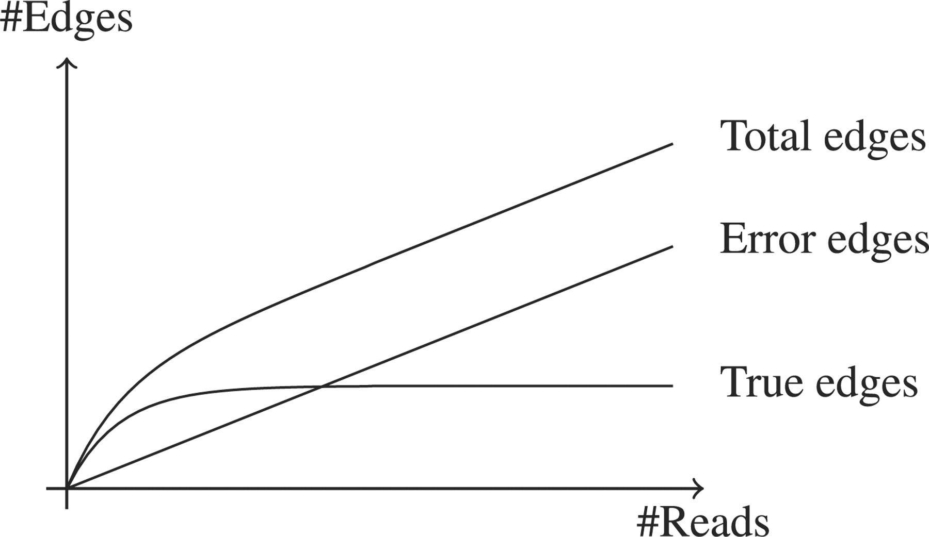

De Bruijn graphs scale poorly with erroneous data
Conway T C , Bromage A J Bioinformatics 2011;27:479-486
© The Author 2011. Published by Oxford University Press. All rights reserved. For Permissions, please email: journals.permissions@oup.com
Notes:
A sketch showing the relationship between the number of sequence reads and the number of edges in the graph. Because the underlying genome is fixed in size, as the number of sequence reads increases the number of edges in the graph due to the underlying genome that will plateau when every part of the genome is covered. Conversely, since errors tend to be random and more or less unique, their number scales linearly with the number of sequence reads. Once enough sequence reads are present to have enough coverage to clearly distinguish true edges (which come from the underlying genome), they will usually be outnumbered by spurious edges (which arise from errors) by a substantial factor.

Slide 77
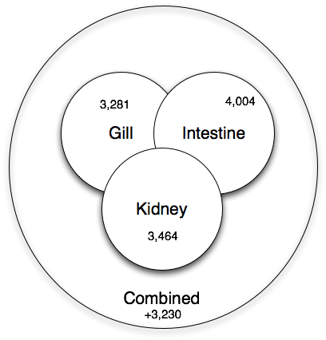
Co-assembly is important for sensitivity
Shared low-level transcripts may not reach the threshold for assembly.

Slide 78
Is your assembly good?
For genomes, N50 is an OK measure:
“50% or more of the genome is in contigs > this number”
That assumes your contigs are correct…!
What about mRNA and metagenomes??
Truly reference-free assembly is hard to evaluate.

Slide 79
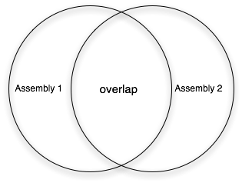
How do you compare assemblies?

Slide 80
What’s the best assembler?
Bradnam et al., Assemblathon 2:
http://arxiv.org/pdf/1301.5406v1.pdf

Slide 81
What’s the best assembler?
Bradnam et al., Assemblathon 2:
http://arxiv.org/pdf/1301.5406v1.pdf

Slide 82
What’s the best assembler?
Bradnam et al., Assemblathon 2:
http://arxiv.org/pdf/1301.5406v1.pdf

Slide 83
Note: the teams mostly used multiple software packages

Slide 84
Answer: it depends
Different assemblers perform differently, depending on
Repeat content
Heterozygosity
Generally the results are very good (est completeness, etc.) but different between different assemblers (!)
There Is No One Answer.

Slide 85
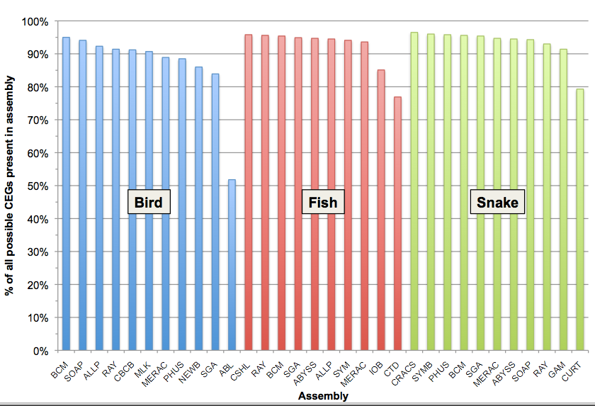
Estimated completeness: CEGMA
Each assembler lost different ~5% CEGs

Slide 86
Practical issues
Do you have enough memory?
Trim vs use quality scores?
When is your assembly as good as it gets?
Paired-end vs longer reads?
More data is not necessarily better, if it introduces more errors.

Slide 87
Practical issues
Many bacterial genomes can be completely assembled with a combination of PacBio and Illumina.
As soon as repeats, heterozygosity, and GC variation enter the picture, all bets are off (eukaryotes are trouble!)

Slide 88
Mapping & assembly
Assembly and mapping (and variations thereof) are the two basic approaches used to deal with next-gen sequencing data.
Go forth! Map! Assemble!

