Slide 1
General considerations for RNA-seq quantification for differential expression or how to count.
Ian Dworkin
@IanDworkin
Monday, August 17th 2015

Slide 2
Overview of lecture today and tomorrow
Today
The absolute basics of experimental design.
Overview of RNAseq pipelines.
How to count (reads).
Tomorrow (Tuesday)
The statistical underpinnings for differential expression analysis.
Dealing with multiple comparisons.

Slide 3
Caveats
There are whole courses on proper experimental design. Great books too.
For experimental design I highly recommend:
Quinn & Keough: Experimental Design and data analysis for biologists.
http://www.amazon.com/Experimental-Design-Data-Analysis-Biologists/dp/0521009766/

Slide 4
Goals
I am not planning on trying to provide any sort of overview of statistical methods for genomic data. Instead I am going to provide a few short ideas to think about.
Statistics (like bioinformatics) is a rapidly developing area, in particular with respect to genomics. Rarely is it clear what the “right way” to analyze your data is.
Instead I hope to aid you in using some common sense when thinking about your experiments for using high throughput sequencing.

Slide 5
A simple truth: There is no technology nor statistical wizardry that can save a poorly planned experiment. The only truly failed experiment is a poorly planned one.
To consult the statistician after an experiment is finished is often merely to ask him(her) to conduct a post mortem examination. He(she) can perhaps say what the experiment died of.
Ronald Fisher

Slide 6
The basics of experimental design
There are a few basic points to always keep in mind:
Biological replication (as much as you can afford) is extremely important. To robustly identify differentially expressed (DE) genes requires statistical powers.
(note: this is not how many reads you have for a gene within a sample, but how many statistically independent samples per treatment).
Technical replication does not generally help with statistical power.

Slide 7
The basics of experimental design
There are a few basic points to always keep in mind:
Biological replication.
Design your experiment to avoid confounding your different treatments (sex, nutrition) with each other or with technical variables (lane within a flow cell, between flow cell variation).
Make diagrams/tables of your experimental design, or use a randomized design.

Slide 8
The basics of experimental design
There are a few basic points to always keep in mind:
Biological replication.
Design experiment to avoid confounding variables.
Sample individuals (within treatment) randomly!

Slide 9
Useful references
Paul L. Auer and R.W. Doerge 2010. Statistical Design and Analysis of RNA-Seq Data. Genetics. 10.1534/genetics.110.114983
PMID: 20439781
Bullard, J. H., Purdom, E., Hansen, K. D., & Dudoit, S. (2010). Evaluation of statistical methods for normalization and differential expression in mRNA-Seq experiments BMC Bioinformatics, 11, 94. doi:10.1186/1471-2105-11-94

Slide 10
Designing your experiment before you start.
Sampling
Replication
Blocking
Randomization
Over all we are going to be thinking about how to avoid Confounding sources of variation in the data.
All of these are larger topics that are part of Experimental Design.

Slide 11
Sampling
Sampling design is all about making sure that when you “pick” (sample) observations, you do so in a random and unbiased manner.
Proper sampling aims to control for unknown sources of variation that influence the outcome of your experiments.
This seems reasonable, and often intuitive to most experimental biologists, but it can be very insidious.
Whiteboard…
Sampling
Replication
Blocking
Randomization

Slide 12
Sampling
Sampling
Replication
Blocking
Randomization

Slide 13
Biological replicates Not technical ones.
There is little purpose in using technical replication (i.e. same sample, multiple library preps) from a given biological sample UNLESS part of your question revolves around it.
Focus on biological variability. While you are confounding some sources of technical and biological variability, we already know a lot about the former, and little about the latter (in particular for your system).

Slide 14
Replication
Imagine you have an experiment with one factor (sex), with two treatment levels ( males and females).
You want to look for sex specific differences in the brains of your critters based on transcriptional profiling, so you decide to use RNA-seq.
Perhaps you have a limited budget so you decide to run one sample of male brains, and one sample of female brains, each in one lane of a flow cell.
What (useful) information can you get out of this?
Not much (but there may be some). Why?
Sampling
Replication
Blocking
Randomization

Slide 15
Replication
Why?
No replication. How will you know if the differences you observe are due to differences in males and females, random (biological) differences between individuals, or technical variation due to RNA extraction, processing or running the samples on different lanes.
All of these sources of variation are confounded, and there are no particularly good ways of separating them out.
But there are lots of sources of variation, so how do we account for these?
Sampling
Replication
Blocking
Randomization

Slide 16
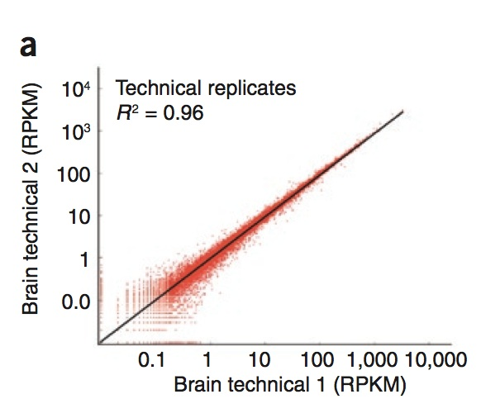
Replication
To date, several studies have suggested that “technical” replicates for RNA-seq show very little variation/ high correlation.
Sampling
Replication
Blocking
Randomization
Mortazavi et al. 2008
How might such a statement be misleading about variation?

Slide 17
Replication
This study looked at a single source of technical variation.
Running exactly the same sample on two different lanes on a flow cell.
This completely ignores other sources of “technical variation”
variation due to RNA purification
variation due to fragmentation, labeling, etc..
lane to lane variation
flow cell to flow cell variation
All of these may be important (although unlikely interesting) sources of variation…
However…..
Sampling
Replication
Blocking
Randomization

Slide 18
Replication
Many studies have ignored the BIOLOGICAL SOURCES of VARIATION between replicates. In most cases biological variation between samples (from the same treatment) are generally far more variable than technical sources of variation.
While it would be nice to be able to partition various sources of technical variation (such as labeling, RNA extraction), it often too expensive to perform such a design (see white board).
IF you have limited resources, it is generally far better to have biological replication (independent biological samples for a given treatment) than technical replication.
Does these lead to confounded sources of variation?
Sampling
Replication
Blocking
Randomization

Slide 19
Blocking
Blocks in experimental design represent some factor (usually something not of major interest) that can strongly influence your outcomes. More importantly it is a factor which you can use to group other factors that you are interested in.
For instance in agriculture there is often plot to plot variation. You may not be interested in the plot themselves but in the variety of crops you are growing.
But what would happen if you grew all of strain 1 on plot 1 and all of strain 2 on plot 2?
Whiteboard.
These plots would represent blocking levels
Sampling
Replication
Blocking
Randomization

Slide 20
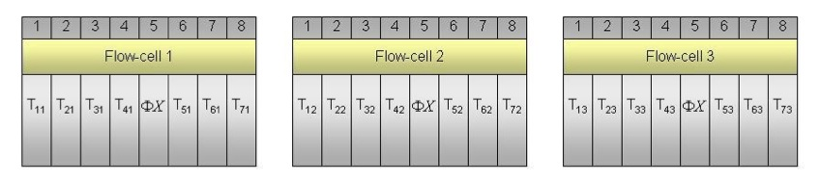
Blocking
Sampling
Replication
Blocking
Randomization
In genomic studies the major blocking levels are often the slide/chip for microarrays (i.e. two samples /slide for 2 color arrays, 16 arrays/slide for Illumina arrays).
For GAII/HiSeq RNA-seq data the major blocking effect is the flow cell itself, or lanes within the flow cell.
Auer and Doerge 2010

Slide 21
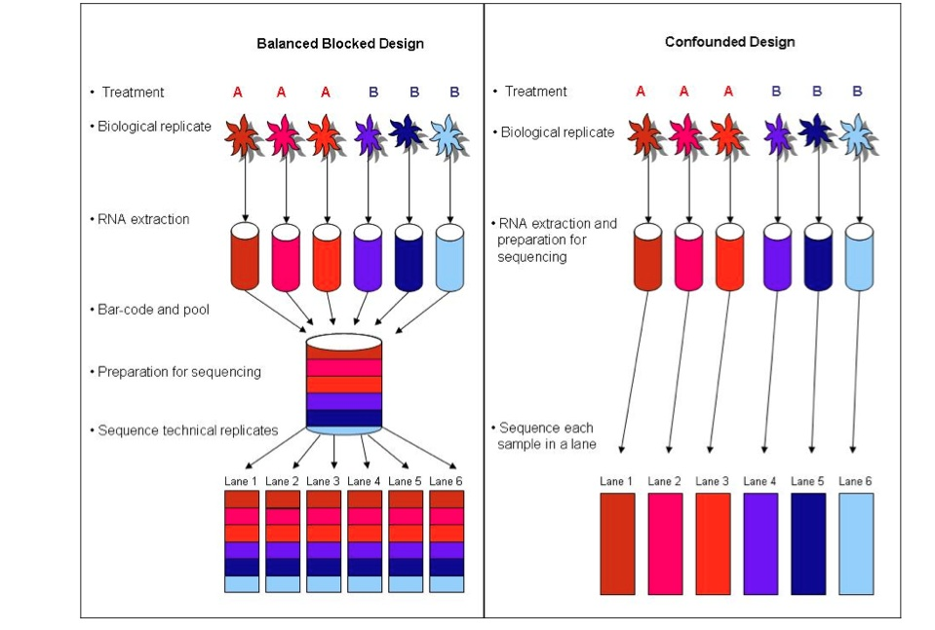
Blocking
Incorporating lanes as a blocking effect
Sampling
Replication
Blocking
Randomization
Auer and Doerge 2010

Slide 22
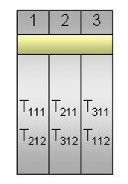
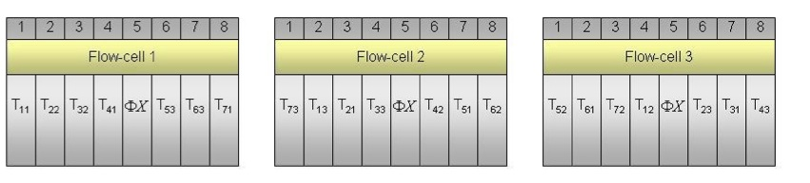
Blocking designs
Balanced Incomplete Blocking
Design (BIBD)
Sampling
Replication
Blocking
Randomization
Let’s dissect these subscripts.
Balanced for treatments across flow cells.. Randomized for location
Auer and Doerge 2010

Slide 23
What standard technical issues should you consider for blocking:
Flow Cell
Lane
Adaptors
Library prep
Same instrument
People!
RNA extraction/purification

Slide 24
What happens when you fail to block (or replicate)?

Slide 25
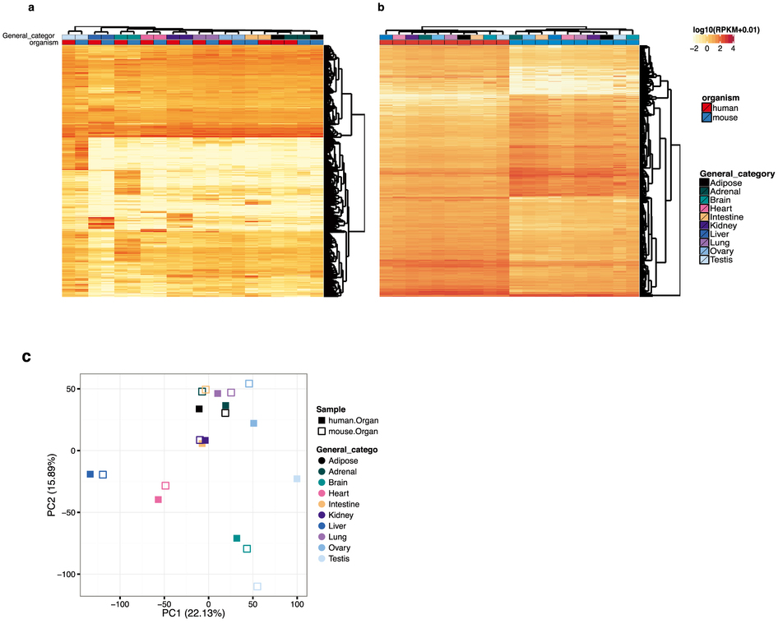
In a recent analysis of the mod-encode data, RNAseq data suggested that clustering (for gene expression) more by species than by tissue. This was an unusual finding.
Yue F, Cheng Y, Breschi A, et al.: A comparative encyclopedia of DNA elements in the mouse genome. Nature. 2014; 515(7527): 355–364
Lin S, Lin Y, Nery JR, et al.: Comparison of the transcriptional landscapes between human and mouse tissues. Proc Natl Acad Sci U S A. 2014; 111(48): 17224–17229
Notes:
Figure 1. Study design. Sequencing batches as inferred based on the sequence identifiers of the RNA-Seq reads.
How to cite: Gilad Y and Mizrahi-Man O 2015 A reanalysis of mouse ENCODE comparative gene expression data [v1; ref status: awaiting peer review, http://f1000r.es/5ez] F1000Research 2015, 4:121 (doi: 10.12688/f1000research.6536.1)

Slide 26
A new re-analysis demonstrated some potentially serious issues with the experimental design
This is the paper we will do for a “journal club” Read the paper, and the comments and reviews (http://f1000r.es/5ez)
Gilad Y and Mizrahi-Man O. A reanalysis of mouse ENCODE comparative gene expression data [v1; ref status: indexed, http://f1000r.es/5ez] F1000Research 2015, 4:121 (doi: 10.12688/f1000research.6536.1)

Slide 27
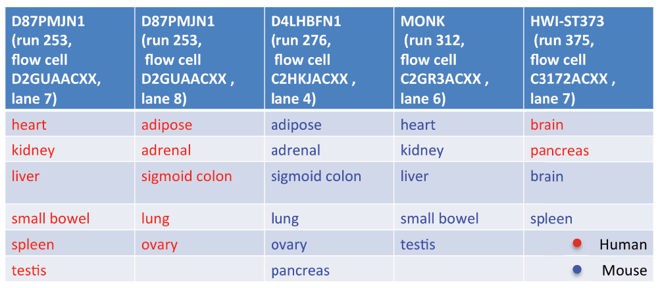

Figure 1. Study design for :
Yue F, Cheng Y, Breschi A, et al.: A comparative encyclopedia of DNA elements in the mouse genome. Nature. 2014; 515(7527): 355–364
Lin S, Lin Y, Nery JR, et al.: Comparison of the transcriptional landscapes between human and mouse tissues. Proc Natl Acad Sci U S A. 2014; 111(48): 17224–17229
Gilad Y and Mizrahi-Man O 2015 [v1; ref status: awaiting peer review, http://f1000r.es/5ez] F1000Research 2015, 4:121 (doi: 10.12688/f1000research.6536.1)
Notes:
Figure 1. Study design. Sequencing batches as inferred based on the sequence identifiers of the RNA-Seq reads.
How to cite: Gilad Y and Mizrahi-Man O 2015 A reanalysis of mouse ENCODE comparative gene expression data [v1; ref status: awaiting peer review, http://f1000r.es/5ez] F1000Research 2015, 4:121 (doi: 10.12688/f1000research.6536.1)

Slide 28
Using RNAseq
Transcriptome assembly.
Improving genome assembly/annotation.
SNP discovery (large genomes)
Transcript discovery (variants for Transcription start site, alternative splicing, etc..)
Quantification of (alternative transcripts)
Differential expression analysis across treatments.

Slide 29
Using RNAseq: differential expression
Differential expression of what?

Slide 30
Using RNAseq: differential expression
Differential expression of what?
Differential expression at the level of “genes”
Allele specific expression
Quantification of alternative transcripts

Slide 31
Your primary goals of your experiment should guide your design.
The exact details (# biological samples, sample depth, read_length, strand specificity) of how you perform your experiment needs to be guided by your primary goal.
Unless you have all the $$, no single design can capture all of the variability.

Slide 32
Your goals matter
For instance: If your primary interest in discovery of new transcripts, sampling deeply within a sample is probably best.
For differential expression analyses, you will almost never have the ability to perform Differential expression analysis on very rare transcripts, so it is rarely useful to generate more than 15-20 million read pairs (see Meg’s slides).

Slide 33
Are single_ended reads ever useful?
In my experience (plants and animals), almost never.
My primary organism (Drosophila melanogaster) is one of the best annotated and experimentally validated genomes.
Even still, we get surprising ambiguity for reads 75bp and shorter, which mostly goes away with PE.
Hopefully less of a problem now (as most people are doing 100 -150 bp+).

Slide 35
What was once thought to be separate goals are now clearly recognized as intertwined.
Early work for RNA-seq tried to “mirror” the type of gene level analysis used in microarrays.
However, RNA-seq has demonstrated how important it is to take into account alternative transcripts, even when attempting to get “gene level” measures.

Slide 36
How do we put together a useful pipeline for RNAseq
What are the steps we need to consider?

Slide 37
How do we put together a useful pipeline for RNAseq
What are the steps we need to consider?
Genome/transcriptome assembly.
Mapping reads to genome/transcriptome.
Deal with alternative transcripts (new transcriptome)?
Remap & count reads.
Differential expression.

Slide 38
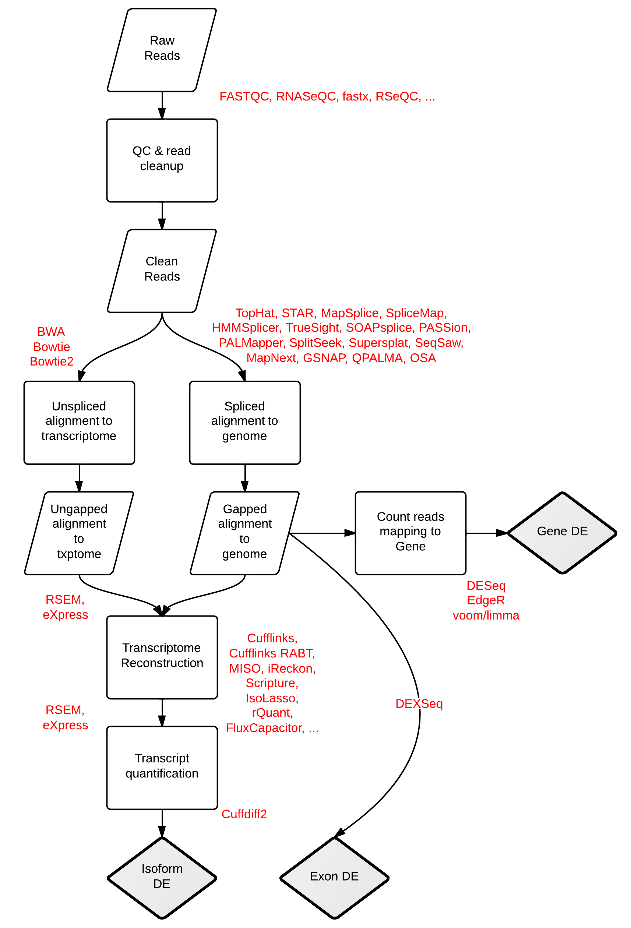
RNA-seq Workflows and Tools. Stephen Turner. Figshare. http://dx.doi.org/10.6084/m9.figshare.662782

Slide 39
The “tuxedo” protocol for RNA-seq
Trapnell et al 2012

Slide 40
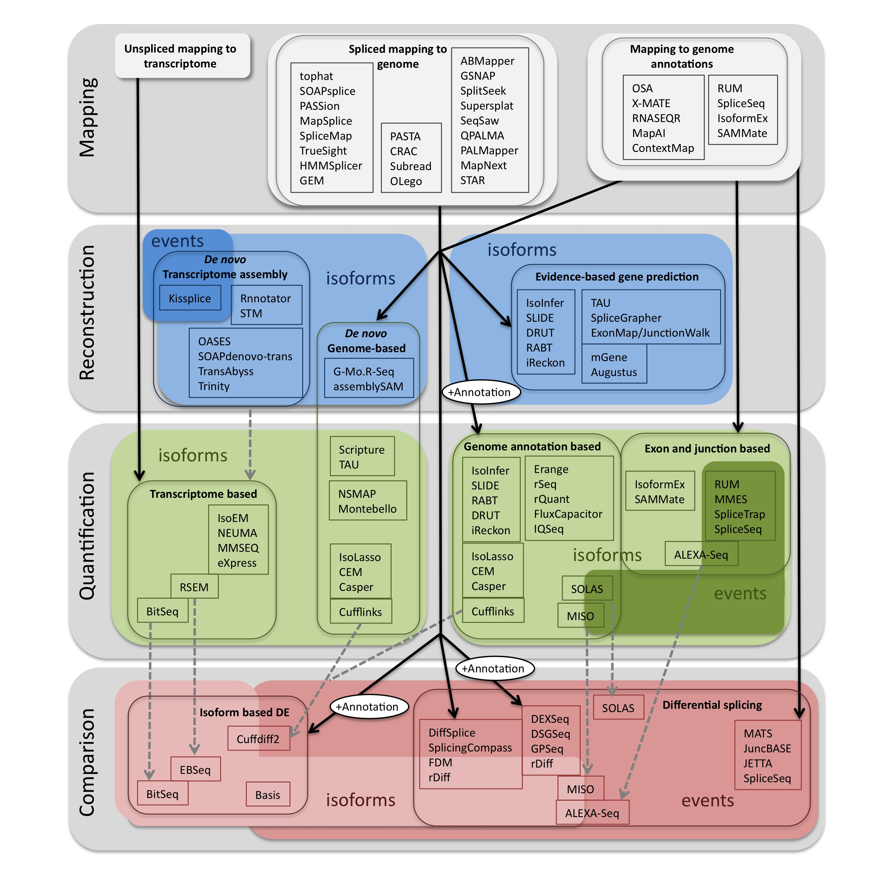
Pipelines for RNA-seq (geared towards splicing)
Methods to Study Splicing from RNA-Seq. Eduardo Eyras, Gael P. Alamancos, Eneritz Agirre. Figshare. http://dx.doi.org/10.6084/m9.figshare.679993 also see
http://arxiv.org/abs/1304.5952

Slide 41
Vijay et al 2012

Slide 42
Nookaew et al 2102 NAR

Slide 43
The point…
There is no single “best” way forward yet. It is probably best to try several pipelines and think carefully about each of the steps.

Slide 44
How should we map reads
Do we want to map to a reference genome (with a “splice aware” aligner)?
Or do we want to map to a transcriptome directly.
What is preferable, to generate a de novo transcriptome or map to a “closely” related species?

Slide 45
And before we map reads…
How should we filter (based on quality) reads (if at all)?
What are some of the considerations (Matt…)

Slide 46
Mapping to a transcriptome
What are the downsides to mapping to a transcriptome?

Slide 47
Mapping to a transcriptome
unspliced read aligners are useful against a transcript (or cDNA) database, such as that generated for a de novo transcriptome.
For this BW is faster than seed based approaches (shrimb & stampy), but the latter may be preferred if mapping to "distant" transcriptomes.

Slide 48
Mapping to the genome
How do we deal with alternative transcripts or paralogs during mapping?
"splicing aware" aligners:
Exon First: (tophat, MapSplice, SpliceMap) Fig1A Garber
Step 1 - map reads to genome
Step 2 -unmapped reads are split, and aligned.
Seed & extend (Fig1B Garber) (GSNAP, QPALMA)
kmers from reads are mapped (the seeds), and then extended

Slide 49
Garber et al. 2011

Slide 50
The variation in the mapping step (at least with a reference genome) seems to have modest effects.
RNA-seq gene profiling - a systematic empirical comparison
Fonseca et al (2014). http://dx.doi.org/10.1101/005207

Slide 51
What does this tell us?
These cells are biological replicates (diagonals)
These cells are for different software
Nookaew et al 2102 NAR

Slide 52
Differentially expressed genes based on software for quantification
Differentially expressed genes based on software for mapping
Nookaew et al 2102 NAR

Slide 53
Which to use
If a (close to?) perfect match transcriptome assembly is available for mapping. Burrows-wheeler based aligners can be much faster than seed based methods (upto 15x faster)
BW based aligners have reduced performance once mismatches are considered.
Exponential decrease in performance with each additional mismatch (iteratively performs perfect searches).
Seed methods may be more sensitive when mapping to transcriptomes of distantly related species (or high polymorphism rates).
From Garber et al. 2011

Slide 54
How could mapping reads (whether to a reference genome or transcriptome) influence our downstream counts?

Slide 55
How could mapping reads (whether to a reference genome or transcriptome) influence our downstream counts?

Slide 56
Merging all transcripts?
Trapnell et al 2012.

Slide 57
Counting
What are we trying to count?

Slide 58
Counting
We are interested in transcript abundance.
But we need to take into account a number of things:

Slide 59
Counting
One of the most difficult issues has been how to count reads.
What are some of the issues that we need to account for during counting of reads?

Slide 60
Counting
One of the most difficult issues has been how to count reads.
What are some of the issues that we need to account for during counting of reads?
Transcript length (my be a minor concern depending on application).
Ambigously (multi-)mapped reads. How should you count those.

Slide 61
Dealing with multi-mapped reads
Several options:
Only use reads that map uniquely (exclude all multi-mapped reads).
What might be the problem with such an approach?

Slide 62
Dealing with multi-mapped reads
Several options:
Only use reads that map uniquely (exclude all multi-mapped reads).
What might be the problem with such an approach?
What happens if your transcriptome assembly (because of polymorphism), has assembled two or more genes for a single true gene?

Slide 63
Dealing with multi-mapped reads
Several options:
Only use reads that map uniquely.
Use all reads (unique + multi-mapped).
What are the problems here?

Slide 64
Dealing with multi-mapped reads
Several options:
Only use reads that map uniquely.
Use all reads (unique + multi-mapped).
What are the problems here?
Pseudo-replication(ish)

Slide 65
Dealing with multi-mapped reads
Several options:
Only use reads that map uniquely.
Use all reads.
Unique reads + assigning multi-mapped reads “randomly”
Unique reads + model based inference for where reads belong.

Slide 66
Counting
What are we trying to count?
Gene level measure (eXpress, corset, RSEM, HTSeq, summarizeOverlaps (Bioconductor)…).
Exon level (HTSeq, ???)
Transcript level (HTSeq, Cufflinks, ….)
Clustering (corset)
Kmer (sailfish, RNA-skim)

Slide 67
Counting
We are interested in transcript abundance.
But we need to take into account a number of things:
How many reads in the sample.
Length of transcripts
GC content and sequencing bias
(how many transcripts)

Slide 68
Old ways of counting
RPKM (reads aligned per kilobase of exon per million reads mapped) – Mortazavi et al 2008
FPKM (fragments per kilobase of exon per million fragments mapped). Same idea for paired end sequencing.
Transcripts per million (we will come to that).
See:
https://haroldpimentel.wordpress.com/2014/05/08/what-the-fpkm-a-review-rna-seq-expression-units/

Slide 69
None of these measures are great for differential expression analysis.
For appropriate differential expression analysis (as with all statistical modeling), keeping all of the data is better.
So having counts of mapped reads, along with information like GC content, transcript length, total # reads is far more useful.
We will discuss this tomorrow.

Slide 70
Accounting for multiple isoforms (when counting alternative transcripts).
- Only count reads that map uniquely to an isoform (Alexa-Seq, HTSeq). Can be very problematic, when isoforms do not have unique exons.
- so called "isoform-expression" methods (cufflinks, MISO) model the uncertainty parametrically (often using MLE). The model with the best mix of isoforms that models the data (highest joint probability) is the best estimate. How this is handled differs a great deal by the different.

Slide 71
Garber et al. 2011

Slide 72
Garber et al. 2011

Slide 73
Trapnell et al 2013

Slide 74
However…
There has been a great deal of discussion and disagreement about this (see seqanswer forums, and “discussions” between Simon Anders and Lior Patcher).
Fundamentally there are numerous cases where both methods fail. So take care.

Slide 75
Seqanswer or blog postings of use
http://seqanswers.com/forums/showpost.php?p=102911&postcount=60
http://gettinggeneticsdone.blogspot.com/2012/11/star-ultrafast-universal-rna-seq-aligner.html
http://gettinggeneticsdone.blogspot.com/2012/12/differential-isoform-expression-cuffdiff2.html
http://gettinggeneticsdone.blogspot.com/2012/09/deseq-vs-edger-comparison.html

Slide 76
Problems with cufflink and cuffdiff? Reproducibility…
http://seqanswers.com/forums/showthread.php?t=20702
http://seqanswers.com/forums/showthread.php?t=17662
http://seqanswers.com/forums/showthread.php?t=23962
http://seqanswers.com/forums/showthread.php?t=21020
http://seqanswers.com/forums/showthread.php?t=21708
http://www.biostars.org/p/6317/

Slide 77
Take home message
For Differential expression analysis, by and large counts are best, not an adjusted count.
For gene-by-gene analyses, accounting for transcript length is not essential.
However, there are several situations where variation in counts due to the influence of transcript length is important.
Multivariate analyses (clustering, PCA, MDS).
Collapsing multiple transcripts (of potentially different length) into a “gene” level measure of counts.
You can also include transcript length (or effective length) as a covariate in the statistical analysis itself (either as an offset or a covariate).

Slide 78
Counting at the “gene” or exon level may be simpler (at least initially).
i.e. all mapped reads for transcripts associated with a particular “gene” get counted (HTSeq, corset, eXpress, RSEM (?)).

Slide 79
Counting reads
Htseq (python library) works with Deseq.
In our experience this is both easy (ish) to use and counting in a sensible manner.
I remain very confused about getting “counts” out of both RSEM and Cufflinks…
eXpress has some nice features, and is fast.

Slide 80
Differential expression
DEseq (http://www.ncbi.nlm.nih.gov/pubmed/20979621)
EDGE-R
EBseq (RSEM/EBseq)
RSEM (http://deweylab.biostat.wisc.edu/rsem/)
eXpress (http://bio.math.berkeley.edu/eXpress/overview.html)
Beers simulation pipeline(http://www.cbil.upenn.edu/BEERS/)
DEXseq (http://bioconductor.org/packages/release/bioc/html/DEXSeq.html)
Limma (voom)

Slide 81
Example workflows
http://jura.wi.mit.edu/bio/education/hot_topics/QC_HTP/QC_HTP.pdf
http://jura.wi.mit.edu/bio/education/hot_topics/RNAseq/RNAseqDE_Dec2011.pdf
http://www.bioconductor.org/help/workflows/rnaseqGene/

