Slide 1
The (slightly delayed) Welcome lecture

Slide 2
Challenge #1:
Most biologists still don’t know much about computational science.
Among many biologists, there is a general fear or skepticism of computers.
This leads to shallow thinking about computational science.

Slide 3
Challenge #2:
Most computational scientists still don’t know much about biology.
Extant computational solutions may not use appropriate heuristics, or default parameters.
“It works on my data…”, but their data != yours!
Solutions/programs may not be couched in the right terms for the biology, or with proper appreciation for biological complexity.

Slide 4
Challenge #3:
Both biology and computational science are deep, complex fields of study, inhabited by extremely smart people!
None of this is easy, on any side of things.
If it were easy, they wouldn’t need people as smart as all of us to do it, right??
A two week course can’t possible teach you everything.

Slide 5
Challenge #4:
Sequencing technology is changing very fast.
We don’t understand its limitations or biases very well.
The software and compute infrastructure lags behind volume of data & type of data.

Slide 6
This is not the #1 problem you will face with bioinformatics.
Here is the #1 problem:
How do you know if your computational answer is right or wrong?

Slide 7
This is not the #1 problem you will face with bioinformatics.
Here is the #1 problem:
How do you know if your computational answer is right or wrong?
If you can’t answer this question, then what’s the point of doing the computation?

Slide 8
Controls
Just as with experiments, you can put negative and positive controls in your bioinformatics.
e.g. with BLAST,
Do you see expected matches with the parameters and database you’re using?
Positive controls are often easier than negative, in “discovery” science…

Slide 9
Internal controls
Use molecules and sequences for which you have expectations.
“I know this gene comes up, based on qPCR. I expect to see it in my mRNAseq.”
Or, “human? I didn’t expect to see human!”

Slide 10
External controls & replication
Does the whole process work?
“I can reproduce what this other person/lab did, with their data, when I use my own software.”
This is much more rarely done…

Slide 11
Black box nature of algorithms
When you listen to a computational biologist explain their clever algorithm…
…it’s a big mistake to think that they necessarily know what’s going on.
Software is full of bugs and unintended consequences.

Slide 12
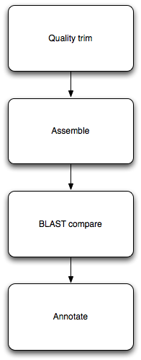
Pipelines
Each step can be understood, and tested/controlled individually.
Each step is re-usable! Just need to figure out input/output formats.
Automate, automate, automate.

Slide 13
The opportunity:
The sequence is here! As you know!
“In the land of the blind, the one eyed is king.” -- those prepared to think about how to use sequencing technology to answer their question will have a substantial leg up.
Who knows? Some of you might even like this mix!

Slide 14
Our goals
Provide a safe & welcoming place to experiment.
Lots and lots of help (in the form of Tas)
Provide lots of data sets, tools, scripts.
Research specific help as possible.

Slide 15
Our requirements of you
Nothing.
This is a requirements free zone.
You can safely skip the entire course…

Slide 16
Our expectations
Questions!
Ask for help when you need it!
Tolerance (in both directions)

Slide 17
Our hopes
Enthusiasm!
Engagement!

Slide 18
Daily schedule (tentative)
7-8: breakfast. They mean it. /cc Frona’s Bakery
9:15am – lecture
10:30am – tutorial 1
12-1pm - lunch
1:15pm – tutorial 2
3pm – free time!
5-6:30 - dinner
7pm – tutorial/lecture/etc

Slide 19
Weekly schedule – tentative wk1
Tuesday – BLAST, sequence quality foo
Wed – mapping & assembly; genomic visualization
Thursday – Genomic intervals & bioinfo survival
Friday – SNP calling, experimental design
Saturday – pipelines & protocols for mRNAseq

Slide 20
Dramatis personae
Titus Brown (that’s me)
Ian Dworkin -- co-instructor
Istvan Albert – co-instructor
Cody Nicks – go-fer and aide-de-camp

Slide 21
Dramatis personae
Amanda Charbonneau– TA and cruise director
Elijah Lowe– TA
Will Pitchers – TA
Aswathy Sebastian - TA
Qingpeng Zhang – TA.

Slide 22
Dramatis personae
Other instructors:
Daniel Standage, Meg Staton, Chris Chandler, Adina Howe, Aaron Darling, Matt MacManes.

Slide 23
Written rules
No night-swimming without a buddy.
I mean it.

Slide 24
Code of Conduct
http://angus.readthedocs.org/en/2014/code-of-conduct.html
tl;dr? Don’t be a jerk.
I will post Judi Brown Clark’s contact information on the wall shortly.
Note: this is not because of known prior problems, ICYW.

Slide 25
Food and drink
Anything group-intended can be purchased by Cody. Please write it down on the list in the back.
Cody can also drive you to the market; he’ll probably go every two or three days.
Please don’t ask Cody to spot you $$; ask me.

Slide 26
Games and location.
We have volleyball, frisbee, frisbee golf, boche ball…?
Also cards. Other board games needed?
There’s good places to run, to swim, to hike, to bike, and to fish.
We also have laundry and weight room (?)

Slide 27
Unwritten rules

Slide 28
Framing the approach
How does all this stuff work, generally?
Can we automate things and/or do them more efficiently?

Slide 29
How does this stuff work?
Typically, you need to run multiple different programs in sequence.
Each program takes in data, in files; and outputs data, in files.
(Some programs also produce pretty pictures via the Web.)
Notes:
Ipython notebook

Slide 30
Automation & computational efficiency matter
You’ll learn to run lots of different programs here.
We’ll run into some practical problems:
Some programs take a long time to run.
Some programs take many different parameters; which are best?
Some programs don’t finish on “cheap” hardware.
How do we run many long-running programs? How do we remember what we did? How do we get our programs to finish?

Slide 31
“Heuristics”
What do computers do when the answer is either really, really hard to compute exactly, or actually impossible?
They approximate! Or guess!
The term “heuristic” refers to a guess, or shortcut procedure, that usually returns a pretty good answer.

Slide 32
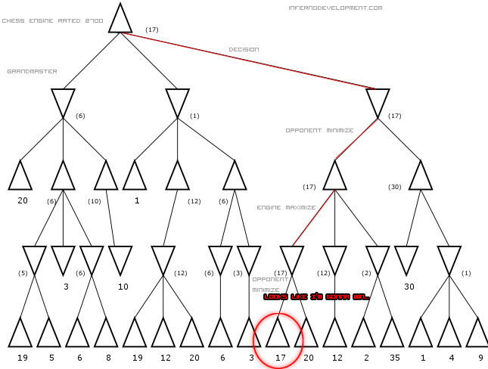
Often explicit or implicit tradeoffs between compute “amount” and quality of result
http://www.infernodevelopment.com/how-computer-chess-engines-think-minimax-tree

Slide 33
This kind of issue comes up a lot.
Mapping.
Assembly.
Statistics (Monte Carlo and resampling methods).
Simulations.
More generally, most “interesting” algorithms involve approximations and shortcuts. When are they (in)appropriate for your task?

Slide 34
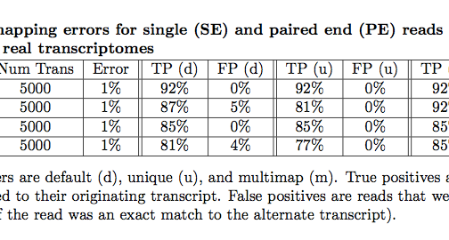
What are the limits of data + compute?
Mappers will ignore some fraction of reads due to errors.
Pyrkosz et al., unpub.

Slide 35
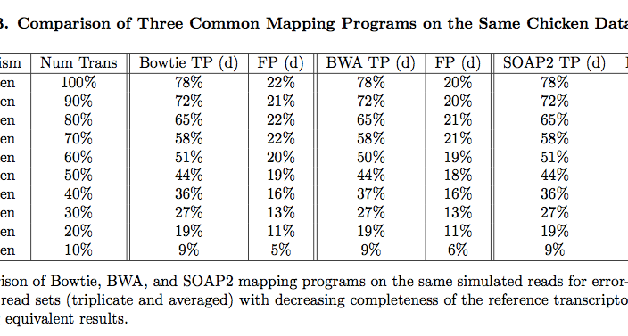
Does choice of mapper matter?
Reference completeness matters more!
Pyrkosz et al., unpub.

Slide 36
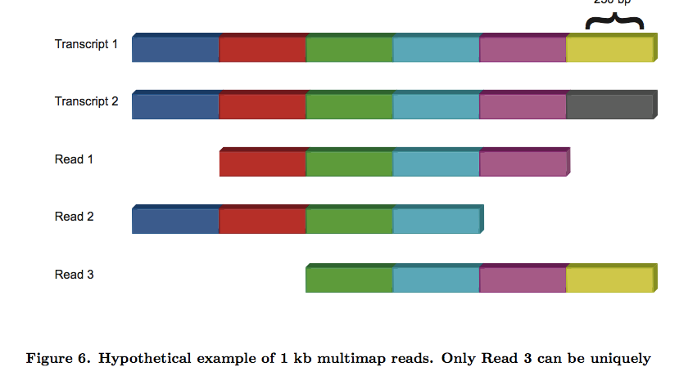
Real problem? Our data can’t uniquely specify solution!
Here, there is no direct way to know if last exon is connected to first exon.
Pyrkosz et al., unpub.

Slide 37
Concluding thoughts
There’s what you can do today, computationally, with existing programs. This is often limited by our time, experience, etc.
There’s what you could, in theory, do with the data you had. This is the upper limit on your accuracy.
Figuring out the difference is one of the main reasons you’re here :)

Slide 38
Any questions or comments?

Slide 39
Process and materials!
Use the ngs-2014@lists.idyll.org list to organize things!
Twitter: #ngs2014; I’m @ctitusbrown
Facebook group?

Slide 40
Use the stickies, Luke…

