Slide 1
Transcriptome Assembly

Slide 2
Transcriptome Assembly
What tissue(s)
How many individuals
How many reads
Short reads/long reads
Reference guided versus de novo

Slide 3
Transcriptome Assembly

Slide 4
Transcriptome Assembly

Slide 5
Transcriptome Assembly
Why easier than genome assembly?

Slide 6
Transcriptome Assembly
Why harder than genome assembly?

Slide 7
Transcriptome Assembly
The steps:

Slide 8
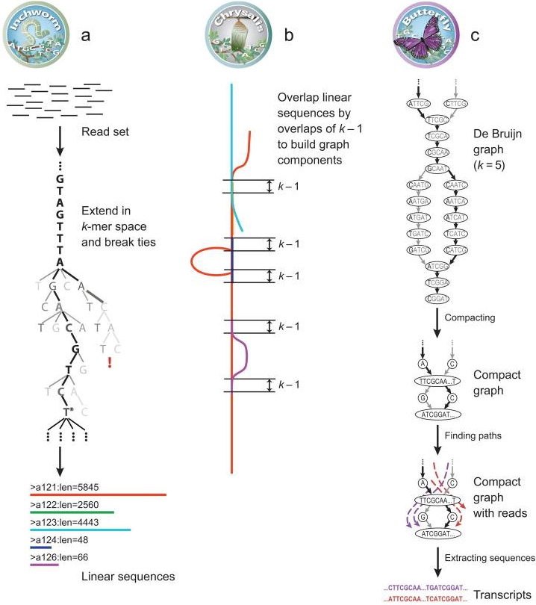
Transcriptome Assembly
Trinity

Slide 9
Transcriptome Assembly
http://www.broadinstitute.org/videos/trinity-how-it-works

