Slide 1


Slide 2
regular expressions
A pattern that strings can match

Slide 3
regular expressions
A pattern that strings can match
We have already seen examples!
'*.txt' matches filenames ending in '.txt’

Slide 4
regular expressions
A pattern that strings can match
Like '*.txt' matches filenames ending in '.txt'
Warning: notation can get ugly

Slide 5
regular expressions
A pattern that strings can match
Like '*.txt' matches filenames ending in '.txt'
Warning: notation can get ugly
Writing patterns for strings as strings...

Slide 6
regular expressions
A pattern that strings can match
Like '*.txt' matches filenames ending in '.txt'
Warning: notation can get ugly
Writing patterns for strings as strings…
...using only the symbols on the keyboard (instead
of inventing new symbols like mathematicians do)

Slide 7


Slide 8
Why not just use “find”?
in python:
searchstring=“thing I’m lookin for”
for lin in file:
if searchstring in lin:
print lin

Slide 9
Why not just use “find”?
in python:
searchstring=“thing I’m lookin for”
for lin in file:
if searchstring in lin:
print lin
FLEXIBILITY

Slide 10
Regular Expressions are useful if you only kind of know what you are looking for.
especially if you know how it would be formatted

Slide 11
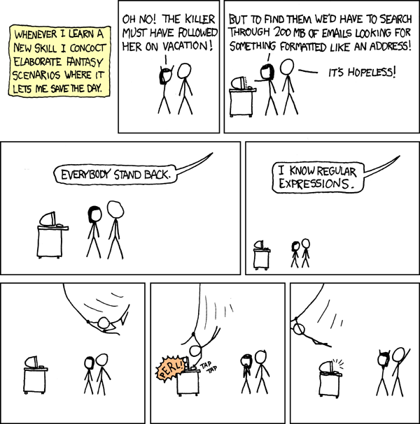

Slide 12
More common than you might think!
e.g.
pull filenames out of textfiles
find all the phone numbers in am email
search for a range of dates

Slide 13
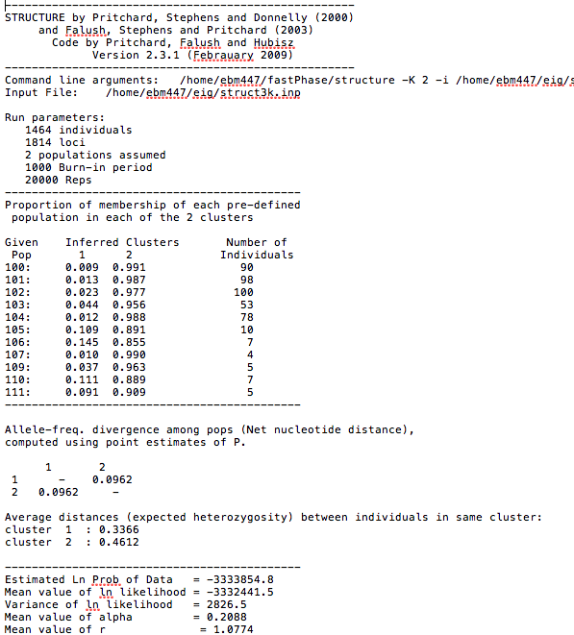

Slide 14

RegExPal demo
regexpal.com
structureoutput.txt

Slide 15
Cheat sheet from regexpal
Regular characters act normally
. Any character except newline.
\. A period (and so on for \*, \(, \\, etc.)
^ The start of the string.
$ The end of the string.
\d,\w,\s A digit, word character [A-Za-z0-9_], or whitespace.
\D,\W,\S Anything except a digit, word character, or whitespace.
[abc] Character a, b, or c. [a-z] a through z.
[^abc] Any character except a, b, or c.
aa|bb Either aa or bb.
? Zero or one of the preceding element.
* Zero or more of the preceding element.
+ One or more of the preceding element.
{n} Exactly n of the preceding element.
{n,} n or more of the preceding element.
{m,n} Between m and n of the preceding element. ??,*?,+?,

Slide 16
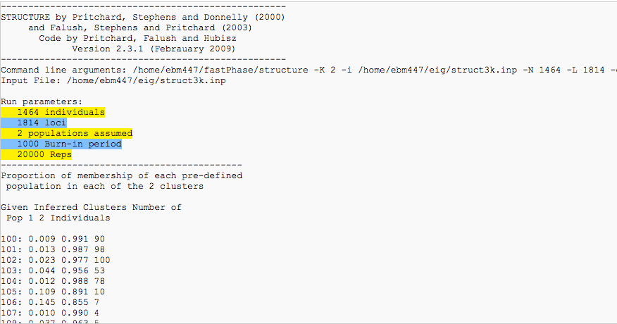
Mini-exercise!
You want to search through a bunch of different output files and get the run parameters for each one.
Write a regular expression in regexpal that will find only the five lines following “Run Parameters”

Slide 17
My answer:
^\s+\d+ \w+.+

Slide 18
ipython notebook reg ex demo using
structureoutput.txt

