Slide 1
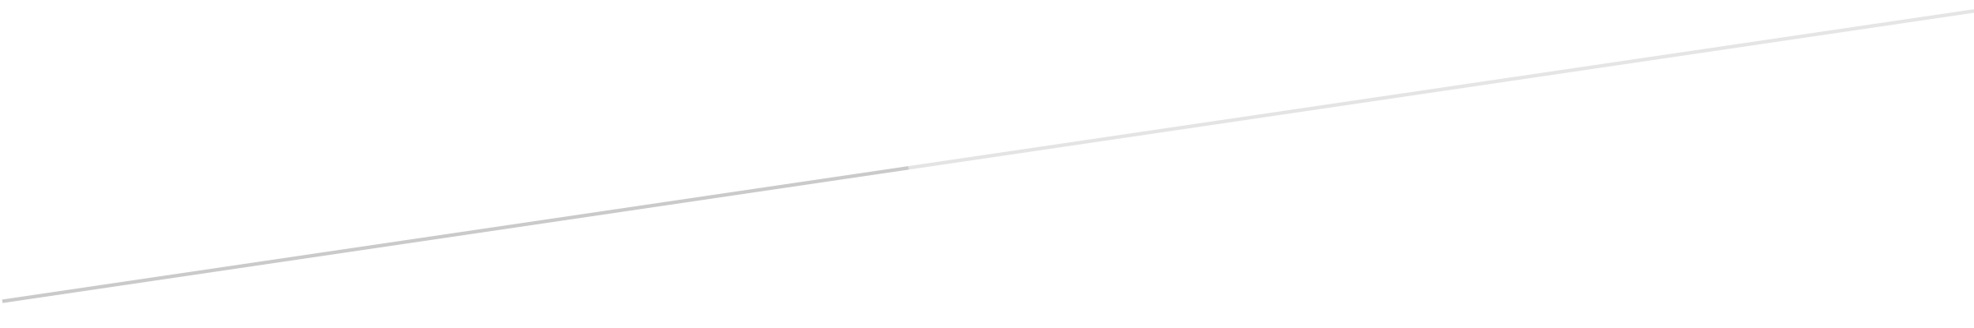

BIP PREDICTION
DATA MINING PROJECT
Alessandro Baldassari
841561
Alberto Bendin
841734
Paolo Cappello
841469
Alessandro Chiolini
864446
Lucija Megla
859315

Slide 2
1. Data preparation

Slide 3
Using Rstudio we extract some information from the date column, like the weekdays and holidays and we attach for each subarea the latitude and longitude data.

Slide 4
# Data mining and text mining - Politecnico di Milano
# Alessandro Baldassari
# Data Mining competition - BIP data
# Loading dataset
train <- read.csv("~/Git/data mining/dataset_polimi.csv")
# Product type String -> boolean
train$Categoria_prodotto <- as.character(train$Categoria_prodotto)
train$Prodotto_1 <- "0"
train$Prodotto_1[train$Categoria_prodotto == "Prodotto_1"] <- "1"
# Extraction of day and month from date
train$Data <- as.Date.factor(train$Data)
train$Day <- sapply(train$Data, FUN=function(x) {weekdays(as.Date(x,'%y-%m-%d'))})
train$Month <- sapply(train$Data, FUN=function(x) {months(as.Date(x,'%y-%m-%d'))})
# Extraction of year
train$Data <- as.character(train$Data)
train$Year <- sapply(train$Data, FUN=function(x) {substr(x, 1, 4)})
train$Day_Number <- sapply(train$Data, FUN=function(x) {substr(x, 9, 10)})
train$Day_Number <- as.integer(train$Day_Number)
# Adding stable holidays
train$Holiday <- 0
train$Holiday[train$Month == 'gennaio' & train$Day_Number == 1] <- 1
train$Holiday[train$Month == 'gennaio' & train$Day_Number == 6] <- 1
train$Holiday[train$Month == 'aprile' & train$Day_Number == 25] <- 1
train$Holiday[train$Month == 'maggio' & train$Day_Number == 1] <- 1
train$Holiday[train$Month == 'giugno' & train$Day_Number == 2] <- 1
train$Holiday[train$Month == 'agosto' & train$Day_Number == 15] <- 1
train$Holiday[train$Month == 'novembre' & train$Day_Number == 1] <- 1
train$Holiday[train$Month == 'dicembre' & train$Day_Number == 8] <- 1
train$Holiday[train$Month == 'dicembre' & train$Day_Number == 25] <- 1
train$Holiday[train$Month == 'dicembre' & train$Day_Number == 26] <- 1
# Adding moving holidays
train$Holiday[train$Month == 'marzo' & train$Day_Number == 27 & train$Year == '2016'] <- 1
train$Holiday[train$Month == 'marzo' & train$Day_Number == 28 & train$Year == '2016'] <- 1
train$Holiday[train$Month == 'aprile' & train$Day_Number == 5 & train$Year == '2015'] <- 1
train$Holiday[train$Month == 'aprile' & train$Day_Number == 6 & train$Year == '2015'] <- 1
train$Holiday[train$Month == 'aprile' & train$Day_Number == 20 & train$Year == '2014'] <- 1
train$Holiday[train$Month == 'aprile' & train$Day_Number == 21 & train$Year == '2014'] <- 1

Slide 5
After some testing we decide to trasform each non-working day into a special day called «Festivo» and we obtain our definitive dataset that look like the following extract

Slide 6
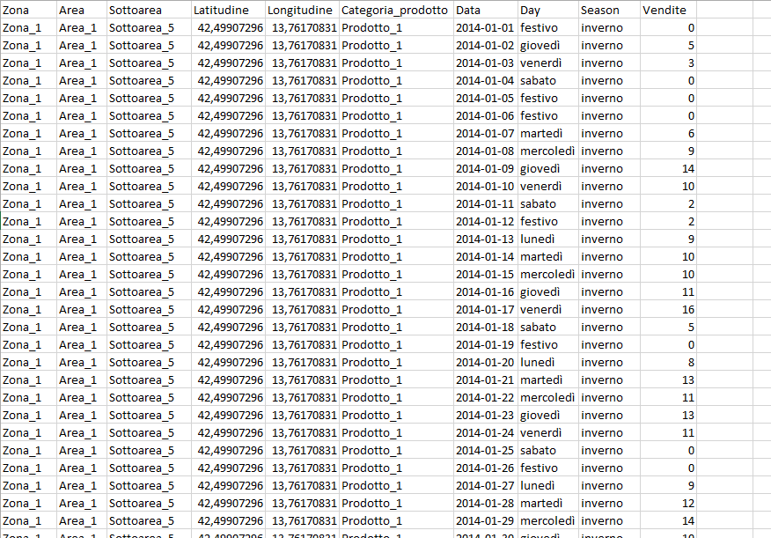

Slide 7
Finally we divide the resulting dataset into many subset, one for each subarea and product, and we start creating the model using Weka.

Slide 8
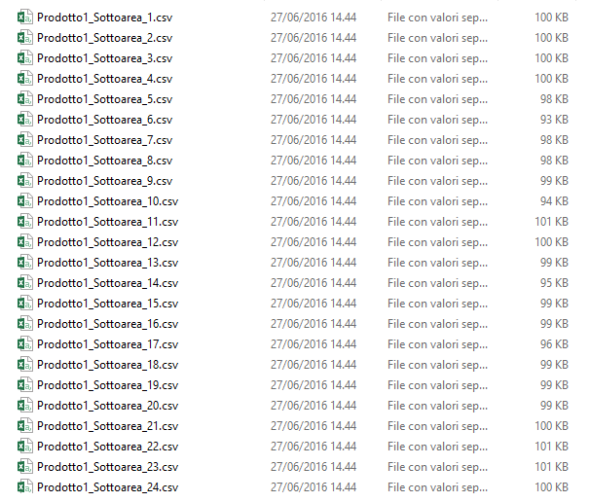

Slide 9
2. Model Creation

Slide 10
After setting up a regression with different learners on Knime we decide to switch to Weka with a plugin available in Weka Package Manager, that is «TimeSeries». This plugin allows us to make a prediction on a target column.
We build up 288 models, one for each file that we create finally in the data preparation

Slide 11
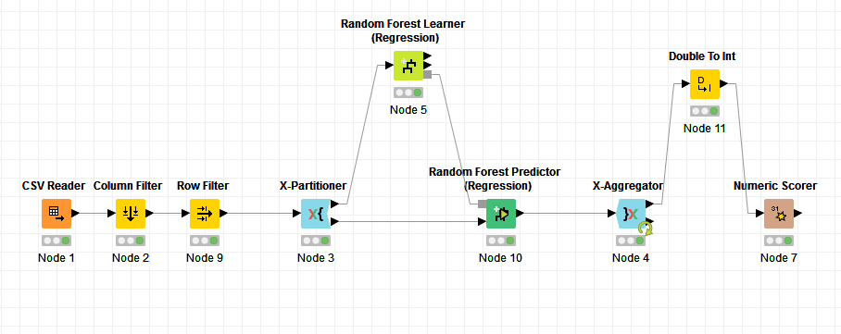
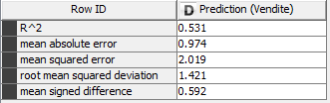
Knime Prediction with Random Forest Learner

Slide 12
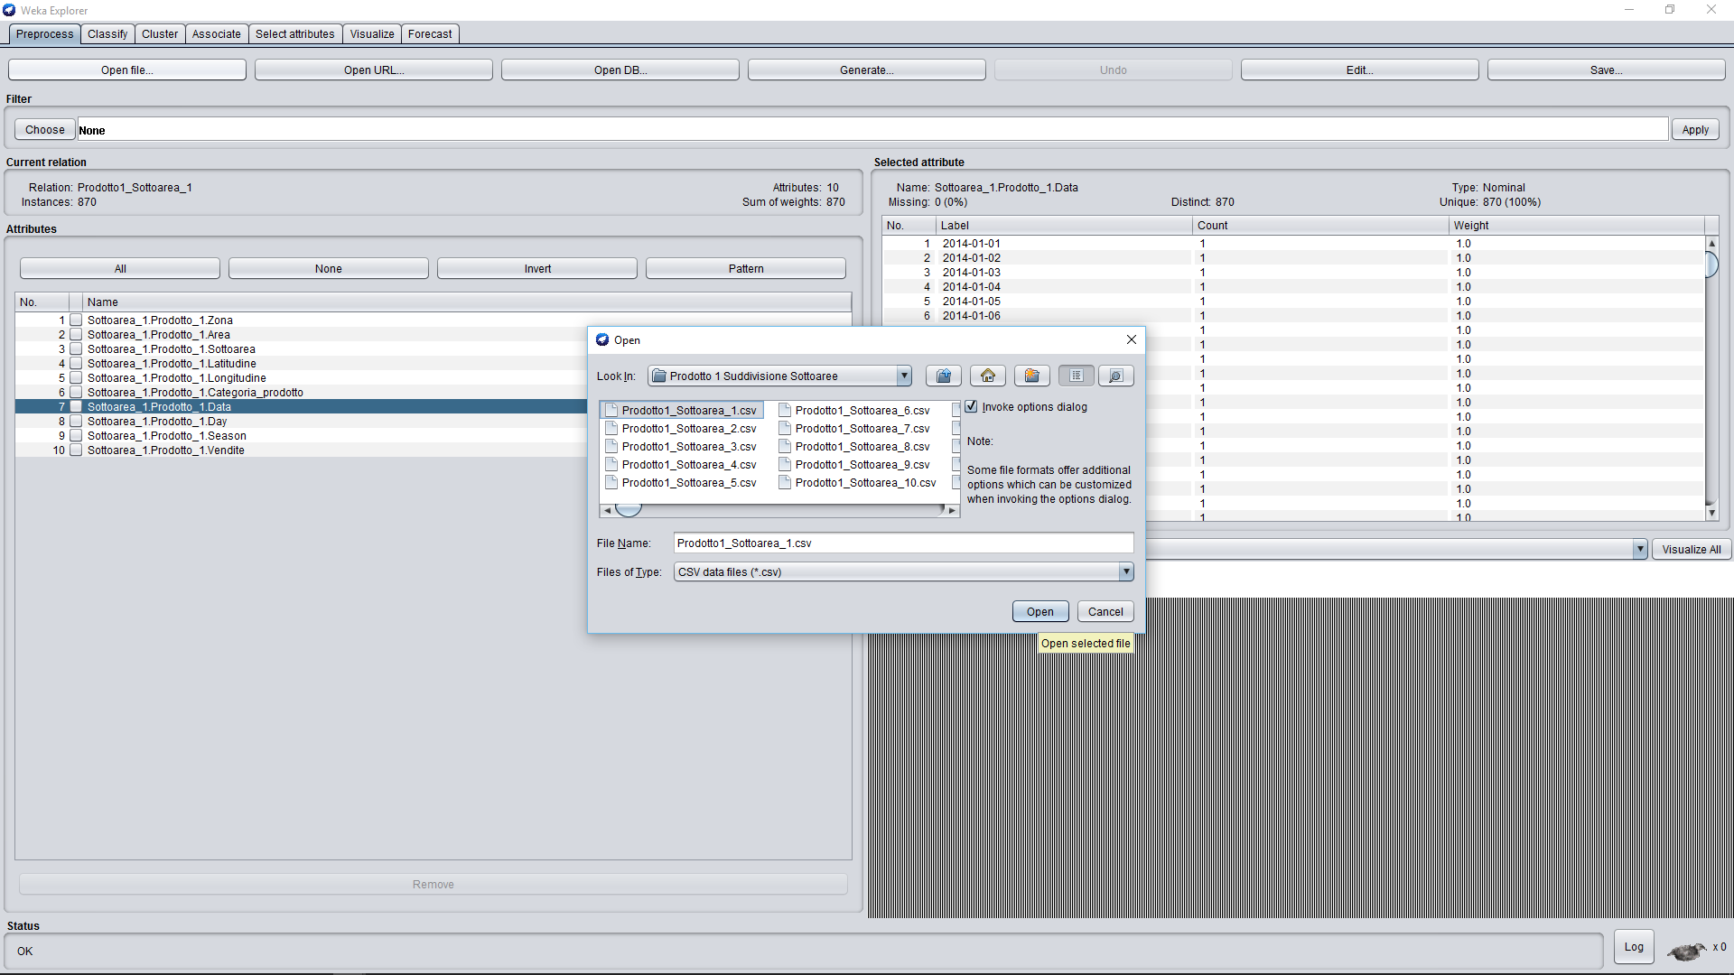
Weka Setup

Slide 13
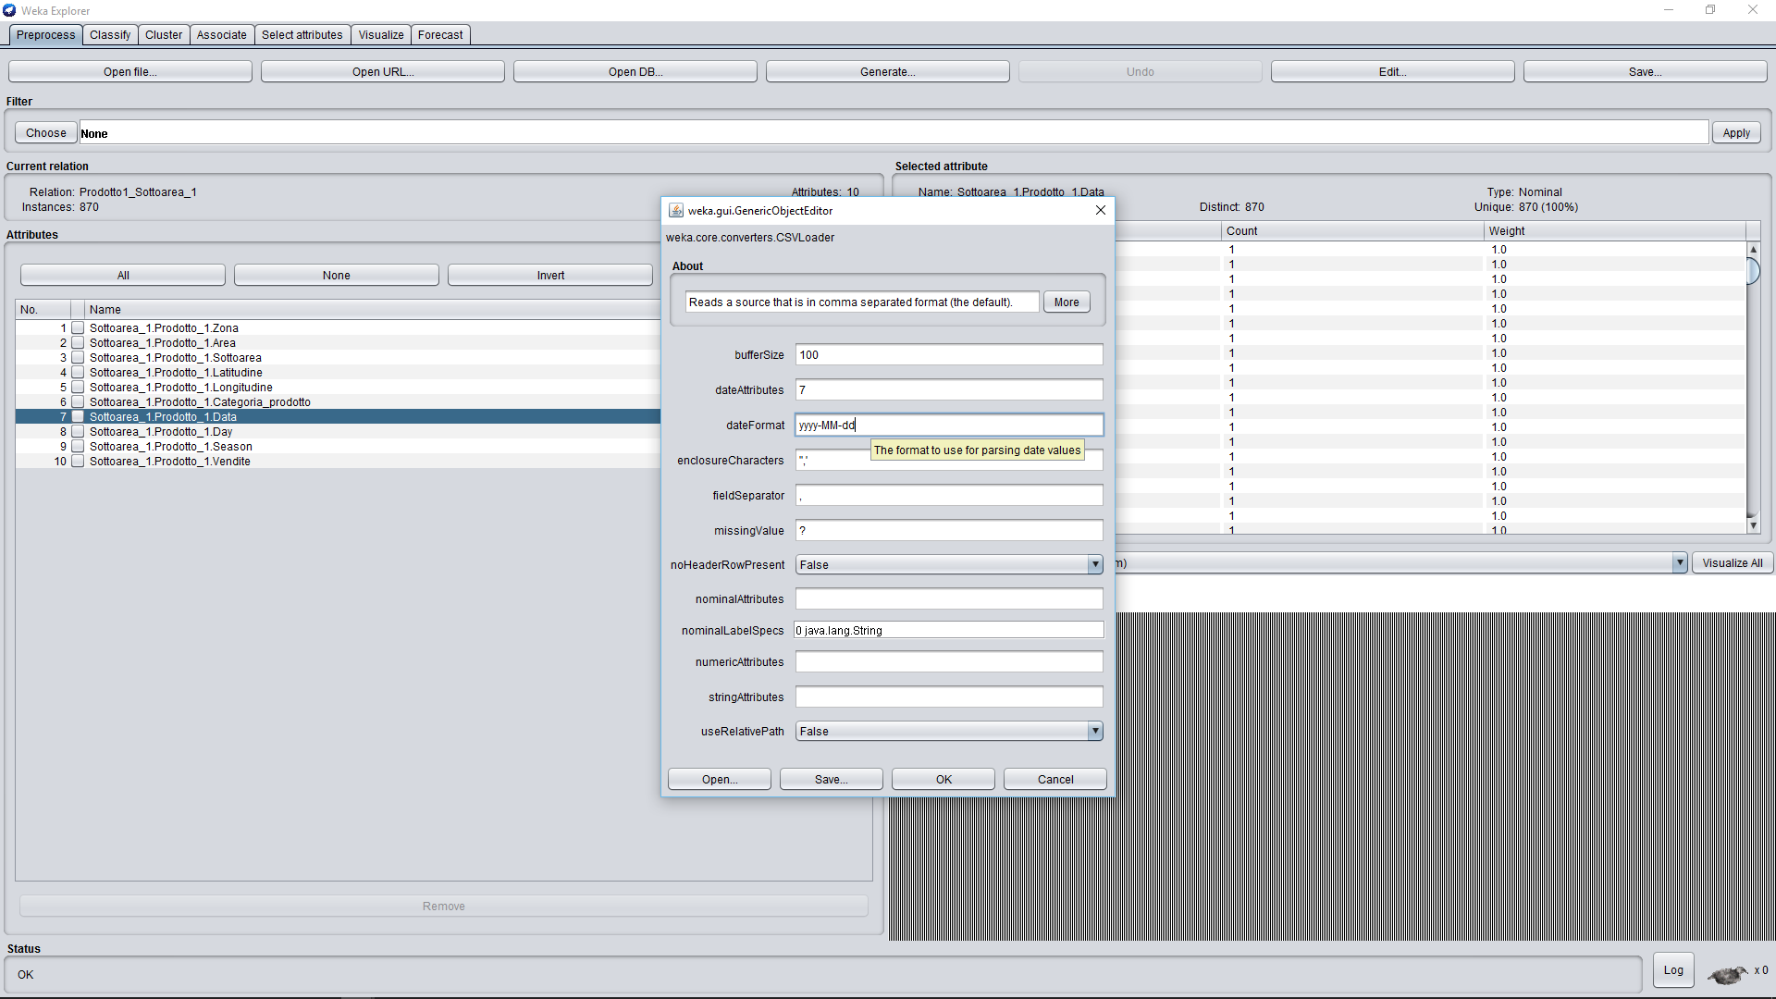

Slide 14
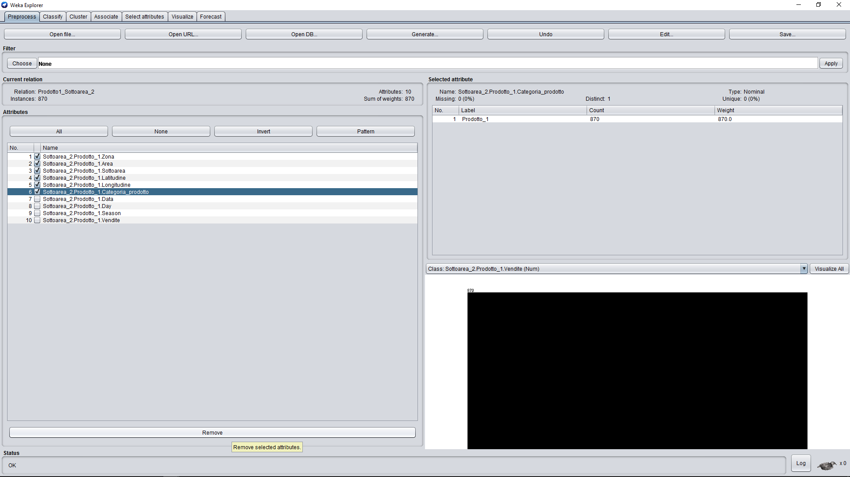

Slide 15
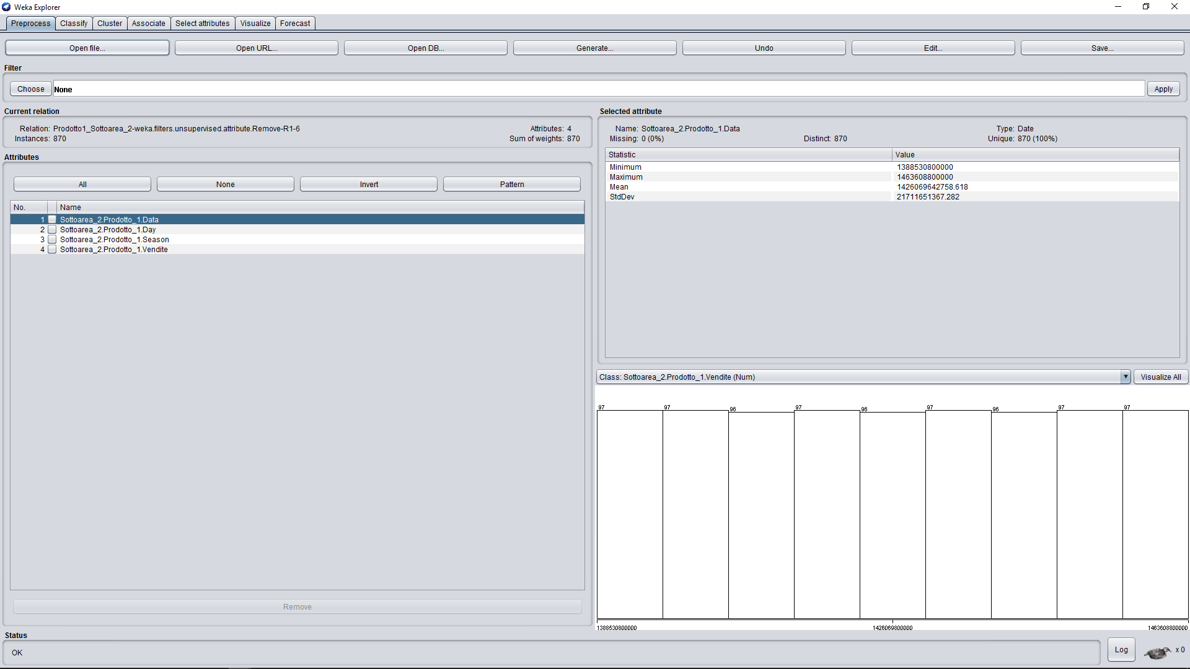

Slide 16
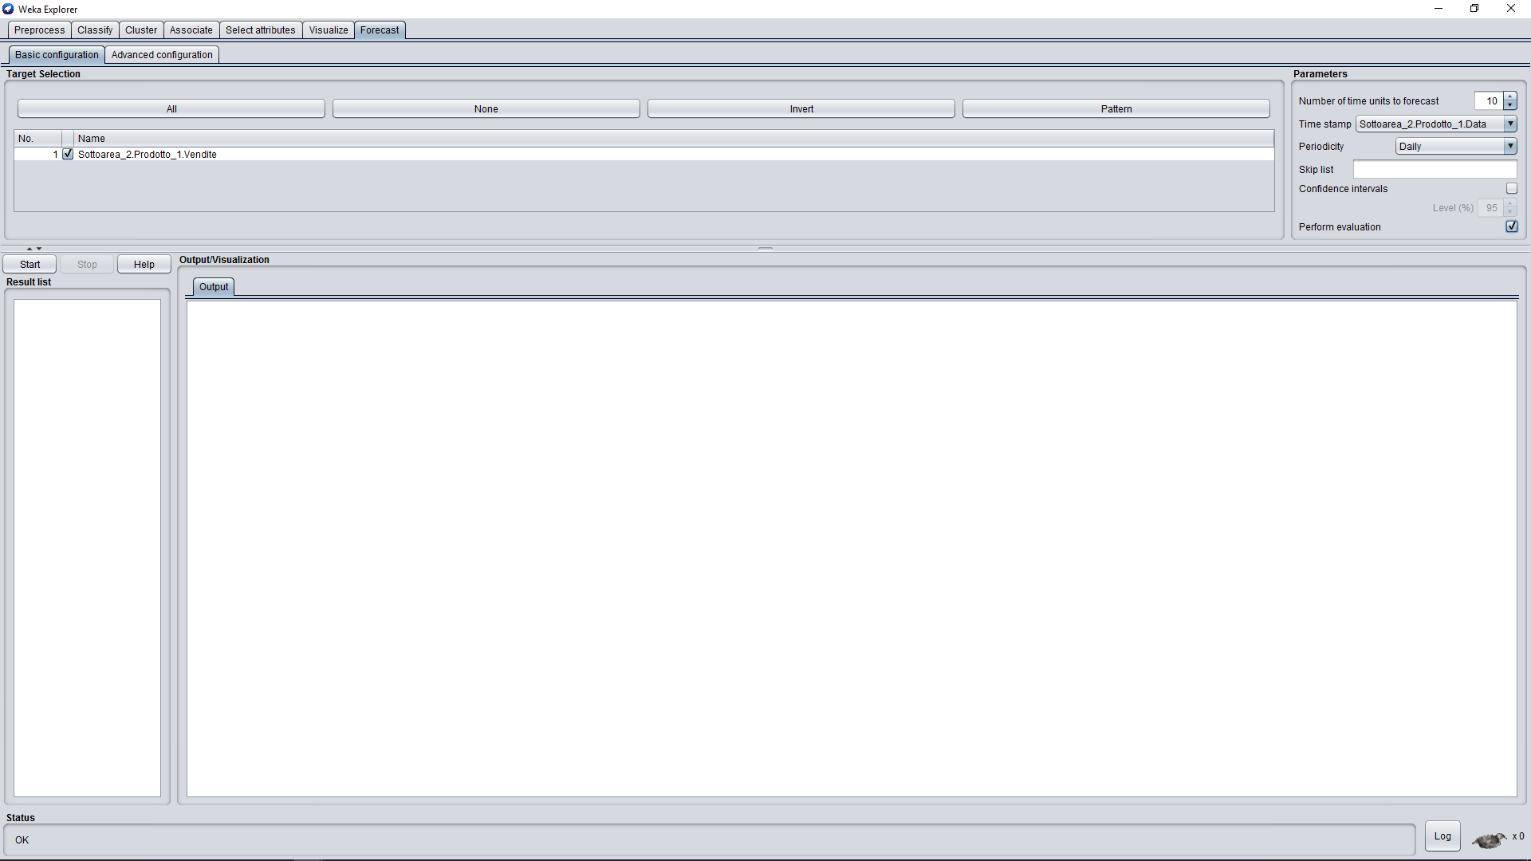

Slide 17
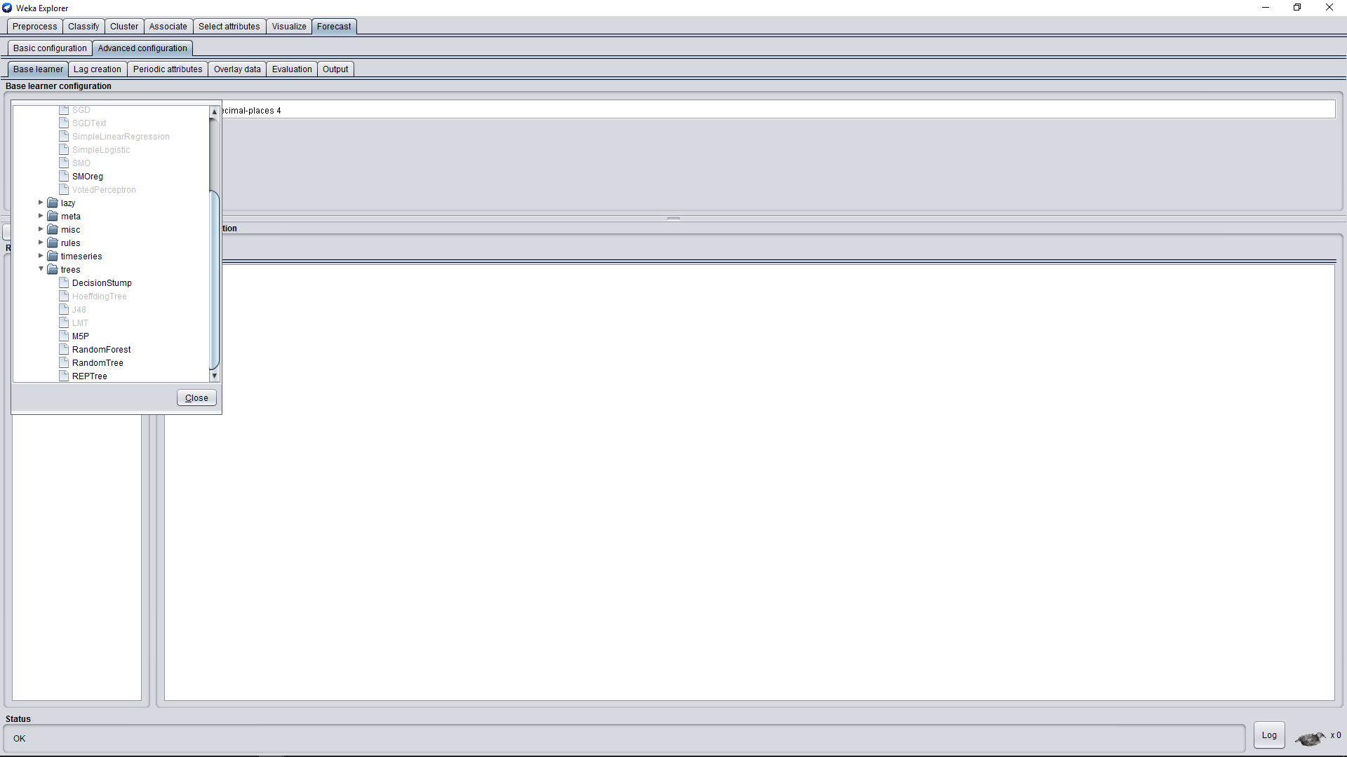

Slide 18
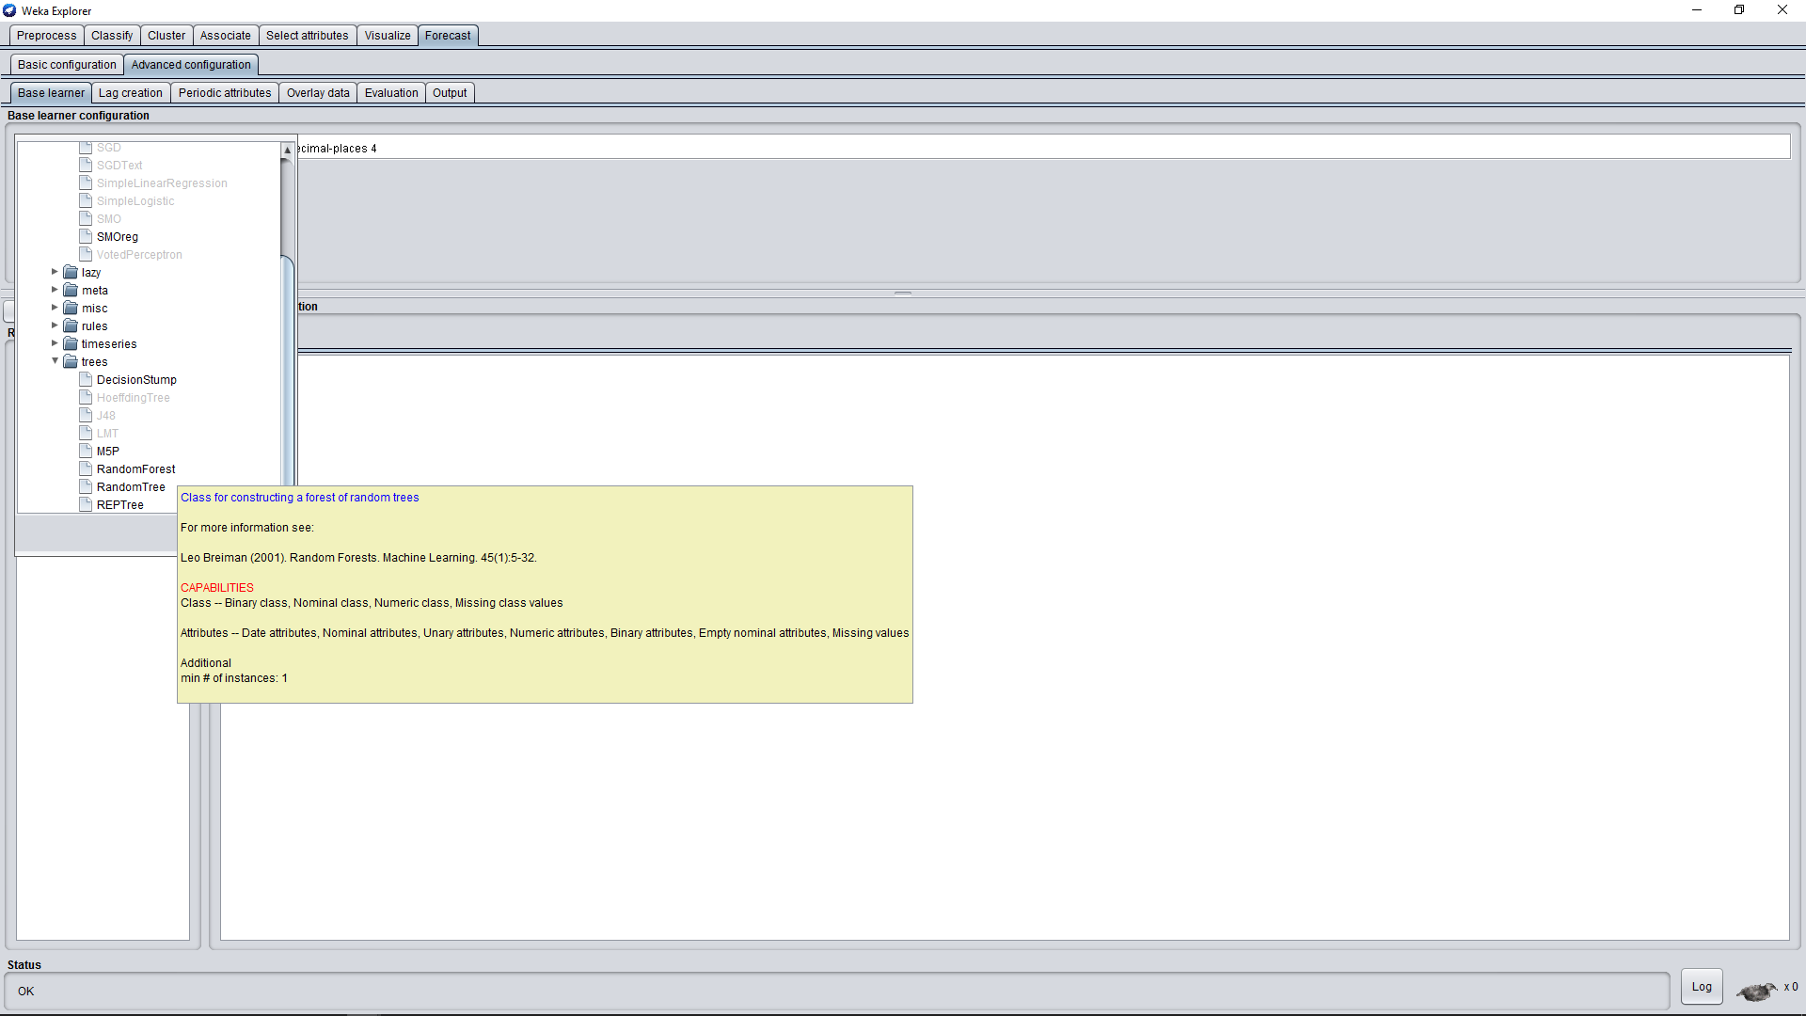

Slide 20
2.1 Tuning

Slide 21
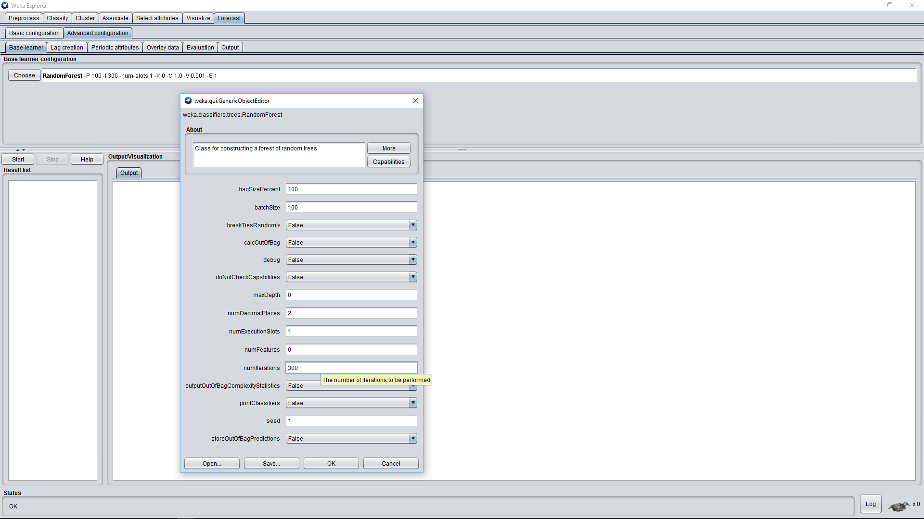

Slide 22
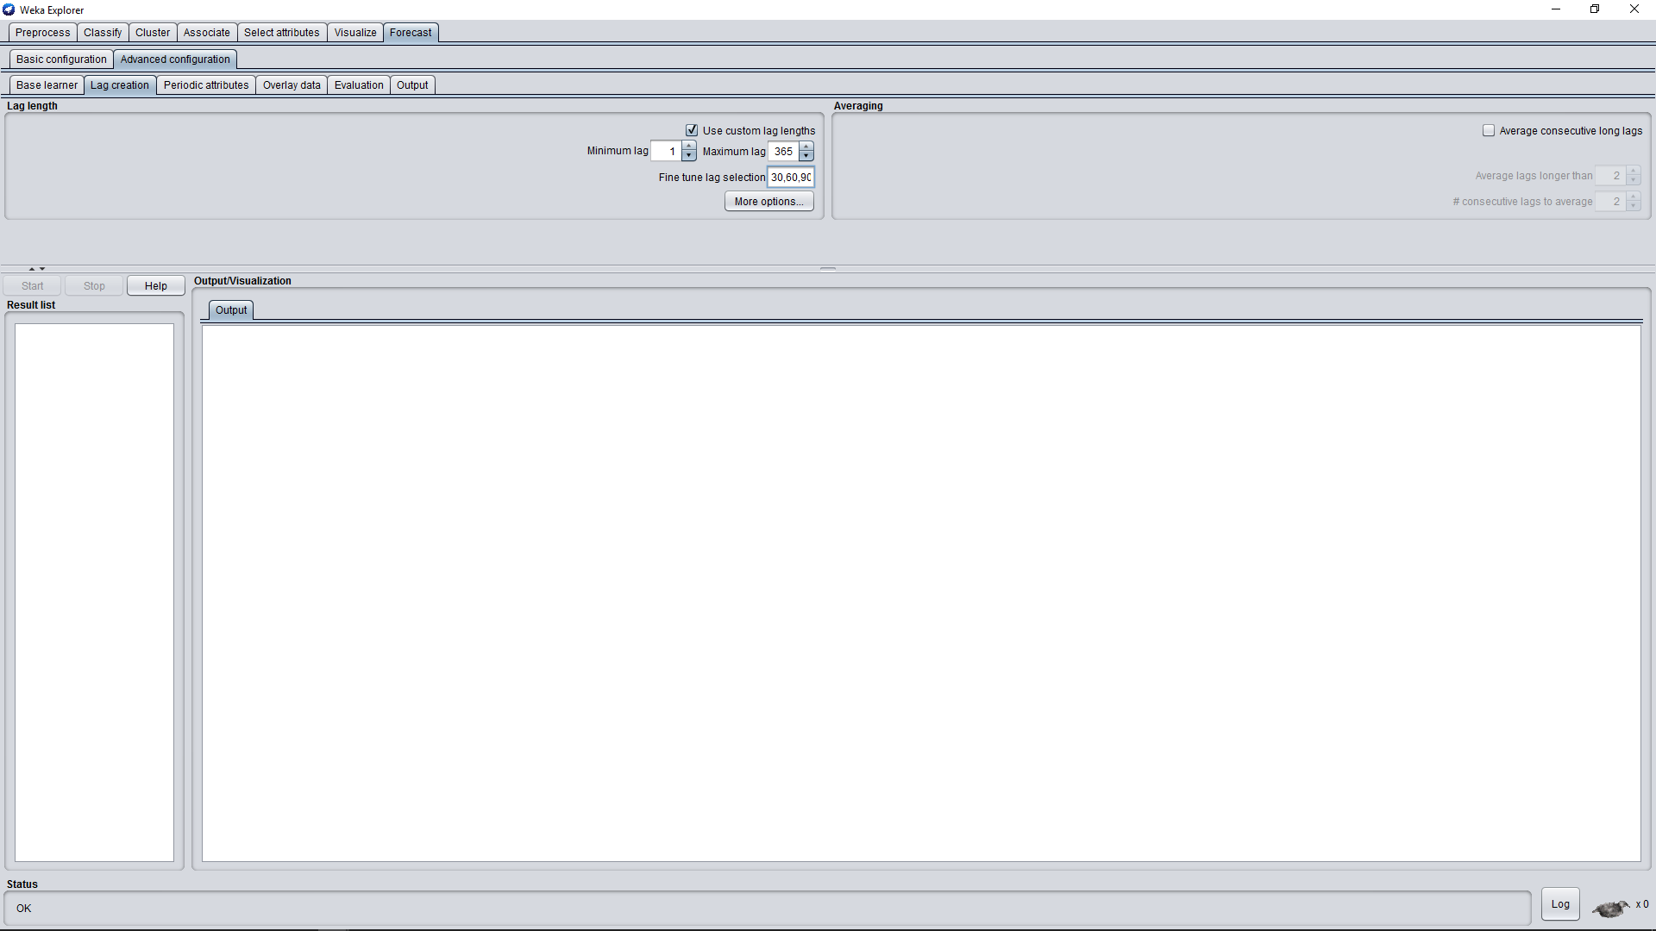

Slide 23
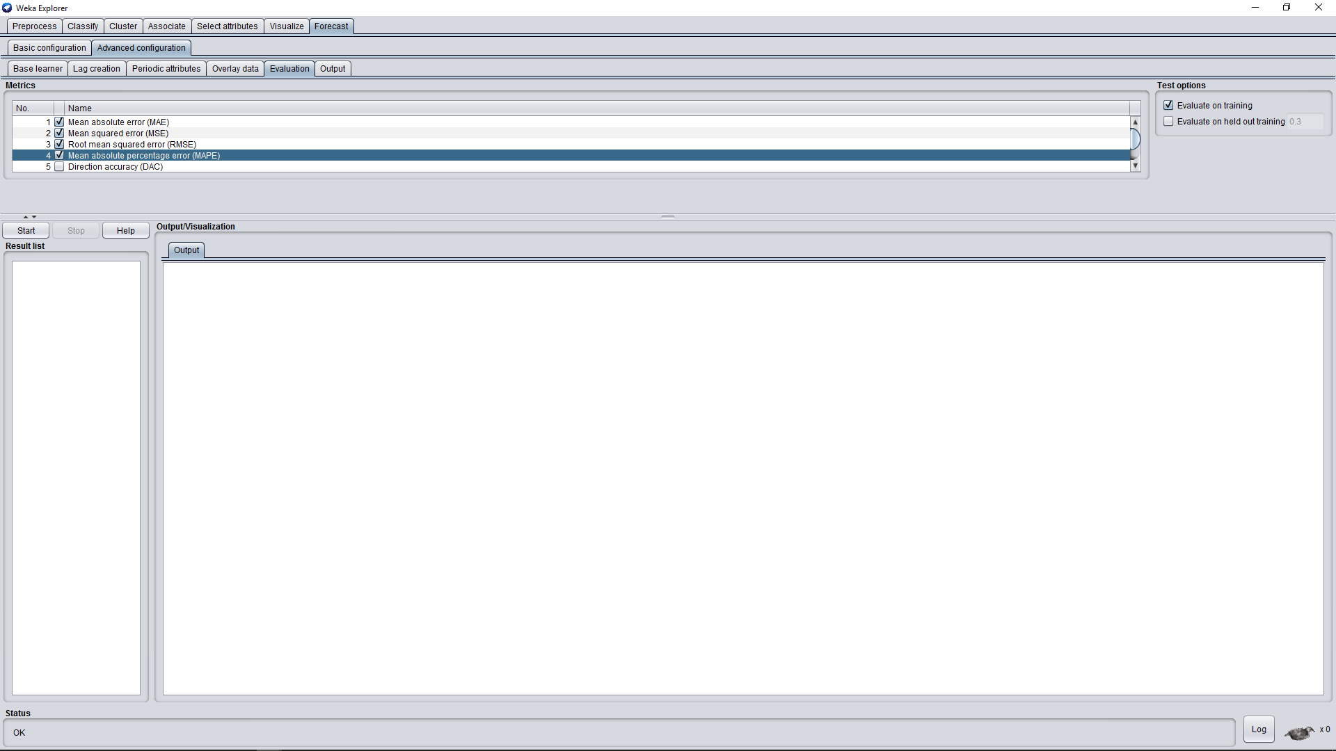

Slide 24
2.2 Weka Results

Slide 25
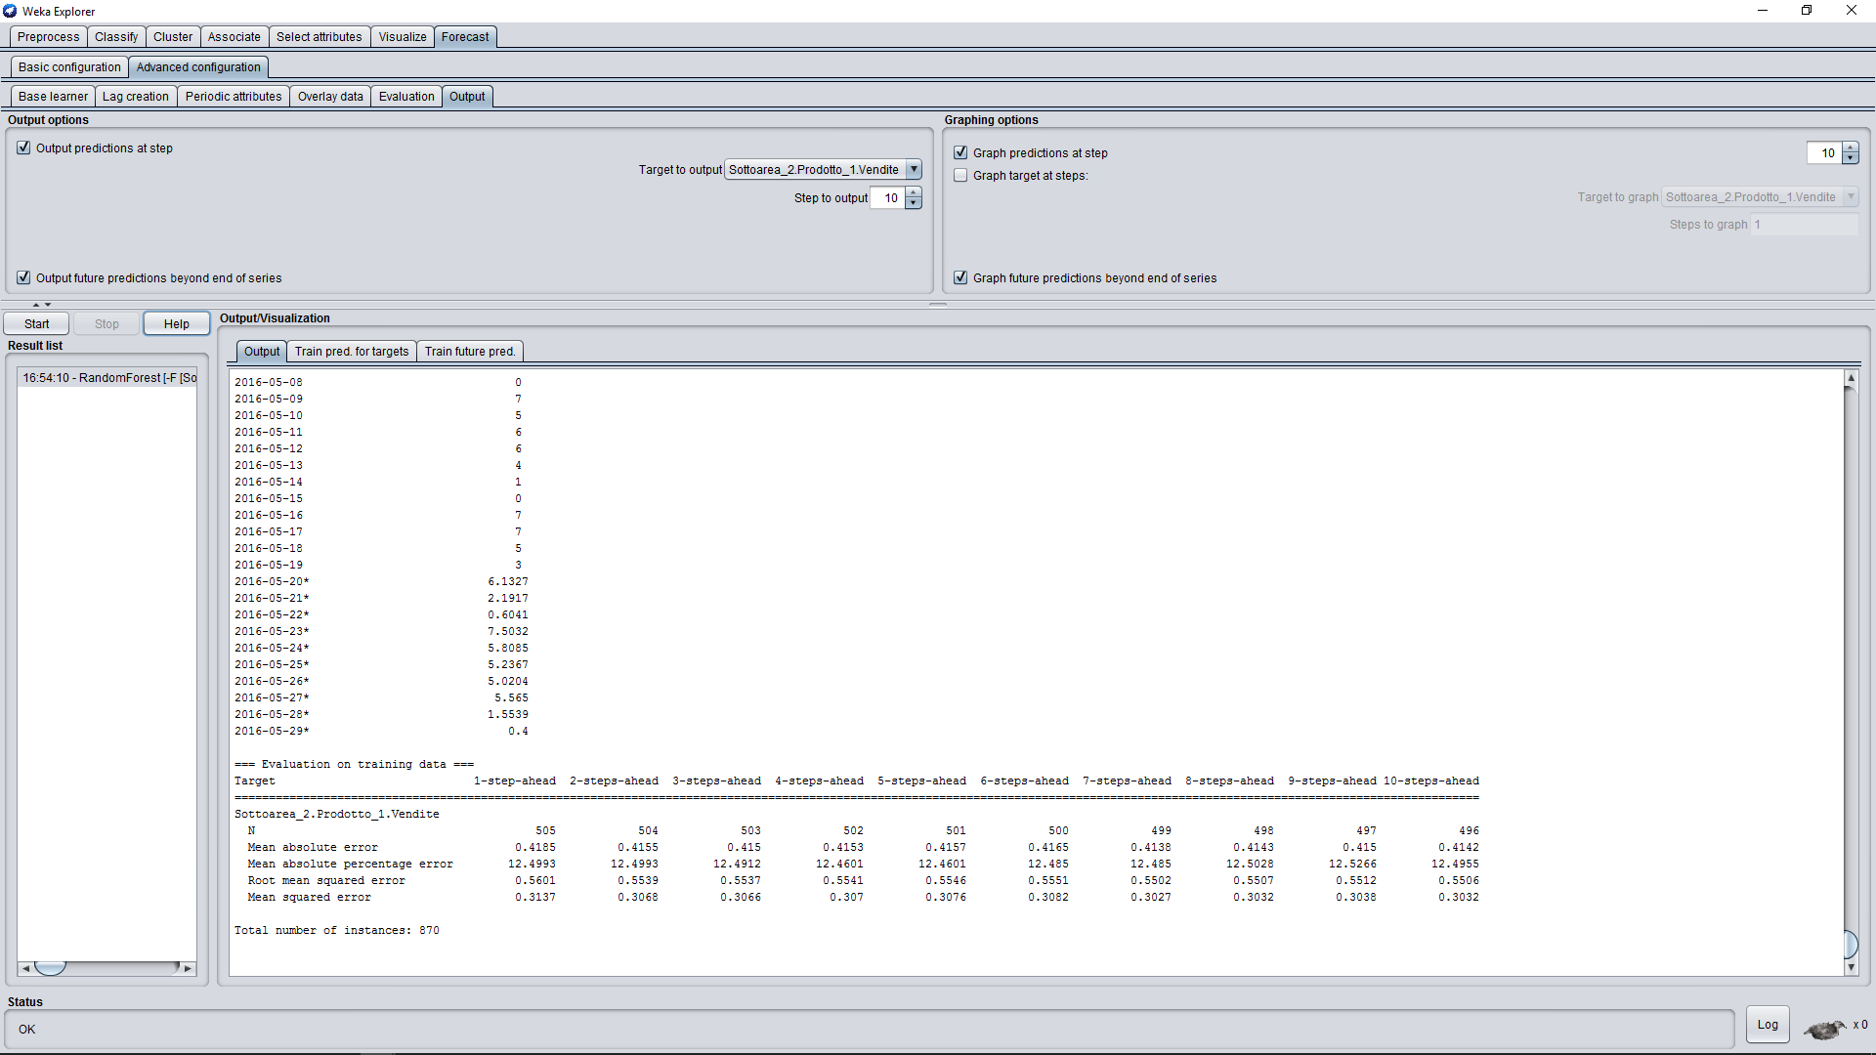

Slide 26
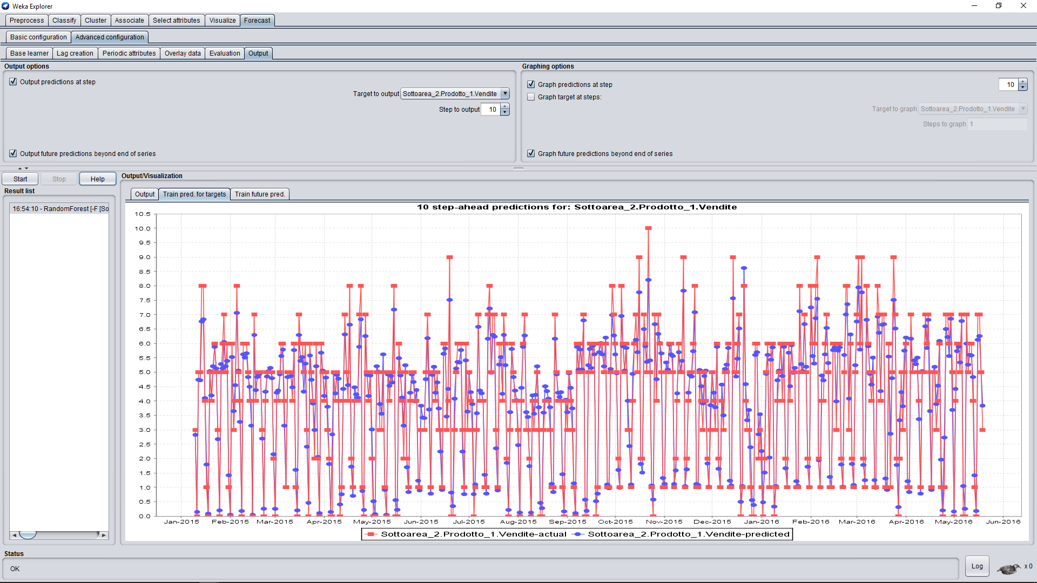

Slide 27
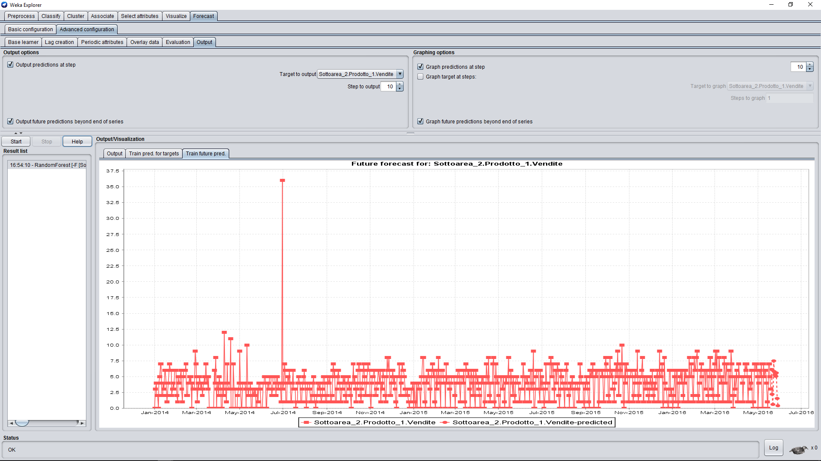

Slide 28
3. Result Elaboration

Slide 29
Using Knime we exctract from each txt file that report the statistics elaborated by Weka the data that were predicted and put them into two csv file, one for each product, to better read them in an organized table.

Slide 30
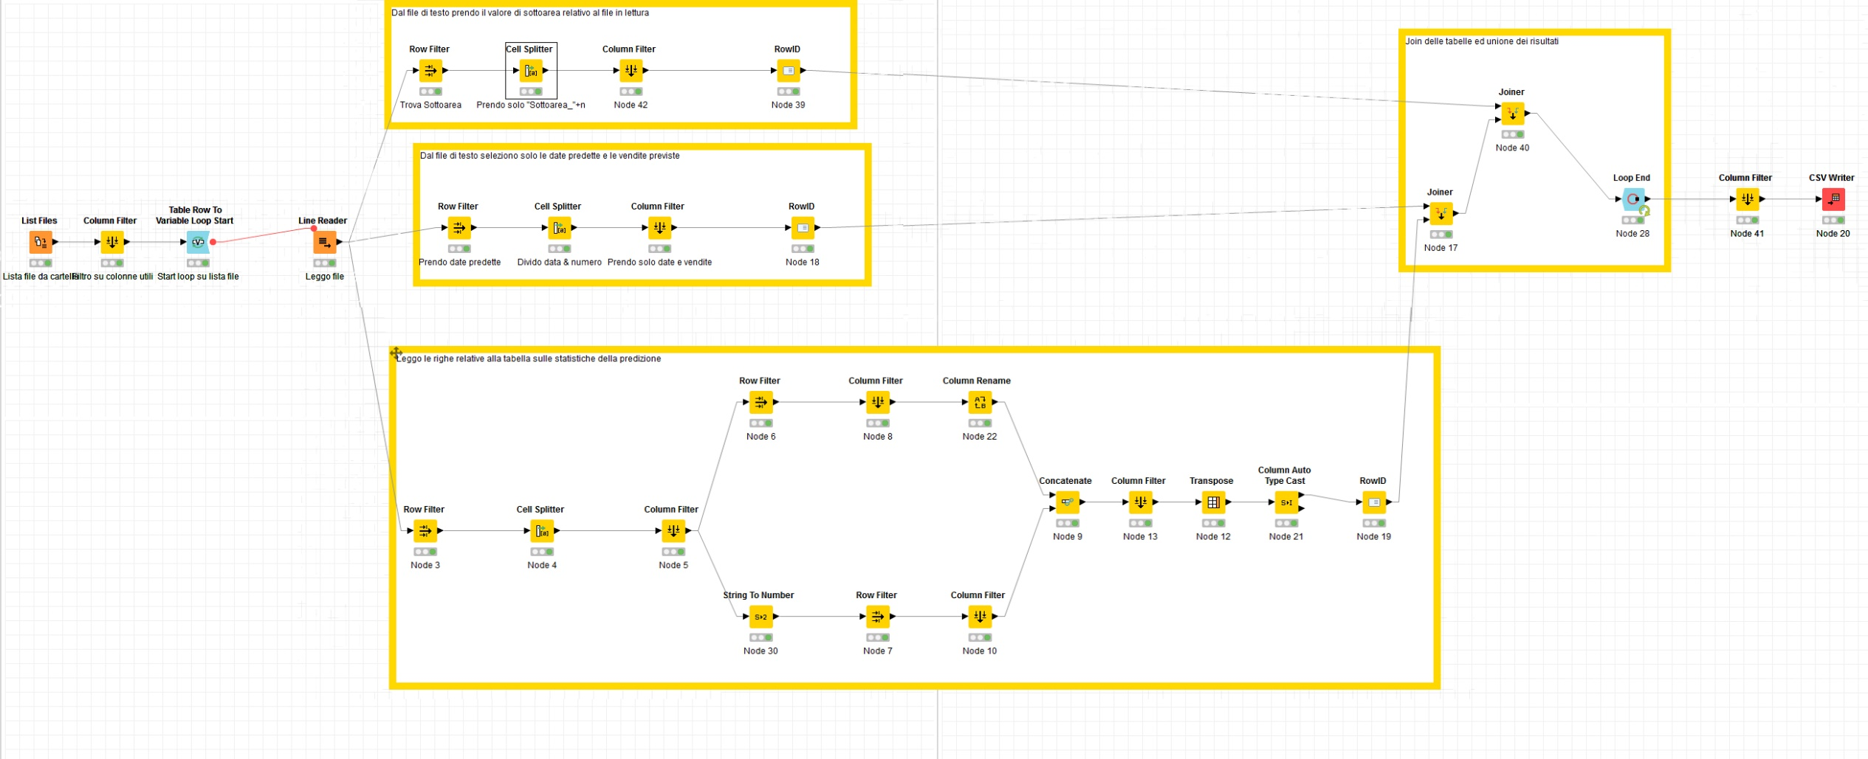

Slide 31
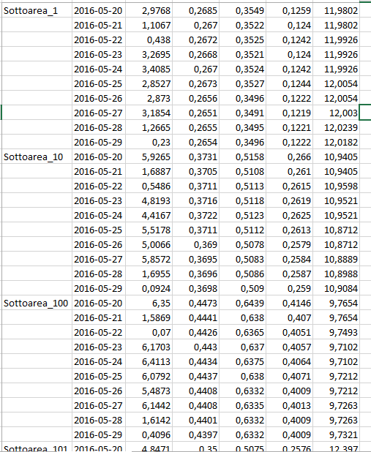

Slide 32
Then we attached to that simple table a column header, the references to Area and Zona for each Subarea, the coordinates to copletely report the final tables and give them the best readability

Slide 33
Prodotto 1
Prodotto 2

