Slide 1
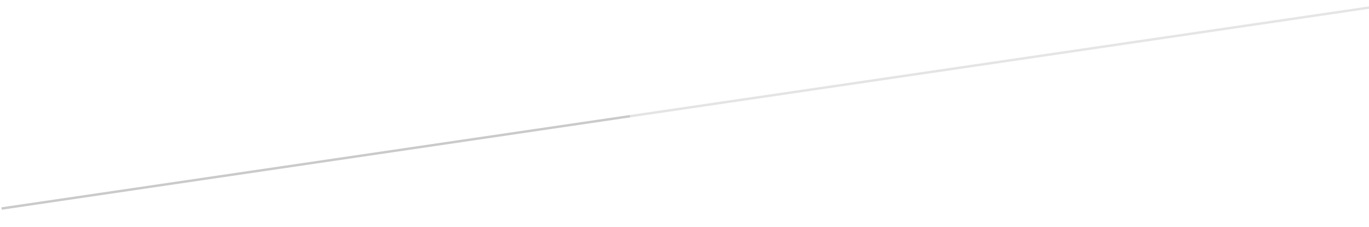

BIP PREDICTION
DATA MINING PROJECT
Alessandro Baldassari
841561
Alberto Bendin
841734
Paolo Cappello
841469
Alessandro Chiolini
864446
Lucija Megla
859315

Slide 2
1. Data preparation

Slide 3
Using Rstudio we extract some information from the date column, like the weekdays and holidays and we attach for each subarea the latitude and longitude data.

Slide 4
# Data mining and text mining - Politecnico di Milano
# Alessandro Baldassari
# Data Mining competition - BIP data
# Loading dataset
train <- read.csv("~/Git/data mining/dataset_polimi.csv")
# Product type String -> boolean
train$Categoria_prodotto <- as.character(train$Categoria_prodotto)
train$Prodotto_1 <- "0"
train$Prodotto_1[train$Categoria_prodotto == "Prodotto_1"] <- "1"
# Extraction of day and month from date
train$Data <- as.Date.factor(train$Data)
train$Day <- sapply(train$Data, FUN=function(x) {weekdays(as.Date(x,'%y-%m-%d'))})
train$Month <- sapply(train$Data, FUN=function(x) {months(as.Date(x,'%y-%m-%d'))})
# Extraction of year
train$Data <- as.character(train$Data)
train$Year <- sapply(train$Data, FUN=function(x) {substr(x, 1, 4)})
train$Day_Number <- sapply(train$Data, FUN=function(x) {substr(x, 9, 10)})
train$Day_Number <- as.integer(train$Day_Number)
# Adding stable holidays
train$Holiday <- 0
train$Holiday[train$Month == 'gennaio' & train$Day_Number == 1] <- 1
train$Holiday[train$Month == 'gennaio' & train$Day_Number == 6] <- 1
train$Holiday[train$Month == 'aprile' & train$Day_Number == 25] <- 1
train$Holiday[train$Month == 'maggio' & train$Day_Number == 1] <- 1
train$Holiday[train$Month == 'giugno' & train$Day_Number == 2] <- 1
train$Holiday[train$Month == 'agosto' & train$Day_Number == 15] <- 1
train$Holiday[train$Month == 'novembre' & train$Day_Number == 1] <- 1
train$Holiday[train$Month == 'dicembre' & train$Day_Number == 8] <- 1
train$Holiday[train$Month == 'dicembre' & train$Day_Number == 25] <- 1
train$Holiday[train$Month == 'dicembre' & train$Day_Number == 26] <- 1
# Adding moving holidays
train$Holiday[train$Month == 'marzo' & train$Day_Number == 27 & train$Year == '2016'] <- 1
train$Holiday[train$Month == 'marzo' & train$Day_Number == 28 & train$Year == '2016'] <- 1
train$Holiday[train$Month == 'aprile' & train$Day_Number == 5 & train$Year == '2015'] <- 1
train$Holiday[train$Month == 'aprile' & train$Day_Number == 6 & train$Year == '2015'] <- 1
train$Holiday[train$Month == 'aprile' & train$Day_Number == 20 & train$Year == '2014'] <- 1
train$Holiday[train$Month == 'aprile' & train$Day_Number == 21 & train$Year == '2014'] <- 1

Slide 5
After some testing we decide to trasform each non-working day into a special day called «Festivo» and we obtain our definitive dataset that look like the following extract

Slide 6
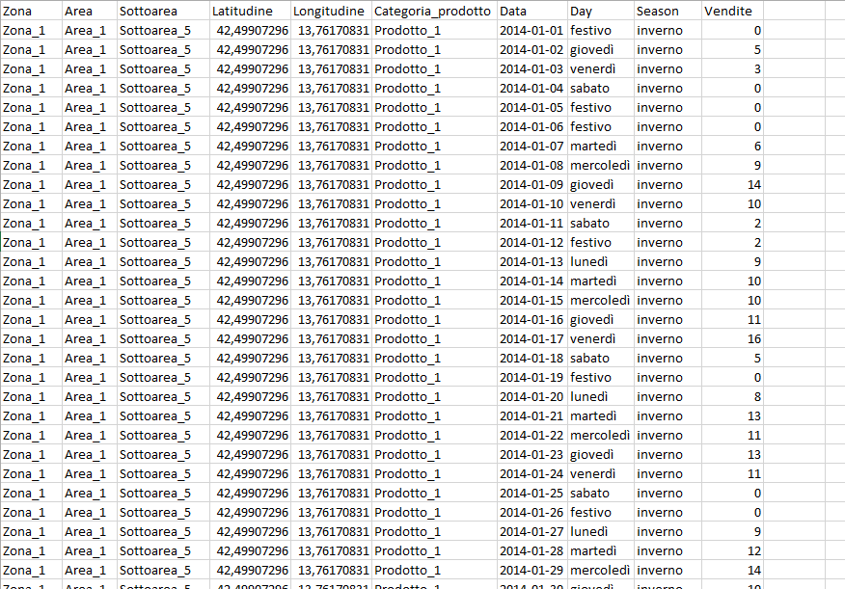

Slide 7
Finally we divide the resulting dataset into many subset, one for each subarea and product, and we start creating the model using Weka.

Slide 8
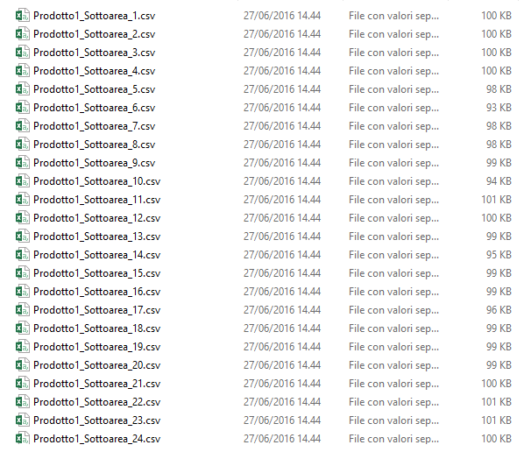

Slide 9
2. Model Creation

Slide 10
After setting up a regression with different learners on Knime we decide to switch to Weka with a plugin available in Weka Package Manager, that is «TimeSeries». This plugin allows us to make a prediction on a target column.
We build up 288 models, one for each file that we create finally in the data preparation

Slide 11
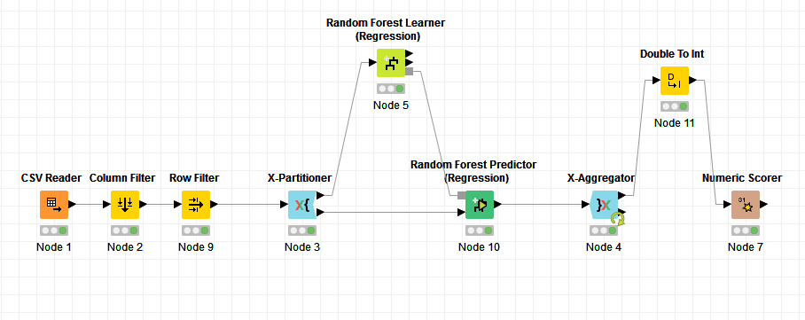
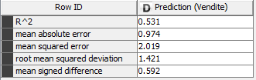
Knime Prediction with Random Forest Learner

Slide 12
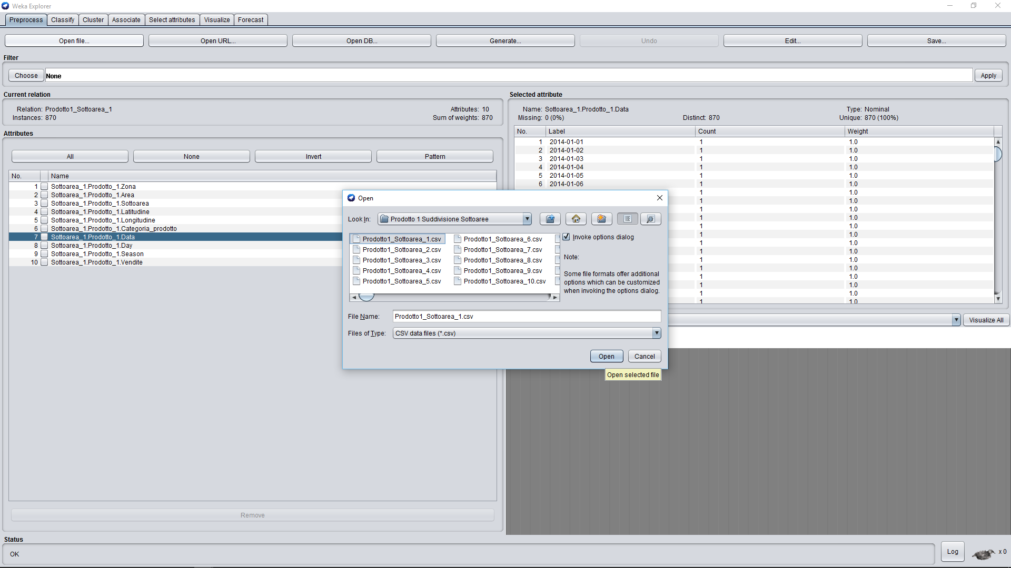
Weka Setup

Slide 13
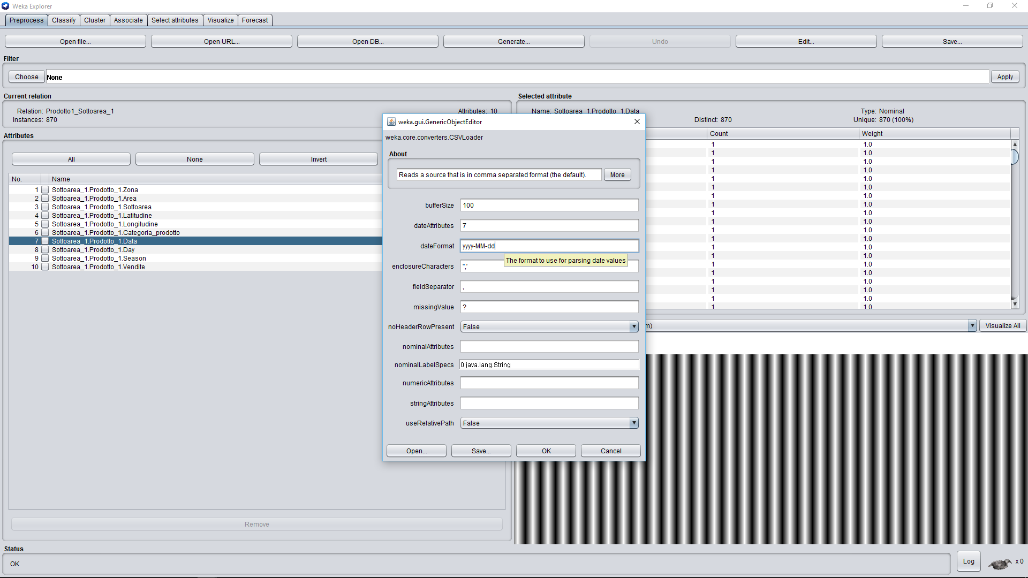

Slide 14
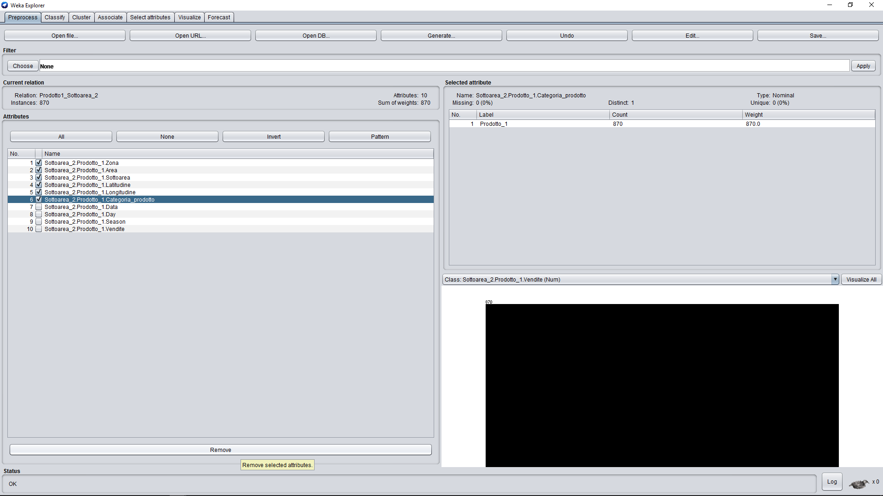

Slide 15
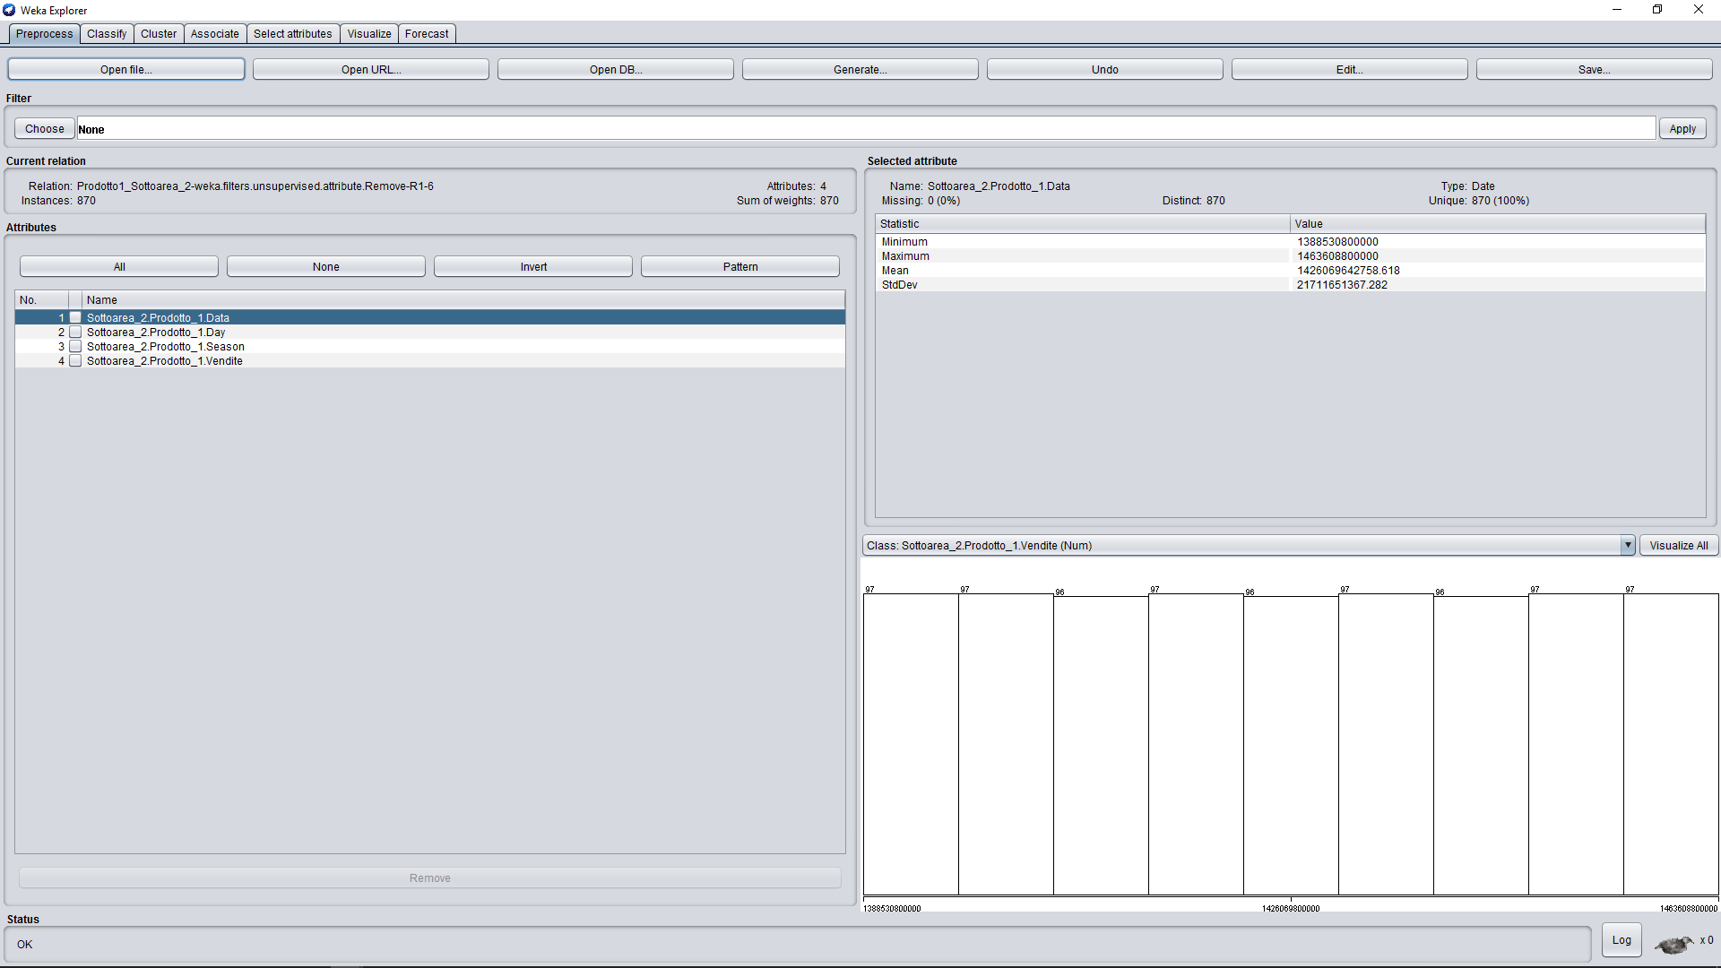

Slide 16
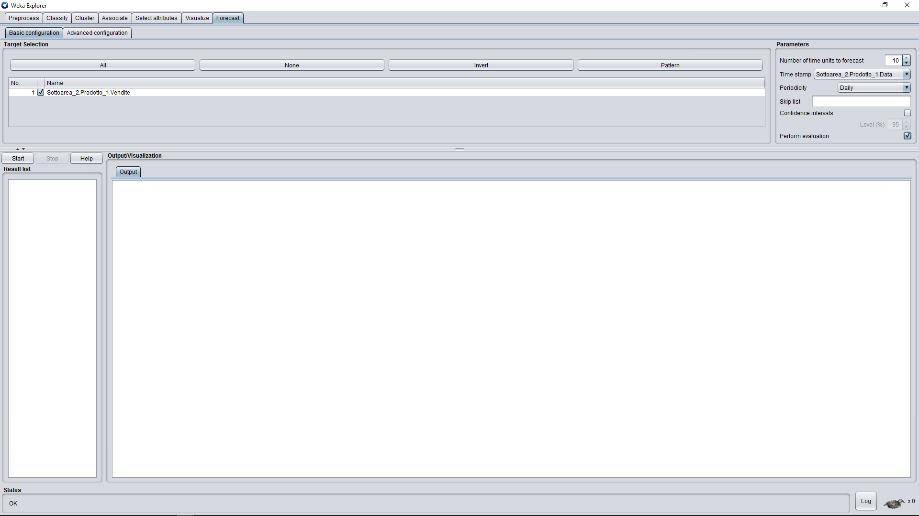

Slide 17
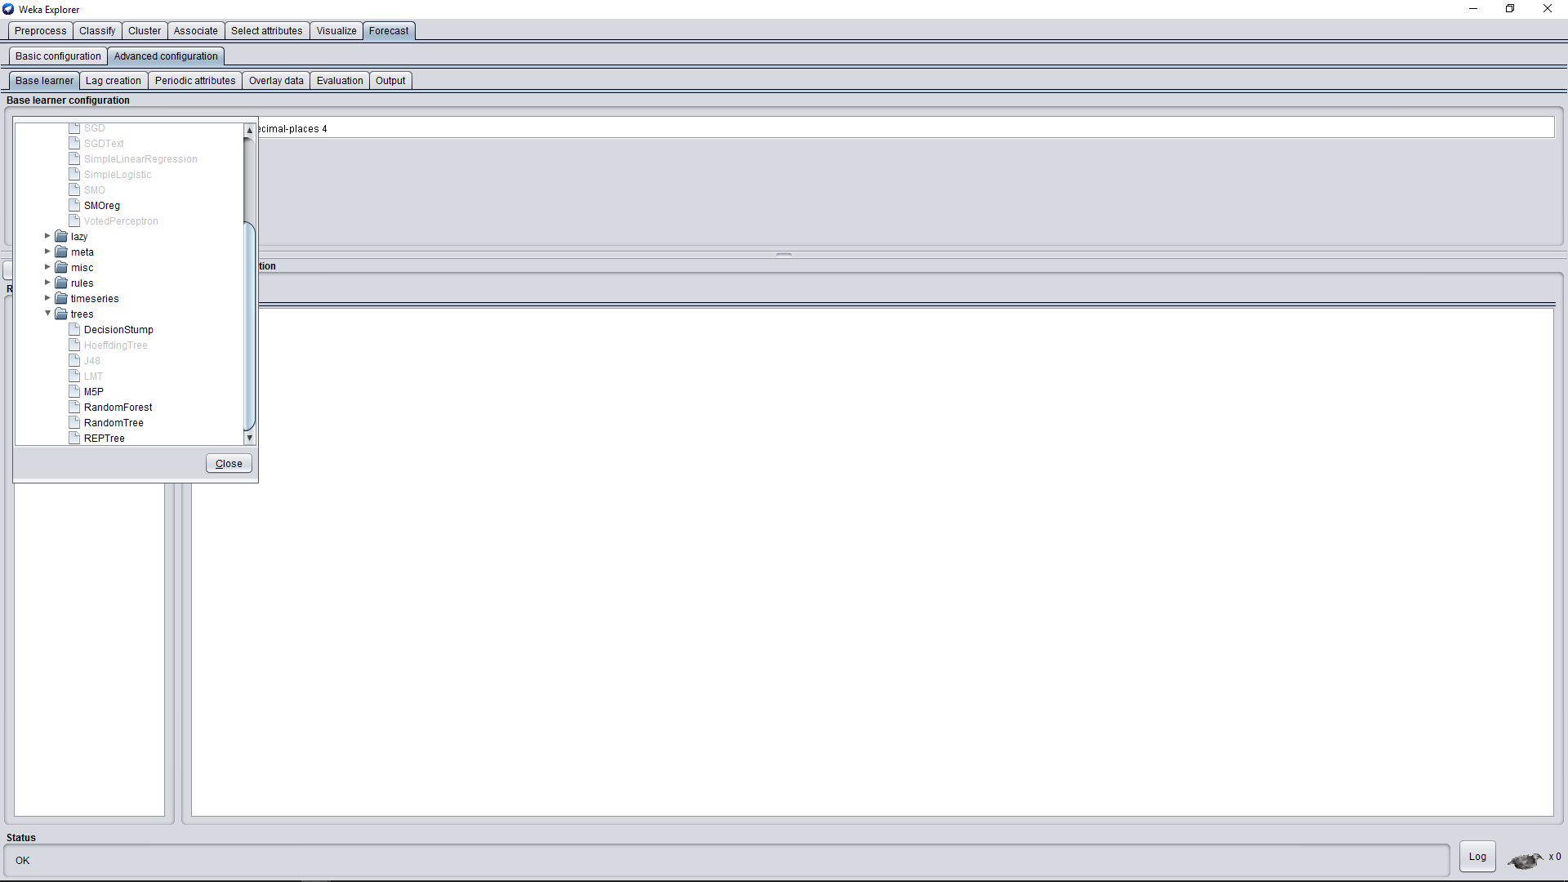

Slide 18
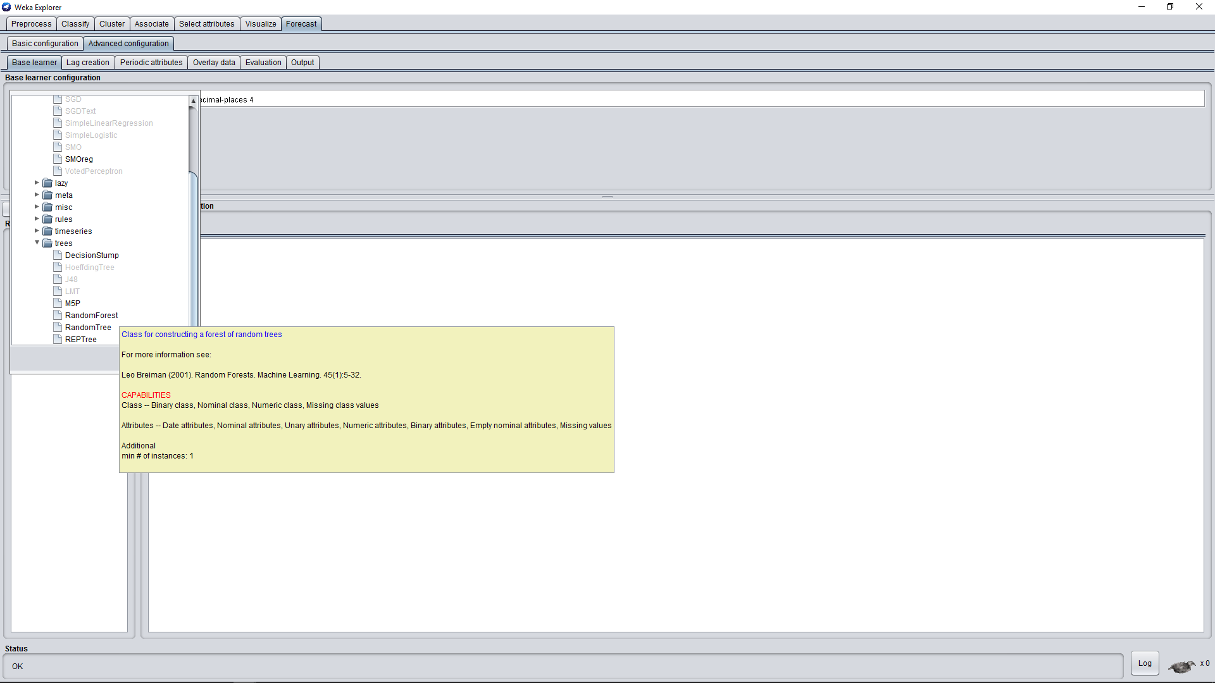

Slide 20
2.1 Tuning

Slide 21
Base Learner: we tried different algorithms. The default one was Linear Regression, but we also tried Multilayer Perceptron, HoltWinters, Gaussian Processes. In the end we stuck with a Random Forest which seemed to be the most accurate in our opinion. After having played with its parameters we changed only its “numIterations” from the default 100 to 300, a value which doesn’t increase the processing time too much and improves the accuracy of the output.

Slide 22
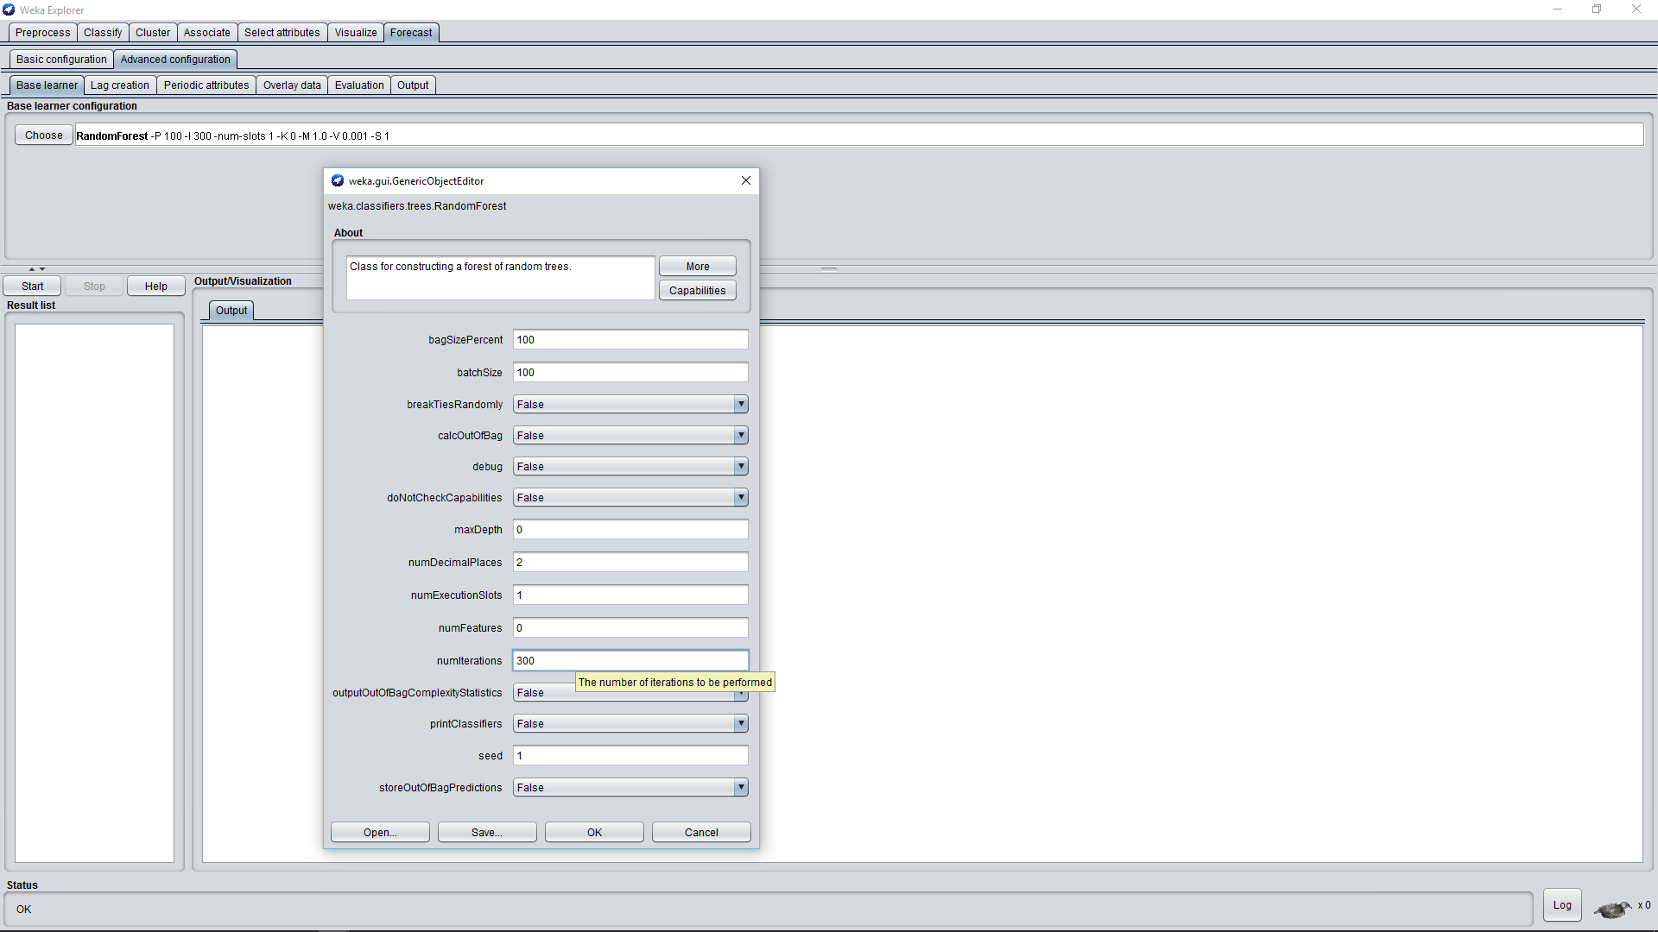

Slide 23
Lag creation: our time window is across the year, so we set a minimum lag of 1 and a maximum lag of 365; this is to capture the relationship between past values and current ones with a periodicity that goes from a day to a whole year. We also set up a more precise tuning over the lagged variables of 30, 60, 90, 365 to better capture recurring behaviors of the sales on predefined time periods as months, quarters of year…

Slide 24
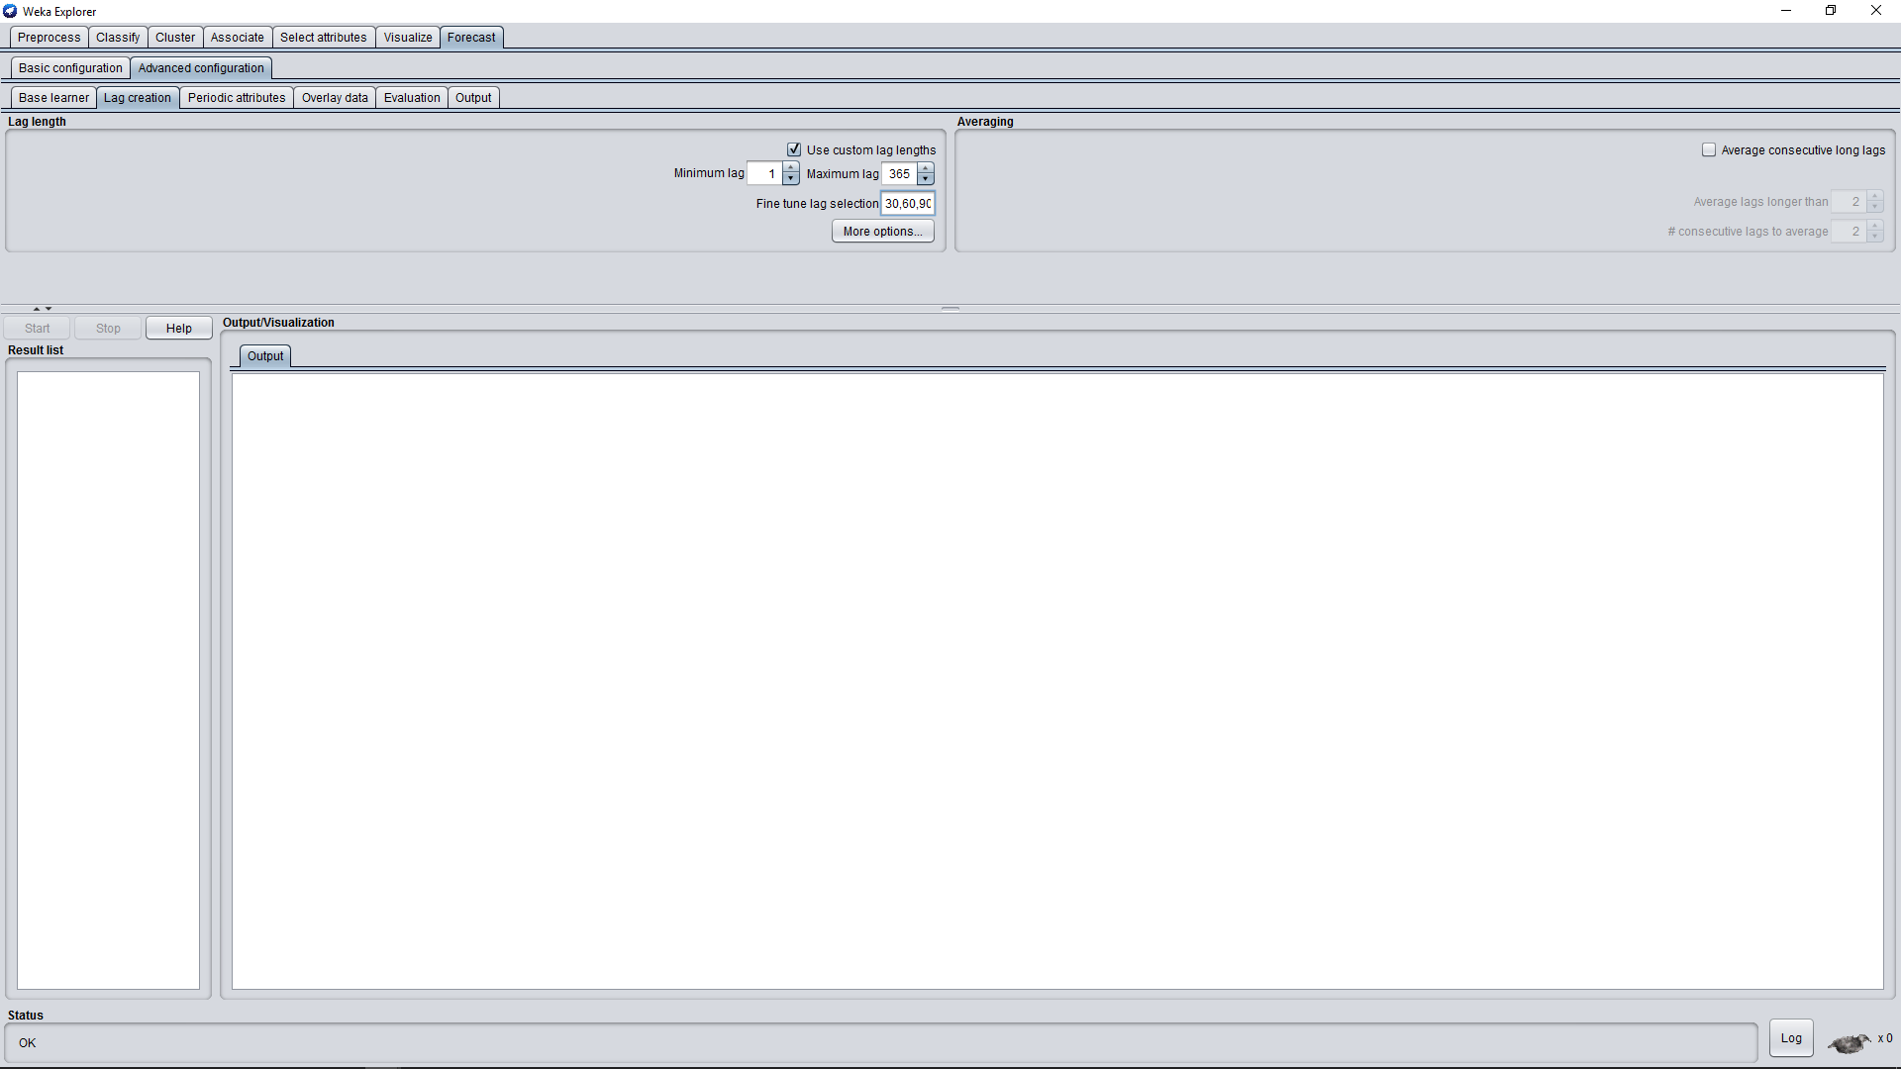

Slide 25
Evaluation: we simply enabled the following performance metrics: Mean absolute error (MAE), Mean Squared Error (MSE), Root Mean Squared Error (RMSE) and Mean Absolute Percentage Error (MAPE)

Slide 26
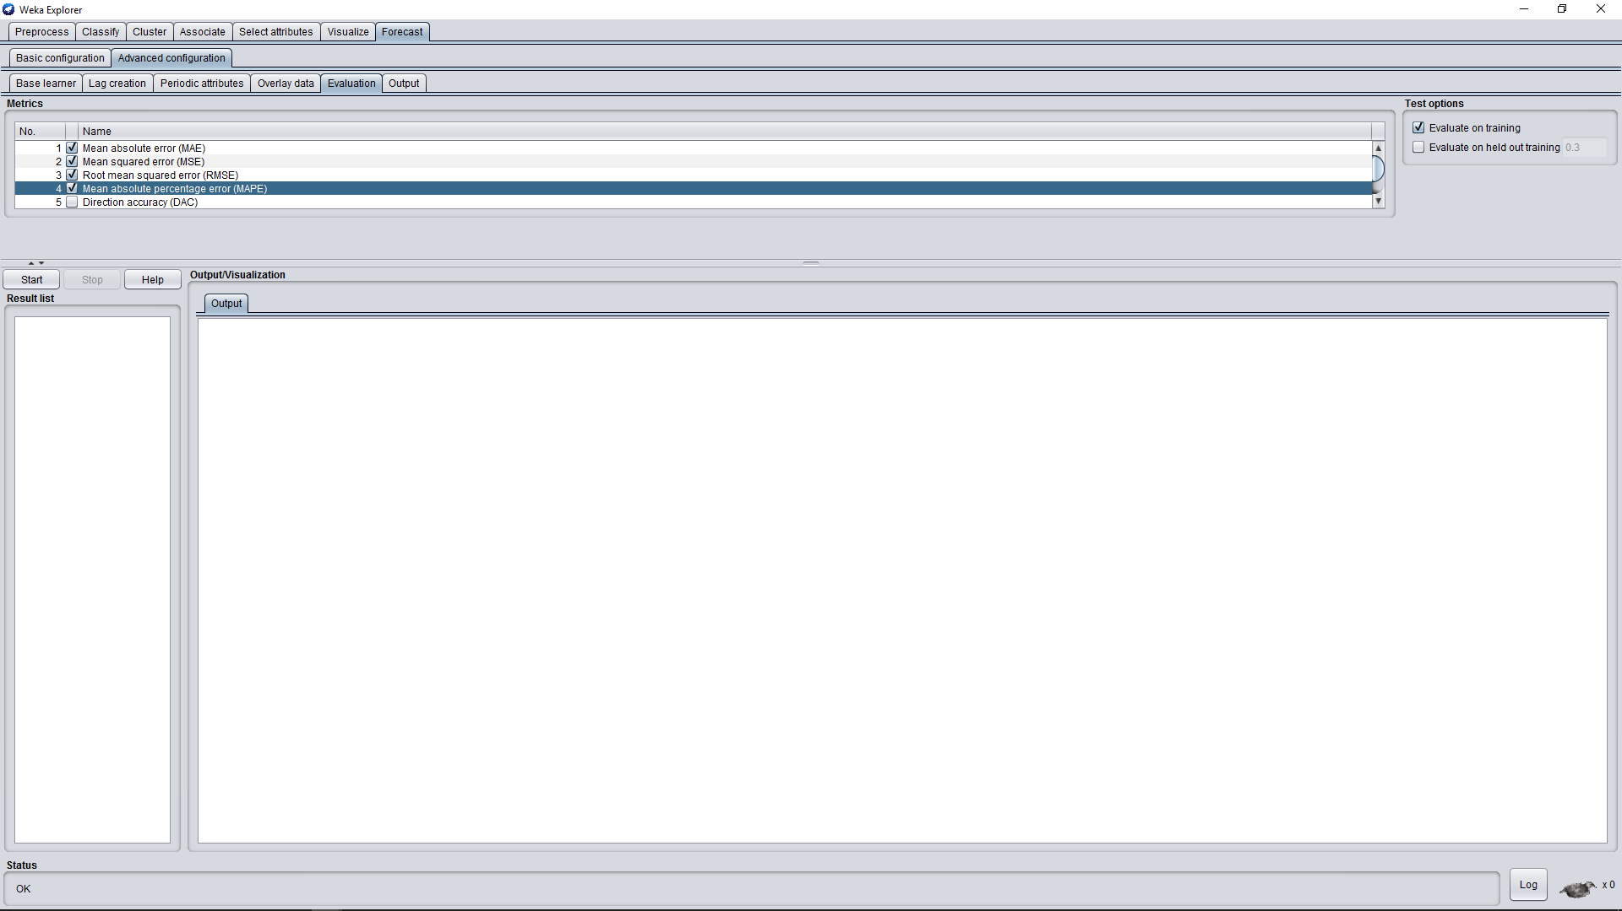

Slide 27
2.2 Weka Results

Slide 28
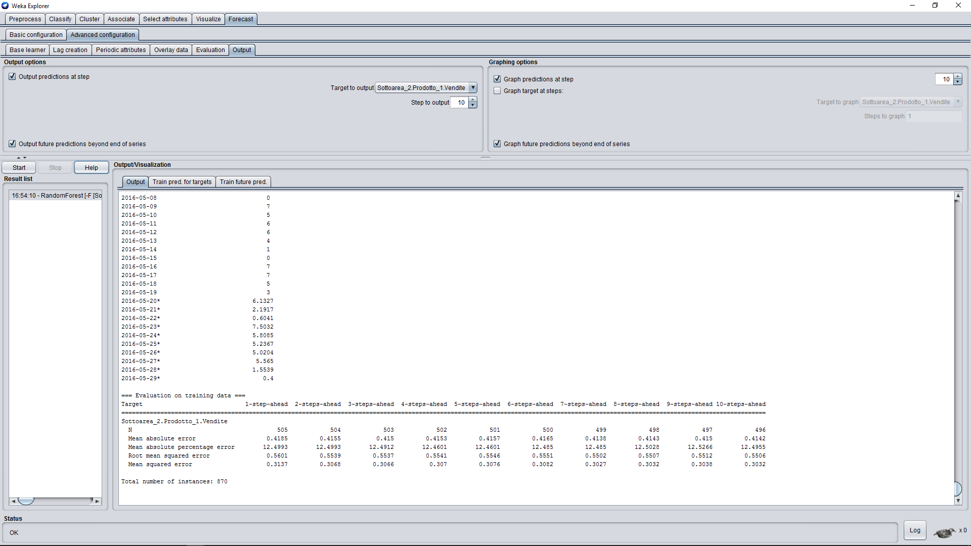

Slide 29
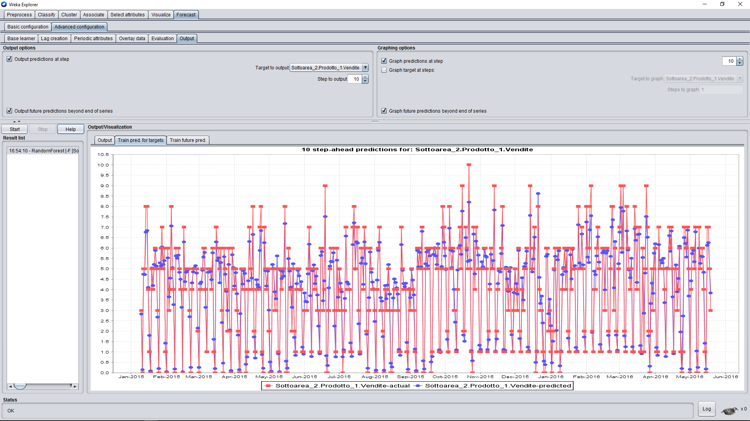

Slide 30
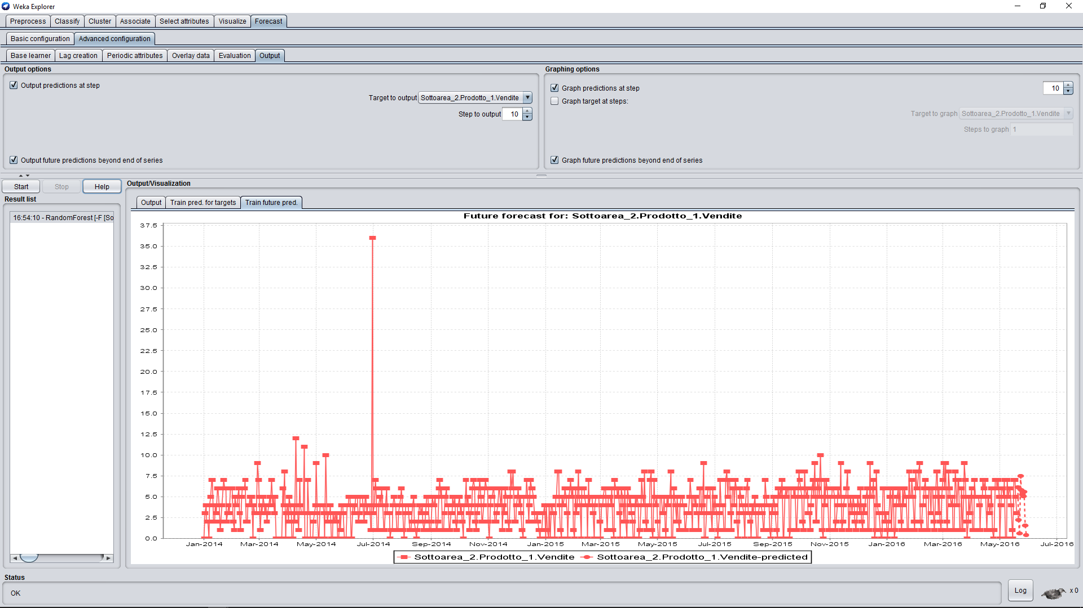

Slide 31
3. Result Elaboration

Slide 32
Using Knime we exctract from each txt file that report the statistics elaborated by Weka the data that were predicted and put them into two csv file, one for each product, to better read them in an organized table.

Slide 33
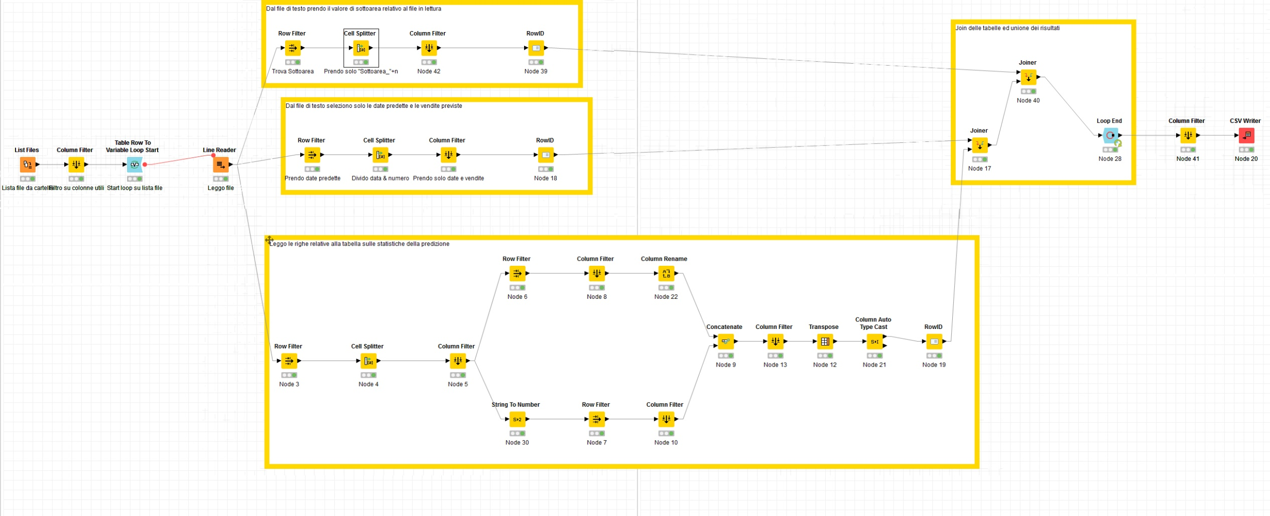

Slide 34
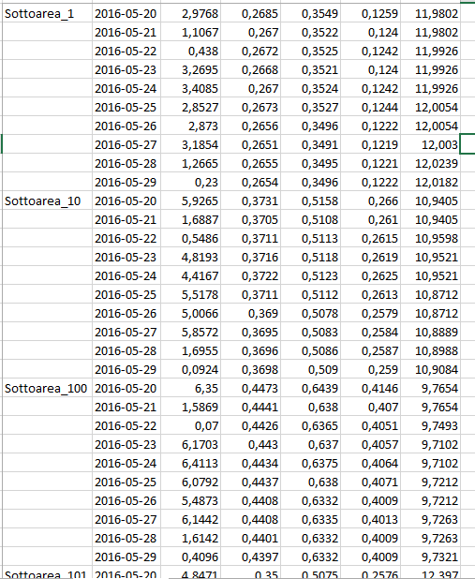

Slide 35
Then we attached to that simple table a column header, the references to Area and Zona for each Subarea, the coordinates to copletely report the final tables and give them the best readability

Slide 36
Prodotto 1
Prodotto 2

