Slide 1
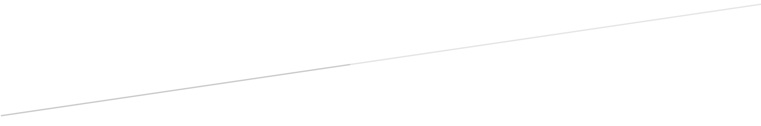

BIP PREDICTION
DATA MINING PROJECT
Alessandro Baldassari
841561
Alberto Bendin
841734
Paolo Cappello
841469
Alessandro Chiolini
864446
Lucija Megla
859315

Slide 2
1. Data preparation

Slide 3
Using Rstudio we extracted some information from the date column, like the weekdays and holidays and we attached for each subarea the latitude and longitude data.
# Loading dataset
train <- read.csv("~/Git/data mining/dataset_polimi.csv")
# Extraction of day and month from date
train$Data <- as.Date.factor(train$Data)
train$Day <- sapply(train$Data, FUN=function(x) {weekdays(as.Date(x,'%y-%m-%d'))})
train$Month <- sapply(train$Data, FUN=function(x) {months(as.Date(x,'%y-%m-%d'))})
# Adding stable holidays
train$Holiday <- 0
train$Holiday[train$Month == 'gennaio' & train$Day_Number == 1] <- 1
train$Holiday[train$Month == 'gennaio' & train$Day_Number == 6] <- 1
train$Holiday[train$Month == 'aprile' & train$Day_Number == 25] <- 1
train$Holiday[train$Month == 'maggio' & train$Day_Number == 1] <- 1
train$Holiday[train$Month == 'giugno' & train$Day_Number == 2] <- 1
train$Holiday[train$Month == 'agosto' & train$Day_Number == 15] <- 1
train$Holiday[train$Month == 'novembre' & train$Day_Number == 1] <- 1
train$Holiday[train$Month == 'dicembre' & train$Day_Number == 8] <- 1
train$Holiday[train$Month == 'dicembre' & train$Day_Number == 25] <- 1
train$Holiday[train$Month == 'dicembre' & train$Day_Number == 26] <- 1
# Adding «moving» holidays
train$Holiday[train$Month == 'marzo' & train$Day_Number == 27 & train$Year == '2016'] <- 1
train$Holiday[train$Month == 'marzo' & train$Day_Number == 28 & train$Year == '2016'] <- 1
train$Holiday[train$Month == 'aprile' & train$Day_Number == 5 & train$Year == '2015'] <- 1
train$Holiday[train$Month == 'aprile' & train$Day_Number == 6 & train$Year == '2015'] <- 1
train$Holiday[train$Month == 'aprile' & train$Day_Number == 20 & train$Year == '2014'] <- 1
train$Holiday[train$Month == 'aprile' & train$Day_Number == 21 & train$Year == '2014'] <- 1

Slide 4
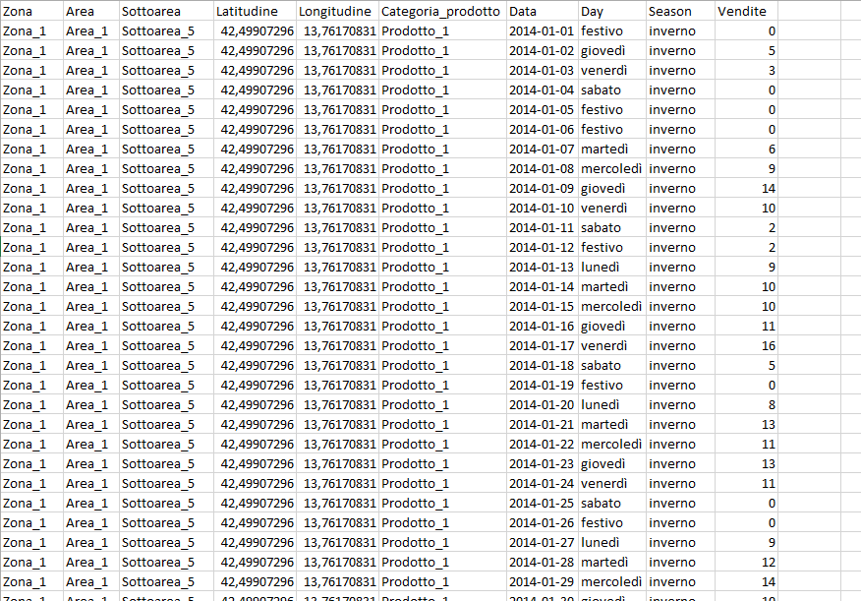
Because the data flow for non-working day was the same, we introduced a special day called «Festivo» and we obtained our definitive dataset that looks like the following extract.

Slide 5
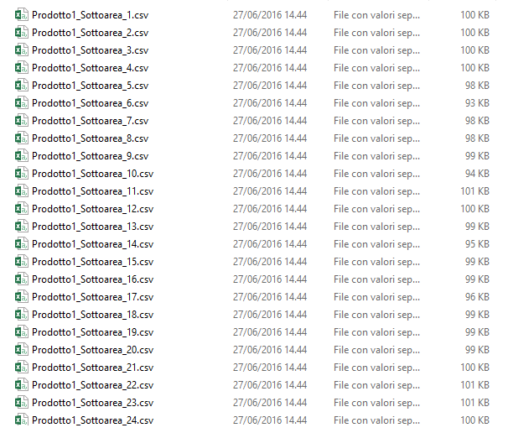
Finally we divided the resulting dataset into many subsets, one for each subarea and product, and we started creating the model using Weka.

Slide 6
2. Model Creation

Slide 7
After setting up a regression with different learners on Knime we decided to switch to Weka with the «TimeSeries» plugin available in the Weka Package Manager. This allows us to do a time series to forecast a target column.
We built 288 models, one for each file that we created in the data preparation phase.

Slide 8
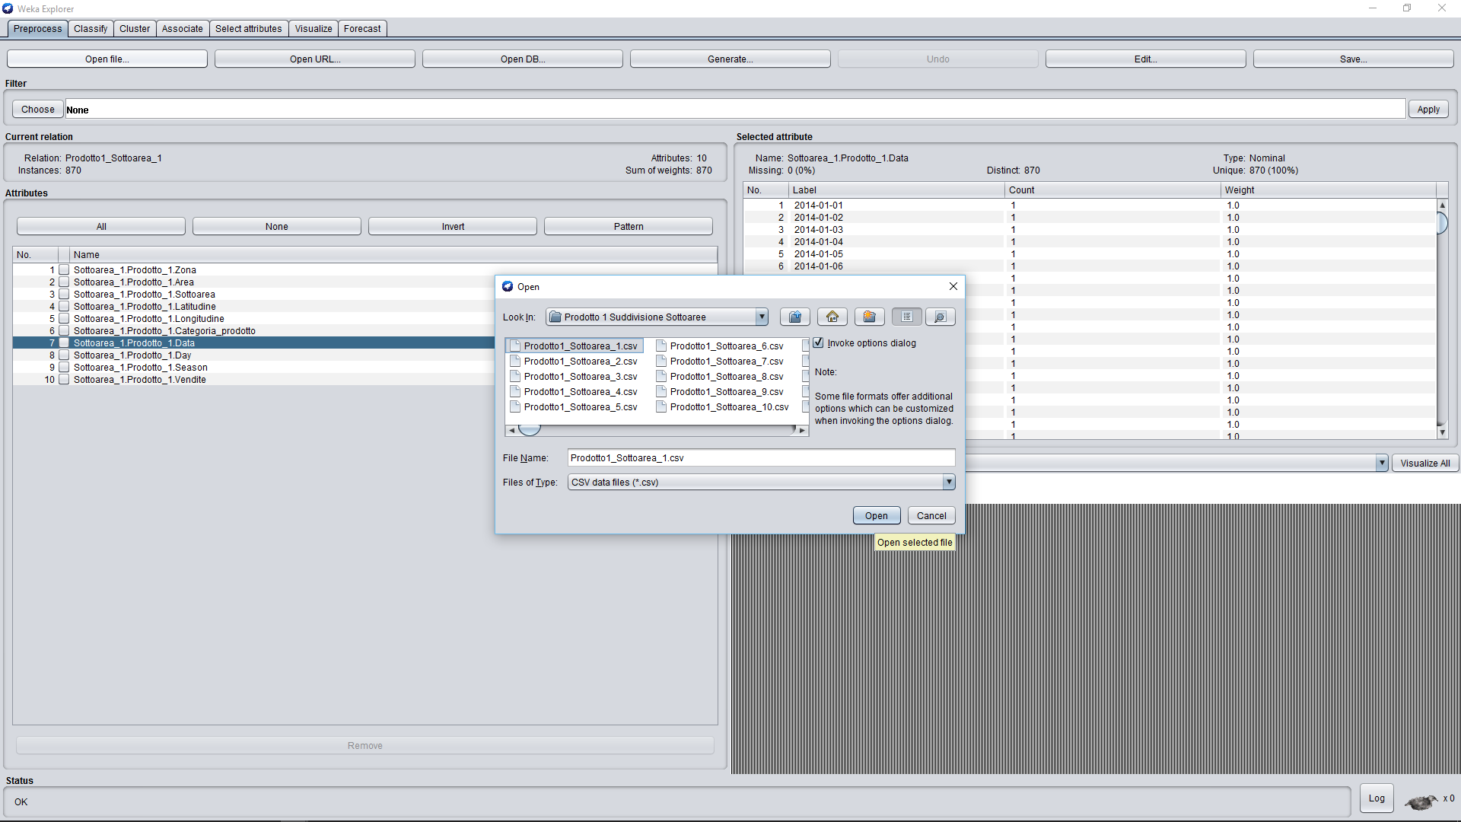
Switch to Weka: Setup

Slide 9
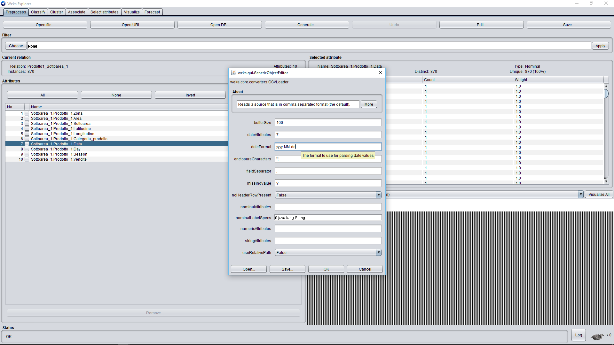
Setting of the “date” attribute

Slide 10
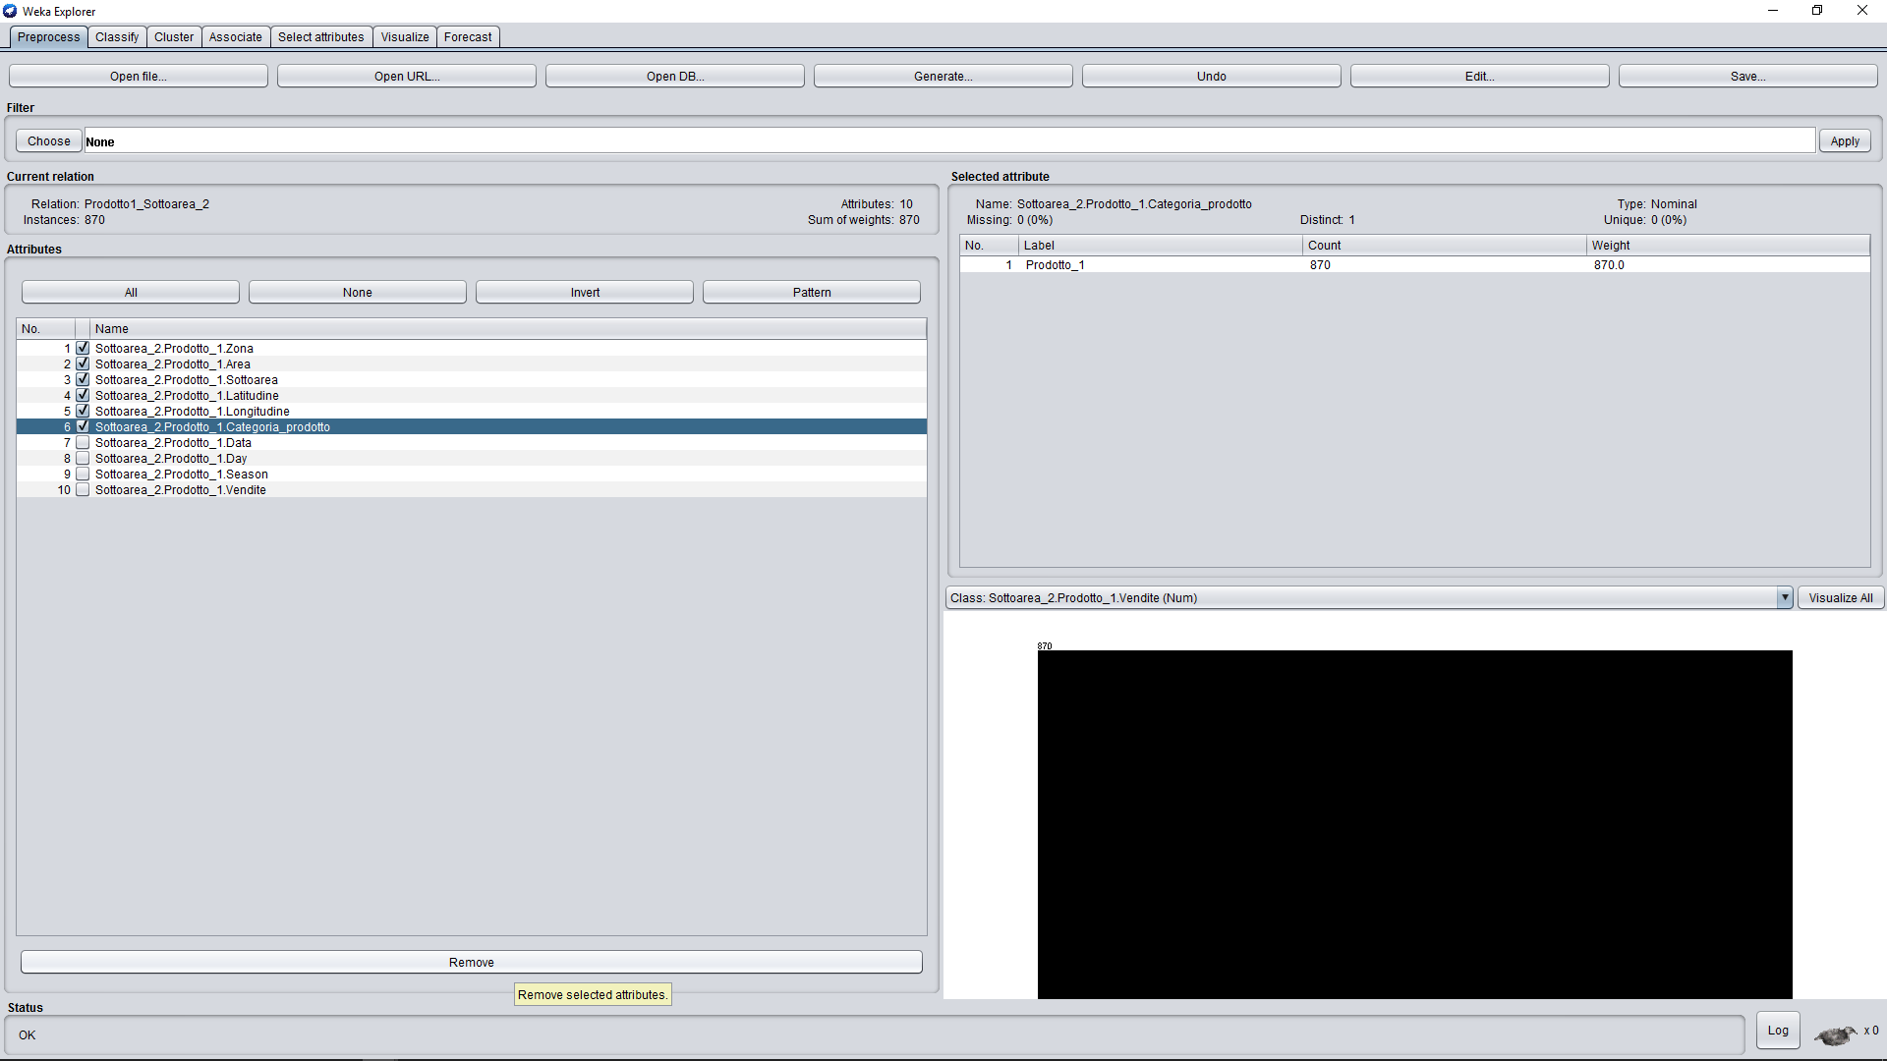
Deletion of useless features

Slide 11
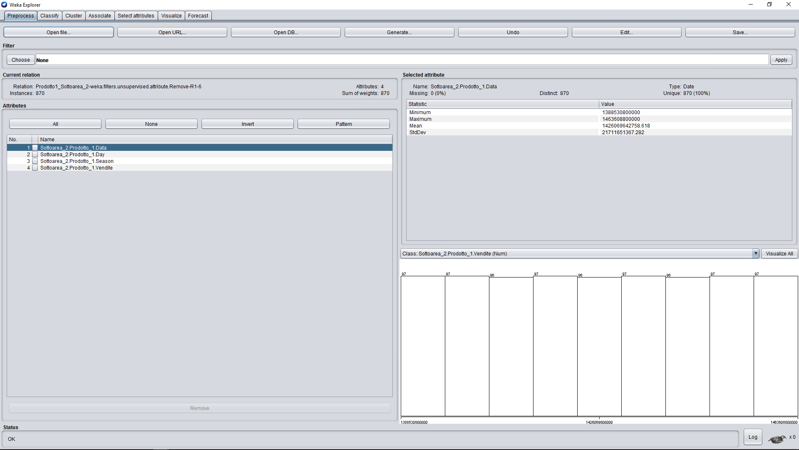
Check attribute “Data” read as type “Date”

Slide 12
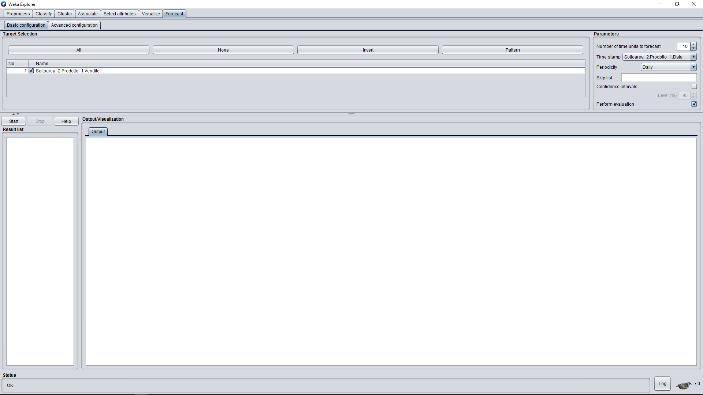
Forecaster: Basic configuration

Slide 13
2.1 Tuning

Slide 14
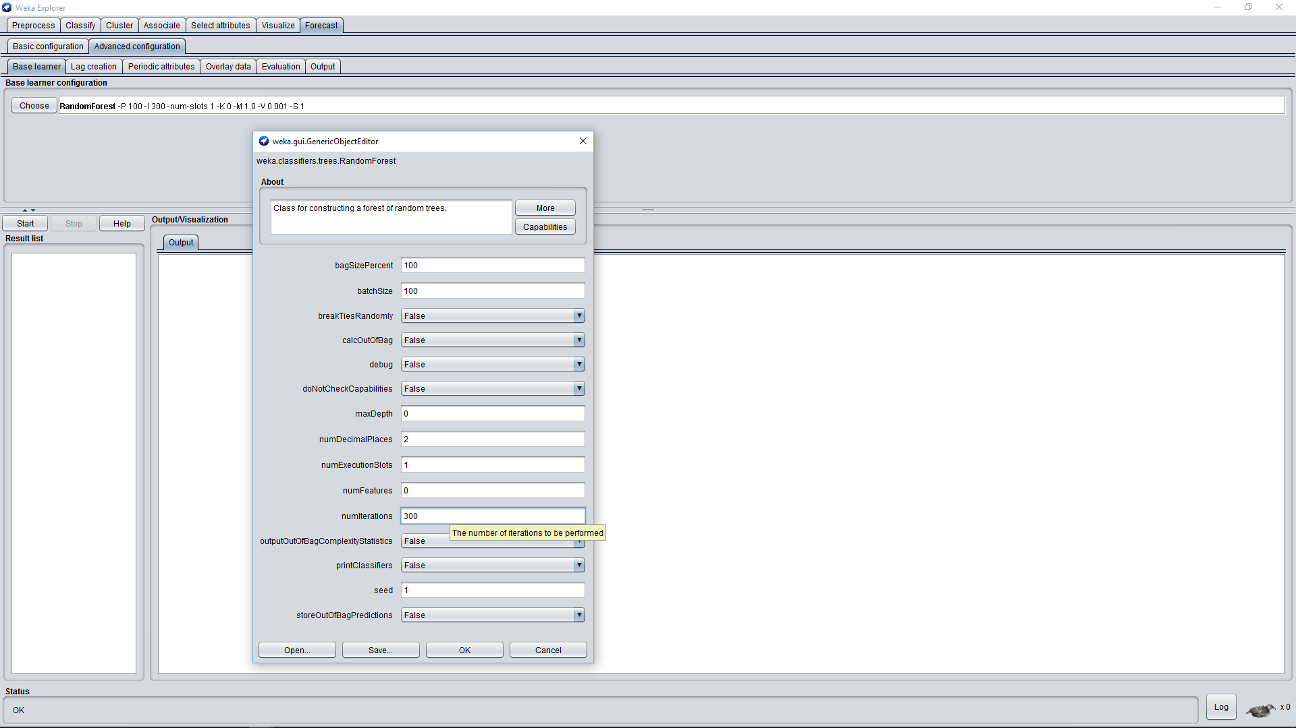
Base Learner: we chose Random Forest which was the most accurate

Slide 15
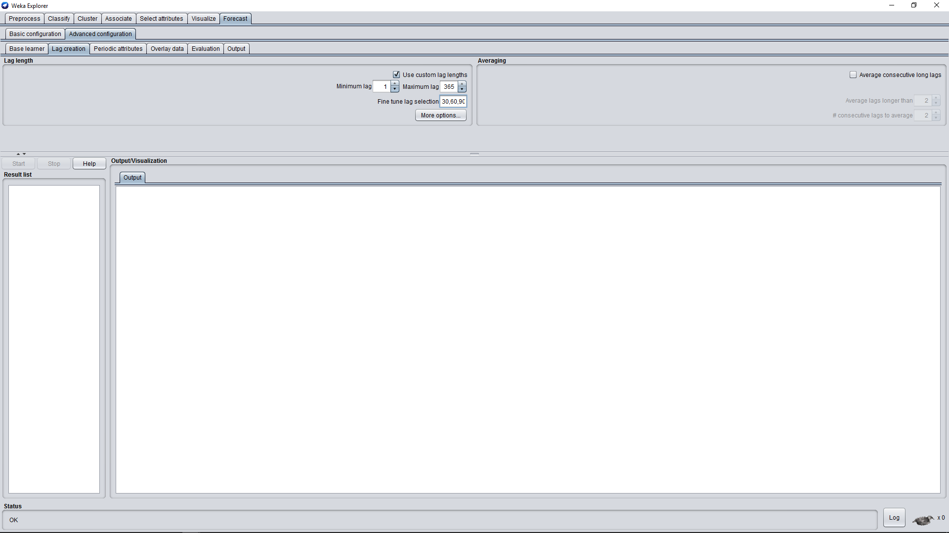
Lag creation: this is to capture the relationship between past values and current ones

Slide 16
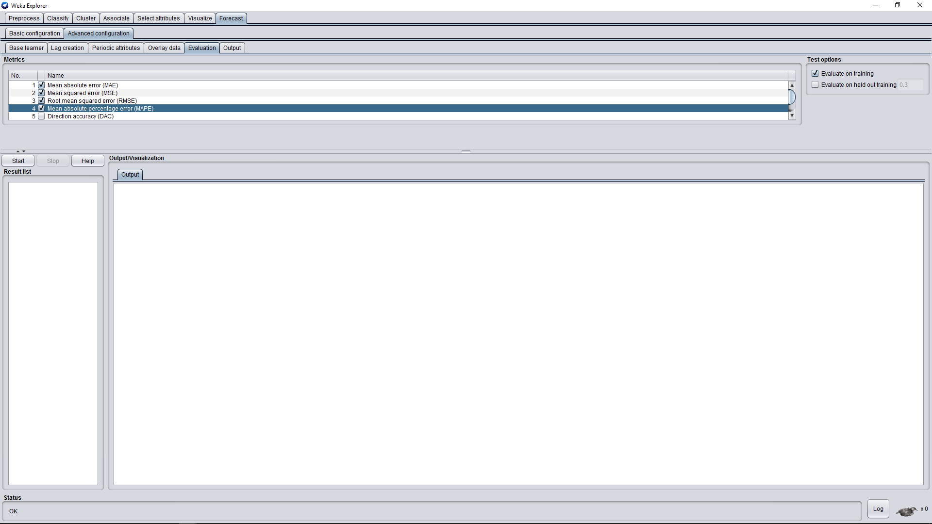
Evaluation

Slide 17
2.2 Weka Results

Slide 18
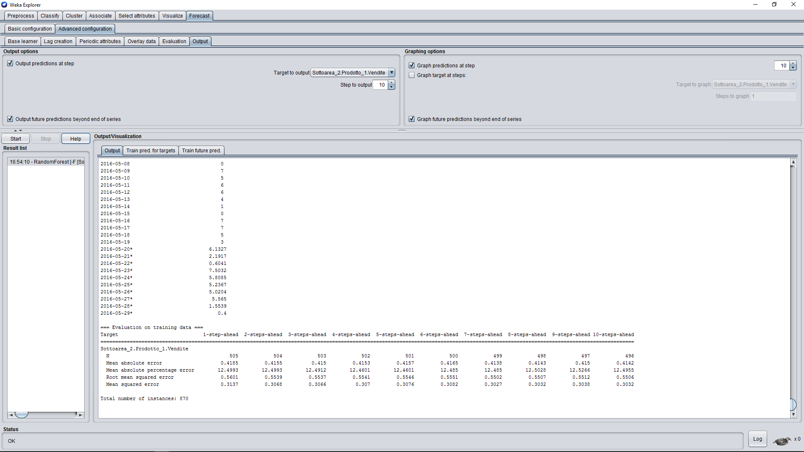
Textual output

Slide 19
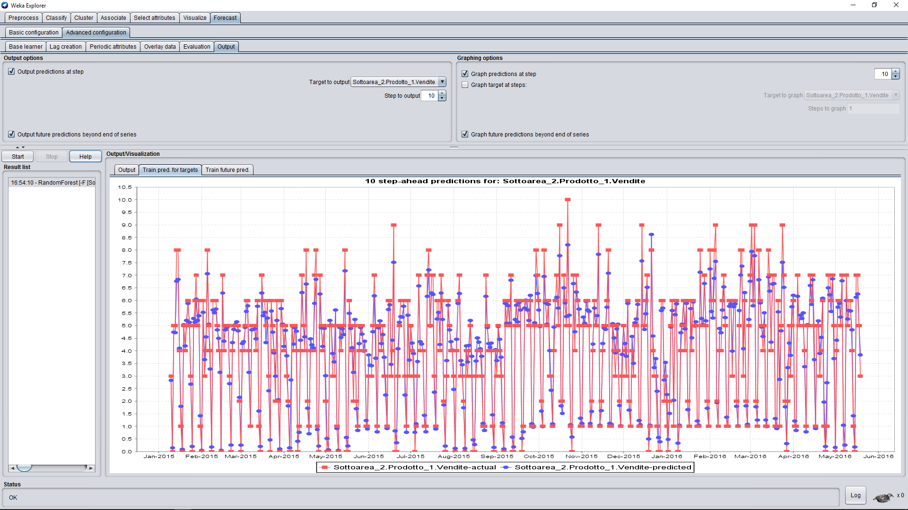
Graphical output: actual values vs predicted values

Slide 20
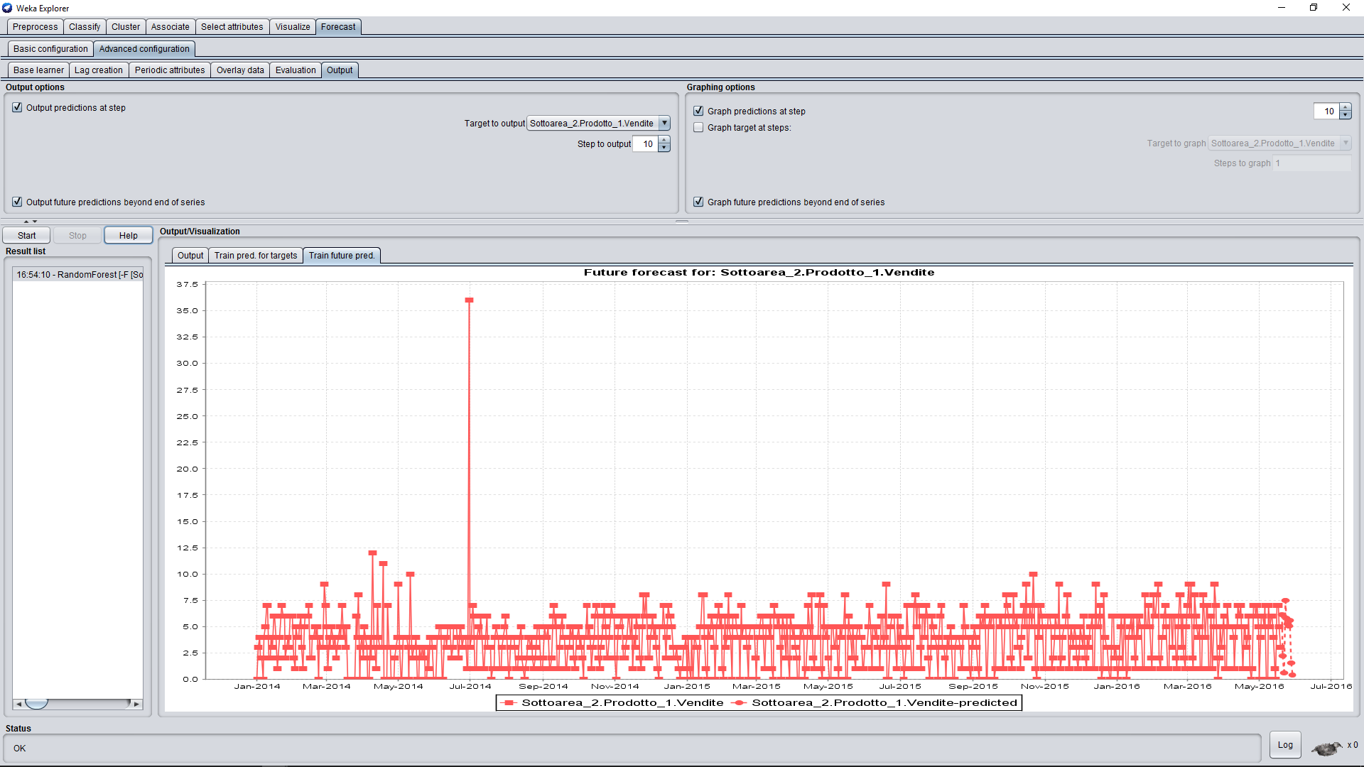
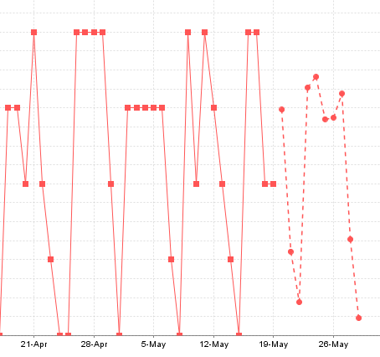
Graphical output: future forecast (dashed line with points)

Slide 21
3. Result Elaboration

Slide 22
Using Knime we extracted from each txt file (which reports the statistics elaborated by Weka) the data that were predicted and we put them into two csv files, one for each product, to better read them in an organized table.

Slide 23
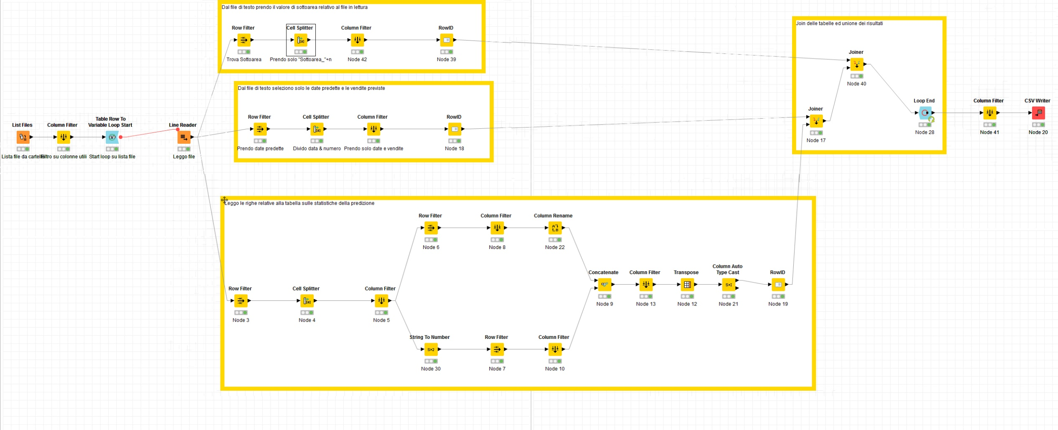
Knime workflow

Slide 24
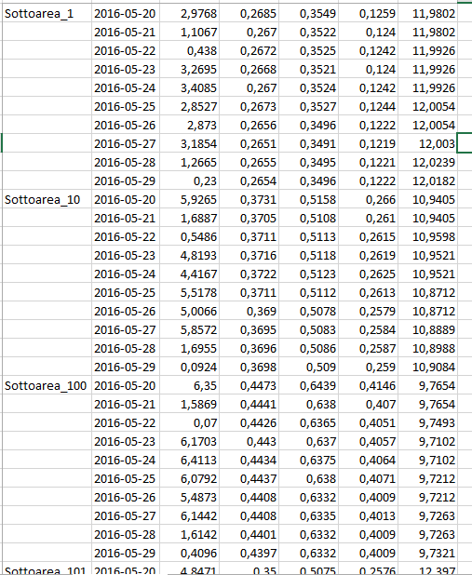
Example of the results

Slide 25
Finally we attached to the resulting table a column header, the references to Area and Zona for each Subarea and the GPS coordinates; this is to restore all the features of the original dataset we were given, thus allowing more powerful and complete queries on the data.
We made the most granular models possible based on Subarea attribute. In this way we can group models to make a prediction on Area or Zona attributes.

Slide 26
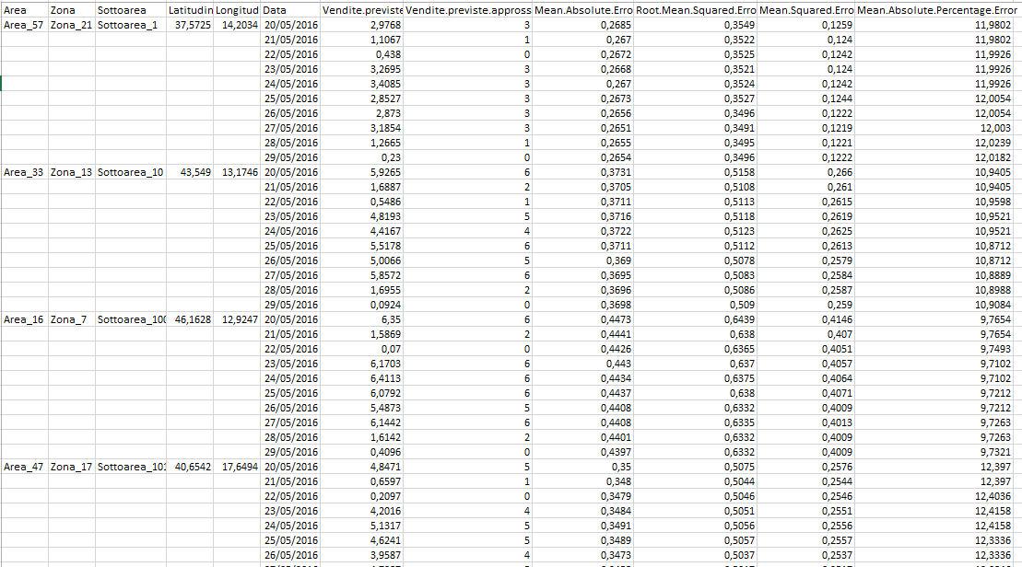

Slide 27
The results!
Prodotto 1: .csv, .xls
Prodotto 2: .csv, .xls

Slide 28
THANK YOU FOR THE ATTENTION

