Slide 1

Predicting Factuality of Reporting and Bias of News Media Sources
Ayushi Choudhary, Tai-Hua Chung, Olivia Natasha, Pragyan Sharma, Jinjin Yu

Slide 2

Agenda
Context
Previous Research
Problem Statement
Methodology Overview
Data Exploration
Modeling
Conclusion
Limitations
Future Plan

Slide 3
Context
Fake news :
False information fabricated as authentic news
Does not follow the process integrity
Intend to mislead and/or gain financially or politically
Importance of detecting Fake News
Problems with existing solutions
Because:
Spreads faster than real news
People consider more frequent, more credible
Attract network traffic for financial gain
Manual fact-checking is slow
Automatic fact-checking are not accurate and lack people’s trust

Slide 4
Previous Work - MIT Research
Data Resource:
MIT Research
Article level
Website level
Wikipedia
Twitter
Structure of the URL
Web Traffic Information
Title
Body
Modeling: SVM → Accuracy rate & f1 score

Slide 5

Problem Statement
Detecting factuality and bias of News Media Sources
Explore methods to improve the level of accuracy by finding a better model and new variables

Slide 6
Methodology Overview
Dataset
Sampling
Modeling
Evaluation
MIT Research
Individual
Combination
New feature:
About Us
Terms of Use (Web scrape)
K-Fold cross-validation
O
SVM
New Classifier:
Logistic Regression
Random Forest
ADA Boosting
KNN
XGBoost
Accuracy rate
f1-score
O
Our Method

Slide 7
Data Exploration

Slide 8



Data
Sample of articles from the target website
Wikipedia page
Twitter account
Structure of its URL
Information about the Web traffic/Alexa Rank
Structure of Website
Body
Title
Has Page
Summary
Category
Table of Contents
Content
Has Account
Has Location
Is Verified
Created at
URL Match
Description
Counts
Has “About Us”
Has “Terms of Use”

Slide 9
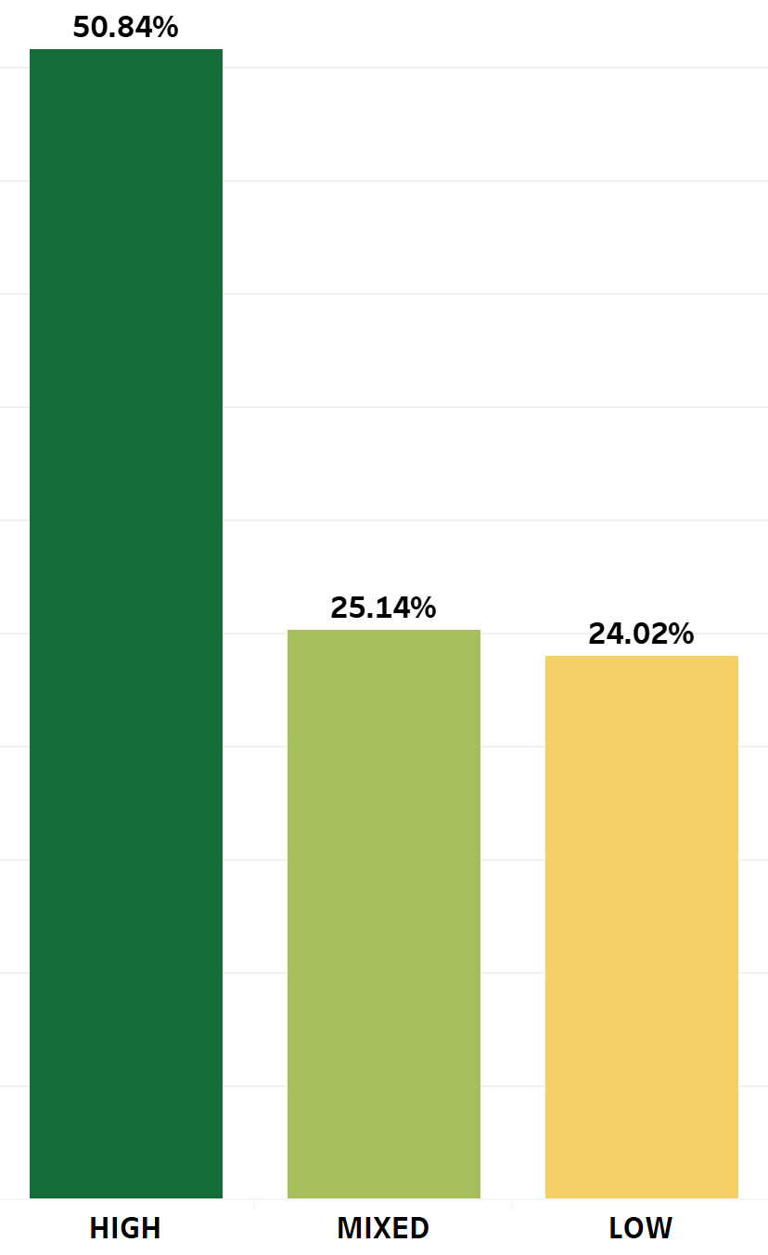
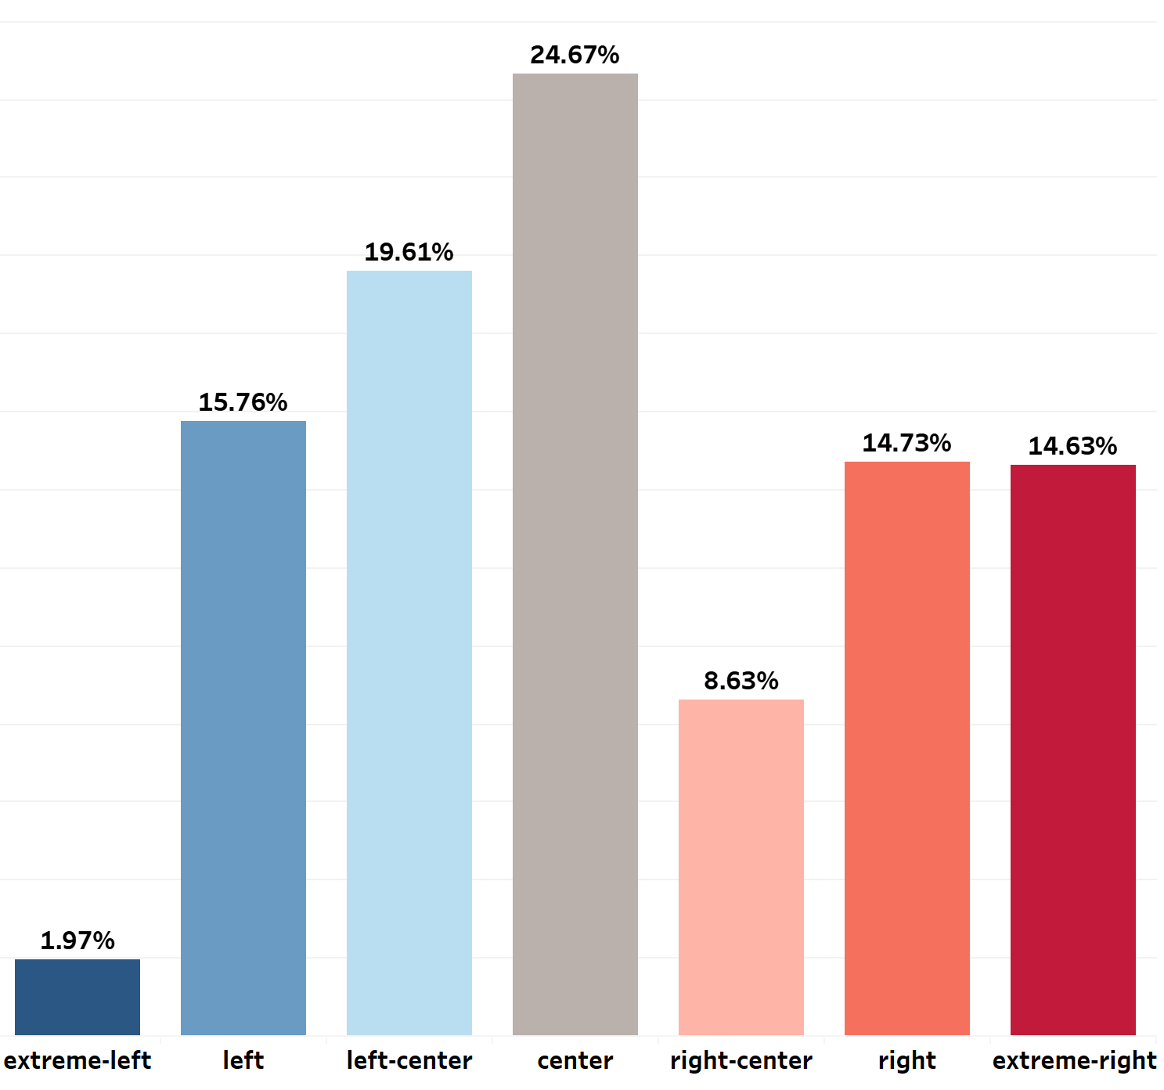
Fact
Bias
Data consisted of 1066 points
High accuracy news accounts for 50%
Neutral news (center bias) accounts for 25%

Slide 10
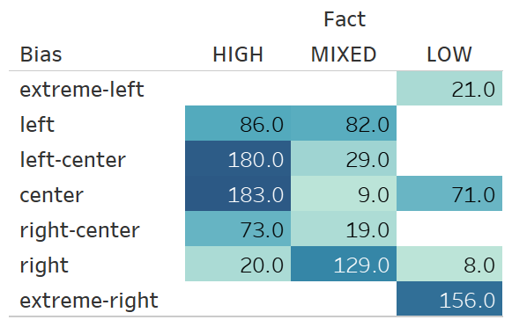
High factual news site are less likely to be biased
Low factual news site are more likely to be biased towards extreme right

Slide 11
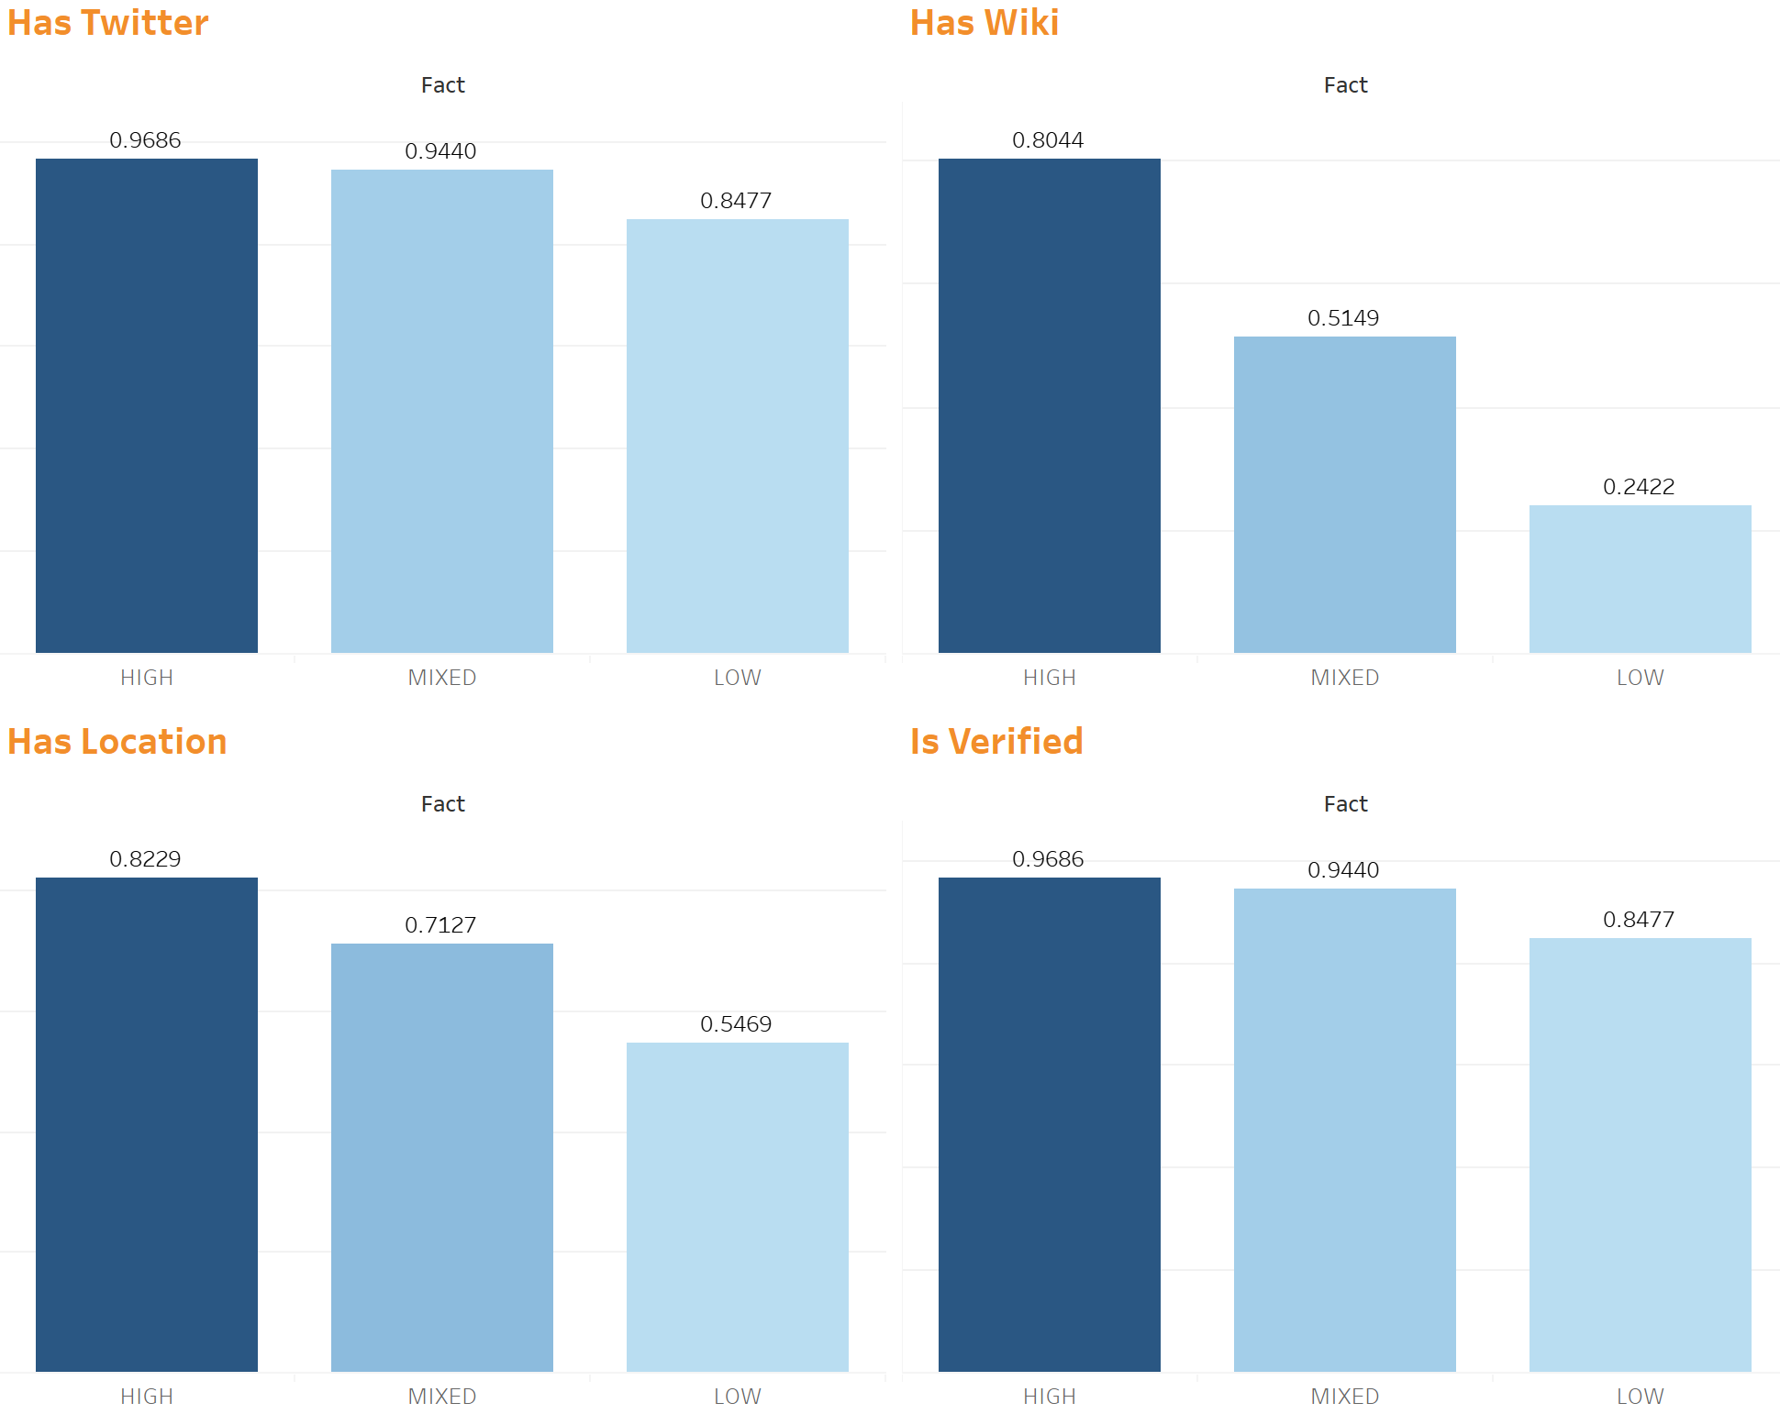
Has Twitter
Has Wiki
High accuracy news sources on average are more likely to have all the categories present compared to the others
Has Location
Is Verified

Slide 12
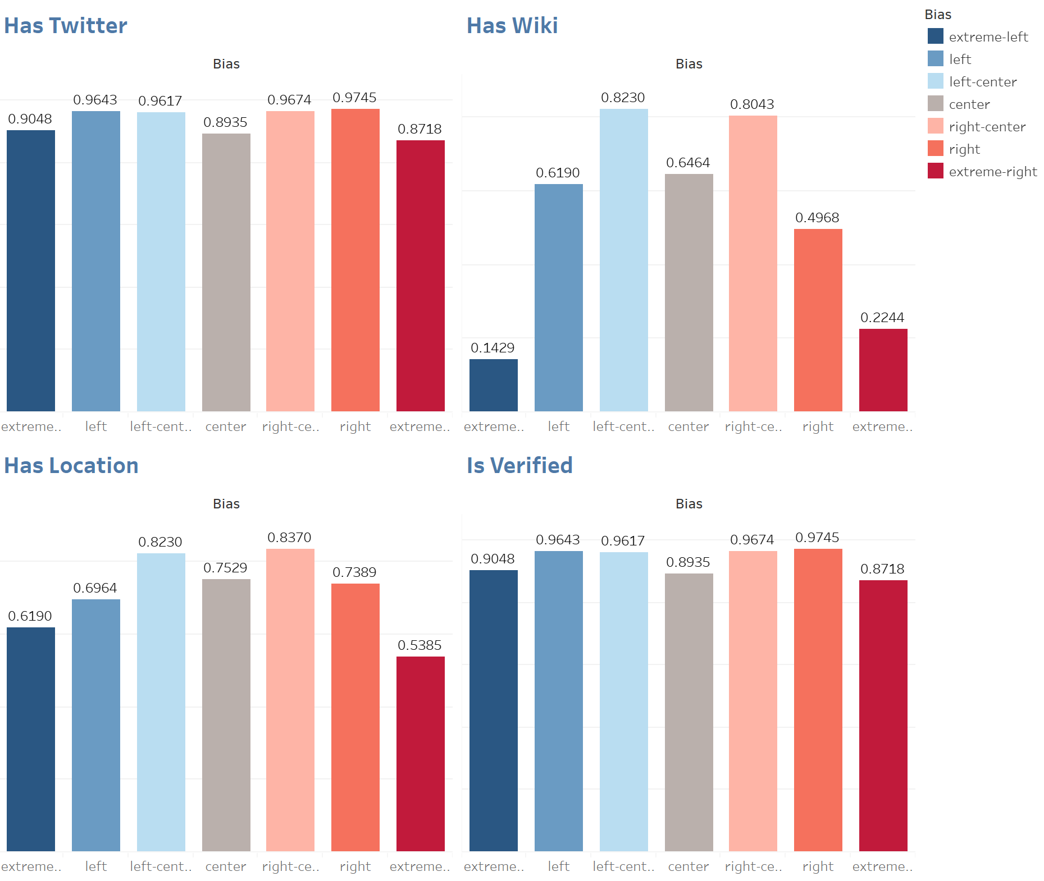
Wikipedia and Location has more impact on bias (if the news sources are centered they are likely to have that information public) compared to Twitter and whether it is verified or not

Slide 13
Modeling

Slide 14
Process
Dataset
PCA
Sampling
Modeling
Evaluation
Individual
Combination
New features
Use PCA, if required
5-Fold cross-validation
SVM
Logistic Regression
Random Forest
ADA Boosting
KNN
XGBoost
Accuracy rate
F1-score
Notes:
This is the process we followed for our analysis.
We used individual datasets like article body, title, whether they have wiki page or not, and then created multiple combinations for the datasets, We used PCA for the ones, based on whether is required or not.
For Sampling we used K-fold cross validation using different methodologies like SVM, Logistics Regression,
And then we used Accuracy score and F1 score to decide which model to pick that is our best model and then compared it with the ones that are given in the MIT paper.

Slide 15
Modeling Outputs: Fact
 |  | Factuality
 |  | F1 Score | Accuracy | Best Classifier
Traffic | Alexa Rank | 43.35 | 57.22 | XGBoost
URL | URL Structure | 34.82 | 53.28 | SVC
Twitter | created at | 29.63 | 52.91 | Logistic Regression, AdaBoost
 | has account | 29.63 | 52.91 | All (except KNN)
 | verified | 29.63 | 52.91 | All (except KNN)
 | has location | 36.64 | 52.72 | All (except KNN)
 | URL match | 39.80 | 54.59 | All Except KNN & RF
 | description | 40.75 | 54.97 | LogisticRegression
 | counts | 46.16 | 56.47 | AdaBoost
 | Twitter-All | 47.55 | 59.10 | LogisticRegression
Wikipedia | has page | 43.47 | 59.10 | All (except KNN)
 | table of content | 42.05 | 52.34 | RandomForest
 | categories | 43.41 | 53.65 | RandomForest
 | information box
 | summary | 51.33 | 60.97 | XGBoost
 | content | 51.09 | 60.79 | XGBoost
 | Wikipedia-All | 52.50 | 61.35 | XGBoost
Articles | title | 55.33 | 62.85 | XGBoost
 | body | 57.58 | 65.67 | XGBoost
Added Features | has_about_us | 26.85 | 51.69 | All (except KNN)
 | has_terms_of_use | 26.79 | 51.60 | All (except KNN)
All Variables |  | 56.82 | 65.19 | XGBoost
MIT Research’s best result:
Accuracy | Classifier
64.35 | SVM
Most models have results that are better or on par with existing models.
Slightly better accuracy i.e. 65.67%
Better | Similar (< 1%) | Worse
Notes:
These are the results from the best models for Fact. The green cells indicate that our models did better than the ones given in MIT research work & and red cells mean we did worse. If the accuracy turned out to be + or - 1% we considered it similar. Those cells are coloured in grey. Most of our models have results that are better or at par with existing models.
We have better accuracy for body and title of the article, we also improved results from wiki and twitter. However, the improvements are small.
We got the best accuracy using article body which is 65.67% which is higher than that given in the paper. The model is given
Wikipedia All has lower score because one dataset is missing.

Slide 16
Modeling Outputs: Bias
 |  | Bias
 |  | F1 Score | Accuracy | Best Classifier
Traffic | Alexa Rank | 5.64 | 24.67 | LogisticRegression
URL | URL Structure | 13.31 | 25.24 | LogisticRegression
Twitter | created at | 18.13 | 24.67 | LogisticRegression
 | has account | 5.92 | 23.26 | All Except KNN
 | verified | 5.92 | 23.26 | All Except KNN
 | has location | 7.74 | 23.54 | All Except KNN
 | URL match | 9.44 | 24.95 | All Except KNN
 | description | 16.41 | 25.33 | LogisticRegression
 | counts | 18.13 | 26.65 | LogisticRegression
 | Twitter-All | 20.35 | 28.05 | LogisticRegression
Wikipedia | has page | 10.89 | 25.33 | All Except KNN
 | table of content | 42.02 | 52.62 | RandomForest
 | categories | 18.09 | 28.23 | XGBoost
 | information box
 | summary | 24.98 | 33.96 | XGBoost
 | content | 27.05 | 35.08 | XGBoost
 | Wikipedia-All | 26.35 | 35.65 | XGBClassifier
Articles | title | 32.27 | 38.18 | XGBoost
 | body | 12.78 | 25.05 | AdaBoostClassifier
Added Features | has_about_us | 7.17 | 25.04 | LogisticRegression, AdaBoost
 | has_terms_of_use | 9.50 | 24.48 | All Except KNN
All Variables |  | 35.28 | 42.11 | XGBoost
MIT Research’s best result:
Accuracy | Classifier
41.74 | SVM
Using all the variables improved the prediction for Bias.
Best model is higher by 10% (52.62).
Better | Similar (<1%) | Worse
Notes:
Similarly these are the results for bias:
The best accuracy results given by MIT research paper in 41.74%.
While ours was much better when we used Random forest on table of contents.

Slide 17
Model Output: New Features
We included new features has_about_us and has_term_of_use.
The added features had worse prediction of Fact than original features.
has_about_us
classifier | SVC | LogisticRegression | RandomForestClassifier | AdaBoostClassifier | KNeighborsClassifier | XGBClassifier
accuracy | 0.516888 | 0.516888 | 0.516888 | 0.516888 | 0.326453 | 0.516888
f1 | 0.268498 | 0.268498 | 0.268498 | 0.268498 | 0.253941 | 0.268498
has_terms_of_use
classifier | SVC | LogisticRegression | RandomForestClassifier | AdaBoostClassifier | KNeighborsClassifier | XGBClassifier
accuracy | 0.515954 | 0.515954 | 0.515954 | 0.515954 | 0.478487 | 0.515954
f1 | 0.267877 | 0.267877 | 0.267877 | 0.267877 | 0.290887 | 0.267877

Slide 18
Model Output: New Features
The added features had worse prediction of Bias than most original features.
has_about_us
classifier | SVC | LogisticRegression | RandomForestClassifier | AdaBoostClassifier | KNeighborsClassifier | XGBClassifier
accuracy | 24.6672 | 25.0428 | 24.6672 | 25.0428 | 17.5429 | 24.6672
f1 | 6.586 | 7.1701 | 6.6126 | 7.1701 | 7.6198 | 6.586
has_terms_of_use
classifier | SVC | LogisticRegression | RandomForestClassifier | AdaBoostClassifier | KNeighborsClassifier | XGBClassifier
accuracy | 24.4838 | 24.1082 | 24.4838 | 24.4838 | 19.8017 | 24.4838
f1 | 9.5042 | 8.2693 | 9.5042 | 9.5042 | 8.2097 | 9.5042

Slide 19
Conclusion
Best model for Fact: Body of the article with XGBoost
Best model for Bias: Wikipedia table of content with RandomForest
Single added features did not perform well:
too generic that they cannot differentiate fake and real news websites
fake news websites have their ways to look like a legitimate one

Slide 20

Limitations
Some of the websites that we scraped for no longer exist
Information box dataset for Wikipedia is not available
Timeout issues while scraping the web could lead to inconsistent data
Lacking number of observations
While trying to explore features on article level, we face time constraint
Notes:
Some of the website

Slide 21

Future Plan
Website Level Features:
Whois DNS Info (domain age, requirements)
Associated sites via social media
Domain Categorization
URL cloaking in use
Web server location
Article Level Features:
Average number of words in an article
Occurrence of slang words in titles
Authors of articles are listed
Additional Analysis:
Finding relationship between fact and bias
Notes:
Added new features like About Us and Terms of Use in our feature set. For future we want to add more features like:
Whois DNS Info: Consists of domain name, domain created at and updates at, server info etc.
Domain Categorization: Which domain the website belongs to e.g “Facebook.com” might be placed into the category Social Networking
URL Cloaking: Hiding the target URL from the visitor, such that they cannot see it in their address bar, even after clicking on your shortened affiliate link.

Slide 22

Q & A

Slide 23
Thank You

Slide 24
Appendix

Slide 25
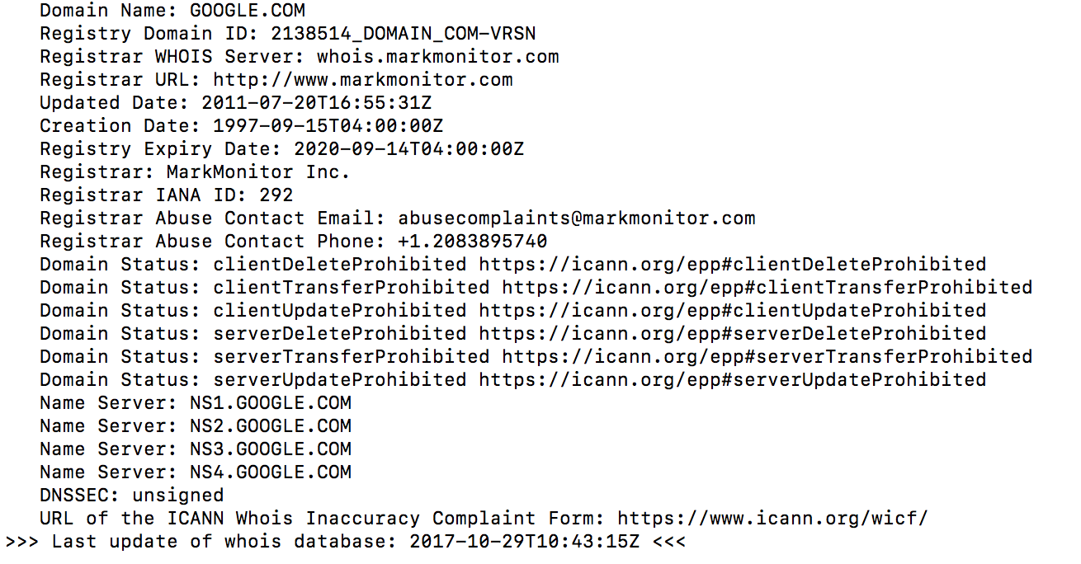
Whois command (domain lookup)

Slide 26
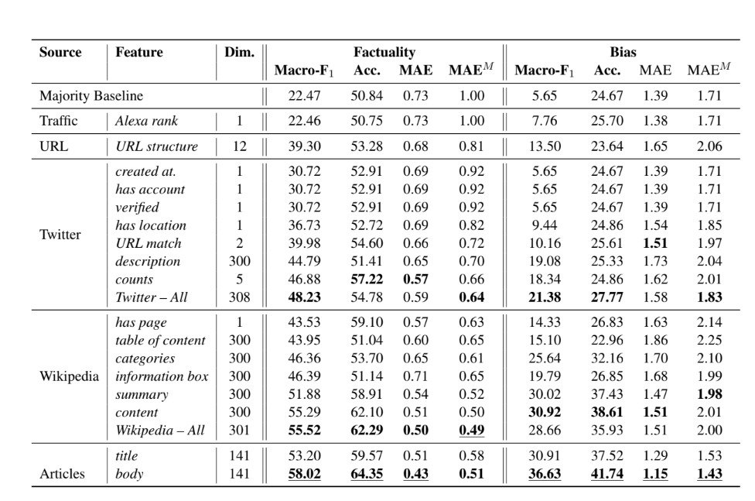
Modeling Outputs from Paper

Slide 27
Added Features
Added ”About Us” and “Terms of Use/Service” variables
Fake news websites typically lacks the About Us page. Most reliable news companies mentions their chief journalists and editors while fake news companies does not want to reveal their writers’ identity and have limited information
Fake news websites have limited information regarding their Terms of Use while reliable news websites often use detailed Terms of Use

