Slide 1
BDA = ML + CC
Big Data Analytics = Machine Learning + Cloud Computing
Chouliaras Andreas 2143
Matzoros Christos Konstantinos 2169
Pappas Apostolos 2109

Slide 2
Preliminaries
In this presentation we will cover the work of
Caesar Wu, Rajkumar Buyya, and Kotagiri Ramamohanarao
regarding big data analytics

Slide 3
Historical Review
Several opinions on the Big Data term origins
Frank Olhorst 1880 (10th US census)
Winshuttle In the 19th century
Bernard Marr Traced the origins back to 18,000 BCE
Erik Larson First to cast the term Big Data
“ The term Big Data is so generic that the hunt for its origins alone was not just an effort to find an early reference of those two words being used together.” -Steve Lohr

Slide 4
Historical Review 2
Several opinions on the Big Data term origins
Cox and Ellsworth is considered as the origin of Big Data because they assigned a relatively accurate meaning to the existing view of Big Data:
“Data sets are generally quite large, taxing the capacities of main memory, local disk and even remote disk. We call this the problem of Big Data. When data sets do not fit in main memory, or when they do not fit even on local disk.”
Today’s term may have extended their meaning but their definition is reasonably accurate

Slide 5
Why Big Data?
A revolution in the way of:
Thinking
Working
Learning
“Big data will be a source of new economic value and innovation”
“Large scale data sets of human behavior have the potential to fundamentally transform the way we fight diseases, design cities and perform research”

Slide 6
Worth the hype?
Can data speak for itself?
Inconclusive
Overstated
Exaggerated
Misinformed
Is bigger better?
Is Big Data a delusion that became a trend?
“We are far from a place where BDA can supplant more traditional methods or theories.”

Slide 7
Interpretation of Big Data
What is the span of “Big” in the “Big Data” term?
Today’s “Big” may become tomorrow’s “small”.

Slide 8
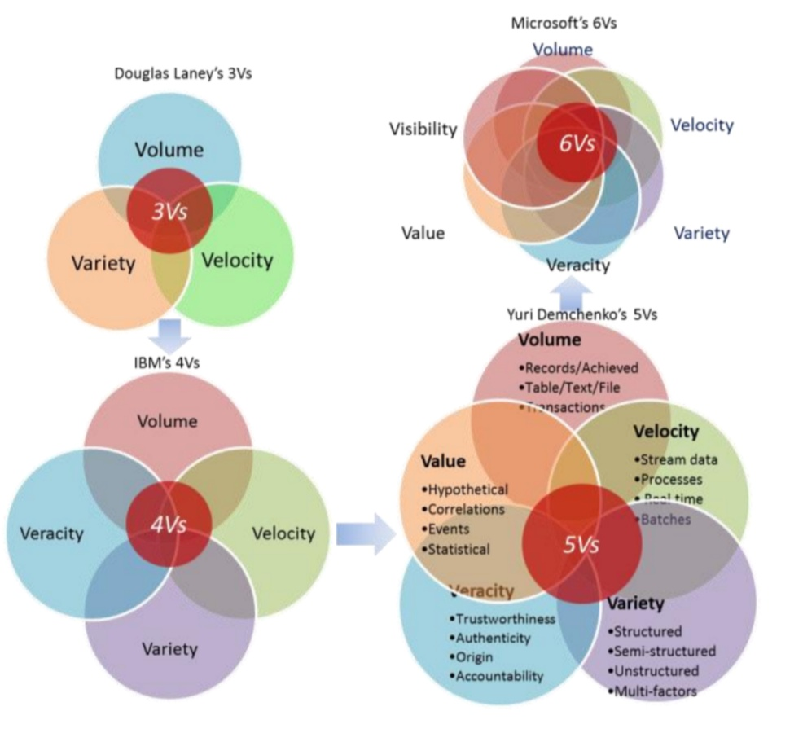
From 3Vs, all the way to 6Vs

Slide 9
Purpose
Hindsight (metadata patterns emerging from historical data)
Insight (deep understanding of issues or problems)
Foresight (accurate prediction in near future)
in a cost effective manner.
Enables decision makers to make right decisions based on predictions through the analysis of available data.

Slide 10
Data domain (Searching for patterns)
Volume of data
Variety of data formats
Velocity (the pace of data generated)
These are the three Vs of the data domain aspect.
The key attribute in the data domain is the volume.

Slide 11
Business Intelligence (Making predictions)
Visibility
Value
Verdict
We see that the business Intelligence domain also has a set of three Vs.
The key attribute here is visibility.
The wisdom of data crowds, or the hierarchical level of abstraction in data patterns.

Slide 12
Statistics Domain (Making assumptions)
Veracity (which is searching for trustworthiness and certainty in data sets)
Validity (how to correctly acquire data and avoid biases)
Variability (how to reduce data complexity and reach desirable outcomes)
Another set of Vs for the statistics domain.
The key attribute is the veracity.
Emphasizes on how to build a statistical model close to the reality.

Slide 13
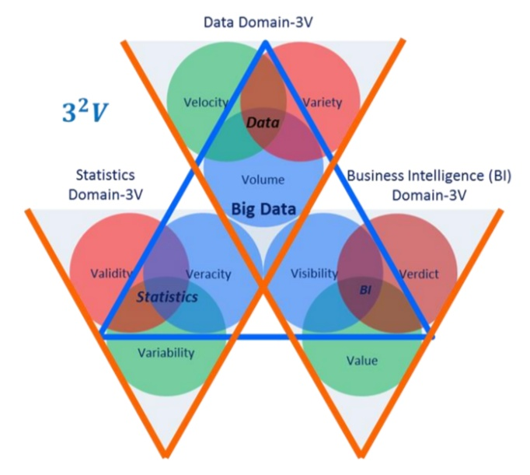
The 9Vs:

Slide 14
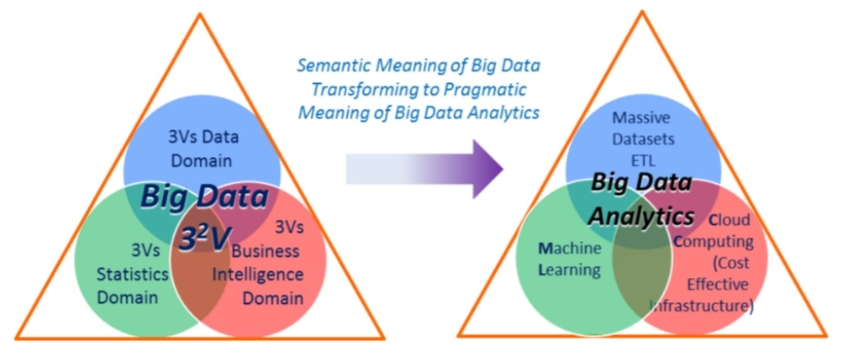
BDA: a pragmatic representation of Big Data

Slide 15
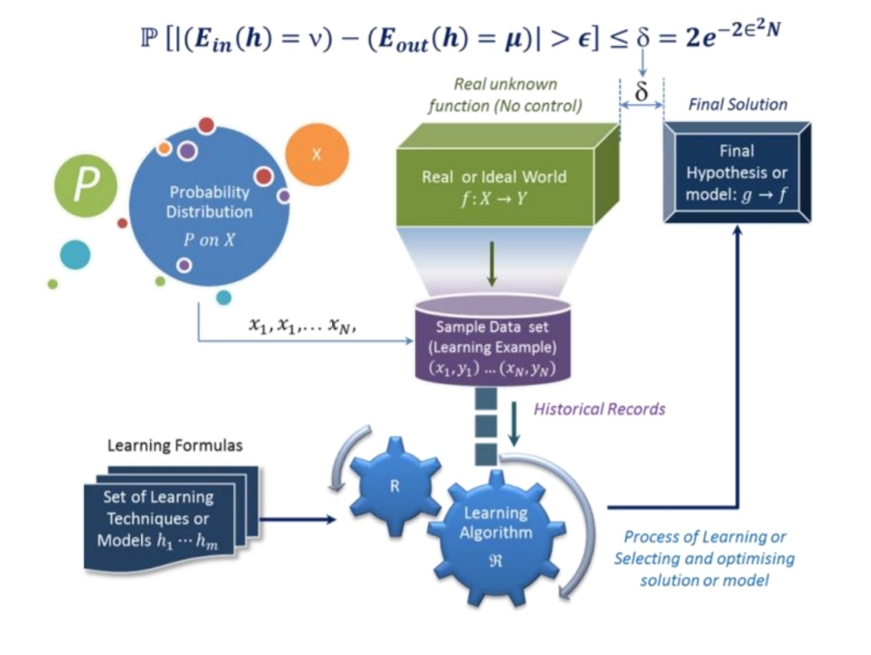
Machine Learning
-An automatic process of pattern recognition by a learning machine.
Learning from data:
Trials
Error

Slide 16
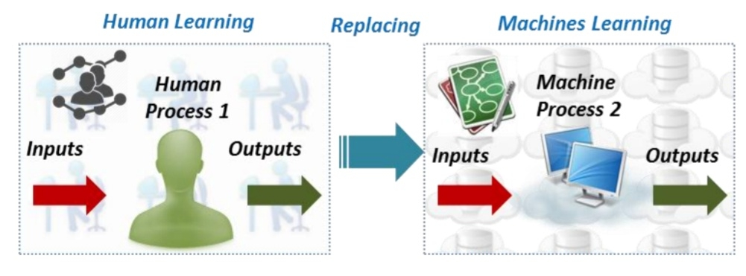
Machine Learning
“An outgrowth or the intersection of computer science and statistics, aims to automatically learn to recognize complex patterns and make intelligent decisions based on existing data sets.”
“Machine Learning turns
data into information”
The ultimate goal is to build systems that are of level of human Competence in performing complex tasks.

Slide 17





Computational Support Models
Massively parallel processing (MPP) database system
In-memory database systems
MapReduce processing model and platforms Bulk Synchronous Parallel (BSP) systems
But a fifth model raised among them

Slide 18
Cloud Computing Rocks. Why?
Cost effective (preferred solution for small businesses)
Plays a critical role in BDA as it offers Subscription-oriented access to:
Computing infrastructure
Data services
Application services
Has an elastic nature as:
It reduces the computational cost for different types of Big Data workloads.
It enables us to easily scale out or scale down to fit all sizes of dataset.

Slide 19
Hadoop: Basic idea and Objective
The Ever-growing data
The cost of computational hardware
drove Google to create Hadoop
Hadoop aims to leverage the commodity hardware for large scale of processing workload.
Not a database but a distributed storage and
computational framework

Slide 20
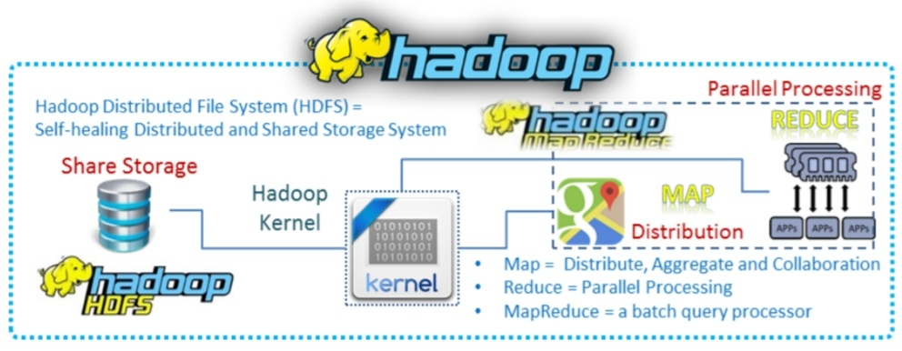
Pros and Cons
Free/open source
Distributed
Allows storing and processing large amount of data
Move processors not data (taking computer to data, rather than other way around)
Processes all workloads in batch mode

Slide 21

Google File System (GFS)
Traditional system design dogma:
A computation system should be designed as reliable as possible.
A failure was not allowed
The GFS principle:
A certain number of system failures is anticipated
But with specified:
Redundancy or Replicating factor and
Automatic recovery

Slide 22
Google File System (GFS)
Designed with five basic assumptions:
Commodity hardware outages caused by software/hardware faults is anticipated
Accepts a few million large files. Typical file size is 100 MB. Accepts smaller files but won’t optimize them.
Typical workload for stream reading: from hundred KBs to 1MB with small random reads for few KBs in batch mode
Has its will defined sematic for multi-clients with minimal synchronization overhead
File storage network bandwidth more important than low latency.

Slide 23
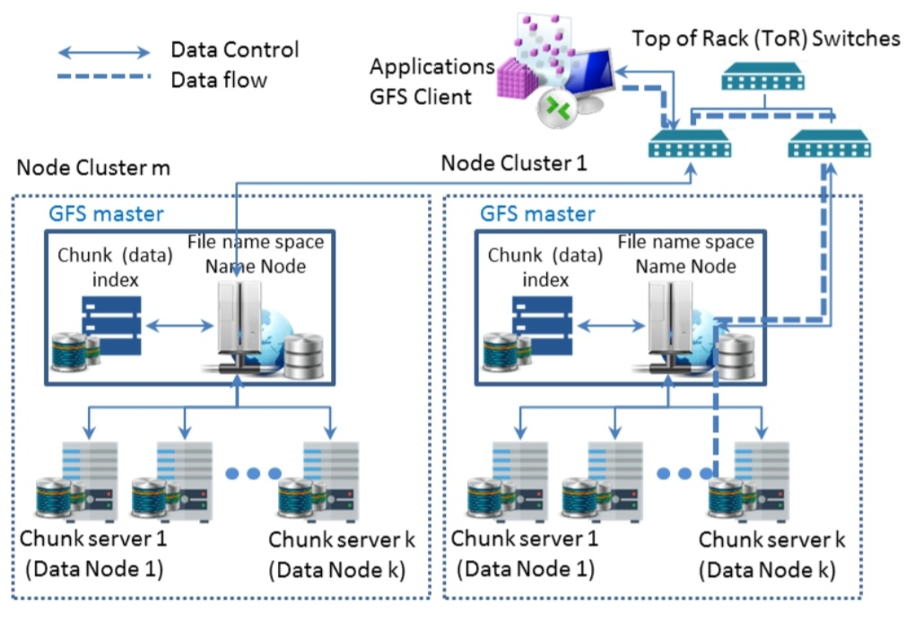
Google File System (GFS)
Architecture adopted by Hadoop Distributed File System (HDFS):
Single master server (name server)
Multiple chunk servers (or data nodes for Hadoop)
Multiple clients
Data structures:
Logs (metadata)
Sort String Table (SSTable)

Slide 24
MapReduce
Programming model (to process large dataset workload)
“Divide and conquer” strategy
Consists of a five step process (by Dean and Ghemawat) or a three-step one (simplified by Lin et al).

Slide 25
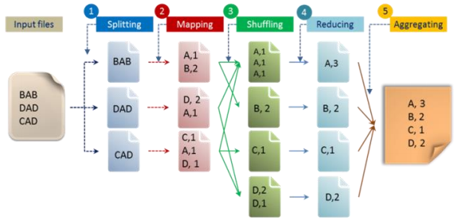
MapReduce: Example

Slide 26
MapReduce
Original Google’s MapReduce is potentially capable to handle five types of workloads:
Large-scale machine learning problems,
Clustering problems for the Google News and Google products,
Extraction of data used to produce reports of popular queries
Extraction of properties of web pages for new experiments and products
Large-scale graph computations

Slide 27

Lucene
“A high performance scalable Information Retrieval (IR) library”
-Otis Gospodnetic
It adds indexing and searching capabilities to applications.
Not an executable application or search engine
But a toolbox or searching tool kits that enable many applications to borrow or use it.
It converts any data to a textual format and enables them to be searchable

Slide 28

Nutch
An open-source and executable search engine file system.
Reasons behind its development:
Creation of a Lucene index
Assist developers to make query of their index

Slide 29

Mahout
A Java-based machine learning library
Developed to satisfy the need that BDA has for techniques such as clustering, collaborative filtering etc.
Can mainly handle three types of ML algorithms:
Collaborative filtering
Clustering Classification

Slide 30
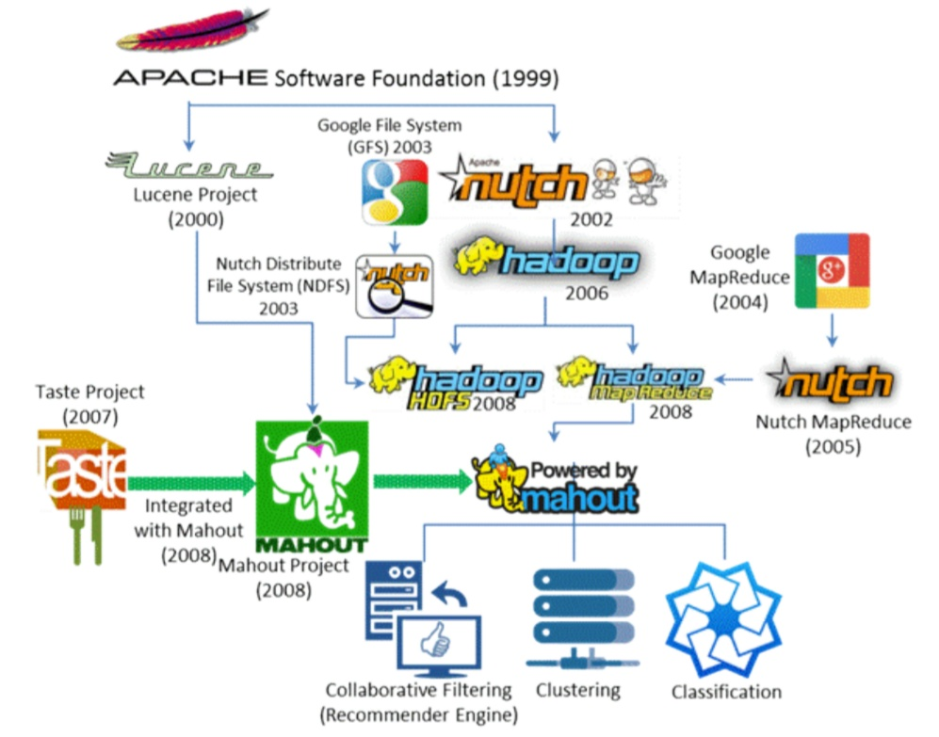
How it all comes together

Slide 31

Spark and Spark Stack
Fast and general purpose platform based on large clusters.
Intends to replace the MapReduce model.
Consists of seven major elements:
Spark Core of data engine
Spark cluster manager
Spark SQL
Spark streaming
Spark ML Library
Spark GraphX
Spark programming tools

Slide 32
Flink and other data process engines
Apart from Spark, there are several data processing engines such as:
Microsoft Dryad, Storm, Tez, Flink, CIEL
They are capable of supporting MapReduce-like processing requirements.
They aim to support more computational functions
The effort made by these platforms is to generalize Hadoop to be able to support a wide variety of BDA workloads

Slide 33

Flink in the spotlight
Kostas Tzoumas, Marton Balassi, Stephan Ewen et. al.
Argued that Flink is the next generation or the 4th generation data processing engine in comparison with others.
Although each one has its own special features.
Flink data engine is truly general purpose framework for Big Data Analytics(BDA).
They claim that Flink is capable of outperforming Spark by 2.5 times.
The reason why is because it is based on
Lambda architecture

Slide 34
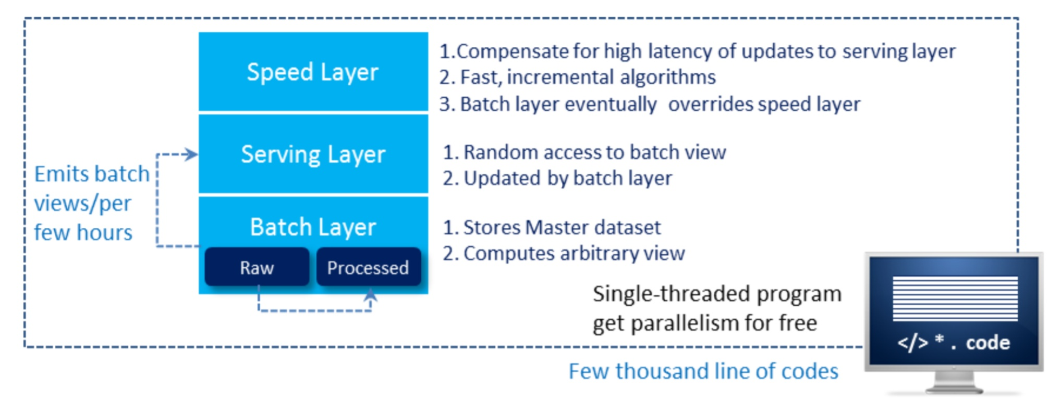
Lambda Architecture
Has three layers that implement a total of seven steps:

Slide 35
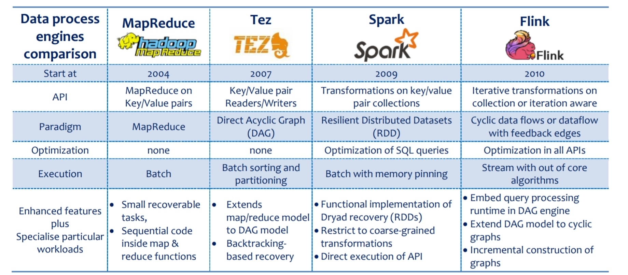
How do these Data Processing Engines compare?

Slide 36
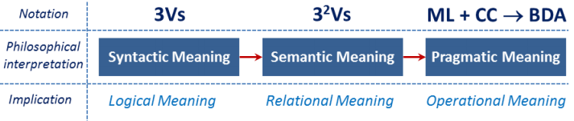
Conclusion
Machine Learning and Cloud Computing are the two most important components of Big Data Analytics.
BDA is not an ideal solution for every analytics problem.

