Slide 1


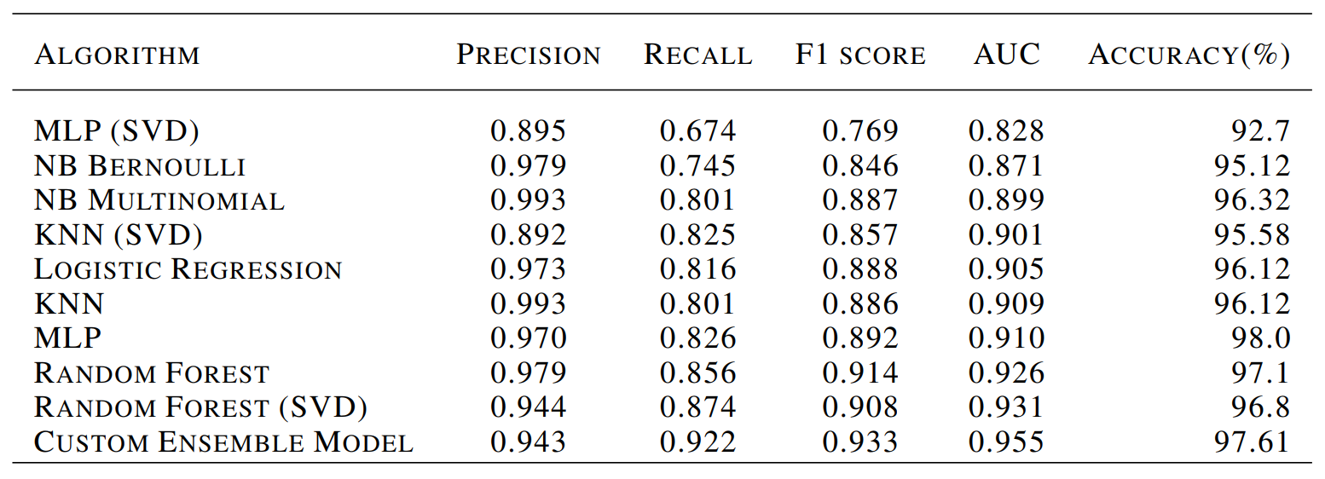
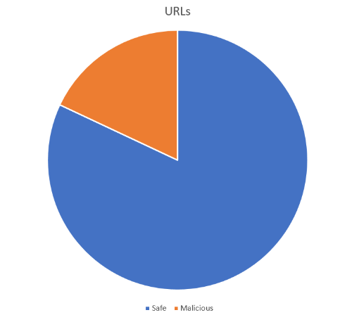
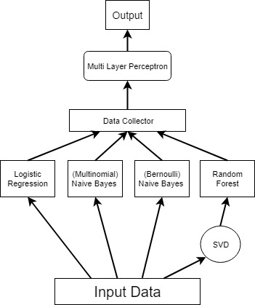
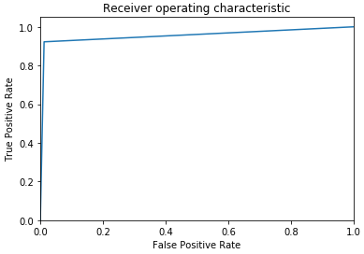
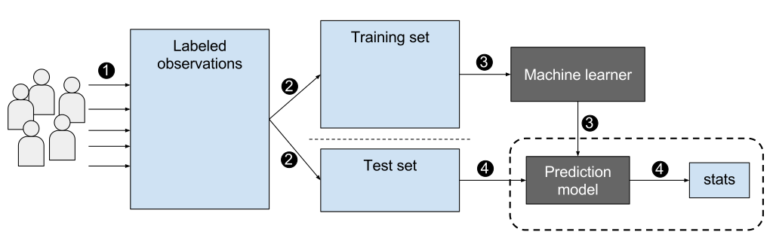
Malicious URL detection using Ensemble Methods
Chouliaras Andreas and Pappas Apostolos
Department of Electrical and Computer Engineering, University of Thessaly, Greece
Abstract
With the continuous expansion of the Internet and its users, more and more security issues come to light. As much as security measures increase to protect systems that make up the Internet, the user remains the most vulnerable part of it. Malicious URLs leading to malicious websites, are a common and serious threat to cybersecurity. Malicious URLs host unsolicited content (spam, phishing, drive-by exploits, etc.) and lure unsuspecting users to become victims of scams (monetary loss, theft of private information, and malware installation), causing losses of billions of dollars every year.
The most classical way of dealing with this threat is the usage of blacklists. Blacklists tend to lack the scalability and the overall ability to to detect newly generated
malicious URLs. In this report, we examine the effectiveness of several Machine Learning algorithms on detecting such Malicious URLs taking training time into account as well. We also examine ensemble methods, in order to further improve our model’s accuracy.
Experimental Results
Introduction
Dataset and Preprocessing
Our dataset contains a total of 420,464 URLs,
75,643 of which are malicious and 344,821
that are safe. Each URL contains only
the host name and the path, excluding
the HTTP Protocol at the beginning.
The algorithm we used for preprocessing
the data is tf-idf, short for ”term frequency-
Inverse document frequency”. It is a numerical
statistic that is intended to reflect how important
a word is to a document in a collection or corpus.
Models Evaluated
We applied several ensemble and non-ensemble algorithms for our experiments. These were:
Logistic Regression
Naïve Bayes (Bernoulli)
Naïve Bayes (Multinomial)
K-Nearest-Neighbors
Multilayer Perceptron Classifier (MLP)
Random Forest
For the models that had a very slow training procedure, we applied feature reduction using the TruncatedSVD algorirthm. We provide the results of both versions
Custom Ensemble Model
The idea here is to exploit the best of our models and use their predictions to further improve the results.
The four models we chose to participate in the
ensemble model were:
Logistic Regression
Naïve Bayes (Multinomial)
Naïve Bayes (Bernoulli)
Random Forest after SVD
We based our choice on the training time
performance. The input of the Multi Layer
perceptron consists of the prediction
vectors of each algorithm stacked
together forming a matrix.
Even though Naïve Bayes models
weren’t very efficient to reduce FN,
the model was effected into making
opposite predictions to theirs when needed.
The results were better than initially expected. We achieved the best accuracy among the constituent models at 97.61% falling short behind the sklearn MLP model. It has lower precision than the constituent models at 94.3% but has by far the best recall at 92.2% and the best F1 score at 93.3&. Finally it has the best AUC at 0.955.
Evaluation Methods
In this report, we evaluated our models using the following metrics:
Accuracy
Precision
Recall
F1 score and
Area Under Curve (known as AUC)
In the Report the Receiver Operating Characteristic curve is provided for each model.
Conclusions
Malicious URLs are a serious threat to cybersecurity. The detection of such URLs plays a critical role for many cybersecurity applications, and clearly machine learning approaches are a promising direction. We tested a lot of machine learning algorithms, more than the included, like SVM which we excluded because it was so slow that we never actually managed to finish the training. We saw how interesting and effective ensemble methods can be and even a custom-made ensemble model that consists of fast and diverse models can produce impressive results.
Refer to the written report for more information.
References:
A. Defazio, F. Bach, and S. Lacoste-Julien. Saga: A fast incremental gradient method with support for non-strongly convex composite objectives. Advances in Neural Information Processing Systems, 2, 07 2014.
J. Hong. The state of phishing attacks. Commun. ACM, 55: 74–81, 01 2012. doi: 10.1145/2063176.2063197
M. E. Maron. Automatic indexing: an experimental inquiry. Journal of the ACM (JACM), 8(3):404–417, 1961.
D. Sahoo, C. Liu, and S. C. Hoi. Malicious url detection using machine learning: a survey. arXiv preprint arXiv:1701.07179, 2017.
S. Sinha, M. Bailey, and F. Jahanian. Shades of grey: On the effectiveness of reputation-based blacklists. In 2008 3rd International Conference on Malicious and Unwanted Software (MALWARE), pages 57–64, Oct 2008. doi: 10.1109/MALWARE.2008.4690858.
S. Yang and A. Browne. Neural network ensembles: Combining multiple models for enhanced performance using a multistage approach. Expert Systems, 21:279 – 288, 11 2004. doi: 10.1111/j.1468-0394.2004.00285.x.
Spring 2019, ECE 417 Poster Session

