Slide 1
Malicious URL detection using Ensemble Methods
CHOULIARAS ANDREAS 2143
PAPPAS APOSTOLOS 2109

Slide 2
Understanding the Problem
As much as security measures increase to protect systems that make up the Internet, the user will always remain the most vulnerable part of it.
Malicious URLs leading to malicious websites are a common and serious threat to Cybersecurity
Links that leads to websites that perform frauds by:
Tricking users into revealing sensitive information which eventually
Leads to theft of money, identity, or even
Installing malware in the user’s system
Causes losses of billions of dollars every year

Slide 3
Black Lists
The most traditional way of dealing with such threats.
Are essentially databases that contain several URLs marked as malicious.
New URLs are created everyday, making these databases somewhat obsolete.
They are incapable in making predictions for new URLs:
If for example https-paypal.verifications-updates.com/ is in a blacklist
The following won’t be:
vasyab.ir/wp/UPDATE-ACCOUNT-INFORMATION/PayPal-SERVICE0Update0Your-Account-Paypalcom/

Slide 4
Machine Learning is the key
There is a wide variety of Machine Learning algorithms
to choose from to address this problem:
Logistic Regression
K Nearest Neighbors
Support Vector Machines
Decision Trees
Bayesian models
Neural Networks etc.
But first we need to look at our dataset

Slide 5
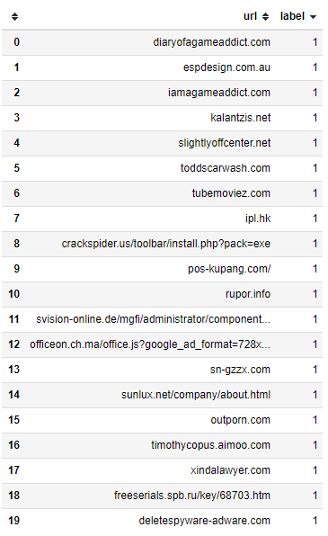
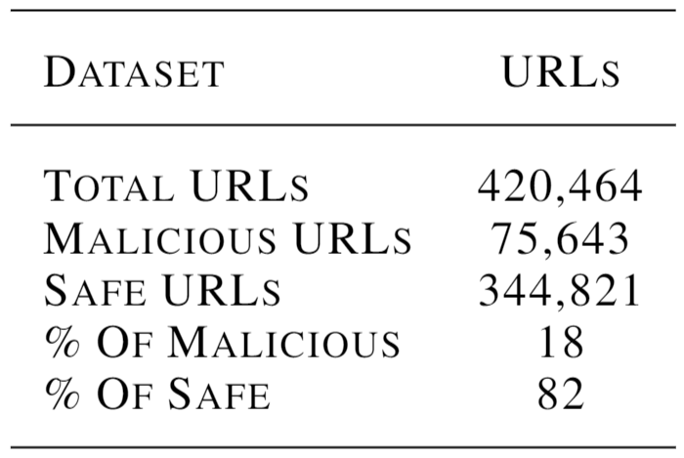
The Dataset We Used
Malicious_n_Non-Malicious URL from www.kaggle.com
It has:
There is a huge imbalance between classes…
But is in not wise to achieve balance by removing instances.
We will probably get high accuracies but that won’t mean a lot.
Solution?
Rely on different metrics to evaluate the models

Slide 6
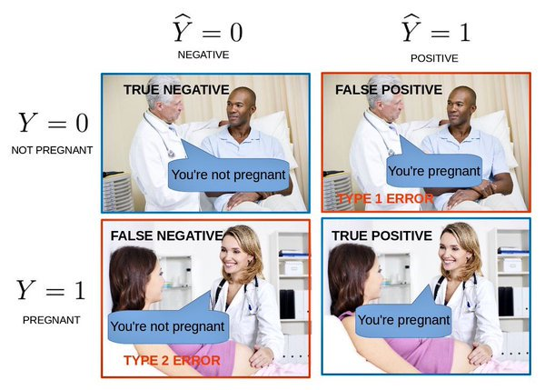
The Evaluation Metrics
TYPE 1 ERROR: False Positive
Predicting a URL to be malicious when it is not
TYPE 2 ERROR: False Negative
Predicting a malicious URL to be safe
Much more devastating than Type 1 Errors in our case
In addition to Accuracy let’s use Precision and Recall.

Slide 7



The Evaluation Metrics (2)
Precision refers to the proportion of positive identifications that was actually correct
Recall refers to the proportion of actual positives that was identified correctly
Let’s use F1 score as well which is just the harmonic mean of Precision and Recall and it is suited to problems where the cost of False Positives and False Negatives are very different.

Slide 8

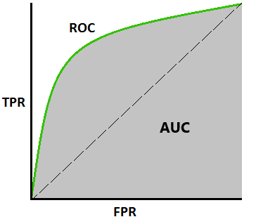

ROC curve and AUC are in fashion
The ROC curve is plotted with True Positive Rate against the False Positive Rate:
The Area Under the Curve represents degree or measure of separability.

Slide 9

Preprocessing
Need to transform dataset into a format, easily manipulated by ML algorithms.
We used the Term Frequency - Inverse Document Frequency (tf-idf) algorithm.
Term frequency (tf) is basically the output of the Bag-of-Words model (frequency of appearance).
A word is considered a signature word of a document, if it doesn’t appear that often in the other documents.
So a signature word’s Inverse Document Frequency must be high:
The tf-idf is the product of these two frequencies.
So, high tf-idf means the tested word appears a lot of times in said document and is absent in the other documents.
This makes the word a signature word of the document.

Slide 10
Preprocessing (2)
After tokenization the dataset has:
420.464 Rows
Somewhere near 420.000 columns
We can see that the dataset is huge and as most values are zeros it has become a sparse matrix.
Finally we split the dataset into:
A training set that consists of 80% of the data
A test set that consists of the rest 20% of the data

Slide 11
The Non-Ensemble Methods
The non-ensemble algorithms used are:
Logistic Regression
K Nearest Neighbors
Multi-Layer Perceptron
Naïve Bayes (Bernoulli)
Naïve Bayes (Multinomial)
Support Vector Machines was tried but they were so slow, they would probably run till today.
We used the Sklearn package to build our models

Slide 12
Logistic Regression
We used the SAGA solver(Defazio et al., 2014), a modification of SAG (Stochastic Average Gradient)
It was also recommended by Scikit documentation as a great solver for very large datasets
Fast Training
Accuracy at 96.3%
Precision 97.3% -> Excellent at reducing False Positives
Recall 81.6%
F1 score 88.8%
AUC 0.905
It displayed an overall good performance

Slide 13
Naïve Bayes
Popular for text categorization.
Bernoulli Naive Bayes:
Super fast training
Accuracy at 95.12%
Precision 97.9% -> Excellent at reducing False Positives
Recall 74.5% -> Bad at reducing False Negatives
F1 score 84.6%
AUC 0.871
We can see this modes wasn’t so successful at reducing the False Negatives.
Multinomial Naive Bayes:
Super fast training
Accuracy at 96.32%
Precision 99.3% -> Perfect at reducing False Positives
Recall 80.1%
F1 score 88.7%
AUC 0.899
Better but also not so successful at reducing the False Negatives.

Slide 14
K-Nearest Neighbors
Very slow.
Accuracy at 96.12%
Precision 99.3% -> Excellent at reducing False Positives
Recall 80.1%
F1 score 88.6%
AUC 0.909
Not bad, but we really need to something about the latency.
Feature Reduction!
Let’s make the model less complicated by reducing the dimentionality

Slide 15
Singular Value Decomposition
We used TruncatedSVD from Sklearn package keeping the 100 top components
According to the sklearn documentation the TruncatedSVD transformer:
Works with any feature matrix (including sparse matrices).
It is Recommended for tf-idf matrices.
We reduced columns from 420.000 to 100. Let’s see how this will effect our models…

Slide 16
K-Nearest Neighbors (SVD)
A little slow. But way faster than before.
Accuracy at 95.58% -> 1% drop
Precision 89.2% -> 10% drop
Recall 82.5% -> 3% increase
F1 score 85.7% -> 3.3% drop
AUC 0.901 -> 0.9% drop
We got better Recall but overall we lost some performance.

Slide 17
Multi-Layer Perceptron
Many times slower than KNN ☹
Accuracy at 98% -> This is impressive
Precision 97% -> Great at reducing False Positives
Recall 82.6%
F1 score 89.2%
AUC 0.910
Very good but again, way too slow…
Here we go again. SVD!

Slide 18
Multi-Layer Perceptron (SVD)
99.6% Faster!
Accuracy at 92.7% -> 5.5% drop
Precision 89.5% -> 7.73% drop
Recall 67.4 % -> 18.5% drop, ouch…
F1 score 76.9% -> 13.8% drop
AUC 0.828 -> 9% drop
Devastating... Too bad
Increasing SVD components would keep MLP training low but it would add considerate latencies at the SVD algorithm. No hope. We need to try something else.

Slide 19
Ensemble Methods
The general idea is that with ensemble methods we try using multiple learning algorithms to obtain better predictive performance than could be obtained from any of the constituent learning algorithms alone.
Many methods to look at. Bagging, Boosting etc.
The models we tried:
Random Forest.
Custom multistage ensemble model using MLP.

Slide 20
Random Forest
Creates multiple random Decision Trees and merges them into one model in order to get a more accurate and stable prediction with less overfitting.
We use 10 estimators (trees). Results:
Slower than KNN but faster than MLP.
Accuracy at 97.1%
Precision 97.9% -> Excellent at reducing False Positives
Recall 85.6%
F1 score 91.4%
AUC 0.926
Very promising…but slow nonetheless

Slide 21
Random Forest (SVD)
We use 10 estimators (trees) again. Results:
Super fast. 97% faster
Accuracy at 96.8% -> ~1% drop
Precision 94.4% -> ~5% drop
Recall 87.4% -> 2% increase
F1 score 90.8% -> ~0.5% drop
AUC 0.931 -> 1% increase
It actually improved. This is impressive.
It managed to reduce the False Negatives

Slide 22
Custom ensemble model.
Why we did all that?
Why we tried so many algorithms?
The idea here is to exploit the best of our models and use their predictions to further improve
the results.
Latencies play a major role here.
We chose the fastest models even though they have very different results:
Logistic Regression
Naïve Bayes (Bernoulli)
Naïve Bayes (Multinomial)
Random Forest (SVD)

Slide 23
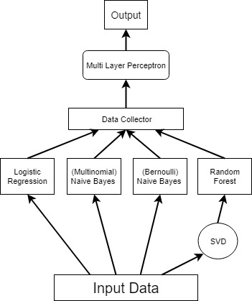
Multistage Ensemble Model
Use a weighted average among those models
But use an MLP to find those weights
Use Stage 1 predictions as input to the MLP model
It will produce a final total prediction.
Two hidden layers with 50 and 10 neurons respectively.

Slide 24
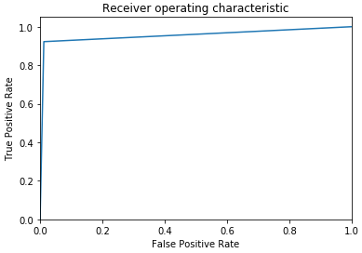
Results.
Fast training
Accuracy at 97.61%
Precision 94.3%
Recall 92.2% -> best so far
F1 score 93.3% -> best so far
AUC 0.955 -> best so far
Great results at reducing False Negatives.
Goal Achieved.

Slide 25
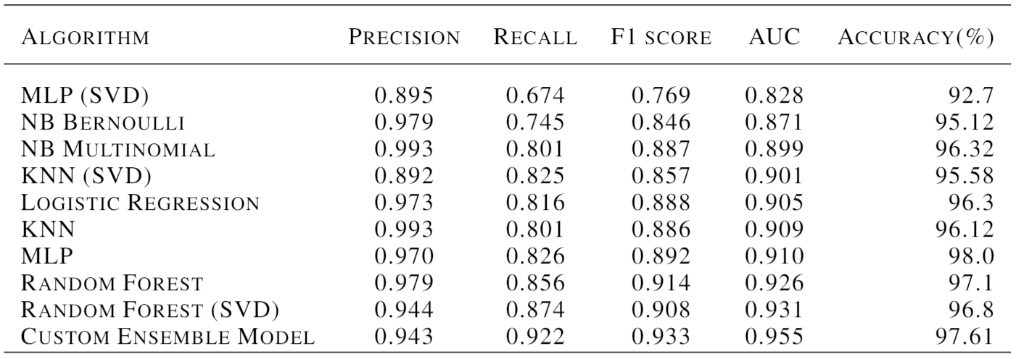
Results of all models:

Slide 26
Conclusion
Ensemble models are a powerful way to make successful models even better.
And don’t be afraid to make custom ensembles.
Understand the problem and don’t be afraid to use even some “weak” models.
You may turn their weakness into extra predictive power.

Slide 27
Thank you
CHOULIARAS ANDREAS 2143
PAPPAS APOSTOLOS 2109

