Slide 1
29.1
Installing Software
By Adam Chu

Slide 2
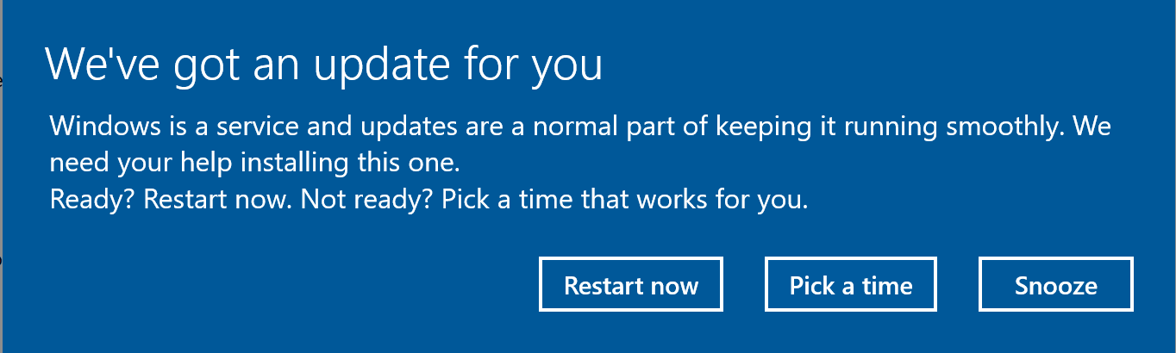
UPDATE Prompt 1
This is a prompt that Microsoft send to Windows
Users when there is a new Update for the OS of a
particular device. The idea behind this Prompt
is that it overwrites your current Screen and Puts
itself on the top of the display stack.
You Can:
Restart now (which will Close Open Applications & Do The Update)
Pick a time (which allows you to select a time, good for when your not going to be using the PC)
Snooze which will just re-ping this prompt at a later time
Note Any Unsaved Work during an update could be lost or deleted & needing restoring from a back-up

Slide 3
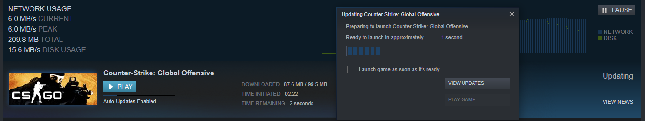
Update Prompt 2
This Update prompt is different as this is designed so that Program and Game Developers have everyone using the same ‘Patch’. This is done by Game Devs as if they change something important on an update, you do not want people using the older system.
This Application called Steam Micro-Manages the games you play by assigning Update periods when the Computer is not likely to be used, also it shows Update prompts if the variant you are using is older than the latest one. And Install Prompts if you have a new file to be installed

Slide 4
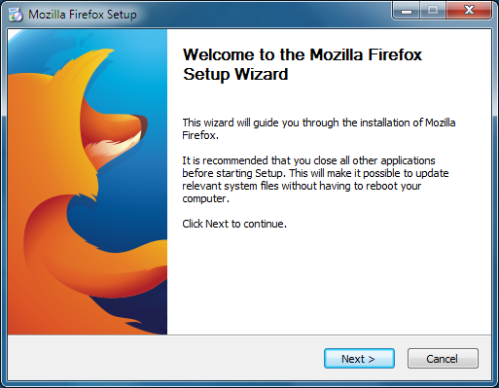
Installing prompt 1
When you open an executable file on your computer, usually a customised prompt will appear using one of the style of a windows alert.
This is designed to help streamline and speed up installation of new software.
You might be asked:
Where do you want to save your new program?
Do you want a shortcut on the Desktop & Start Menu?
Do you want to Install Some Affiliated Software?
And its possible that it might need to Reboot the system before an application is updated

Slide 5
Pros of Updating & Installing Software
Better Functionality: Usually a Software Update or New Software is going to work more cleanly and have: a better UI, new Macros, better Stability, etc. For example Moving from GIMP to Photoshop, which has a much better UI with easier to access or more innovated and tested features like Industry leading Macros & procedures. Also as GIMP is open source it is prone to bugs compared to the full price program.
Better Security: (Firewall, Anti-Virus Rules, New Security measures in the OS). It usually has fixed a flaw in the security system exposed by White-Hat hackers. These updates help to protect and ensure that your device is protected and that none of your data is unsafe.
Better Performance: (Program runs more efficiently and smoother) Due to bad Optimisation and less efficient programming when a product is first released this could lead to: Poor User Response, Polarizing products, etc. If a company creates an Update for this program that helps to improve performance significantly improve customer feedback and usability.
Notes:
1 >> The increase in functionality is also true for an update as well just is much less pronounced as they are changing one or two things, albeit a generational update is more pronounced like Word 2012 to Word 2013 where they had a massive re-design to go along with the Win10 Aesthetic
2 >> its better to talk about Windows & Intel and the constant security updates like Spectre which allows the hacker to see the thread stack of ‘HyperThreaded Cores’ that are logically linked. (HyperThreading One Physical CPU = Two Logical Cores). Because of the way these are created the hacker can see the data in each core using this exploit.
3 >> An example of this is a game called ‘No Mans Sky’ this had the problem that at launch it was not very efficient and that the game was boring which caused negative reviews and refunds from most sellers. But recently they have released an update to the game which added: Better Performance (Everywhere Flying in Space and on planets) (The reason why it was laggy was due to its 18 quintillion procedurally generated universe and it had to generate a solar system as you explored each one) & lots of new functionality like Settlement Building & Cars which were not possible in the poor optimised state at launch.

Slide 6
cons of updating software
Interruption of Work Flow: Time Taken for An Update, Cost of replacing damaged or Unsupported hardware When an update is on a large size (file or WS count) it removes the selected workstations whilst the updates are in progress. Changed Functionality (Methods & Macros) If an update has changed significant points within a program (GUI Wise or Feature Wise) this can force users to relearn the new systems. Cost of replacing damaged or Unsupported hardware Which can cost money for Teachers And Time If a update fails midway and damages or corrupted a hard drive the business then has to pay to replace and re-set up the items damaged like WS and Servers. This can also occur when a Update or Install of software cannot be used due to a hardware incompatibility and then the systems need to be replaced whilst the other issues can still occur
These flaws cause a business to expend time and resources to replace what is lost or damaged this in turn makes updating a program something that should be planned and with risks assessed and prepared for

