Slide 1
Seq2Seq, Attention
BUSINESS
2019
JULYED
北京七月在线科技有限公司
褚则伟 zeweichu@gmail.com
https://www.julyedu.com/

Slide 2

CONTENTS
01
Seq2Seq + Attention
推荐系统实战课程
julyedu.com

Slide 3
Seq2Seq + Attention
01
Supporting text here.
When you copy & paste, choose "keep text only" option.

Slide 4
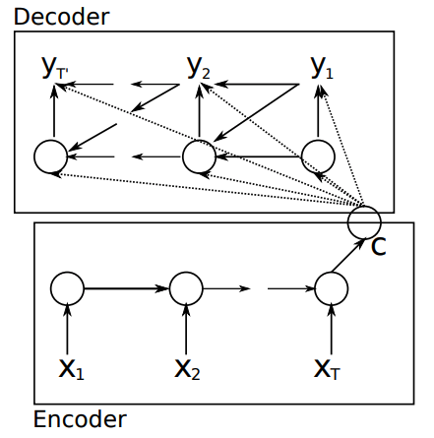
Encoder Decoder模型
Encoder 是一个 GRU
Decoder 也是一个GRU
训练采用cross entropy loss，与语言模型类似
图片来自Cho et. al, Learning Phrase Representations using RNN Encoder-Decoder for Statistical Machine Translation

Slide 5
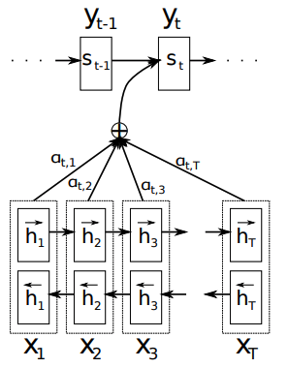

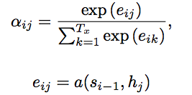
Bahdanau Attention
Encoder是一个双向RNN
Attention Function
图片来自Bahdanau et. al, Neural Machine Translation by Jointly Learning to Align and Translate

Slide 6
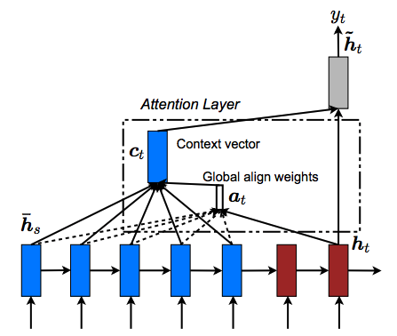
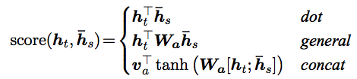
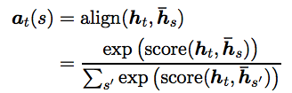

Luong Attention

Slide 7
微信扫一扫关注我们
褚则伟 zeweichu@gmail.com
https://www.julyedu.com/

