Slide 1
King County Home Analysis
Alejandro Colocho

Slide 2
Data
Data of homes up to 2015
21,597 houses
Location data where those houses stand

Slide 3
Questions to Answer
What home and location attributes influence the price of a home?
Are prices between waterfront and non-waterfront homes different?
Are prices between waterfront and non-waterfront homes in the same zip code different?
Are prices for houses renovated in the past 15 years different than houses not renovated or renovated longer than 15 years?

Slide 4
Contributors to Home Prices
Living Area Square Footage
Renovation within past 15 years
Location
Bedrooms
Bathrooms
Floors
Waterfront access
County Grading system
Condition

Slide 5
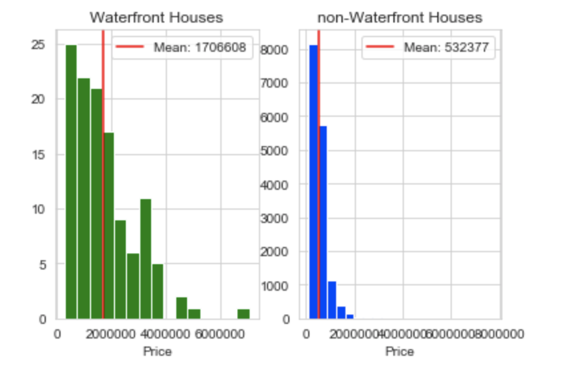
Waterfront vs Non-Waterfront

Slide 6
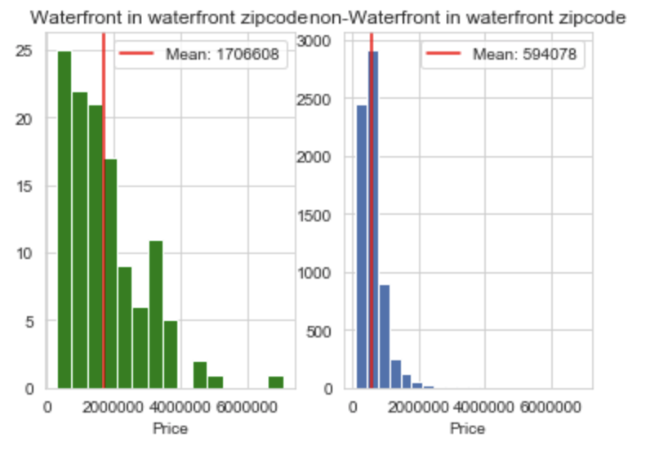
Waterfront vs Non-Waterfront in the same zip code

Slide 7
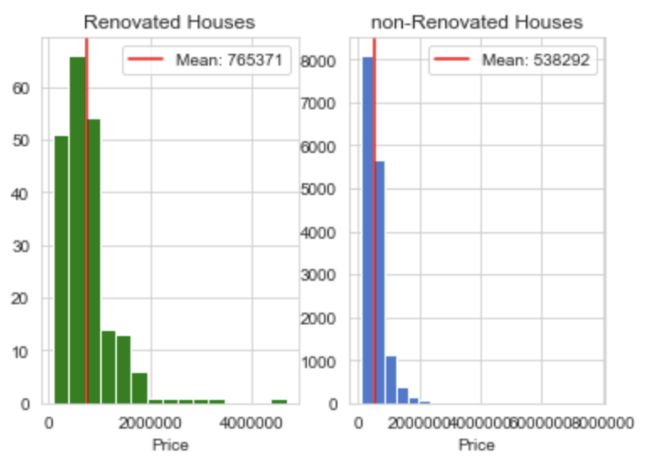
Renovated vs Non-Renovated

Slide 8
Limitations
Condition of the house is too vague.
Renovation is too vague.
No knowledge how the grading system of the county works.

Slide 9
Further Research
Location relative to landmarks and community facilities.
City budget and its relation to the price of a home.

Slide 10
Conclusion
Multiple variables count towards the price of a home, but premium features in the house tend to have a bigger impact.
Bigger does not necessarily mean better.
Renovations tend to increase the price of a home.

Slide 11
Questions

