Slide 1
Churn Analysis
Alejandro Colocho

Slide 2
Data
3,333 subscribers
Account features
Usage
Billing
Churn or non-churn
State
Phone number

Slide 3
Questions to answer
What characteristics do churn customers have?
Which characteristics are more important?
Can we reliably classify churn and non-churn customers?

Slide 4
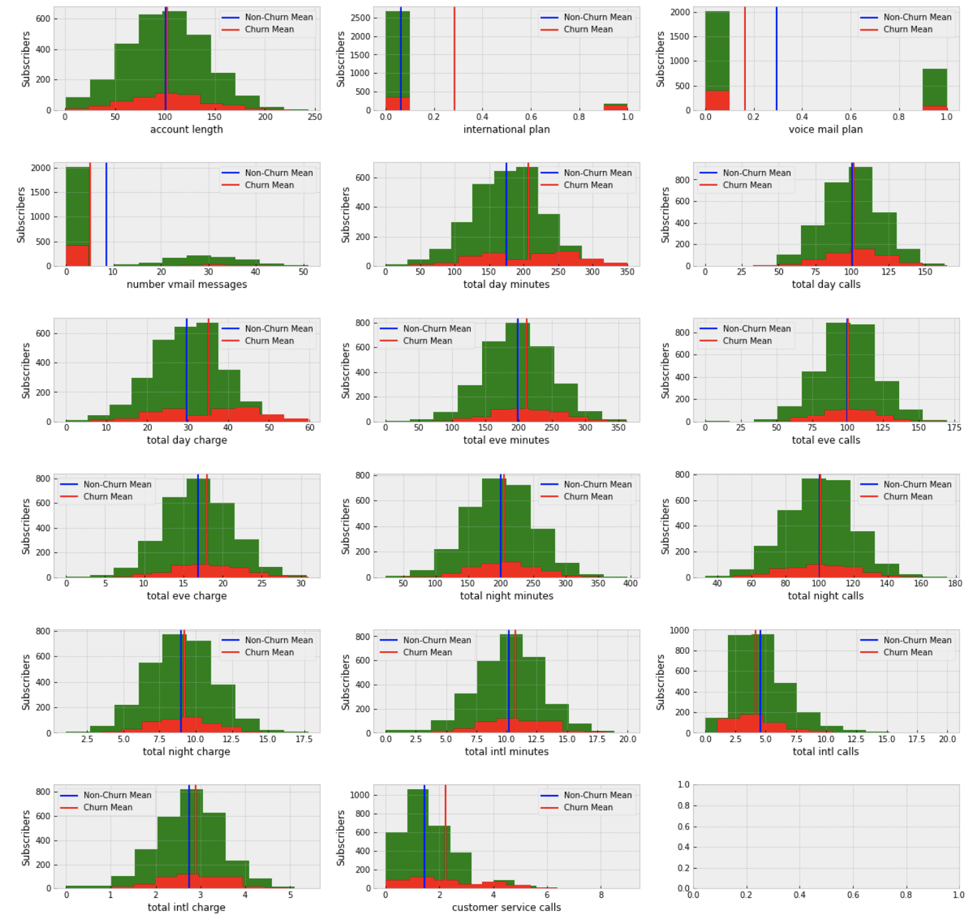
Characteristics
All characteristics are very similar between churn and non-churn customers.

Slide 5
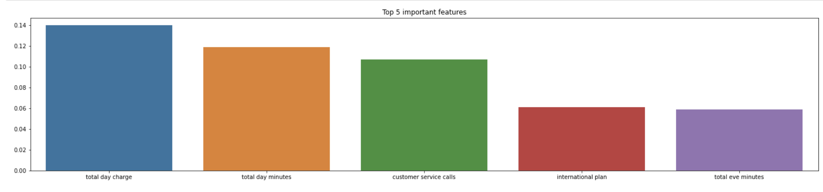
Important characteristics
According to the first model, usage and billing seem to be the top categories that define churn customers.
State is the least important.

Slide 6
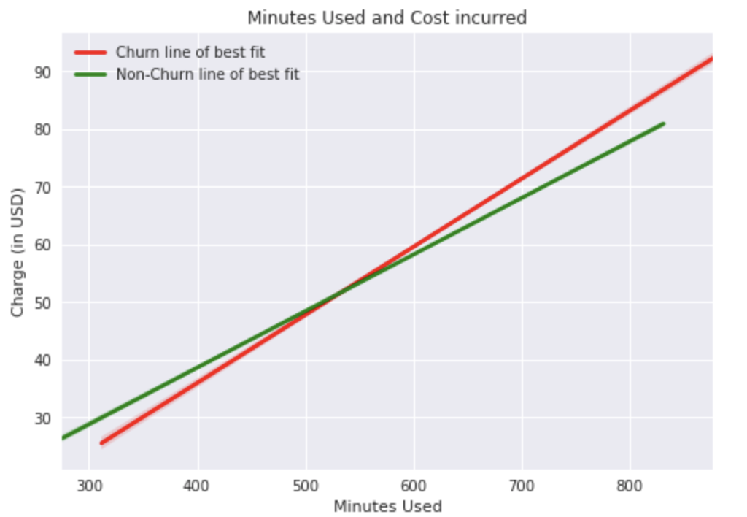
Investigating Usage and billing
More usage is more expensive for churn customers.
Less usage is more expensive for non-churn customers.

Slide 7
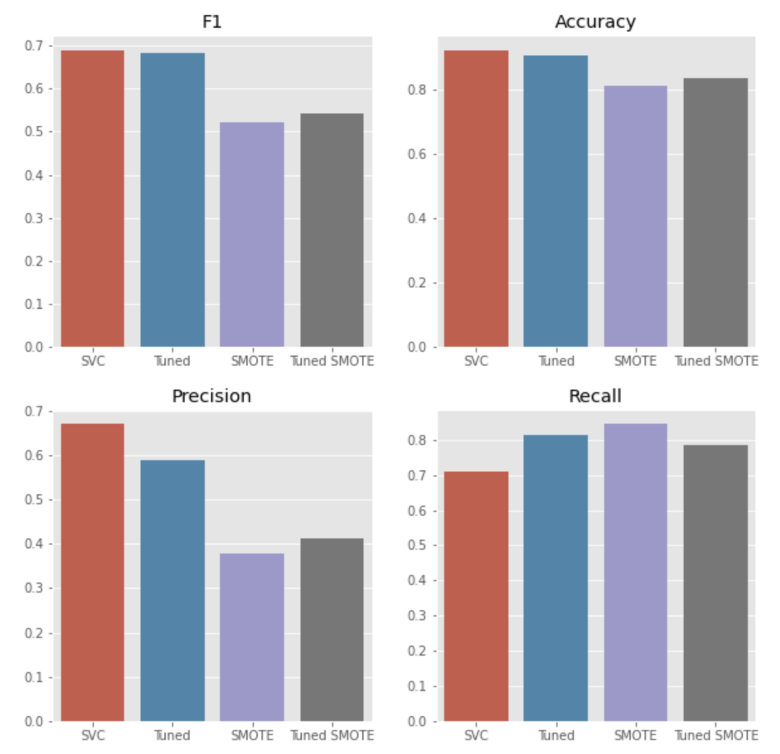
Classifying churn customers
Support vector classification algorithms are the best choice for classifying churn customers.
Further tuning the model allows it to improve how many people are classify as churn customers correctly.

Slide 8
Limitations of data
Small dataset.
Outdated dataset.
Lack of explanation for columns.

Slide 9
Further research
Adding data on mobile internet usage.
Adding data on sms usage.

Slide 10
Conclusion
Churn customers are paying more than non-churn customers.
Any single variable alone cannot be used to predict churn.
More relevant data should be able to increase performance of our model and allow for retention procedures.

