Slide 1
New Proposed Method

Slide 2
Overview
Produce replicas by varying F within errF from data (set 0)
Perform fits to all replicas and obtain a distribution of CFFs
Determine the mean and sigma of CFFs
Using the mean, sigma of CFFs and varying kinematics, produce F values [using the function](Note: the range of kinematics shouldn't exceed the values of next data set)
Build a new ANN model with the data generated in (4) Inputs: Kinematics & F / Outputs: CFFs
Produce samples of F varying within errF from the initial data and combine with initial kinematics
Feed the samples (from 6) to the ANN model built in (5) Output: a distribution of CFFs

Slide 3
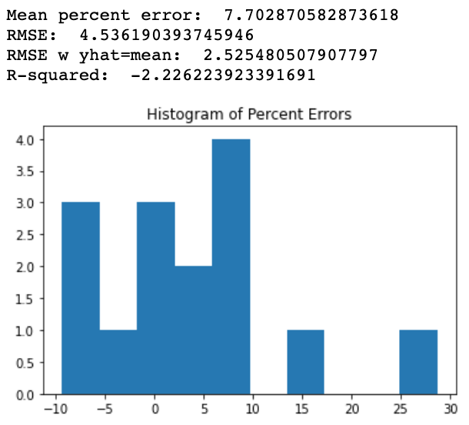
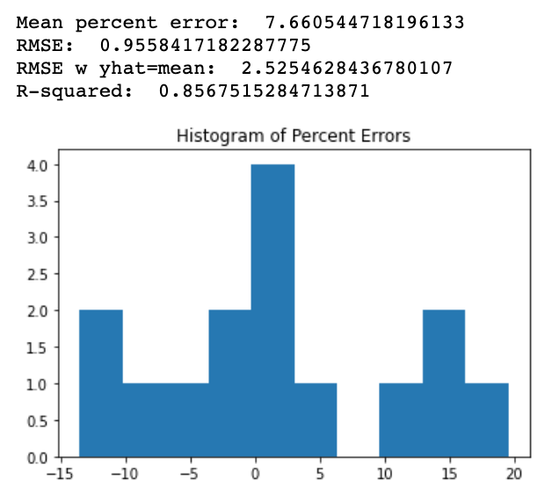
Results from GlobalFit2 method as comparison
ReE
ReHtilde

Slide 4
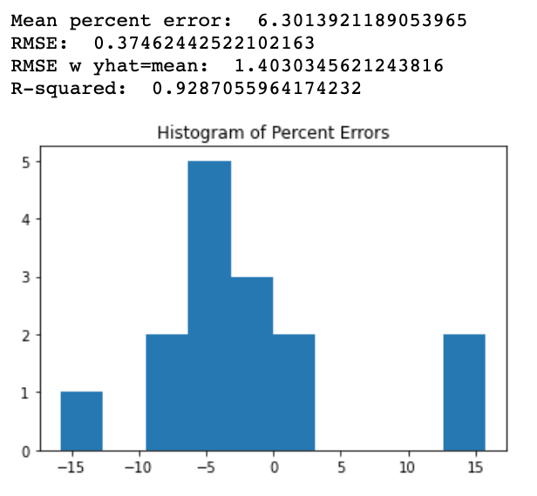
Continued
ReHtilde

Slide 5
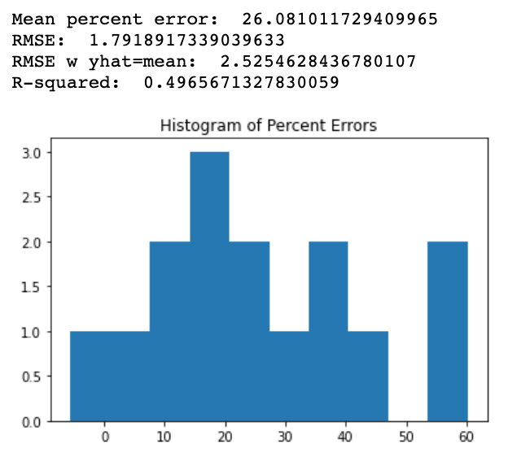
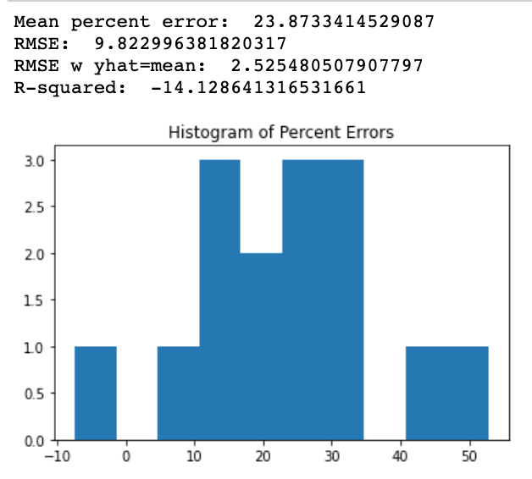
New Method Results
ReH
ReE

Slide 6
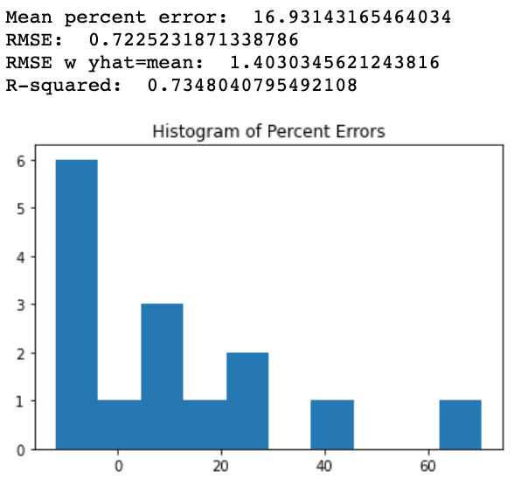
Continued
ReHtilde

Slide 7
Current list of methods
Default chi-squared minimization from scikit-learn with levenberg-marquardt optimizer
Local ANN fit chi-squared minimization
New proposed local fitting method with imputed Fs
Two-stage global fit
Single-stage global fit

