Slide 1
ANN Methods

Slide 2
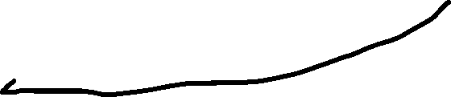
Method 1: Default SciPy Optimizer
Fit three CFFs directly with an optimizer. Everything here is from a single kinematic set. The implementation can be found in a notebook called "Method1.ipynb"
F values
k, QQ, x_b, t, F1, F2, dvcs const, phi
Optimizer
TotalUUXS function
Compton Form Factors

Slide 3
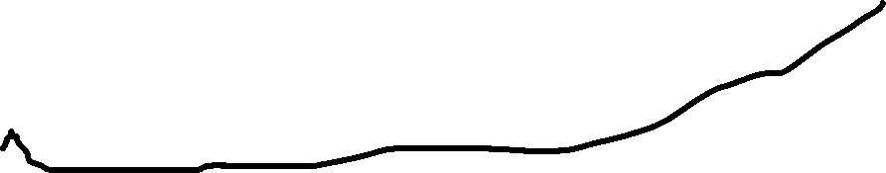
Method 2: ANN Local Fit
Similar to method one, except we use an ANN to produce the compton form factors and optimize its weights. An implementation can be found in the notebook titled "Method2.ipynb"
F values
k, QQ, x_b, t, F1, F2, dvcs const, phi
Optimizer
TotalUUXS function
Kinematics
ANN
Compton Form Factors

Slide 4
Method 3: Prof. Keller's Method
A novel local fitting method. The steps of the process can be found in the powerpoint titled "NewMethod." An implementation can be found in the notebook "Method3.ipynb"
F values (randomly generated using F as mean and errF as std for n sets)
Method 1 (or 2) repeated n times
Randomly generated CFFs using mean and std from previous step
TotalUUXS function
F values
ANN post-training
Kinematics varied slightly within step size
Initial kinematics
ANN
CFF distributions
Optimizer

Slide 5
Method 4: Two-stage Global Fit
Kinematic sets are fitted locally to find CFFs, and then those CFFs are predicted using an ANN with Kinematics as inputs. An implementation can be found in "Method4.ipynb"
F values (randomly generated using F as mean and errF as std for n sets)
Method 1 (or 2) repeated n times
n Optimizers
n sets of CFFs
n sets of CFF estimates
Respective Kinematics
n ANNs
Any Kinematics
CFF estimated distributions
n ANNs post-training

Slide 6
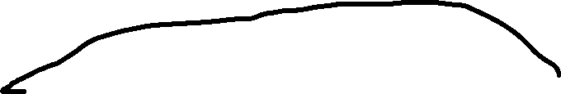
Method 5: Single-stage Global Fit
Global fit on entire pseudo-data set. An implementation can be found in "Method5.ipynb"
F values
Pseudo-data Kinematics
ANN
CFFs
Optimizer
TotalUUXS function
k, QQ, x_b, t, F1, F2, dvcs const, phi
Any Kinematics
ANNs post-training with MC Dropout
CFF estimated distributions

Slide 7
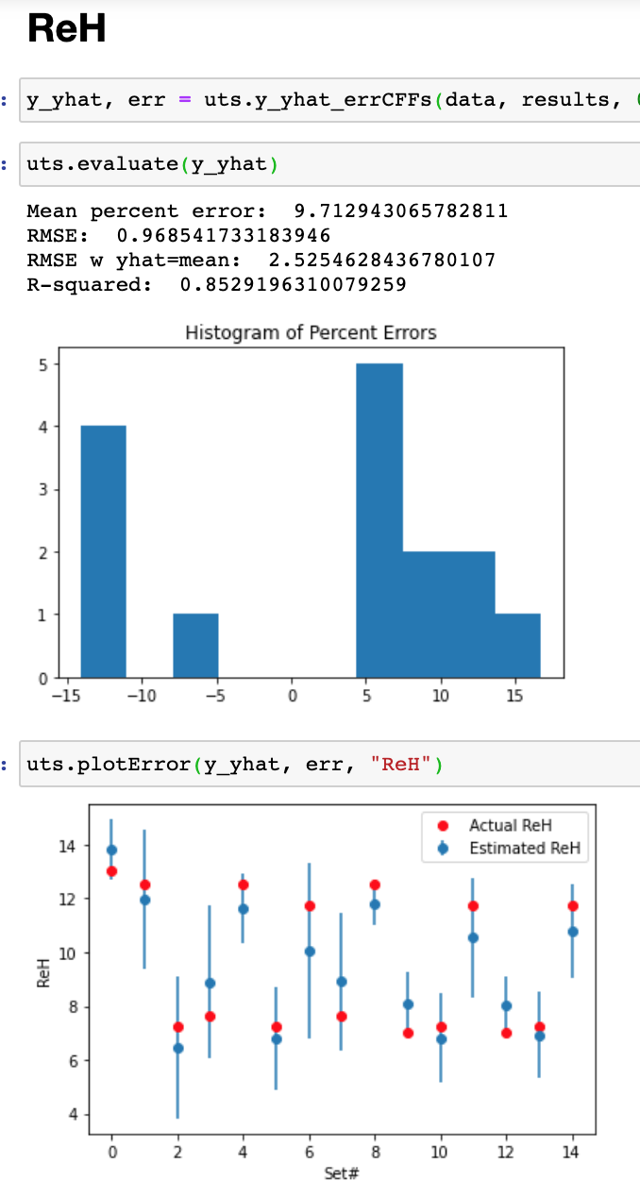
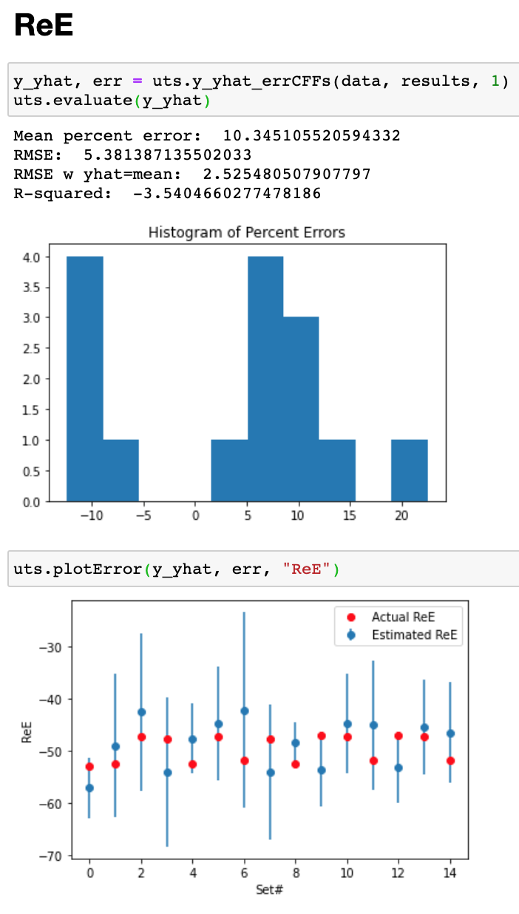
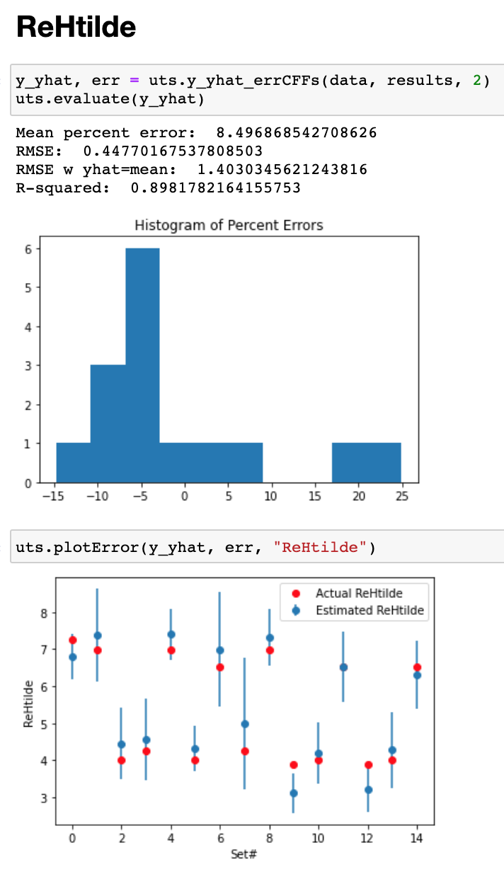

Slide 8
