Slide 1
Nick
ReH
Liliet
Matt
Ishara
Dustin
Notes:
Horizontal line is the truth CFF
Liliet is traditional chi-square fit
Other is ANN
ReE

Slide 2
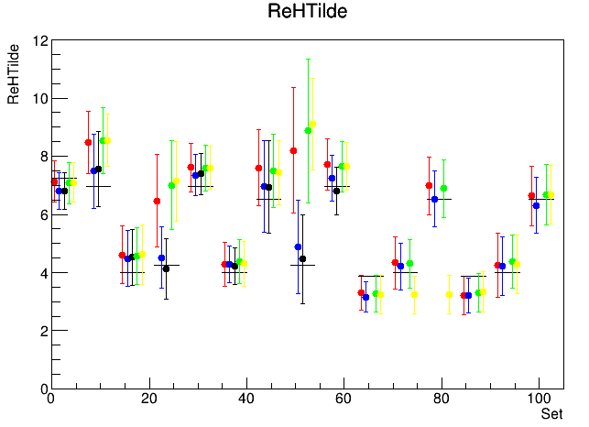
Nick
Liliet
Matt
Ishara
Dustin
Notes:
Horizontal line is the truth CFF
Liliet is traditional chi-square fit
Other is ANN

Slide 3
Global Fit

Slide 4
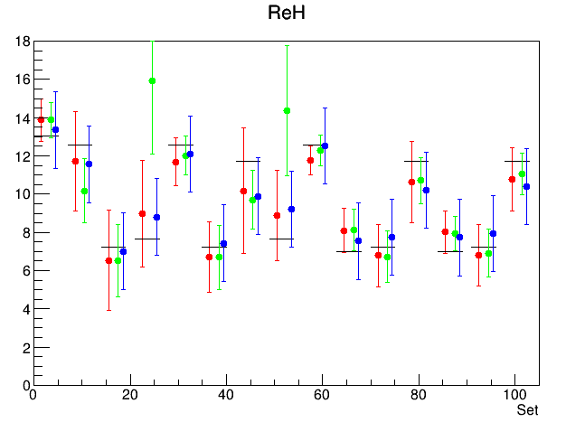
Liliet
Ishara local fit
Global fit from Ishara’s local fit
Notes:
Horizontal line is the truth CFF
Liliet is traditional chi-square fit
The error for the global Fit is not correct yet
Global Fit improve the local fit

Slide 5
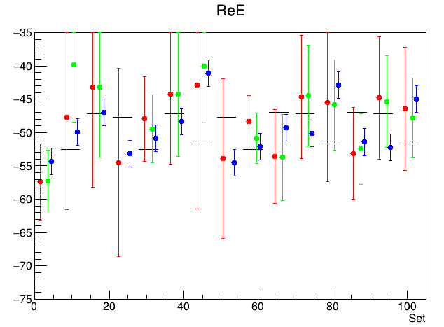
Liliet
Ishara local fit
Global fit from Ishara’s local fit
Notes:
Horizontal line is the truth CFF
Liliet is traditional chi-square fit
The error for the global Fit is not correct yet
Global Fit improve the local fit

Slide 6
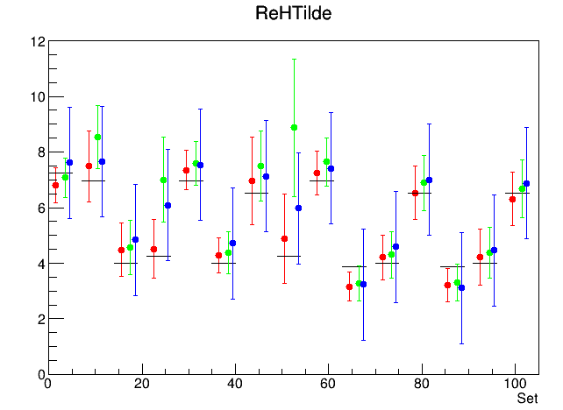
Liliet
Ishara local fit
Global fit from Ishara’s local fit
Notes:
Horizontal line is the truth CFF
Liliet is traditional chi-square fit
The error for the global Fit is not correct yet
Global Fit improve the local fit

Slide 7
Procedure

Slide 8

Local fit on each data-set
$$F=f(kinematics, CFF,φ)$$
Function TBHDVCS
Fixed = constant
Dynamics Variable
Cross section
Fit parameters:
(ReE, ReH, ReHTilde)
The main Result for the local fit is ReH, ReE and ReHTilde for each datasets

Slide 9

Global fit
$$ReE=f(kinematics, fit parameter)$$
Polynomial
Function
Dynamics variable (k,QQ,xb,t)
CFF
9 Fit parameters:
4-dimensional Fit
Fit Method: Least-square minimization
Tools: Root- Minuit

Slide 10
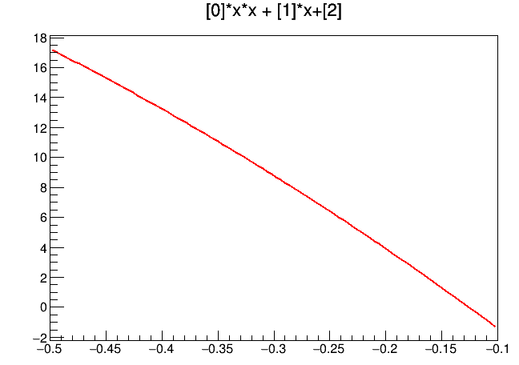

ReH
Kinematics
t = [-0.5 ; -0.1]
t

Slide 11
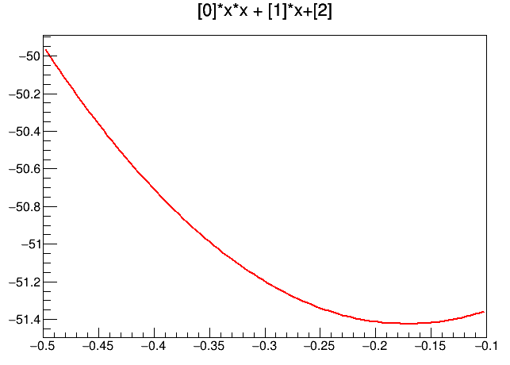
ReE
Kinematics
t = [-0.5 ; -0.1]
t

Slide 12
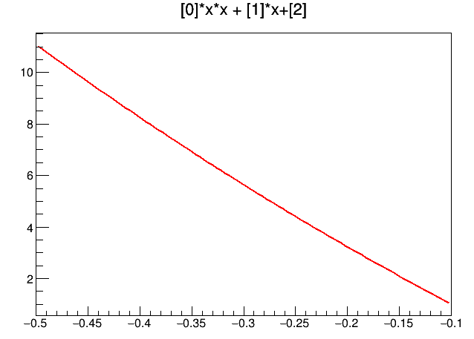
ReHTilde
Kinematics
t = [-0.5 ; -0.1]
t

Slide 13
Error

Slide 14
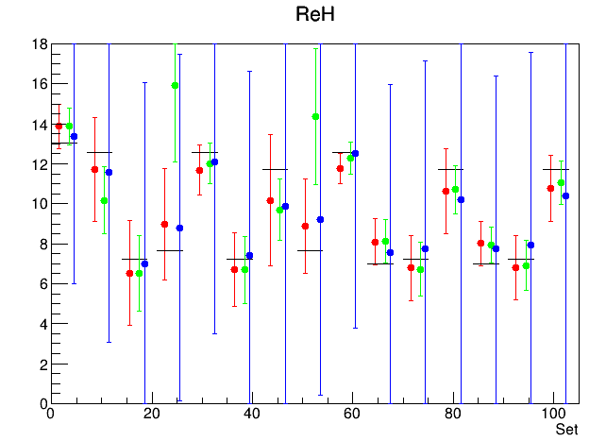
Error propagation
Assuming no correlation
The error is huge (blow up)
Either I made mistakes about the error calculation
Or this is the nature of the methods

Slide 15
4/23/2021
Fix the uncertainty propagation
CFF (with error band) as a function of various kinematic variables
Goodness of fit

Slide 16
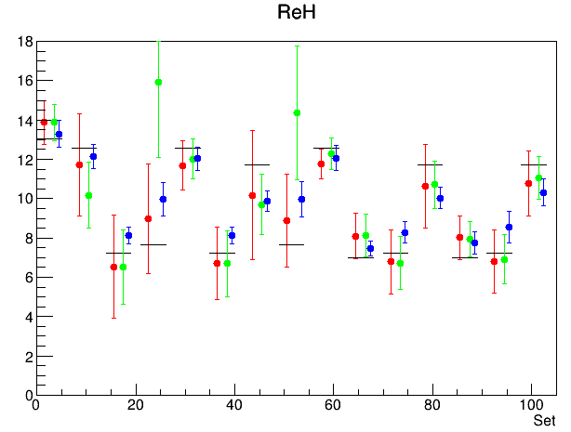
Liliet
Ishara local fit
Global fit from Ishara’s local fit
Notes:
Horizontal line is the truth CFF
Liliet’s fit is traditional chi-square fit
Ishara used NN fit
Global Fit improve the local fit

Slide 17
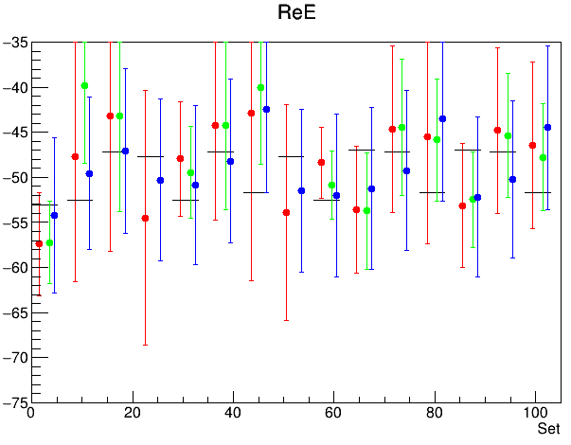
Liliet
Ishara local fit
Global fit from Ishara’s local fit
Notes:
Horizontal line is the truth CFF
Liliet’s fit is traditional chi-square fit
Ishara used NN fit
Global Fit improve the local fit

Slide 18
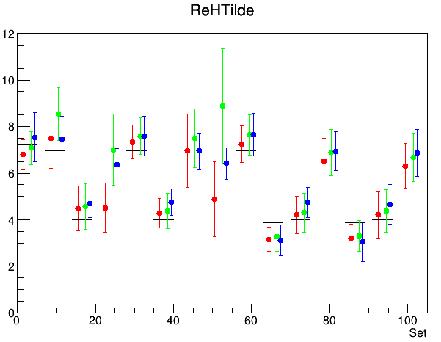
Liliet
Ishara local fit
Global fit from Ishara’s local fit
Notes:
Horizontal line is the truth CFF
Liliet’s fit is traditional chi-square fit
Ishara used NN fit
Global Fit improve the local fit

Slide 19
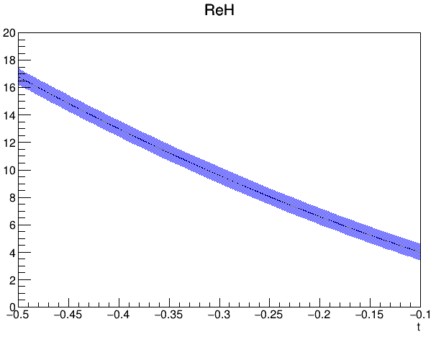
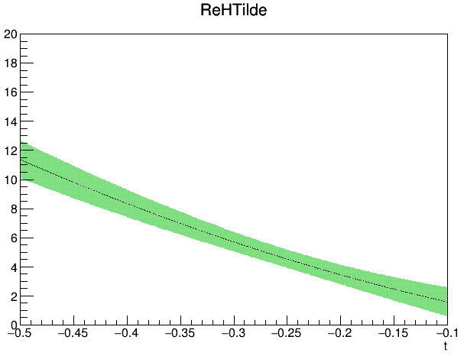
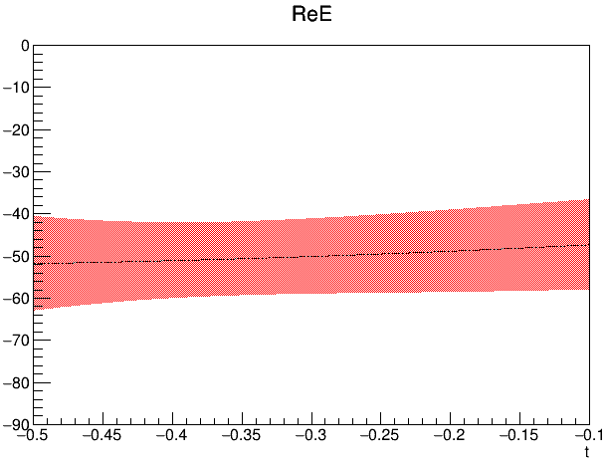
Variables | Value
k | 4.75
QQ | 2.036
xB | 0.416
t | [-0.5 ; -0.1]

Slide 20
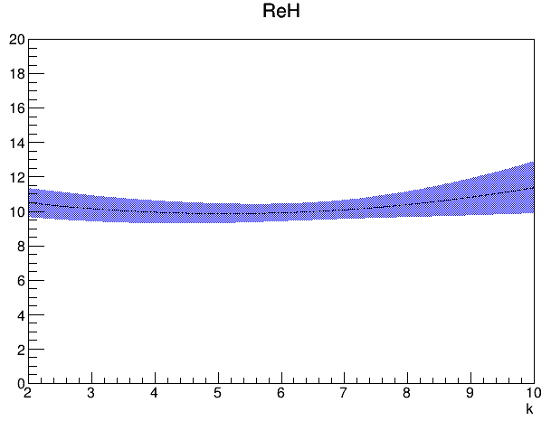
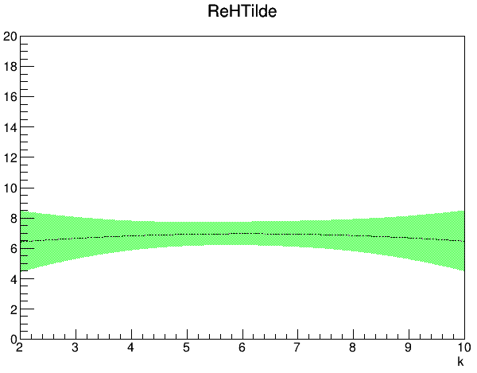
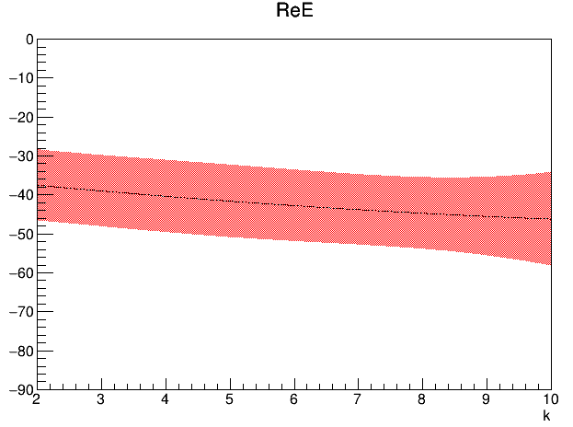
Variables | Value
k | [2 ; 10]
QQ | 2.63258
xB | 0.34501
t | -0.36119

Slide 21
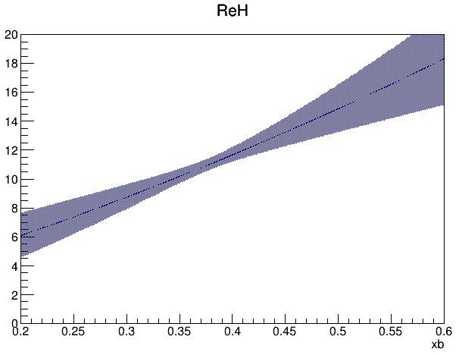
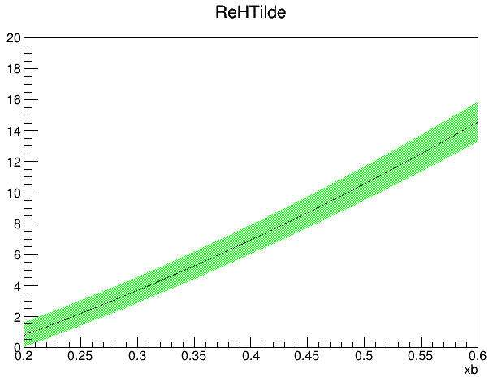
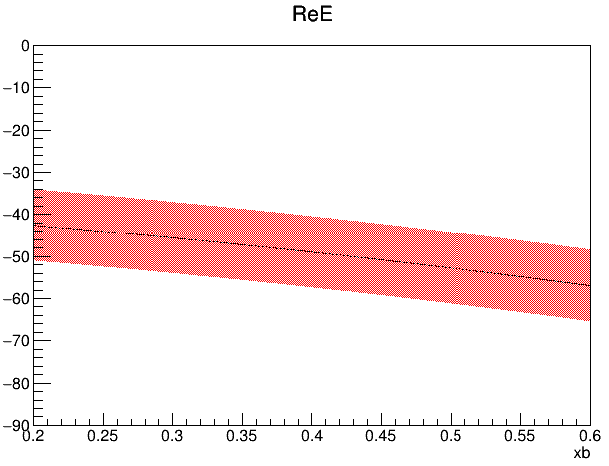
Variables | Value
k | 3.75
QQ | 2.03646
xB | [0.2 ; 0.6]
t | -0.37350

Slide 22
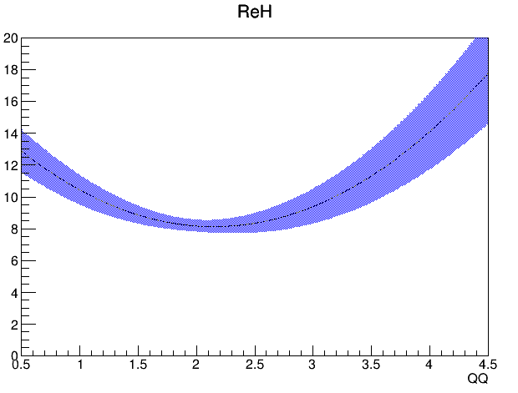
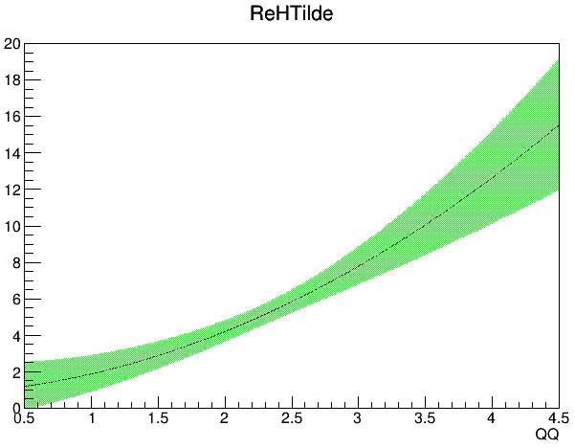
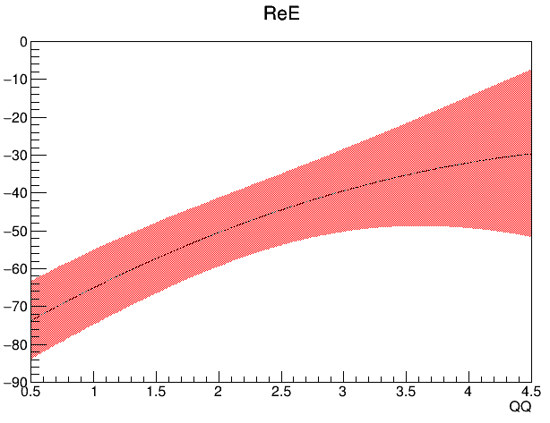
Variables | Value
k | 5.75
QQ | [0.5 ; 4.5]
xB | 0.38558
t | -0.28332

Slide 23
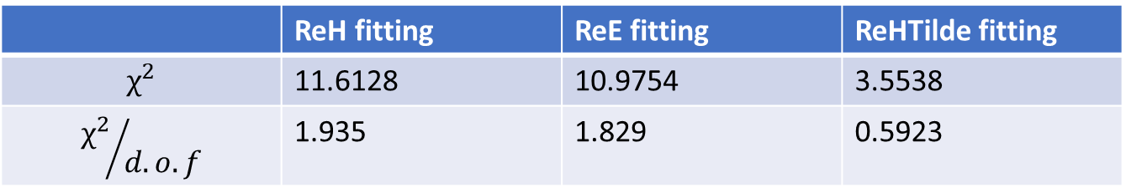
 | ReH fitting | ReE fitting | ReHTilde fitting
$$χ^{2}$$ | 11.6128 | 10.9754 | 3.5538
$${χ^{2}}/{d.o.f}$$ | 1.935 | 1.829 | 0.5923
Degree of freedom = Number of data point - Number of parameter = 15 – 9 = 6
Parameter | ReH fitting | ReE fitting | ReHTilde fitting
0 | 0.0638 | 0.056 | -0.0319
1 | -0.6549 | -1.7601 | 0.3883
2 | 1.7481 | -1.7947 | 0.6316
3 | -7.516 | 19.9939 | 0.428
4 | 13.2528 | -19.9996 | 18.3374
5 | 19.9723 | -19.9442 | 19.7264
6 | 19.9971 | 13.3536 | 19.0057
7 | -19.9838 | 19.1975 | -13.0591
8 | 0.92613 | -59.9517 | -15.9126

Slide 24
