Slide 1
VYTAL House
Recharge. Recover. Evolve.

Slide 2
Vision & Concept
VYTAL House is a cosmos-inspired recovery club owned by Chauncey Gardner and Kathy Ha.
It blends a deep navy hero band and pastel-tinted cards, from Notion’s design system, with SpaceX’s austere black-and-white canvas and bold typography to create a futuristic, welcoming lounge.

Slide 3
Equipment & Modalities
• Hyperbaric chambers: OxyPro Sovereign & EXS‑64 (2.0 ATA, panoramic windows, AI control).
• Red‑light therapy, float pods, cryotherapy and VacuActiv body pods.
• Inspired by Notion’s colorful design and SpaceX’s engineered minimalism.

Slide 4
Design & Brand
Combines Notion’s deep navy hero bands and pastel cards with SpaceX’s black canvas and uppercase D‑DIN typography.
Uses purple pill CTAs and ghost-outline buttons on full-bleed cosmic photography.
Tagline appears across all touchpoints: Recharge. Recover. Evolve.

Slide 5
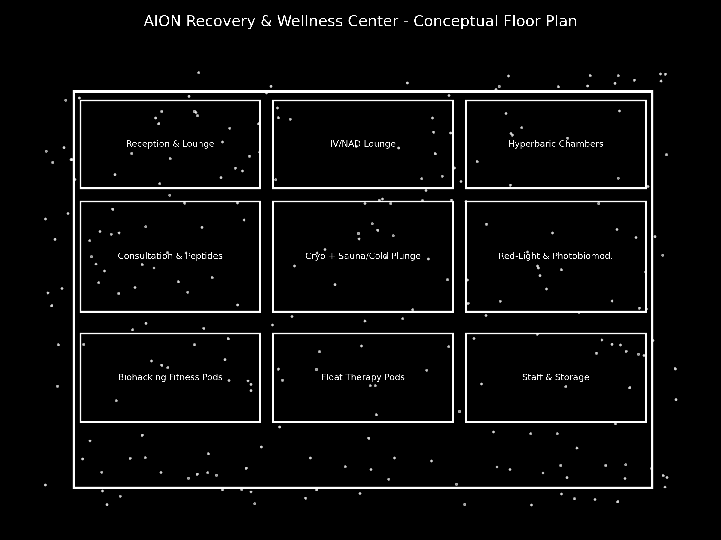
Floor Plan
Conceptual floor plan

Slide 6
Services & Membership
Membership Tiers:
• Core – $299/mo: Red-light, float pods, compression.
• Elite – $599/mo: Unlimited recovery services, monthly IV/peptides.
• Black – $1,499/mo: Concierge wellness & diagnostics.
Add-ons: Cryotherapy, infrared sauna & cold plunge, NAD⁺ infusions.

Slide 7
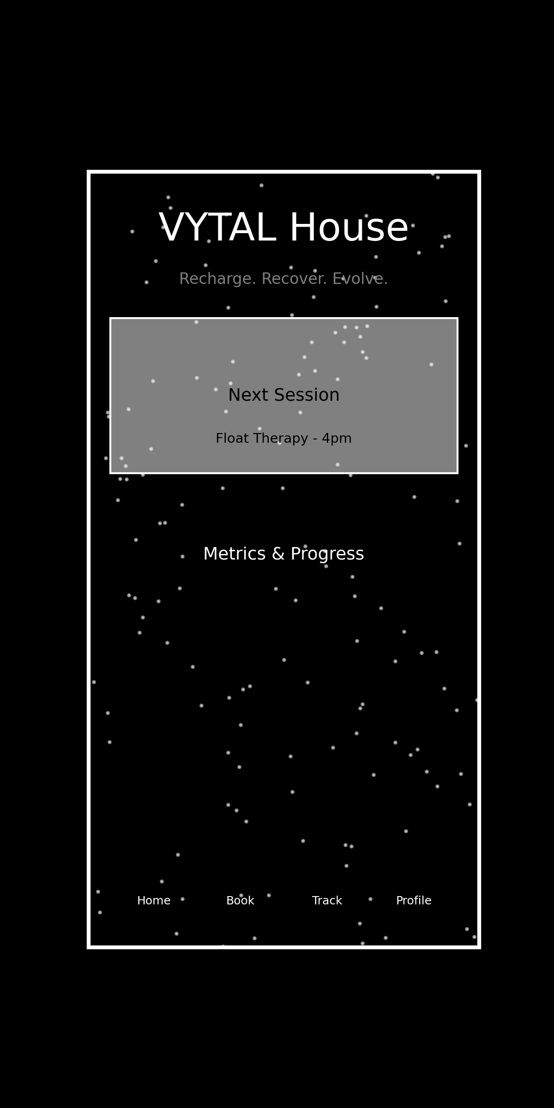
Technology & App
Next.js/React front-end with Stripe payments & headless CMS.
React Native/Flutter mobile app with booking, biometrics & community.
Node.js backend with GraphQL/REST APIs and PostgreSQL, JWT auth & deployed on Vercel/AWS.

Slide 8
Financials & Next Steps
Project revenue of ~$165k/month with ~300 members and high-margin therapies.
Startup costs estimated at $750k–$1.8M.
Next steps: finalize lease, hire medical staff, refine designs, procure equipment, launch marketing, raise capital and open VYTAL House.

