Slide 1
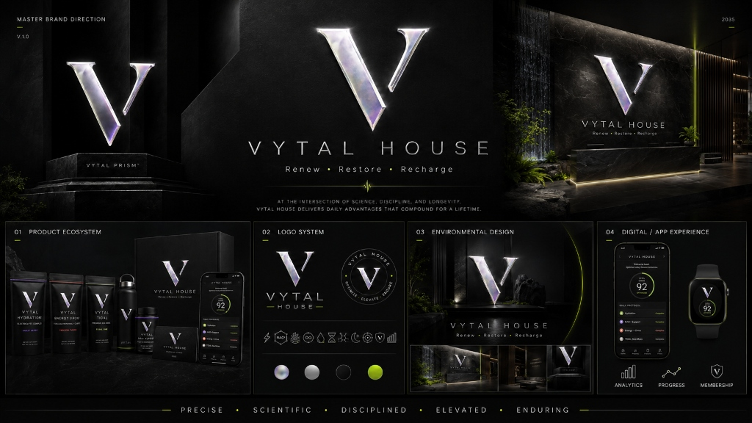
VYTAL HOUSE
RENEW • RESTORE • RECHARGE
Physician-Led Restoration House & Sublingual Performance Ecosystem
AT THE INTERSECTION OF SCIENCE, DISCIPLINE, AND LONGEVITY
Master Brand Direction V1.0 | 2035 Prism Silver Edition

Slide 2
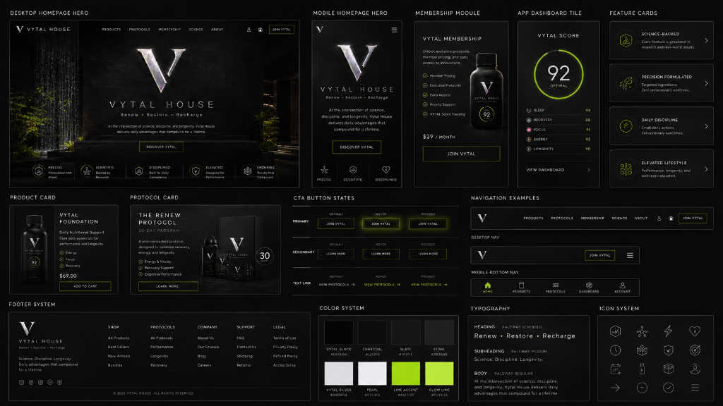
01. EXECUTIVE SUMMARY & MARKET OPPORTUNITY
THE QUANTITATIVE LONGEVITY & SOCIAL WELLNESS MOAT
• TAM/SAM/SOM: $100B+ Longevity & Performance Market Expansion
• The Void: Sober executive social clubs replacing traditional night venues
• Moat: Quantitative Trajectory Loop (Baseline → Protocol → Re-Test → VYTAL Index 0-100)
• Clinical Oversight: 100% Owned Medical PC led by Dr. Abasi Bomani, MD

Slide 3
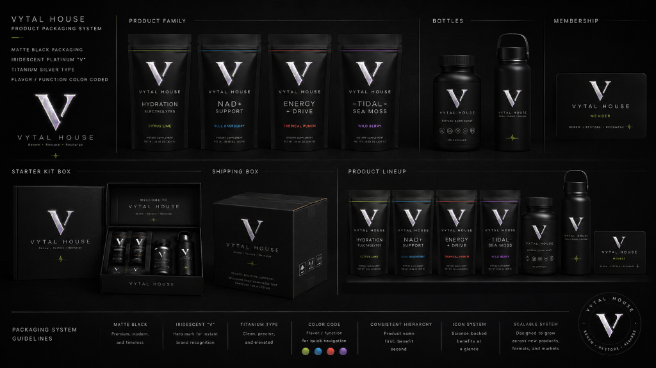
02. VYTAL POUCHES PRODUCT ECOSYSTEM
ZERO TOBACCO • ZERO NICOTINE • SUBLINGUAL PRECISION
• VYTAL Energy (Sour Soursop Lime | Citrus Lime #C6FC06 Ring)
• VYTAL Tidal (Caribbean Sea Moss | Blue Raspberry #00F0FF Ring)
• VYTAL NAD+ Support (Sublingual NAD+ | Wild Berry #CDB8FF Ring)
• Packaging: Soft-Touch Matte Black Aluminum Cans & Starter Kit Boxes

Slide 4
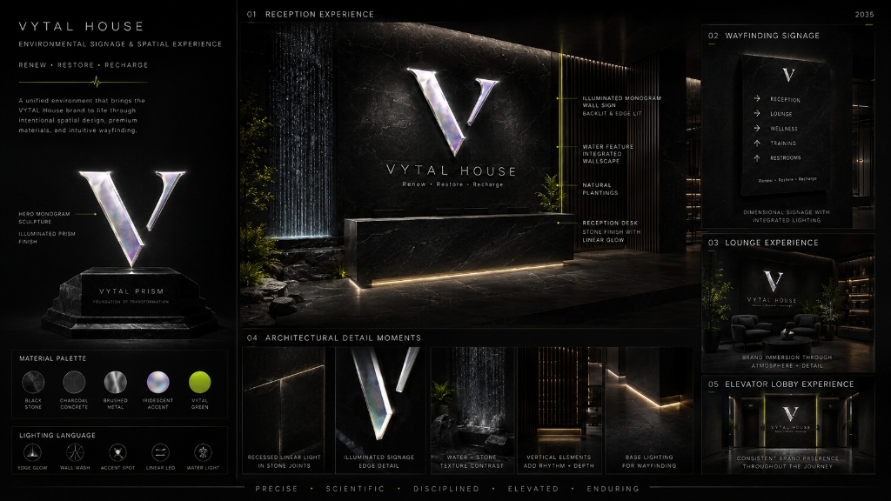
03. THREE-TIER REVENUE ENGINE & FINANCIAL MODEL
RECURRING MEMBERSHIPS + CLINICAL PC FEES + MSO RETAIL
• Digital Portal ($29/mo) | House Access ($295/mo) | Black VIP ($695/mo)
• Unit Economics: 68% Gross Margin | $4.2M Year 1 Flagship Yield
• Capital Requirement: $2.5M Seed Seed Raise | Payback: 14 Months
• Scalability: 5,000 SF Modular Site Replication Model (MD, VA, NY)

Slide 5
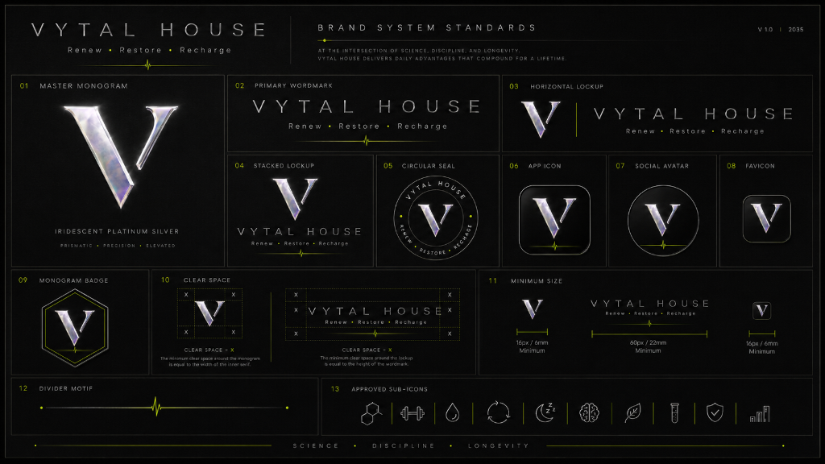
04. BRAND GOVERNANCE & LOGO STANDARDS
11 OFFICIAL LOGO CONFIGURATIONS & MATERIAL PALETTE
• Master Monogram: 3D Iridescent Platinum Silver V Mark
• Primary Color System: Obsidian (#0B0C0E), Graphite (#12161F), Titanium (#B7BDC6)
• Signal Discipline: Acid Lime (#C6FC06) strictly for CTAs & Data Signals
• Production Standard: Zero WIP Labels | 100% Master Brand OS Compliant

