Slide 1
Assignment 1

Slide 2
Assignment 1: mycoroutine API
int mycoroutine_init(co_t *main);
int mycoroutine_create(co_t *co, void(body)(void *), void *arg);
int mycoroutine_switchto(co_t *co);
int mycoroutine_destroy(co_t *co);

Slide 3
Assignment 1: Initializing and destroying coroutines
int mycoroutine_init(co_t *main) {
initialize coroutine list
add main to coroutine list
set current coroutine to main
set main coroutine to main
}
int mycoroutine_destroy(co_t *co) {
if co is not in the coroutine list
return error
if co is the main coroutine
destroy the coroutine list
else
remove the co from the list
free related memory
}

Slide 4
Assignment 1: Initializing the main coroutine and global variables
static list_t *coroutine_list;
static co_t *current_context, *main_context;
int mycoroutine_init(co_t *main) {
initialize coroutine list
add main to coroutine list
current_context = main
main_context = main
}

Slide 5
Assignment 1: Creating and destroying coroutines
int mycoroutine_create(co_t *co, void (body)(void *), void *arg) {
if co is already on the coroutine list
return error
add co to the coroutine list
getcontext(co)
allocate memory for the stack
makecontext(co, body, arg)
}
int mycoroutine_destroy(co_t *co) {
if co is not in the coroutine list
return error
if co is the main coroutine
destroy the coroutine list
else
remove the co from the list
free related memory
}

Slide 6
Assignment 1: Switching coroutines
int mycoroutine_switchto(co_t *co) {
if co is not in the coroutine list
return error
previous_context = current_context
current_context = co
swapcontext(previous_context, current_context)
}

Slide 7
Assignment 1: Testing coroutines
In order to test our coroutines implementation we modified our implementation of assignment 1.1 . We removed busy waiting and added manual context switching between the writing and reading thread each time the pipe is full or empty respectively.
After the 2 threads are done copying the context is switched back to the main context which destroys the coroutines and exits.

Slide 8
Assignment 1: pipe_write function
int pipe_write(unsigned int p, char c, co_t *read_thread) {
if pipe does not exist or is not open for writing
return error
if pipe's buffer is full
mycoroutine_switchto(read_thread)
add character to buffer
update write pointer
return 1
}

Slide 9
Assignment 1: pipe_read function
int pipe_read(unsigned int p, char *c, co_t *write_thread) {
if pipe does not exist
return error
if the pipe is open for writing and empty
mycoroutine_switchto(write_thread)
if the pipe is closed for writing and empty
pipe_remove(p)
return 0
set c to the next value of the buffer
update the read pointer
return 1
}

Slide 10
Assignment 2

Slide 11
Assignment 2: mythreads API
int mythreads_init();
int mythreads_create(mythr_t *thr, void(body)(void *), void *arg);
int mythreads_yield();
int mythreads_sleep(int secs);
int mythreads_join(mythr_t *thr);
int mythreads_destroy(mythr_t *thr);
int mythreads_sem_create(mysem_t *s, int val);
int mythreads_sem_down(mysem_t *s);
int mythreads_sem_up(mysem_t *s);
int mythreads_sem_destroy(mysem_t *s);
void mythreads_exit();

Slide 12
Assignment 2: mythreads API
typedef struct thread_runnable {
void (*body) (void *);
void *arg;
} thread_runnable_t;
enum thread_state {
READY,
SLEEPING,
BLOCKED,
TERMINATED
};
typedef struct mythread {
thread_runnable_t runnable;
co_t co;
enum thread_state state;
unsigned long long sleep_until;
struct mythread *joining_on;
} mythr_t;

Slide 13
Assignment 2: mythreads internal functions
Scheduler related functions:
void run_scheduler(enum thread_state state);
void reload_states(enum thread_state state);
mythr_t *search_threads(bool running_thread_sleeping, mythr_t **earliest_thread);
void switch_thread(enum thread_state running_next_state, mythr_t *next_thread_node);
Utility functions:
void run_thread(void *arg);
void alarm_op(enum alarm_op operation, struct itimerval *previous);
void sleep_until(unsigned long long timestamp);
void thread_timeout_handler(int signum);

Slide 14
Assignment 2: Avoiding race conditions
When certain functions of the library are called by different threads race conditions may occur (i.e. the scheduler function). In this case race conditions exist only because of the automatic switching that is controlled by an alarm. To prevent this, all functions that can cause a race condition run without consuming time from the alarm. This resembles the OS behavior when running atomic operations. After the operation has been completed the alarm is reactivated with the user’s remaining time.
When switching context between different threads an interruption by the alarm could cause unexpected behavior and that’s why before swapping the context the alarm is disabled. The new context has the responsibility to reenable the alarm and this is achieved by the functions described later.

Slide 15
Assignment 2: Sleeping mechanism
Our sleep mechanism relies on timestamps that denote when a thread is in the SLEEPING state. Threads marked as SLEEPING are excluded from CPU scheduling until their state changes. The scheduler is responsible for updating the states of these threads.
If all active threads are in the SLEEPING state, the scheduler invokes a system sleep call. This sleep call lasts for the minimum amount needed for the next thread to wake up.

Slide 16
Assignment 2: The scheduler
The scheduler’s job is to determine if switching to another thread is needed based on the state of the previously running thread and finding which thread needs to run after. The logic of the scheduler is broken into 2 parts:
Only one thread currently exists
More than one threads currently exist

Slide 17
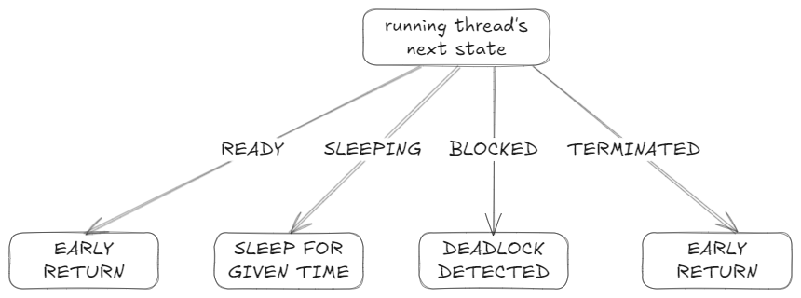
Assignment 2: The scheduler
On the first case when only one thread exists the logic of the scheduler is shown below

Slide 18
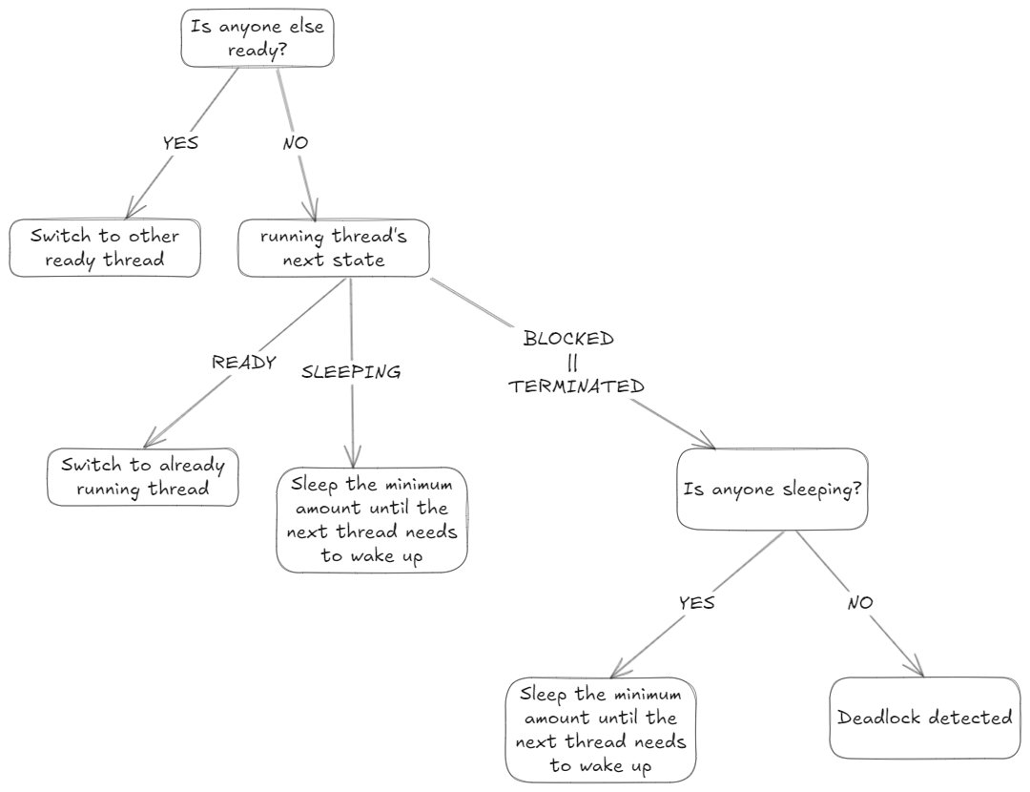
Assignment 2: The scheduler
When multiple threads exist the logic of the scheduler is the following

Slide 19
Assignment 2: The scheduler
This is the first case when only one thread exists
void run_scheduler(enum thread_state state) {
disable alarm
if only one thread exists
switch (state)
case TERMINATED:
case READY:
return
case BLOCKED:
exit because deadlock has been detected
case SLEEPING:
sleep until the given timestamp
return

Slide 20
Assignment 2: The scheduler
This is the general case when multiple threads exist
reload states
find any ready thread
find the thread that needs to wake up the earliest
if there is a ready thread
switch to ready thread
return
switch (state)
case READY:
reset alarm
return
case SLEEPING:
sleep until the next thread needs to wake up
switch to next thread
return
case TERMINATED:
case BLOCKED:
if no thread is sleeping
exit because deadlock has been detected
sleep until the next thread needs to wake up
switch to next thread
}

Slide 21
Assignment 2: Storing threads
In the initial iteration of the library design, all threads were stored in an array. This array stored each thread as an entry, which the scheduler iterated through to identify the next thread to assign to the CPU.
This caused a problem when removing threads where we needed to move the last element to the index of the removed thread. But each time a thread is removed we essentially change the order (and priority) of all the threads. This could lead to many unexpected behaviours and can even be exploited by users in order to give certain threads better priority than other. To solve this we switched from using arrays to linked lists.

Slide 22
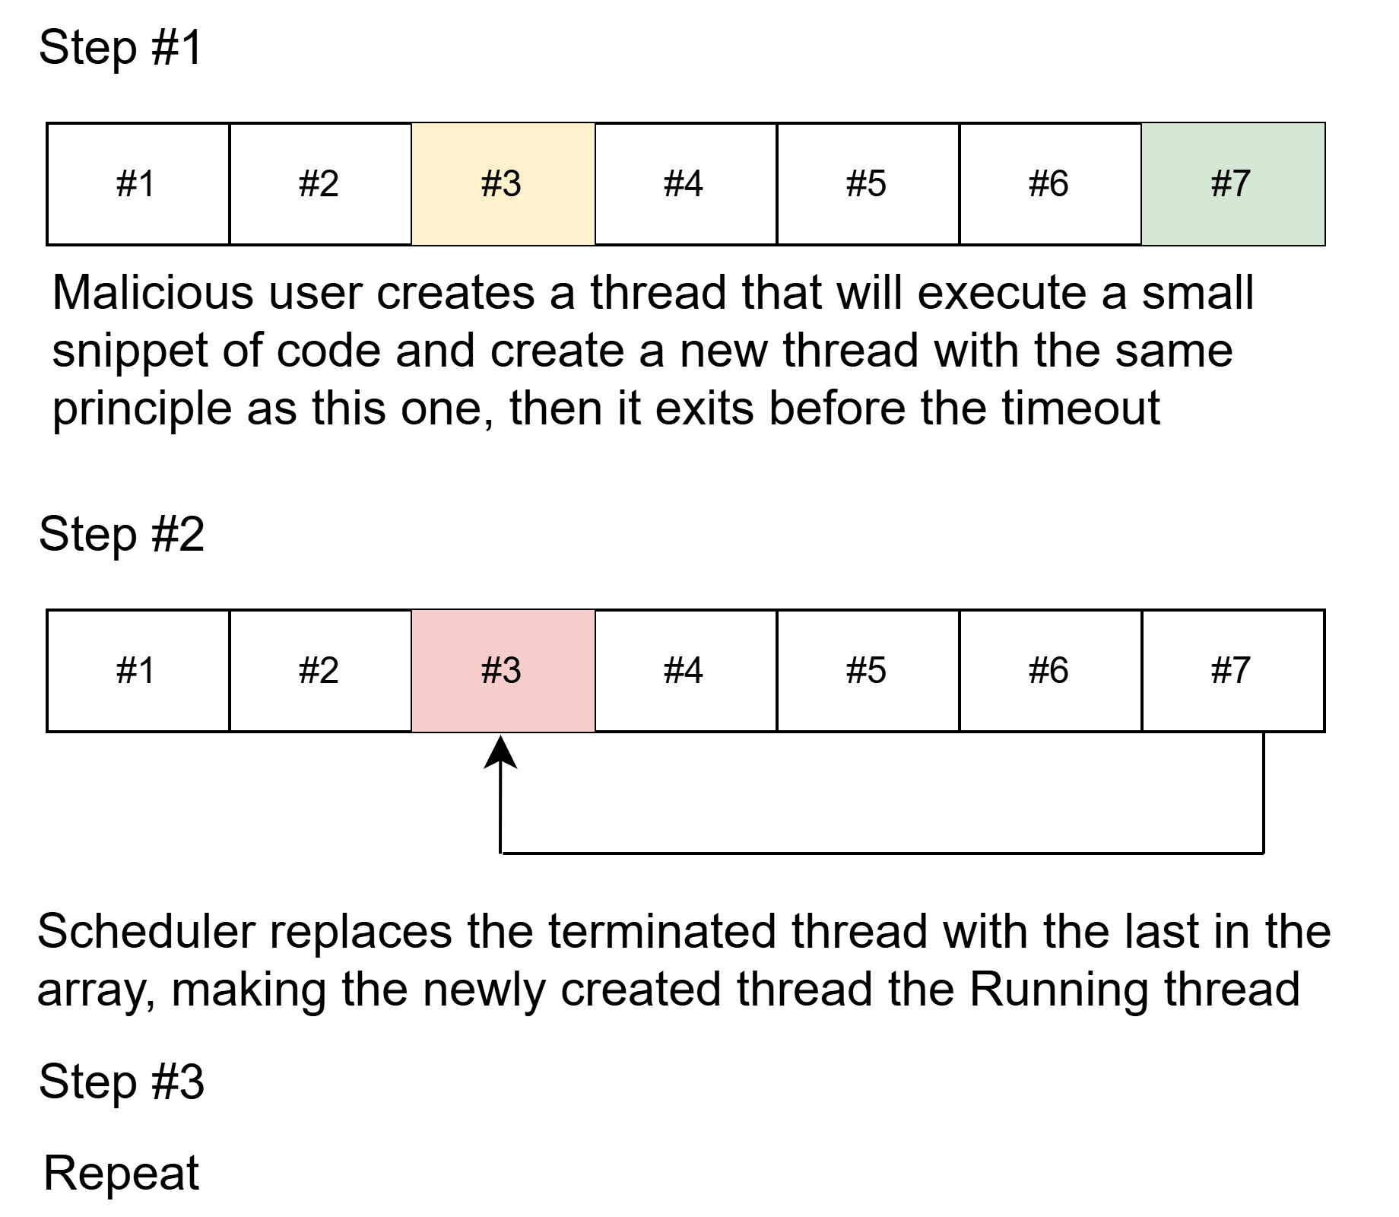
Assignment 2: Storing threads

Slide 23
Assignment 2: Thread slice
After we got everything working we wanted to find out what the best time slice is. We used the assignment 1 of project 1 and we ran some tests with a range of slices in order to determine the best option. The runtime of this project with an input of some kilobytes turns out to be a linear function of the time slice. This is visible in the following graph:

Slide 24

Assignment 2: Thread slice

Slide 25
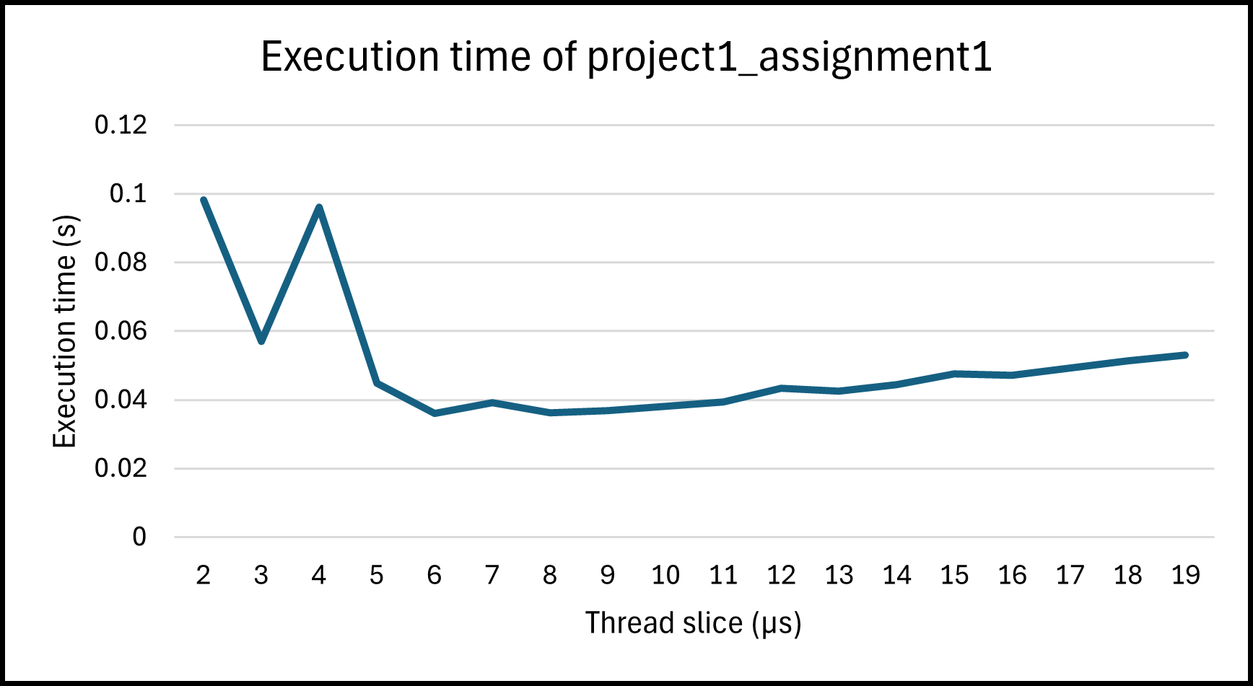
Assignment 2: Thread slice
An interesting part of this graph is at the start of the axis where the slice becomes really small. While we would expect a lower time slice to give us better execution time instead the execution rises really quickly. This is because in such small time slices even the quickest atomic system calls may not have enough time to run so many threads cannot make progress in every slice they are given.
When the slice is 1μs the execution time becomes ~70 seconds which is equivalent to the performance we would get if we set the time slice to 40.000μs (40ms)!

Slide 26
Assignment 2: Scheduler related functions
void reload_states(enum thread_state_t running_next_state) {
node_t *running_node = list_find(thrs, running_thr, NULL);
for all threads starting from the currently running thread
sleep_expired = thread is sleeping
and sleep timestamp has expired
joining_thread_terminated = thread is blocked
and the thread that it is joining on has terminated
if sleep_expired or joining_thread_terminated
set thread state to READY
}
This function is used to refresh the states of all the threads so that they accurately describe the thread. It updates threads that were sleeping but their sleep time has expired and threads that were joining on another thread and that thread has been terminated.

Slide 27
Assignment 2: Scheduler related functions
mythr_t *search_threads(bool running_thread_sleeping, mythr_t **earliest_thread) {
mythr_t *next_ready = NULL
mythr_t *earliest = running_thread_sleeping ? running_thr : NULL
for all threads starting from the currently running thread
if thread is READY
next_ready = thread
break
else if thread is SLEEPING and is the earliest thread to wake up
earliest = thread
*earliest_thread = earliest
return next_ready
}
This function finds the first ready thread after the currently running thread (if there is any)
and finds the thread that is sleeping and needs to wake up the earliest of any other thread.
It is called by the scheduler to find out which thread should be the next to run.

Slide 28
Assignment 2: Scheduler related functions
void switch_thread(enum thread_state_t running_next_state, mythr_t *next_thread) {
set currently running thread state to running_next_state
set currently running thread to next thread
set next_thread state to READY
mycoroutine_switchto(&next_thread->co)
alarm_op(RESET, NULL)
}
This function performs the context switching between the threads. At first it might seem like
the line after the coroutine switch will never run but as explained previously this is done so
that there is no race condition when switching threads. This line along with the run_thread function ensures that any thread that is resumed resets the alarm for itself.

Slide 29
Assignment 2: Utility functions
void run_thread(void *arg) {
void (*body) (void *) = get body of thread from arg
void *body_arg = get arg of thread from arg
reset alarm
body(body_arg)
run_scheduler(TERMINATED)
}
This function is a wrapper of the function that is run by a thread. This is used in order to
reset the alarm every time a new thread starts and to return to the scheduler once it needs
to terminate.

Slide 30
Assignment 2: Utility functions
void alarm_op(enum alarm_op_t operation, struct itimerval *previous) {
switch (operation) {
case DISABLE:
set signal handler to ignore SIGALRM
disable timer and store the previous
break;
case ENABLE_PREVIOUS:
if previous has run out
run_scheduler(READY);
else
set signal handler to normal handling
enable timer and restore previous alarm
break;
case RESET:
set signal handler to normal handling
enable timer and reset alarm
break;
}
}
This function performs an operation on the timer and the signal handling.

Slide 31
Assignment 2: Utility functions
void sleep_until(unsigned long long timestamp) {
calculate sleep amount based on timestamp
while sleep amount is not 0 {
usleep(sleep amount);
recalculate sleep amount
}
}
void thread_timeout_handler(int signum) {
run_scheduler(state of current thread);
}

Slide 32
Assignment 2: API functions
int mythreads_init() {
initialize threads list
initialize semaphore list
add main thread to the list
initialize alarm and signal handler
disarm the alarm
initialize main thread fields
return 1
}
void mythreads_exit() {
destroy main coroutine
destroy threads list
destroy semaphore list
}

Slide 33
Assignment 2: API functions
int mythreads_yield() {
run_scheduler(READY)
return 1
}
int mythreads_sleep(int secs) {
disable alarm
set sleep until timestamp on current thread
run_scheduler(SLEEPING)
return 1
}

Slide 34
Assignment 2: API functions
int mythreads_join(mythr_t *thr) {
disable alarm and store previous alarm
if thr does not exist or has terminated
enable previous alarm
return 1
set joining thread of currently running thread to thr
run_scheduler(BLOCKED)
return 1
}

Slide 35
Assignment 2: API functions
int mythreads_create(mythr_t *thr, void (body)(void *), void *arg) {
disable alarm and store previous alarm
if thr exists
enable previous alarm
return error
add thr to thread list
initialize thread fields
if thread list size is 2
reset alarm
else
enable previous alarm
return 1
}

Slide 36
Assignment 2: API functions
int mythreads_destroy(mythr_t *thr) {
disable alarm and store previous alarm
if thr does not exist or has terminated
enable previous alarm
return 1
destroy thread coroutine
remove thread from thread list
if thread list size is 1
enable previous alarm
else
reset alarm
return 1
}

Slide 37
Assignment 2: API functions
int mythreads_sem_create(mysem_t *s, int val) {
disable alarm and store previous alarm
if semaphore already exists
restore previous alarm
return error
add semaphore to semaphores list
set semaphore value to val
initialize semaphore waiting queue
restore previous alarm
return 1
}

Slide 38
Assignment 2: API functions
int mythreads_sem_destroy(mysem_t *s) {
disable alarm and store previous alarm
if semaphore does not exists
restore previous alarm
return error
destroy waiting list of semaphore
remove semaphore from semaphores list
restore previous alarm
return 1
}

Slide 39
Assignment 2: API functions
int mythreads_sem_up(mysem_t *s) {
disable alarm and store previous alarm
if semaphore does not exists
restore previous alarm
return error
if semaphore value is 1
restore previous alarm
return 0
increment semaphore value
if semaphore value is less than or equal to 0
remove next thread from waiting queue of semaphore
set the state of the next thread to ready
restore previous alarm
return 1
}

Slide 40
Assignment 2: Additional challenges
During the testing phase of the library, we discovered that the scanf function posed issues when reading from the standard input: The function is frequently interrupted by the alarm mechanism, causing it to return immediately with an interrupted error.
In order to fix this issue we wanted to implemented our own scanf function which would solve this problem. We would also need to make some changes to the scheduler:
The scheduler checks if standard input has been updated. Upon detecting an update, the scheduler switches to any thread that was waiting for input. The thread will consume the new data in the standard input only if the format string matches the input. If the format string does not match, the data remains unaltered. This allows for multiple threads that are waiting for new input to process the standard input.

Slide 41
Assignment 3

Slide 42
Assignment 3: Variables
mythreads_sem_t mtx;
mythreads_sem_t readers_queue;
mythreads_sem_t writers_queue;
int readers_waiting = 0;
int writers_wating = 0;
int readers = 0;
int writers = 0;
mythreads_sem_create(mtx, 1);
mythreads_sem_create(writers_queue, 0);
mythreads_sem_create(readers_queue, 0);

Slide 43
Assignment 3: Reader function
void reader(void *arg) {
mythread_sem_down(mtx);
if (writers are wating OR a writer in CS) {
increase readers_waiting by 1;
mythreads_sem_up(mtx);
mythreads_sem_down(readers_queue);
if (readers are waiting) {
decrease readers_waiting by 1;
increase readers by 1;
mythreads_sem_up(readers_queue);
}
else { mythreads_sem_up(mtx); }
}
else {
increase readers by 1;
mythreads_sem_up(mtx);
}
/* read */

Slide 44
Assignment 3: Reader function
mythreads_sem_down(mtx);
decrease readers by 1;
if (NO readers in CS AND writers blocked) {
decrease writers_wating by 1;
increase writers by 1;
mythreads_sem_up(writers_queue);
}
mythreads_sem_up(mtx);
}

Slide 45
Assignment 3: Writer function
void writer(void *arg) {
mythreads_sem_down(mtx);
if (readers OR writers in CS) {
increase writers_waiting by 1;
mythreads_sem_up(mtx);
mythreads_sem_down(writers_queue);
} else {
increase writers by 1;
mythreads_sem_up(mtx);
}
/* write */

Slide 46
Assignment 3: Writer function
mythreads_sem_down(mtx);
decrease writers by 1;
if (readers_waiting > 0) {
decrease readers_waiting by 1;
decrease readers by 1;
mythreads_sem_up(readers_queue);
} else {
if (there are blocked writers) {
decrease writers_waiting by 1;
increase writers by 1;
mythreads_sem_up(writers_queue);
}
mythreads_sem_up(mtx);
}
}

