Slide 1
Assignment 1

Slide 2
Assignment 1: Monitor structure
monitor semaphore {
int val;
cond q;
int down();
int up();
}
int down() {
decrement val by 1
if (val < 0)
wait q
return 1
}
int up() {
// Lost up call
if (val == 1)
return 0
increment val by 1
if (val <= 0)
signal q
return 1
}
Αν αφού μειωθεί το val και εξακολουθεί να είναι αρνητικό πρέπει να περιμένουμε καθώς είτε η τιμή του σηματοφόρου ήταν 0 ή υπήρχαν άλλα νήματα που ήδη περίμεναν.
Αν αφού αυξήσουμε την τιμή του σηματοφόρου εξακολουθεί να είναι μικρότερη ή ίση με το 0, σημαίνει ότι υπάρχουν νήματα που περιμένουν και πρέπει να ξυπνίσει το επόμενο.

Slide 3
Assignment 1: Διαφορετικά μοντέλα monitors
Η λύση αυτή λειτουργεί για open και για eggshell monitors. Στην χειρότερη περίπτωση του open monitor δεν υπάρχουν προβλήματα με προσπεράσεις καθώς τα logistics λειτουργούν με βάση την val και επιπλέον η wait είναι τελευταία εντολή στην συνάρτηση down.
Η λύση λειτουργεί για signal-block και signal-continue αφού όλες η μοναδική κλήση signal στην συνάρτηση up γίνεται στο τέλος.

Slide 4
Assignment 2

Slide 5
Assignment 2: Monitor structure
monitor {
int blocked_workers = 0;
int working_workers = N;
bool main_sleeping = false;
bool main_waiting_worker = false;
cond main_sleep;
cond worker_q;
command, value get_job();
void set_job();
}

Slide 6
Assignment 2: Master και worker threads
Main thread
Worker thread
command = PROCESS_VALUE
WHILE (EOF is not reached) {
Read next value input
set_job();
}
command = TERMINATE
FOR every worker I
set_job();
WHILE (1) {
command, value = get_value();
IF command == TERMINATE
Break;
is_prime(value);
}

Slide 7
Assignment 2: Set job function
set_job():
IF (blocked_workers > 0) {
blocked_workers--;
signal(worker_q);
}
ELSE {
main_sleeping = True;
wait(main_q);
}
IF (blocked_workers + working_workers != N)
main_waiting_worker = True;
Wait(main_q);
}

Slide 8
Assignment 2: Get job function
command, value get_job():
working_workers--;
IF (main_sleeping) {
main_sleeping = False;
signal(main_q);
}
ELSE {
blocked_workers++;
wait(worker_q);
}
copy value, command to local variables
working_workers++;
IF (main_waiting_worker) {
main_waiting_worker = False;
signal(main_sleep);
}
return local copy of value, command

Slide 9
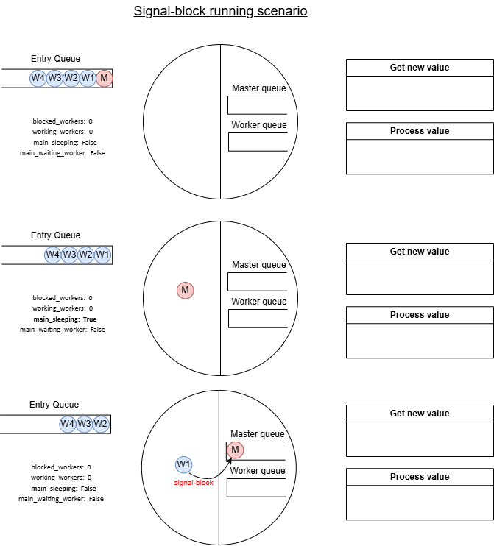
Assignment 2: Get job function

Slide 10
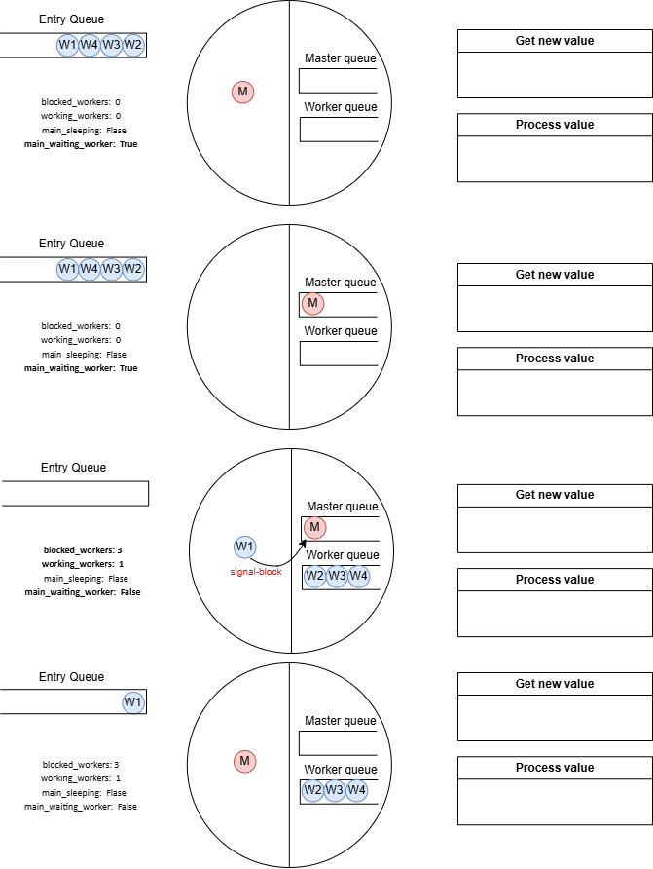
Assignment 2: Get job function

Slide 11
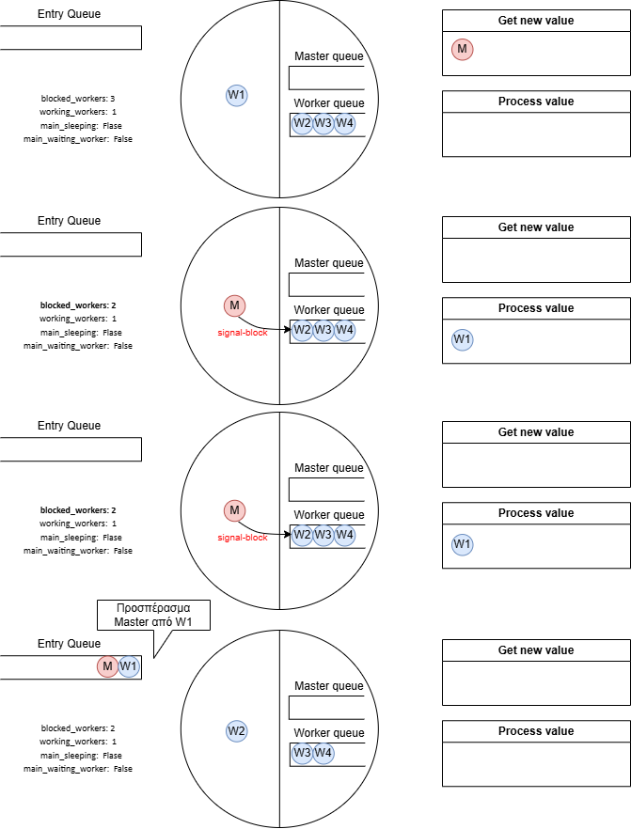
Assignment 2: Get job function

Slide 12
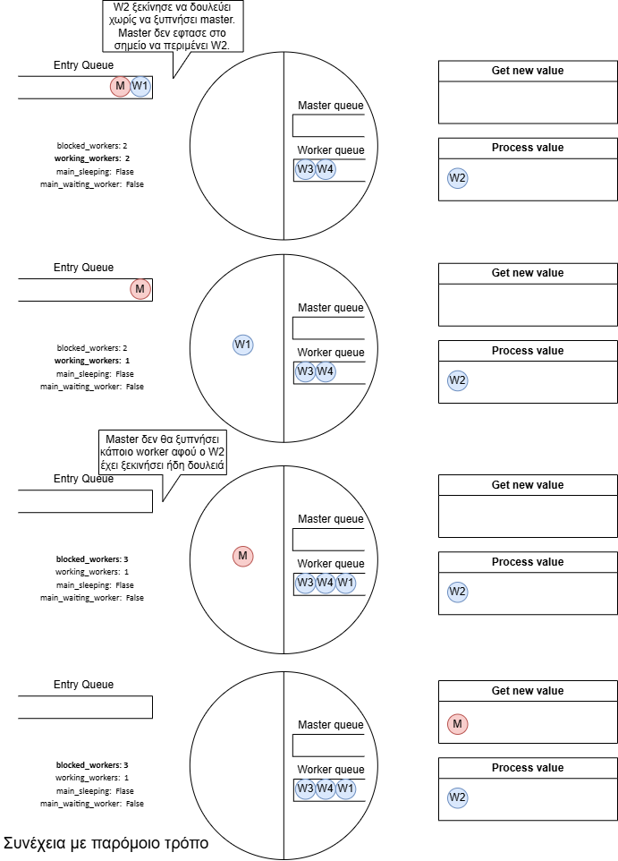
Assignment 2: Get job function

Slide 13
Εναλλακτική προσέγγιση: Χρήση ουράς για τα jobs
Monitor structure
monitor {
int waiting;
Queue<Job> job_queue;
cond workers_queue;
void add(Job job);
Job get();
}
void add(Job job) {
add job to job_queue
if there are workers waiting
signal(workers_queue)
}
Job get() {
if job_queue is empty or there are other workers waiting {
increment waiting by 1
wait(workers_queue)
decrement waiting by 1
}
return first item from job_queue
}

Slide 14
Εναλλακτική προσέγγιση: Χρήση ουράς για τα jobs
Using a queue for the jobs allows the master to not wait for any acknowledgement from the workers.
The worker just puts the next job in a queue and wakes up the next worker if there is one waiting.
This solution works for both signal-block and signal-continue models of monitors because all signal calls happen in the end of each function.
It works for both open and eggshell models of monitors because the waiting variable prevents unwanted execution order.

Slide 15
Assignment 3

Slide 16
Assignment 3: Monitor structure
monitor {
cond red_queue, blue_queue;
int bridge_color;
int on_bridge;
int cars_waiting[2];
int total_cars[2];
void enter_bridge(int color);
void exit_bridge(int color);
}

Slide 17
Assignment 3: Enter bridge
FUNCTION enter_bridge(myColor):
// Decision-making for crossing
IF Bridge.color IS NULL:
SET Bridge.color = myColor
ELSE IF Bridge.color != myColor OR Bridge.carsOn == BRIDGE_LIMIT OR waitingInQueue[myColor] > 0:
INCREMENT waitingInQueue[myColor]
WAIT(Queue[myColor])
DECREMENT waitingInQueue[myColor]
// Logistics before entering
INCREMENT Bridge.carsOn
INCREMENT totalCarsPassed[myColor]
// Notify next car of the same color
IF Bridge.carsOn < BRIDGE_LIMIT AND waitingInQueue[myColor] > 0 AND (totalCarsPassed[myColor] < CON_COLOR_LIMIT OR NOT waitingInQueue[!myColor]):
SIGNAL(Queue[myColor])
END FUNCTION

Slide 18
Assignment 3: Exit bridge
FUNCTION exit_bridge(myColor):
DECREMENT Bridge.carsOn
// If myColor hasnt reached its limit
IF totalCarsPassed[myColor] < CON_COLOR_LIMIT:
// Decision-making for bridge color
IF waitingInQueue[myColor] > 0:
SIGNAL(Queue[myColor])
ELSE IF Bridge.carsOn == 0:
SET totalCarsPassed[myColor] = 0
IF waitingInQueue[!myColor] > 0:
SET Bridge.color = !myColor
SIGNAL(Queue[!myColor])
ELSE:
SET Bridge.color = NULL
// If myColor reached its limit
ELSE IF waitingInQueue[!myColor] > 0:
IF Bridge.carsOn == 0:
SET totalCarsPassed[myColor] = 0
SET Bridge.color = !myColor
SIGNAL(Queue[!myColor])

Slide 19
Assignment 3: Exit bridge
// But Opposite color isnt waiting
ELSE IF waitingInQueue[myColor] > 0:
SIGNAL(Queue[myColor])
// Neither is waiting
ELSE IF Bridge.carsOn == 0:
SET Bridge.color = NULL
SET totalCarsPassed[myColor] = 0
END FUNCTION

Slide 20
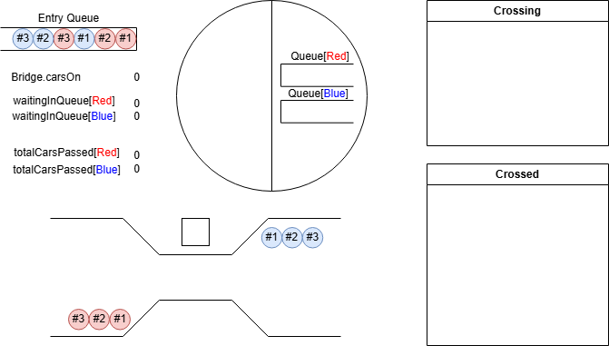
Assignment 3: Παράδειγμα εκτέλεσης
Red #1 is first and therefore claims the bridge for the red color, does logistics and immediately starts.
There’s no need to wake someone up from the red queue since it is empty

Slide 21
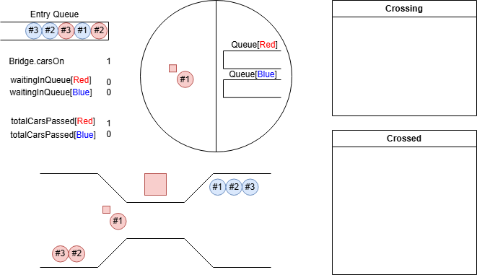
Assignment 3: Παράδειγμα εκτέλεσης
Red #2 checks the bridge’s color, checks if there’s space on the bridge, does logistics and starts crossing.
He can’t wake someone from the queue since the bridge is full.

Slide 22
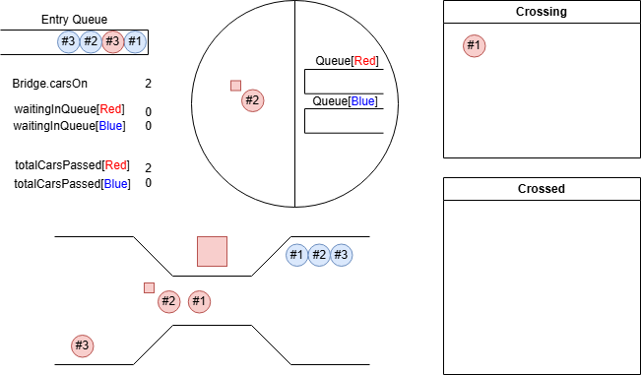
Assignment 3: Παράδειγμα εκτέλεσης
Blue #1 checks the color of the bridge and sees that it isn’t his color so he sleeps in the queue

Slide 23
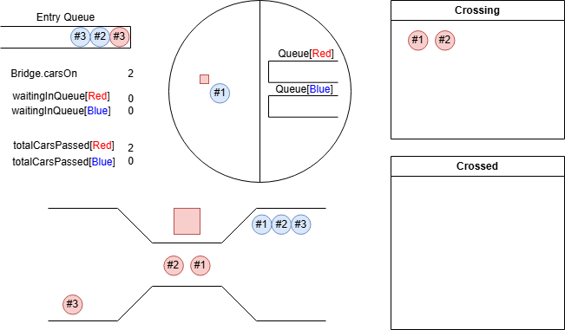
Assignment 3: Παράδειγμα εκτέλεσης
Red #3 sees the bridge is his color but there’s no space so he waits in the queue

Slide 24
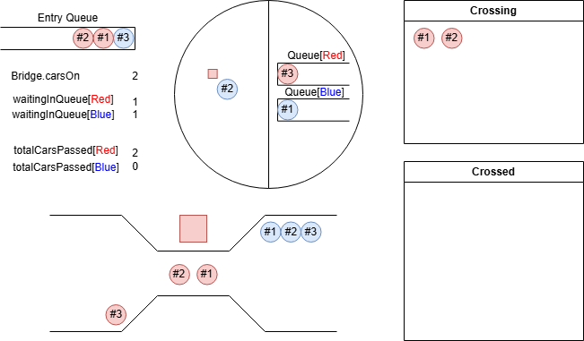
Assignment 3: Παράδειγμα εκτέλεσης
Blue #2 and #3 check the color of the bridge and because it isn’t their color they wait in the queue

Slide 25
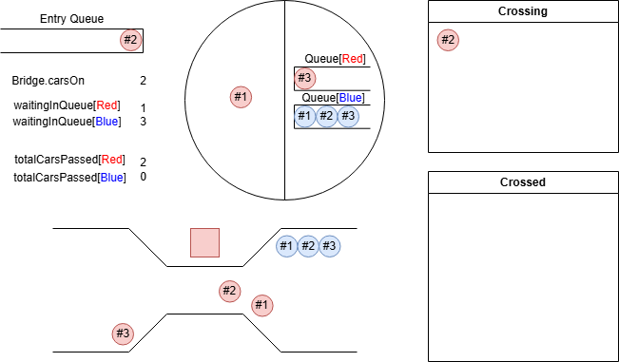
Assignment 3: Παράδειγμα εκτέλεσης
Red #1 is done crossing and thinks:
Red has reached its limit
Someone is waiting from the other color
I am not last
Because of those he
Does nothing

Slide 26
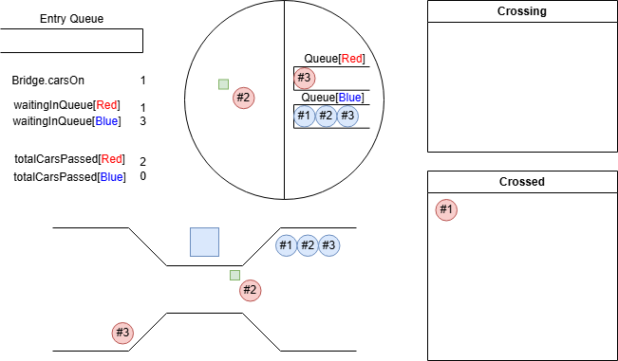
Assignment 3: Παράδειγμα εκτέλεσης
Red #2 is done crossing and thinks:
Red has reached its limit
Someone is waiting from the other color
I am last
Because of those he
Change the bridge color
Wake up a blue car

Slide 27
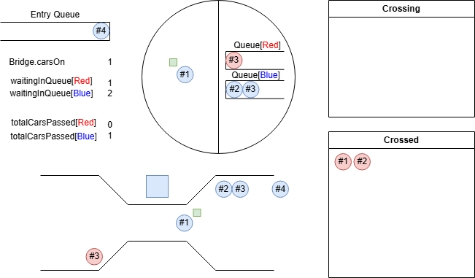
Assignment 3: Παράδειγμα εκτέλεσης
Blue #1 wakes up and does logistics, wakes up another blue car because there is space for another one and starts crossing.

Slide 28
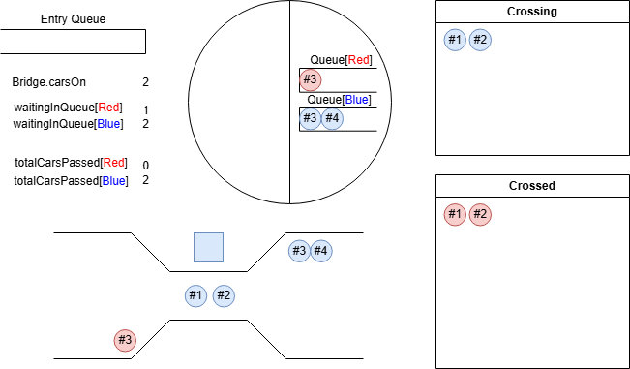
Assignment 3: Παράδειγμα εκτέλεσης
Blue #2 wakes up and does logistics, doesn’t wake up another blue car because there isn’t space for another one and then starts crossing.

Slide 29
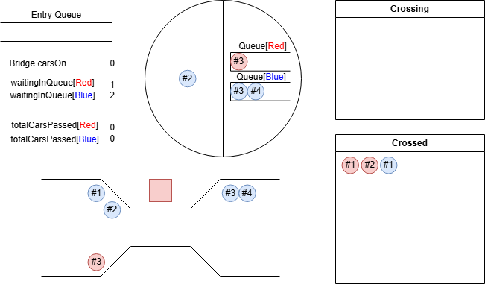
Assignment 3: Παράδειγμα εκτέλεσης
Blue #1 is done crossing and does logistics, he thinks:
Blue has reached its limit
Someone waiting of the opposite color
I am not last
He decides:
I do nothing
Blue#2 is done crossing and
does logistics, he thinks:
Blue has reached its limit
Someone waiting of the opposite color
I am last
He decides:
I change the bridge color and wake up a red car

Slide 30
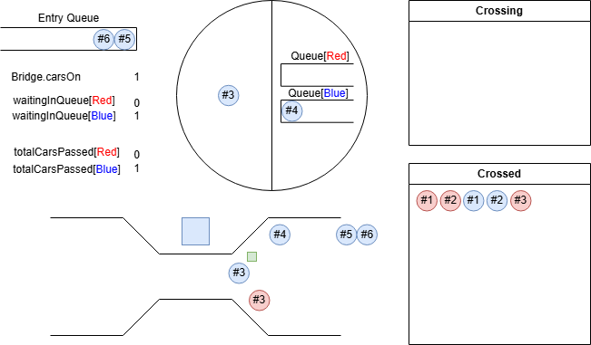
Assignment 3: Παράδειγμα εκτέλεσης

Slide 31
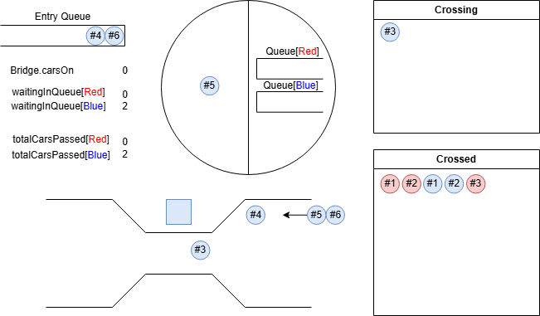
Assignment 3: Παράδειγμα εκτέλεσης
Blue #5 and #6 see there’s someone in the queue so they also wait in the queue

Slide 32
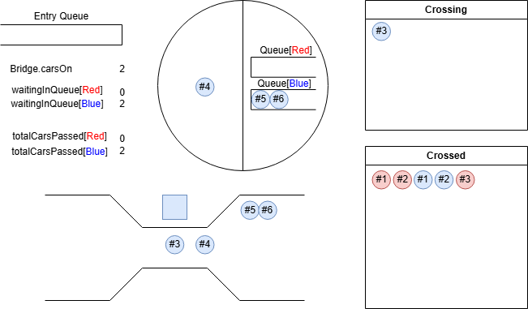
Assignment 3: Παράδειγμα εκτέλεσης
Blue #4 is awoken and does logistics and doesn’t wake someone from the queue because there is no space and starts crossing.

Slide 33
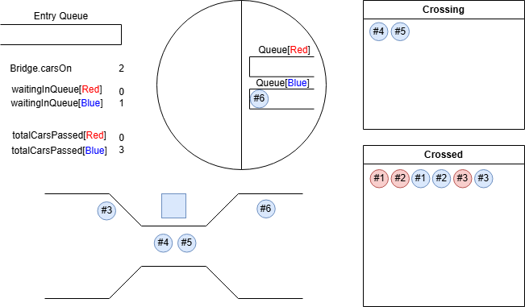
Assignment 3: Παράδειγμα εκτέλεσης
Blue #3 done crossing
Does logistics
Thinks:
Blue has reached its limit
But no one is waiting of the opposite color
Yet there is someone waiting of my color
Decides:
I wake up someone of my color
Blue #5 awoken
Does logistics
Doesn’t wake up someone as there is no space
Starts crossing

Slide 34
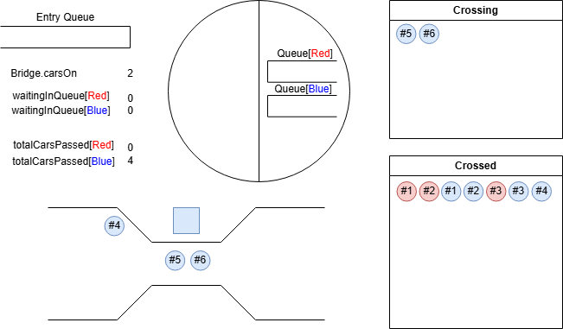
Assignment 3: Παράδειγμα εκτέλεσης
Blue #4 done crossing
Does logistics
Thinks:
Blue has reached its limit
But no one is waiting of the opposite color
Yet there is someone waiting of my color
Decides:
I wake up someone of my color
Blue #6 awoken
Does logistics
Doesn’t wake up someone as there is no space and Queue is empty
Starts crossing

Slide 35
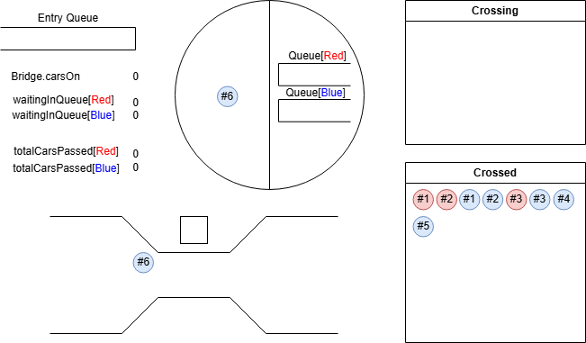
Assignment 3: Παράδειγμα εκτέλεσης
Blue #6 done crossing
Does logistics
Thinks:
Blue has reached its limit
But no one is waiting of the opposite color
But no one is waiting of my color either
Decides:
I set the bridge to unassigned

Slide 36
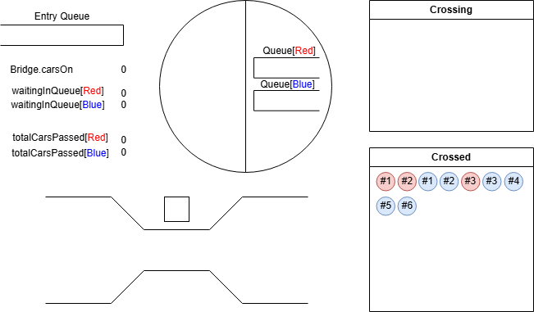
Assignment 3: Παράδειγμα εκτέλεσης
Empty bridge state

Slide 37
Assignment 4

Slide 38
Assignment 4: Monitor structure
monitor {
bool park_closed;
bool train_running;
int passengers_waiting;
int passengers_onboard;
int max_passengers;
cond train_wait;
cond boarding_queue;
cond ride_queue;
void passenger_board();
void passenger_unboard();
void train_fill();
void train_empty();
}

Slide 39
Assignment 4: Passenger board
Void passengers_board() {
Passengers_waiting++;
IF (train_running or passengers_waiting != max_passengers) {
wait(boarding_queue);
passengers_onboard++;
}
ELSE {
Passengers_onboard++;
train_running = true;
signal(train_wait);
}
}

Slide 40
Assignment 4: Passenger unboard
Void passenger_unboard() {
IF (train_running) { wait(ride_queue); }
Passenger_onboard--;
IF (passengers_onboard == 0) { signal(train_wait); }
}

Slide 41
Assignment 4: Train fill
Bool train_fill() {
IF (passengers_waiting < max_passengers) { wait(train_wait); }
FOR N-1 passengers { signal(boarding_queue); }
}

Slide 42
Assignment 4: Train empty
Void train_empty() {
train_running = false;
passengers_waiting -= max_passengers;
FOR every passenger onboard { signal(ride_queue); }
IF (passengers_onboard != 0) { wait(train_wait); }
}

