Slide 1
Exploring Indian food venues in the city of Toronto
Prepared for Coursera Data Science CAPSTONE Course

Slide 2
INTRODUCTION
Consider a person has moved to a new hometown for living. As an Indian who loves Indian food, he may want to explore the best Indian eateries in his new hometown. The report can help understand this capstone project better, from being a tourist to a student in a distant land of Toronto. It focusses on providing the geographical data in different localities of the city of Toronto, where a person can go to satisfy their craving for Indian food.

Slide 3
DATA SOURCE
The data source used was Wiki data postal codes by Neighborhood in the city of Toronto.
Folium maps has been used to construct the density map for each city along with FourSquare Web API to track the geo-coordinates of the different eatery locations.
Foursquare API is used to fetch all the restaurants in the city of Toronto.

Slide 4
METHODOLOGY
Exploratory Data Analysis
The main idea is to visualize the food venues and normalize the neighborhoods of a borough to identify the best neighborhoods serving Indian cuisine.
Inferential Statistical Findings
To identify the most likely neighborhoods that will serve the goal of this project, k-means clustering has been used. It is an unsupervised machine learning algorithm that clusters based on pre-defined cluster size. We group data based on the existing data to help draw more customers to a given food outlet.

Slide 5
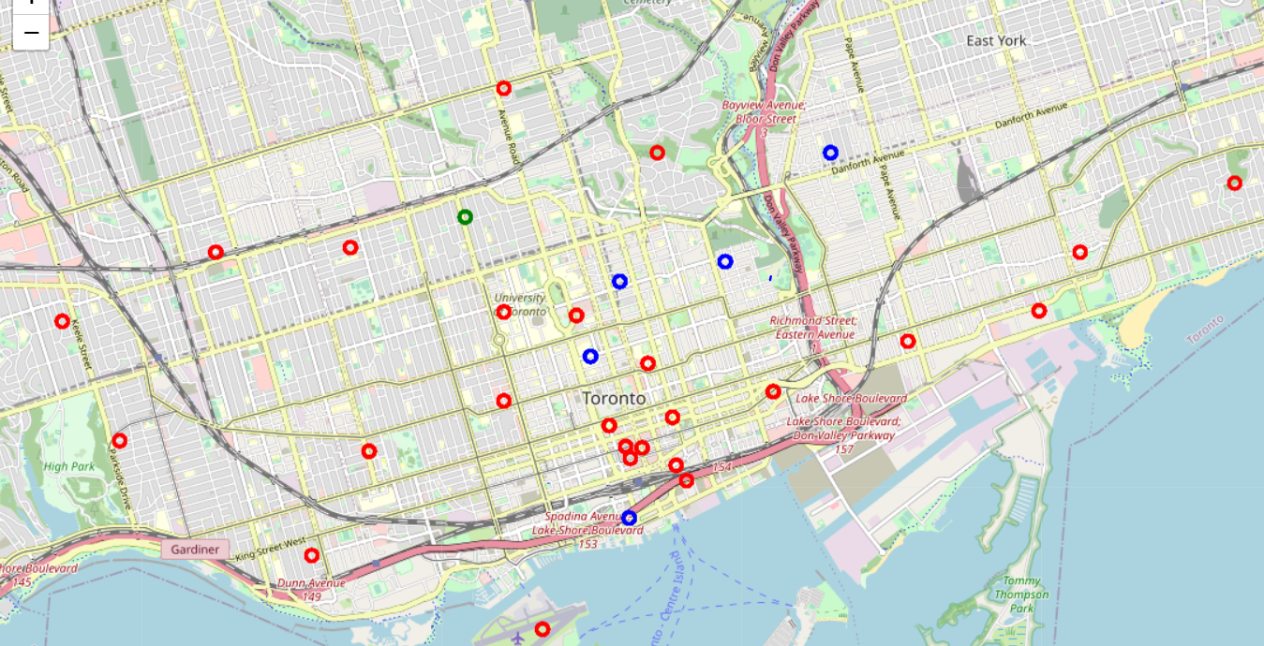
RESULTS
The number of clusters are specified to be 3 to examine the best 3 clusters for our geographical coordinates in the city of Toronto, each indicated by a different color. The red cluster indicated by Cluster 1, seems to show a better representation of nearby Indian restaurants.

Slide 6
DISCUSSION
The objective of this business problem was to help stakeholders identify the best boroughs that served Indian food in the capital city of Toronto. It can also help to provide new residents suggestions based on other venues that are in the nearby area to provide them one of the best dining experience to satisfy their cravings for Indian food.

Slide 7
CONCLUSION
The mean point and mean distance from the mean point are calculated, to get a feel of which is the densest area in terms of Indian restaurants.
The lower the value is the densely packed the restaurants are.
This is very useful even for tourists who may not know which restaurants to choose from the ones that are closer to them as an ideal dining place.

Slide 8
THANK YOU

