Slide 1
Risk Factors for Maternal Morbidity
Alex Cualoping
STAT448
Data Challenge 2

Slide 2
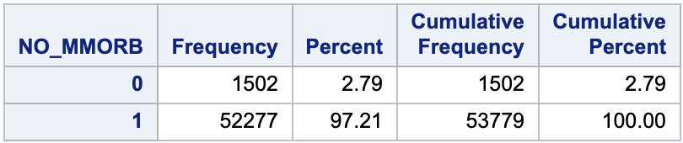
Maternal Morbidity
Maternal morbidity can be defined as any physical or mental illnesses/disabilities that are directly related to pregnancy and childbirth
Morbidity Rate 2015
~1,500 cases out of ~54,000 fully reported births = 2.79%

Slide 3
Goals and Motivation
Determine variables that are correlated with maternal morbidity
Risk gets concerning only when it is unexpected
I believe maternal morbidity can be lowered to <2.5% if doctors are aware of variables that commonly lead to morbidity

Slide 4
Data Cleaning
Standard checks for missing values and inconsistent values
Original dataset – 3,988,733 observations and 241 variables
Only kept variables of interest
13 variables remaining
Only kept fully reported observations
Removed all observations with missing values and non-reported risk factors
53,779 observations remaining

Slide 5
Variables of Interest
NO_MMORB
Risk Factors
RF_PDIAB RF_GDIAB RF_PHYPE RF_GHYPE RF_EHYPE RF_PPTERM RF_ARTEC RF_CESAR
Numeric Variables
MAGER previs WTGAIN dbwt
Notes:
NO_MMORB – maternal morbidity
RF_PDIAB – pre-pregnancy diabetes
RF_GDIAB – gestational diabetes
RF_PHYPE – pre-pregnancy diabetes
RF_GHYPE – gestational diabetes
RF_EHYPE – hypertension eclampsia
RF_PPTERM – previous preterm birth
RF_FEDRG – fertility enhancing drugs
RF_ARTEC – assistive reproductive technology
RF_CESAR – previous cesarean section
OEGest_R3 – premature birth
DMETH_REC – delivery method
CIG_REC – smoker
MAGER – mother’s age
Previs – number of prevists
WTGAIN – weight gain from pregnancy
Dbwt – delivery weight

Slide 6



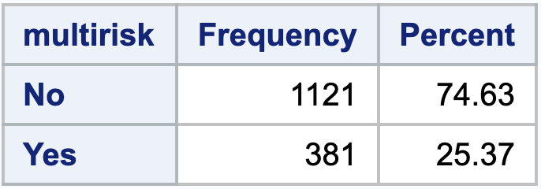
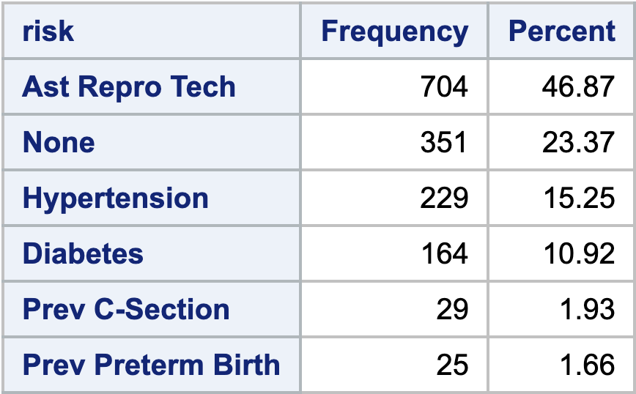
Single and Multiple Risk Factors
Specific Risk Factors for Mothers with Morbidity
The majority of mothers only had one prior risk factor
Assistive Reproductive Technology is the most prevalent single risk factor by a wide margin
No prior risk factors is the second most common factor

Slide 7
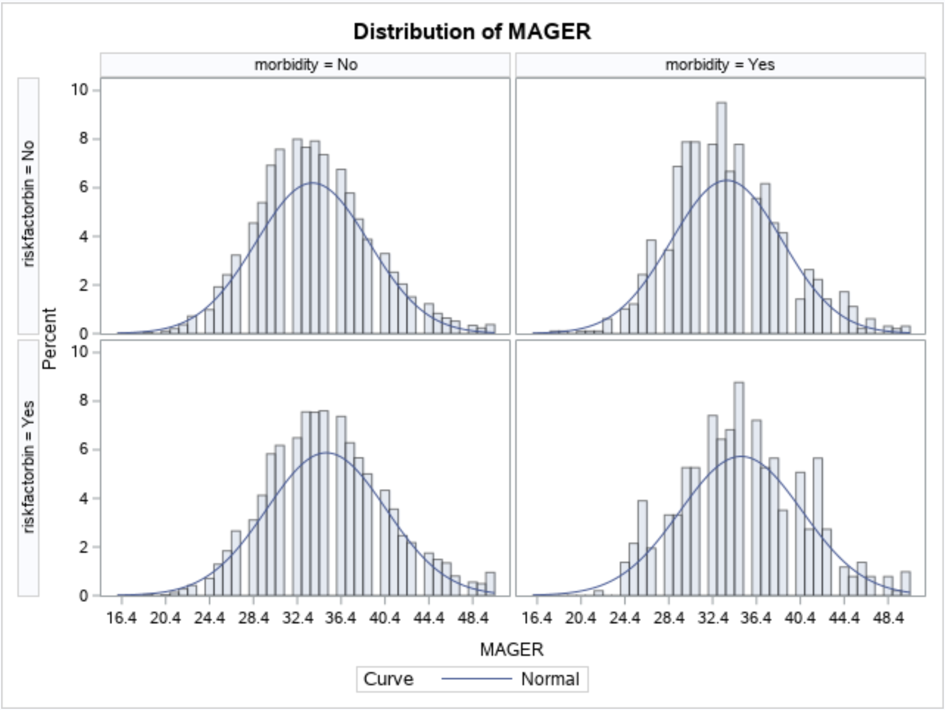
Numeric Variables vs. Morbidity and Risk Factors
Checked distributions for MAGER, previs, WTGAIN, and dbwt
Only noticeable (not significant) difference was within MAGER
Notes:
Checked distribution of…
Mothers Age, # previsits, baby’s birthweight, and weight gain
Cross referenced with morbidity and if any risk factor was present
Only one that looked slightly different was Mother’s Age

Slide 8
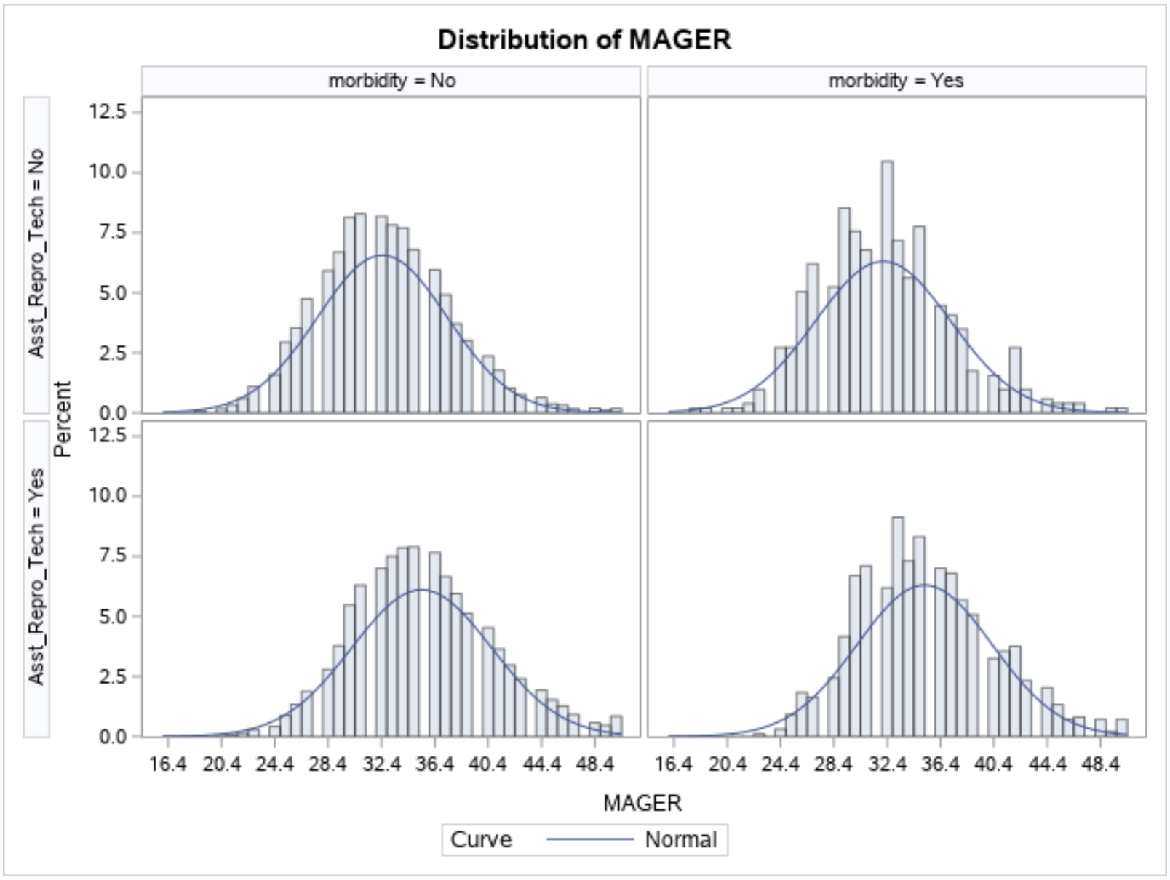
Mothers Age vs. Morbidity and Assistive Reproductive Technology
No difference in histograms for mother’s age
Split into under 35 and 35+ categories

Slide 9
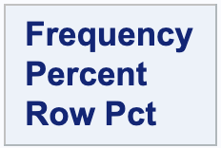
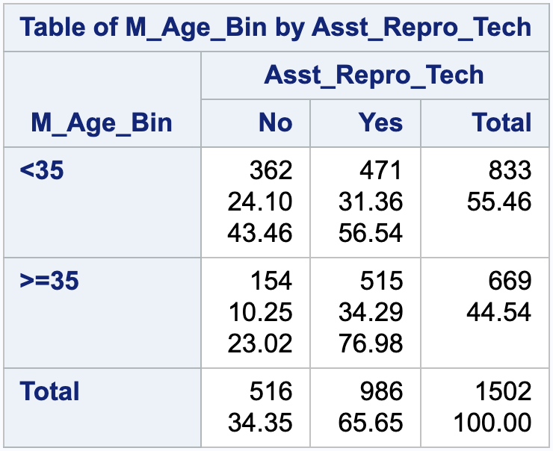
Age and Assistive Reproductive Technology
Maternal Morbidity Present
Assistive Reproductive Technology vs. Mother’s Age
65.65% of all cases of maternal morbidity had a prior risk factor of Assistive Reproductive Technology (single and multiple)
76.98% of Mother’s 35 and older who experience maternal morbidity had used Assistive Reproductive Technology

Slide 10
Findings and Limitations
Doctors should only recommend using assistive reproductive technology if they feel it is necessary
Doctors treating expecting mothers should plan for the potential of maternal morbidity when their patient had used assistive reproductive technology
Findings are strictly correlations, no statistical tests run
Only data regarding physical maternal morbidity was recorded
Factors concerning mental maternal morbidity could be different

Slide 11
References
Koblinsky, Marge et al. “Maternal morbidity and disability and their consequences: neglected agenda in maternal health.” Journal of health, population, and nutrition vol. 30,2 (2012): 124-30. doi:10.3329/jhpn.v30i2.11294

