Slide 1
Parallelism & Heterogeneity
Why do we need to care?
James Reinders (Intel)

Slide 2
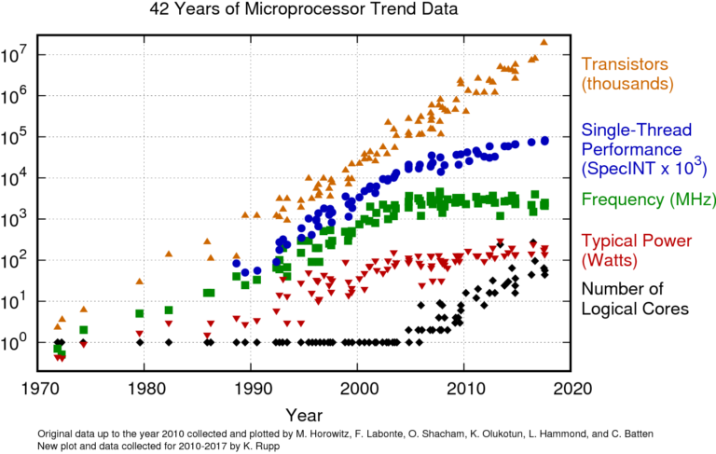
Our quest for more performance is eternal; how we obtain it adopts to the times
Source: tinyurl.com/karlruppdata (CC BY 4.0 license)

Slide 3
Our quest for more performance is eternal; how we obtain it adopts to the times
Source: tinyurl.com/karlruppdata (CC BY 4.0 license)

Slide 4
Our quest for more performance is eternal; how we obtain it adopts to the times
The famous
“Hit the Power Wall”
~2006

Slide 5
Our quest for more performance is eternal; how we obtain it adopts to the times
The famous
“Hit the Power Wall”
~2006
Why?
Performance stopped scaling with frequency enough to justify the power increases.
Before 2006: Double Perf = Double Performance; that used to be OKAY
(actual math: Double Frequency, Quadrupled Power – but Shrink in Half to Halve the Power)

Slide 6
Our quest for more performance is eternal; how we obtain it adopts to the times
The famous
“Hit the Power Wall”
~2006
Why?
Performance stopped scaling with frequency enough to justify the power increases.
Before 2006: Double Perf = Double Performance; that used to be OKAY
(actual math: Double Frequency, Quadrupled Power – but Shrink in Half to Halve the Power)
Around 2006 – Three problems converged:
Power Wall: Thermal Constraints meant performance Increases no longer allowed to scale up power needs
Memory Wall: Frequency scaling of computation not scaling system performance, largely due to memory
ILP Wall: Not enough single-threaded parallelism to fuel performance gains.

