Slide 2

Github for Dummies
UGENT MIS RESEARCH GROUP
SSHT session - 25th November 2020

Slide 3
Version control systems (VCS)
Class of systems for managing changes to computer programs, documents, large web sites, or other collections of information
Stand-alone applications or embedded in various types of software (e.g. word, content management systems )
GIT: an open-source, distributed version control systems
GitHub: a platform for hosting and collaborating on Git repositories

Slide 4
Glossary
repository: where files’ current and historical data are stored, ofter on a server
clone: a local version of a repository
branch: a set of files under version control may be branched or forked at a point in time so that two copies of those files may develop at different speeds or in different ways
fork: a copy of a repository on GitHub owned by a different user
Commit: a Git object, a snapshot of the repository

Slide 5
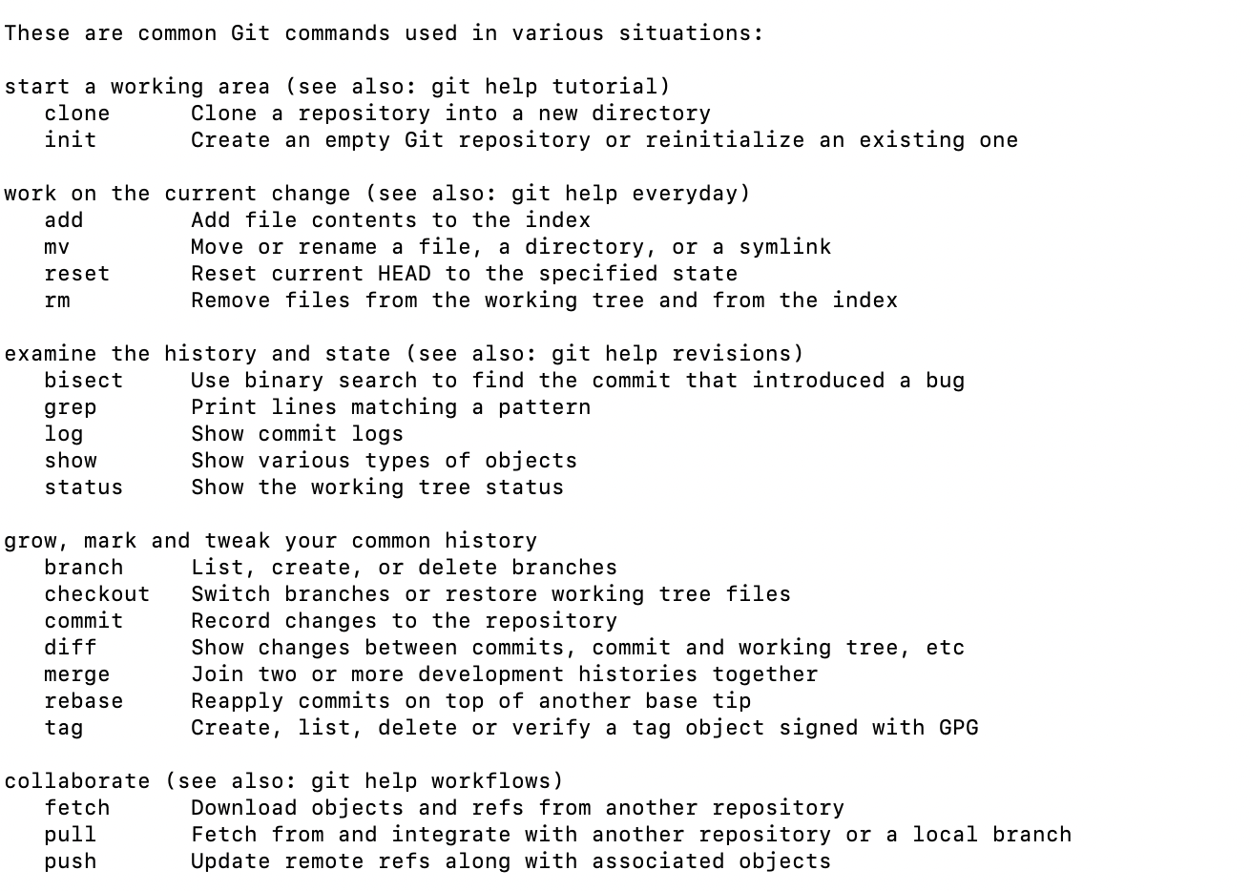
Git command line instructions
See Git Cheat Sheet or Git help

Slide 6
GIT Demo
Create github account
Install Github + Install Command line tools
Create directory
Connect Directory to GitHub Reposity
Add file
Commit file
Pull changes

Slide 7
GITHuB Desktop Demo

Slide 8
GitHUB R-Studio demo

Slide 9
Github special files
README.md
.GIT directory: meta-data about repository

Slide 10
Github.com
User
Organisation
Project is place to track issues, features and tasks related to repositories
GitHub Issues to track ideas, enhancements, tasks, or bugs for work on GitHub
GitHub Enterprise: github.ugent.be

Slide 11
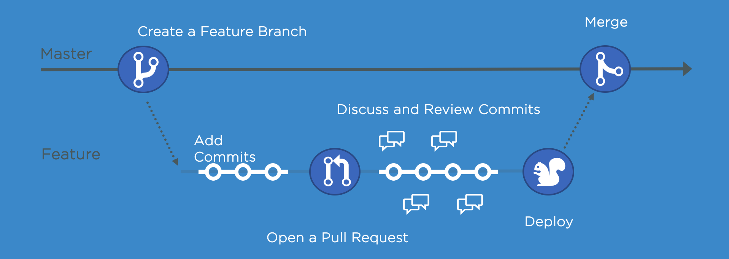
Extra functionalities
GitHub flow and Discussions
GitHub pages to host a website about yourself, your organisation, or your project
GitHub classroom to distribute code, give students feedback and collect assignments

Slide 12
Using GitHub in research
Share code
Share data
Share R scripts using RStudio

Slide 13

Frederik Gailly Business Informatics Research Group E Frederik.Gailly@ugent.be @fgailly www.mis.ugent.be/gailly

