Slide 2

Github for Dummies
UGENT MIS RESEARCH GROUP
SSHHT session - 25th November 2020

Slide 3
Version control systems (VCS)
Class of systems for managing changes to computer programs, documents, large web sites, or other collections of information
Stand-alone applications or embedded in various types of software (e.g. word, content management systems )
GIT: an open-source, distributed version control systems
GitHub: a platform for hosting and collaborating on Git repositories

Slide 4
Glossary
repository: where files’ current and historical data are stored, ofter on a server
clone: a local version of a repository
branch: a set of files under version control may be branched or forked at a point in time so that two copies of those files may develop at different speeds or in different ways
fork: a copy of a repository on GitHub owned by a different user
Commit: a Git object, a snapshot of the repository

Slide 5
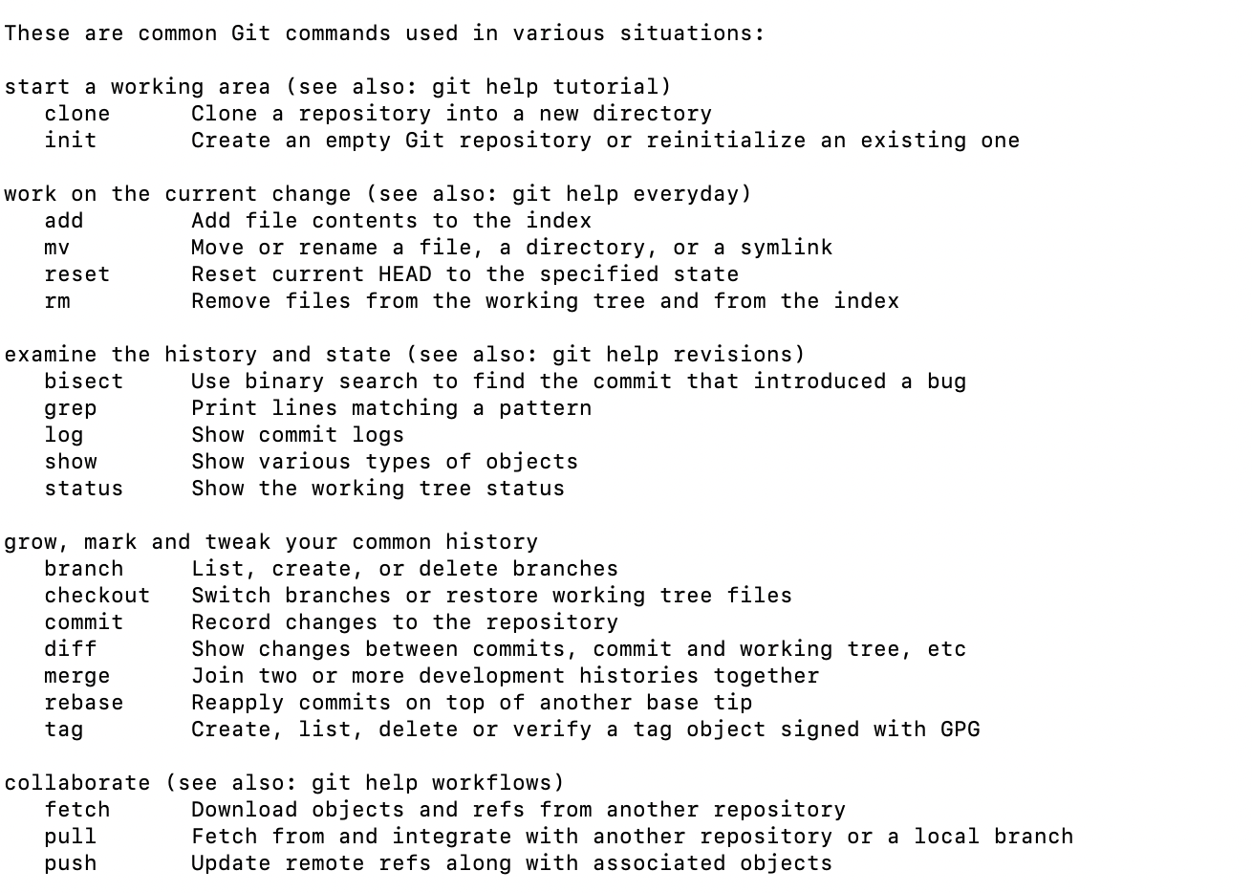
Git command line instructions
See Git Cheat Sheet or Git help

Slide 6
GIT Demo
Create github account
Install Github + Install Command line tools
Create directory
Connect Directory to GitHub Reposity
Add file
Commit file
Pull changes

Slide 7
GITHuB Desktop Demo

Slide 8
GitHUB PyCharm demo

Slide 9
Github.com
User
Organisation
Project is place to track issues, features and tasks related to repositories
GitHub Issues to track ideas, enhancements, tasks, or bugs for work on GitHub
GitHub Enterprise: github.ugent.be

Slide 10
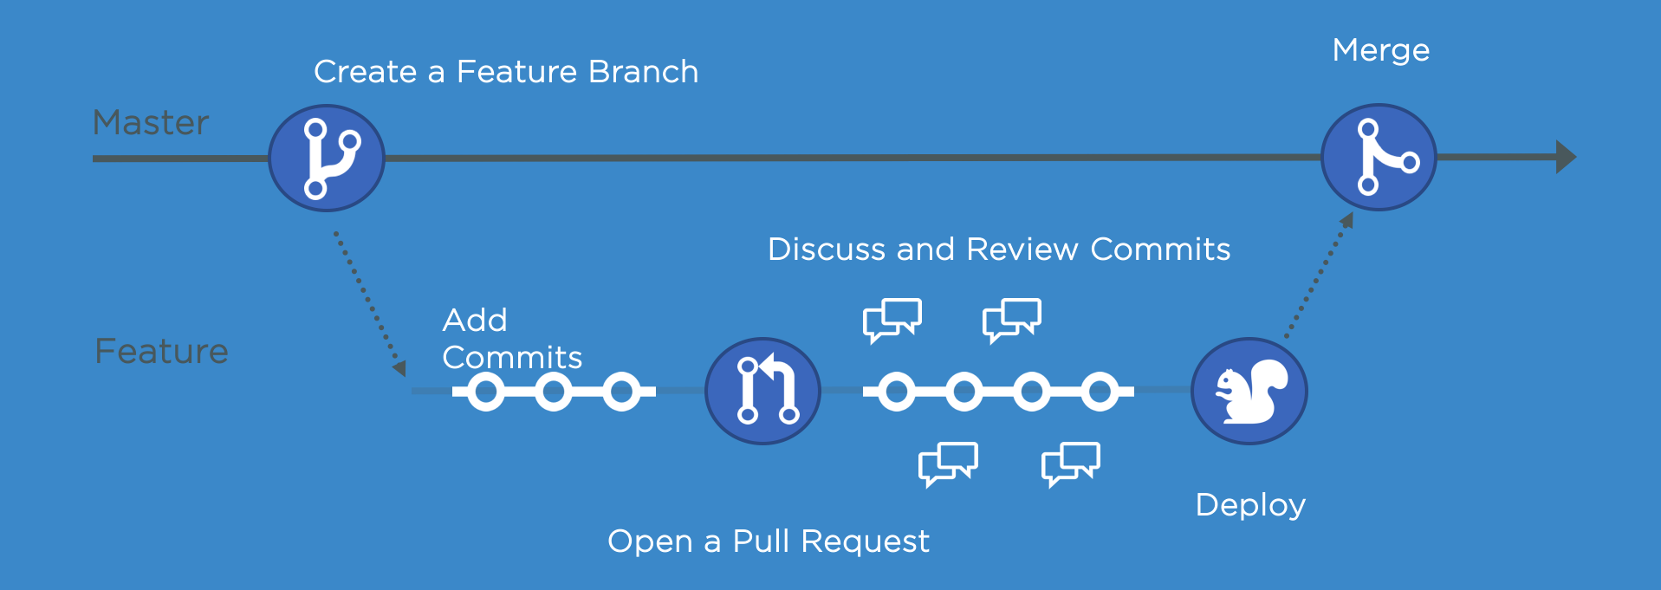
Extra functionalities
GitHub flow and Discussions
GitHub pages to host a website about yourself, your organisation, or your project
GitHub classroom to distribute code, give students feedback and collect assignments

Slide 11
Using GitHub in research
Share code
Share data
Share R scripts using RStudio

Slide 12

Frederik Gailly Business Informatics Research Group E Frederik.Gailly@ugent.be @fgailly www.mis.ugent.be/gailly

