Slide 1
RPL 7/20/23
Stiles and Sam

Slide 2
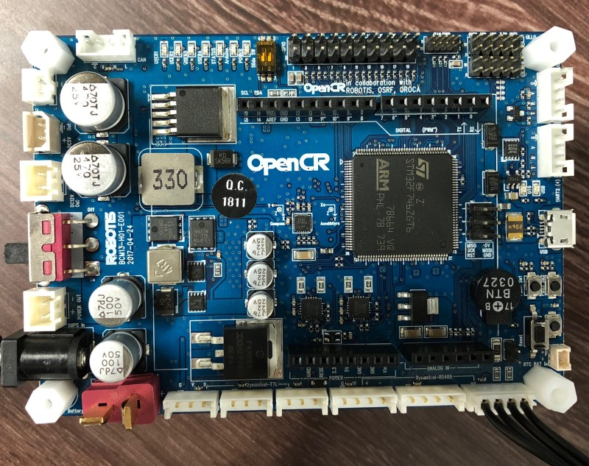
Current progress:
We have succeeded in fixing the wifi drivers on the raspberry pi, and we have also fixed the Dynamixels attached to the Turtlebot that were previously not functioning properly
Current problems:
We are still trying to learn what the functions on the OpenCR
actually do
Next Steps:
We plan to make the turtlebot move in a single defined area
and then move on to mapping out a larger portion of the room and navigating it

