Slide 1
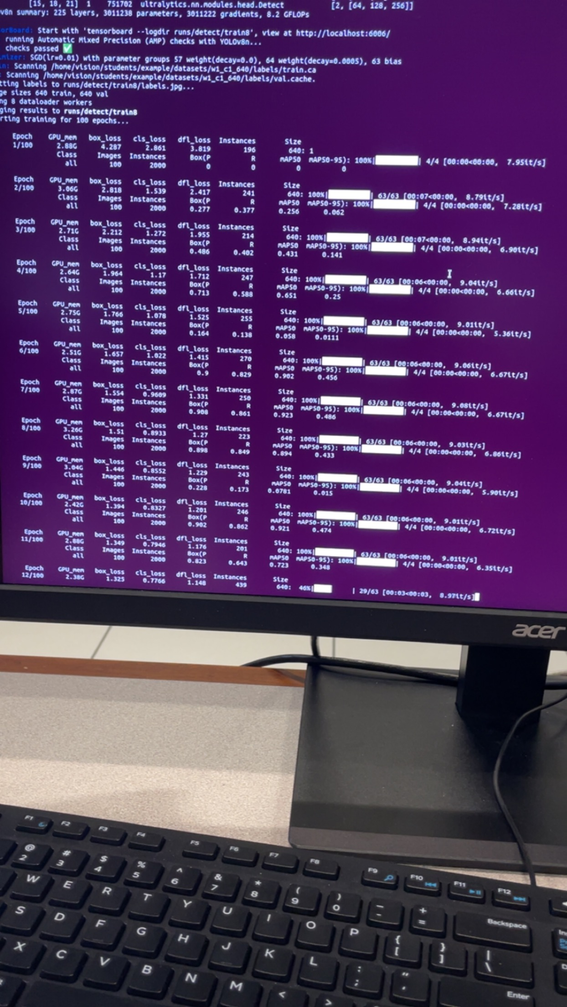
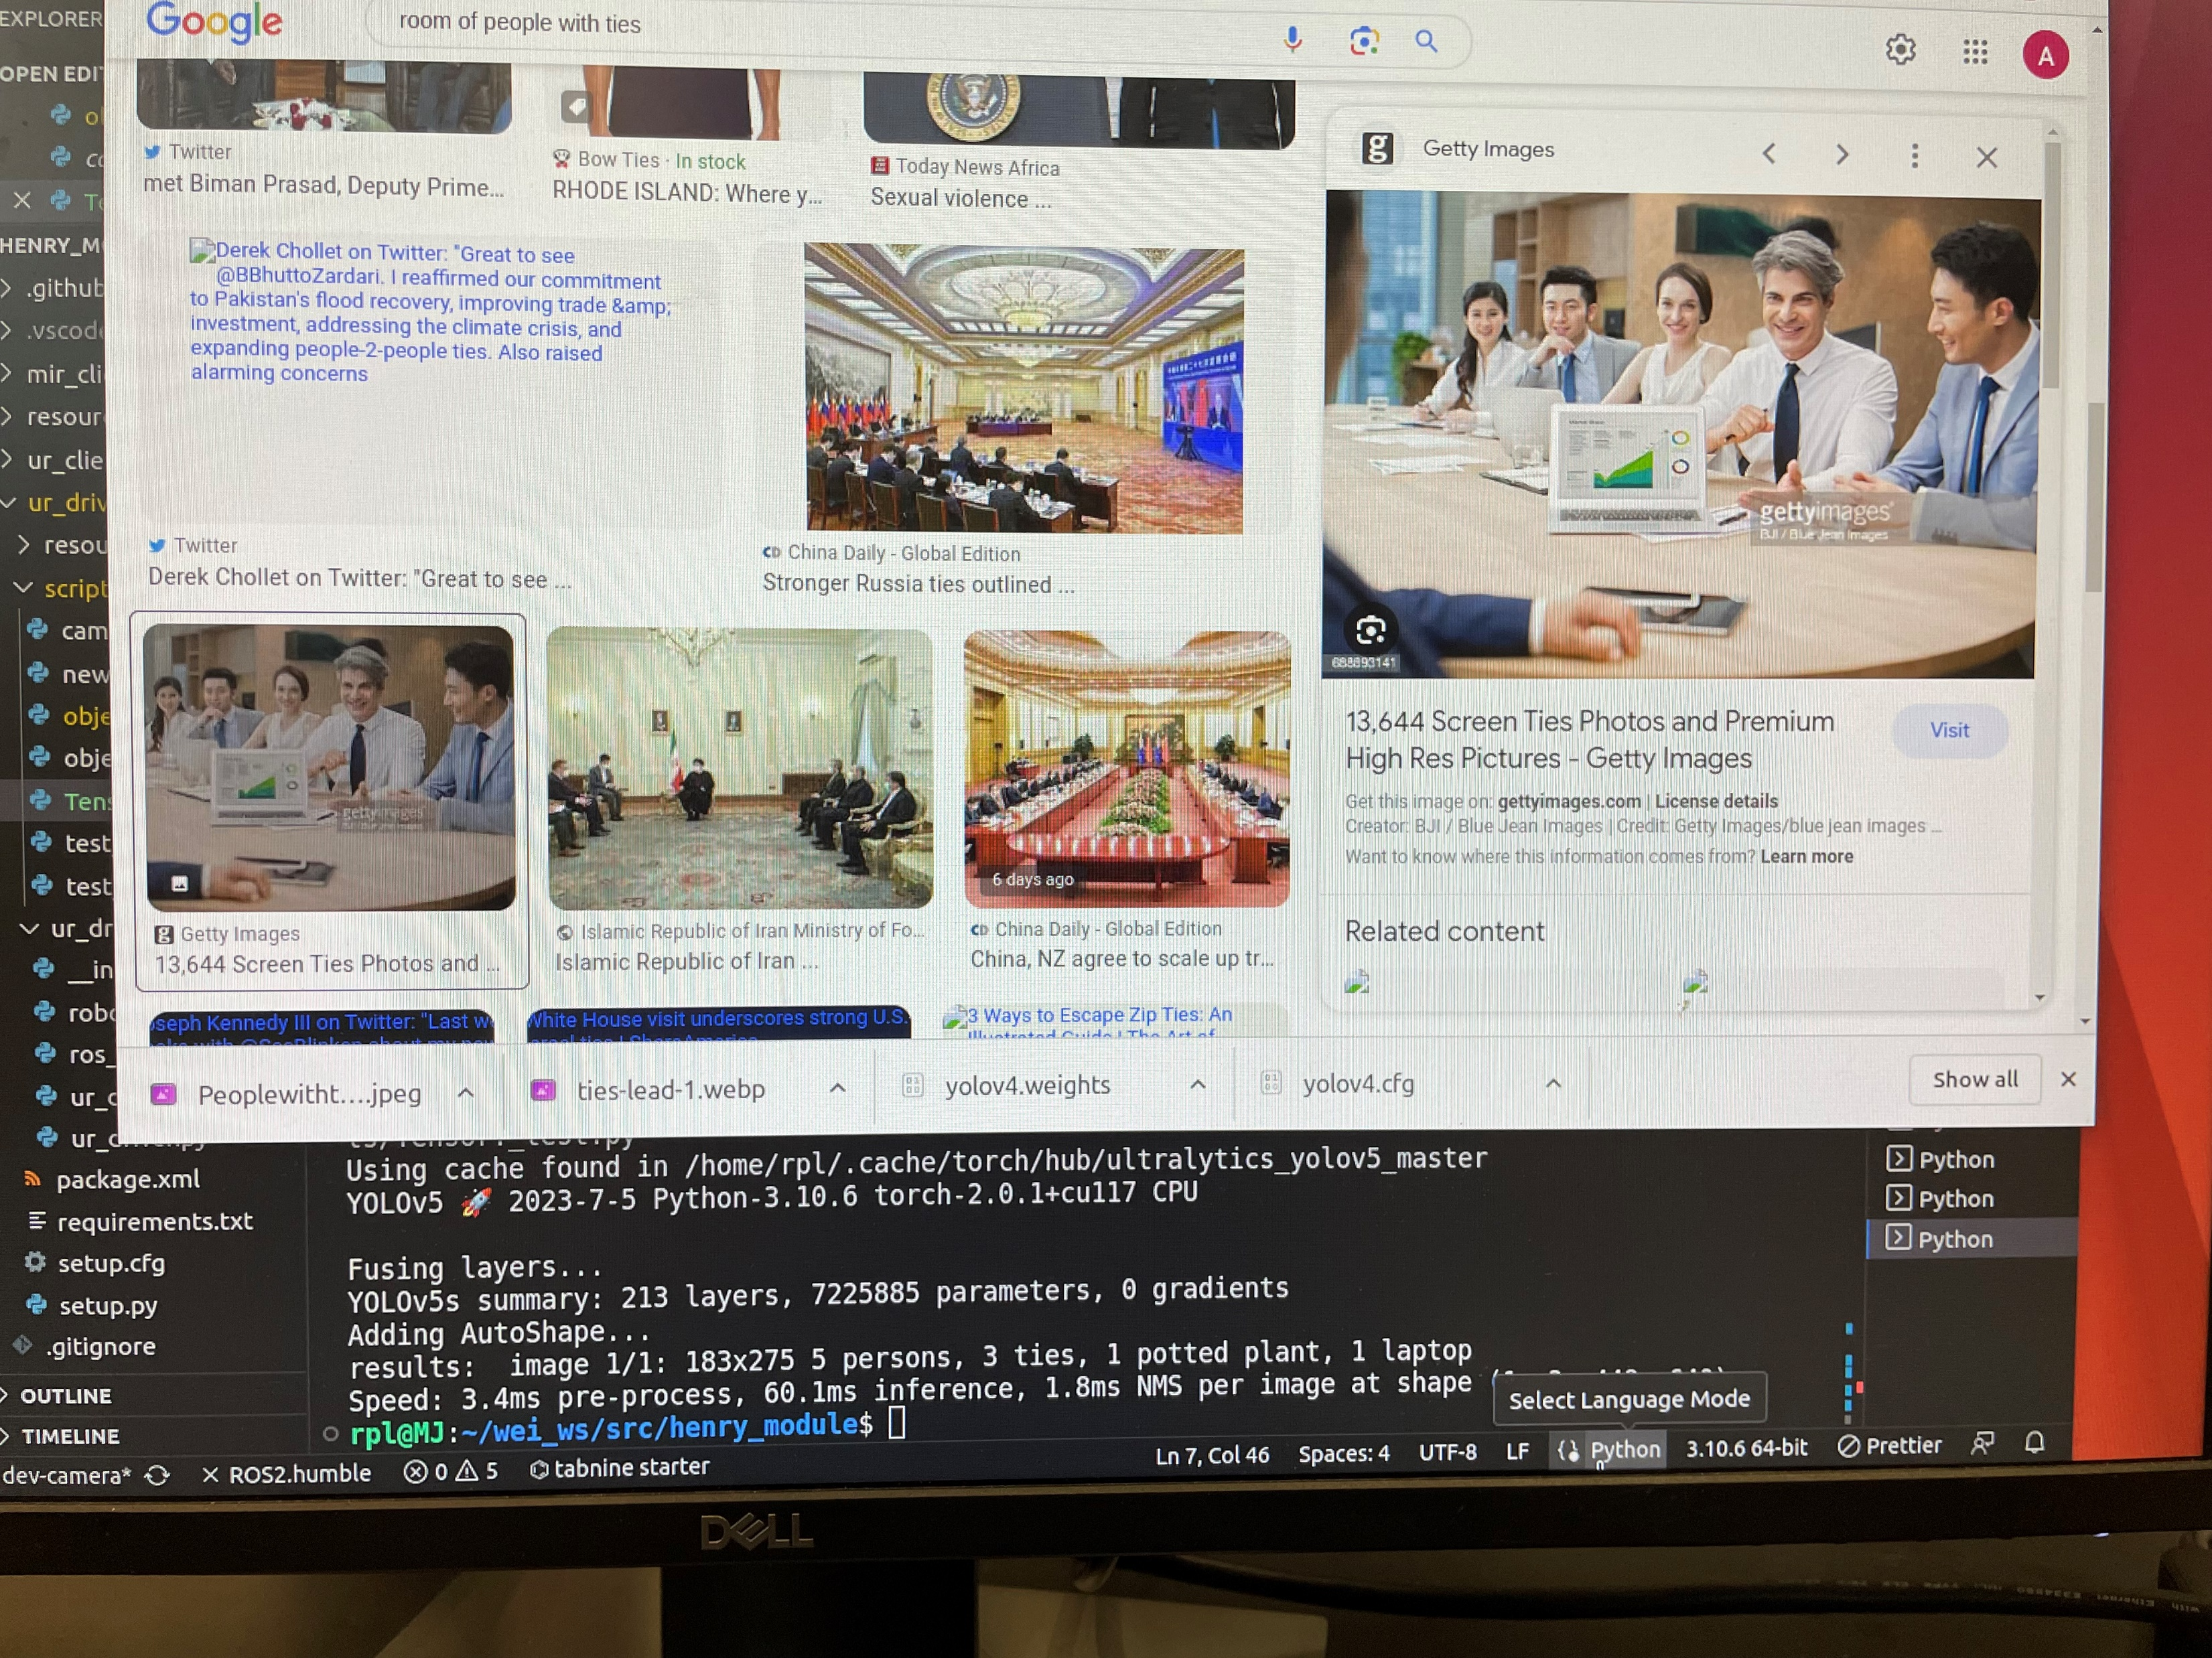
Updates:
Started exploring pre-trained machine learning models in YOLO with Rory (object detection in google images)
Started dataset collection and annotation with Make Sense object detection.
Began custom model training with well plates pictures taken around the lab
Future:
Expand object classes to include additional tools around the lab
Dataset Augmentation(noise and variants)

