Slide 1
RPL Meeting 7/6
Stiles Jarrett
Sam Kelly

Slide 2
Sam Kelly
I’m freshman at Illinois State University. I’m majoring in Physics Education. I plan to be a high school physics teacher in Chicago.

Slide 3
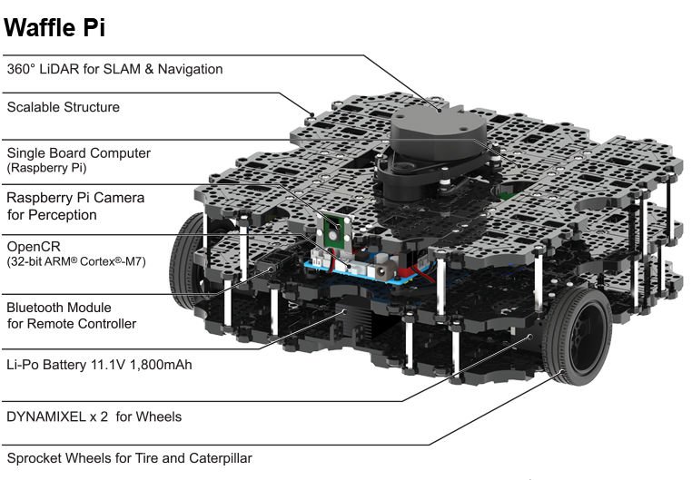
Current project
Utilize IR sensors on Garby JR. (Turtlebot 3 waffle pi)
to procedurally scan the lab in order to collect and
deposit trash into a trash can
Current progress
Current Problems
We recently had to start from square one on our
robot because we moved from the icreate to the turtlebot.
We were unable to install many of the necessary pre-requisites
on our laptop because our assigned laptops have admin restrictions.

