Slide 1
RPL Meeting 7/13
Stiles Jarrett
Sam Kelly

Slide 2
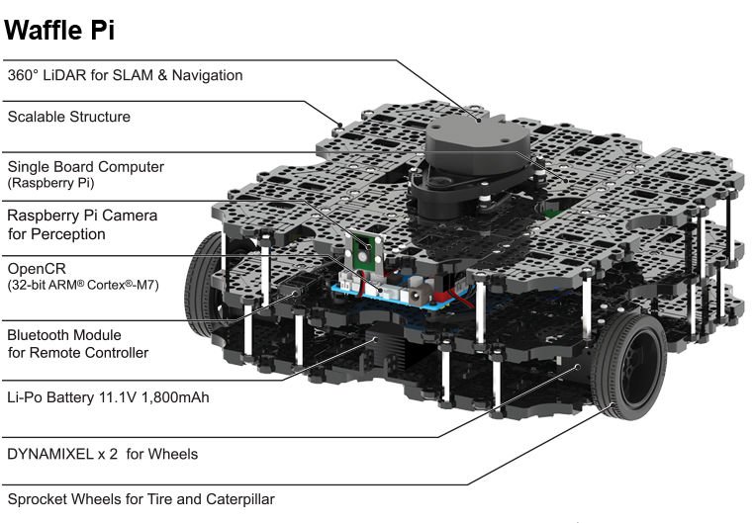
Current project
Utilize IR sensors on Garby JR. (Turtlebot 3 waffle pi)
to procedurally scan the lab in order to collect and
deposit trash into a trash can
Current progress
Current Problems
We are currently in the process of setting up wifi on the
Raspberry pi attached to the robot in order to install
Gazebo and connect to a remote pc
In order to connect the turtlebot to wifi you need to install
a package that requires wifi to install. We need to figure
out a way to install the package on a computer before
we add it to the turtlebot

