Slide 1
Team Deblock
-Sumedh Sawant
-Sakshaat Mathur
-Adwait Shelar
-Aditi Onkar
-Rachit Sharma

Slide 2


Slide 3
CONTENTS
Our Aim
How
Algorithm
Home Page
Web3 & SOLIDITY
Working
Why CryptoCares ?

Slide 4
Our Aim
-Using Blockchain and cryptocurrency to raise money, organise campaigns and donate to various charities around the globe.
-Providing transparency to individuals and charities regarding their donations, money and personal information.
-Revolutionising philanthropy by taking an efficient, transparent and impactful step powered by Blockchain for the betterment of our Society.

Slide 5
How ?
Our website CryptoCares will have an easy-to-read interface that can be interpreted by anyone.
The homepage will have the information for all the current charities enlisted and the option for creating one.
The user can easily select the charity and the amount they wish to donate.
User and the charity will be given complete privacy over their data and transaction , ensuring that we keep transparency between everyone.

Slide 6
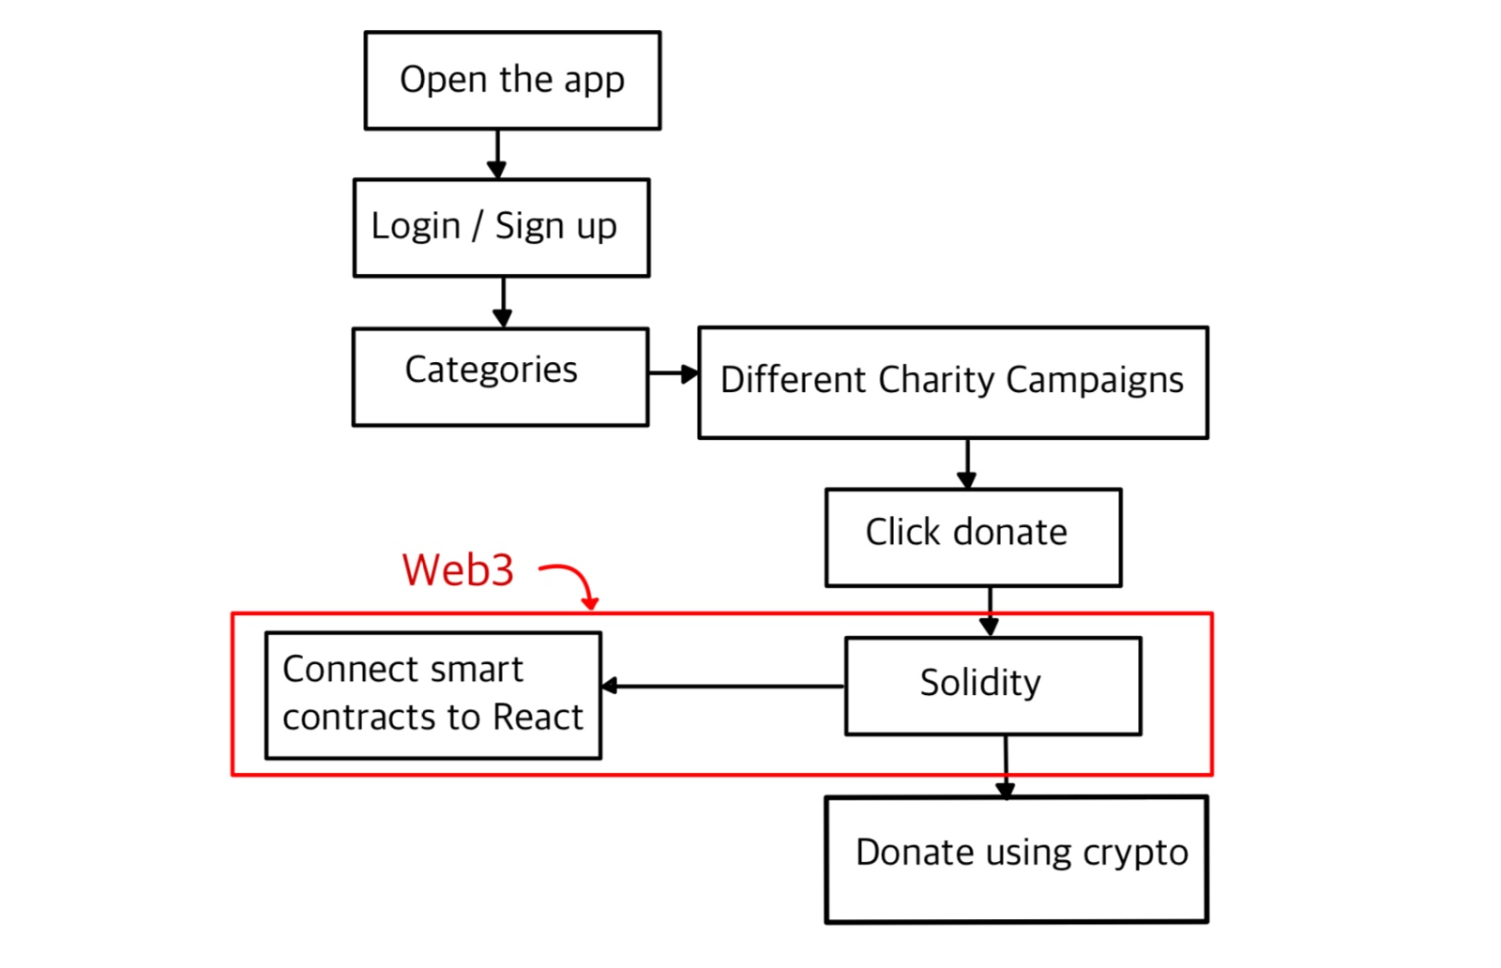
Algorithm

Slide 7
CryptoCares: Building Futures, One Digital Coin at a Time.
-DeBlock

Slide 8
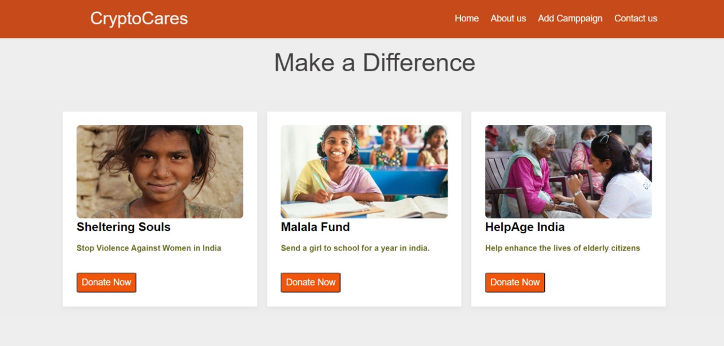
Home Page

Slide 9
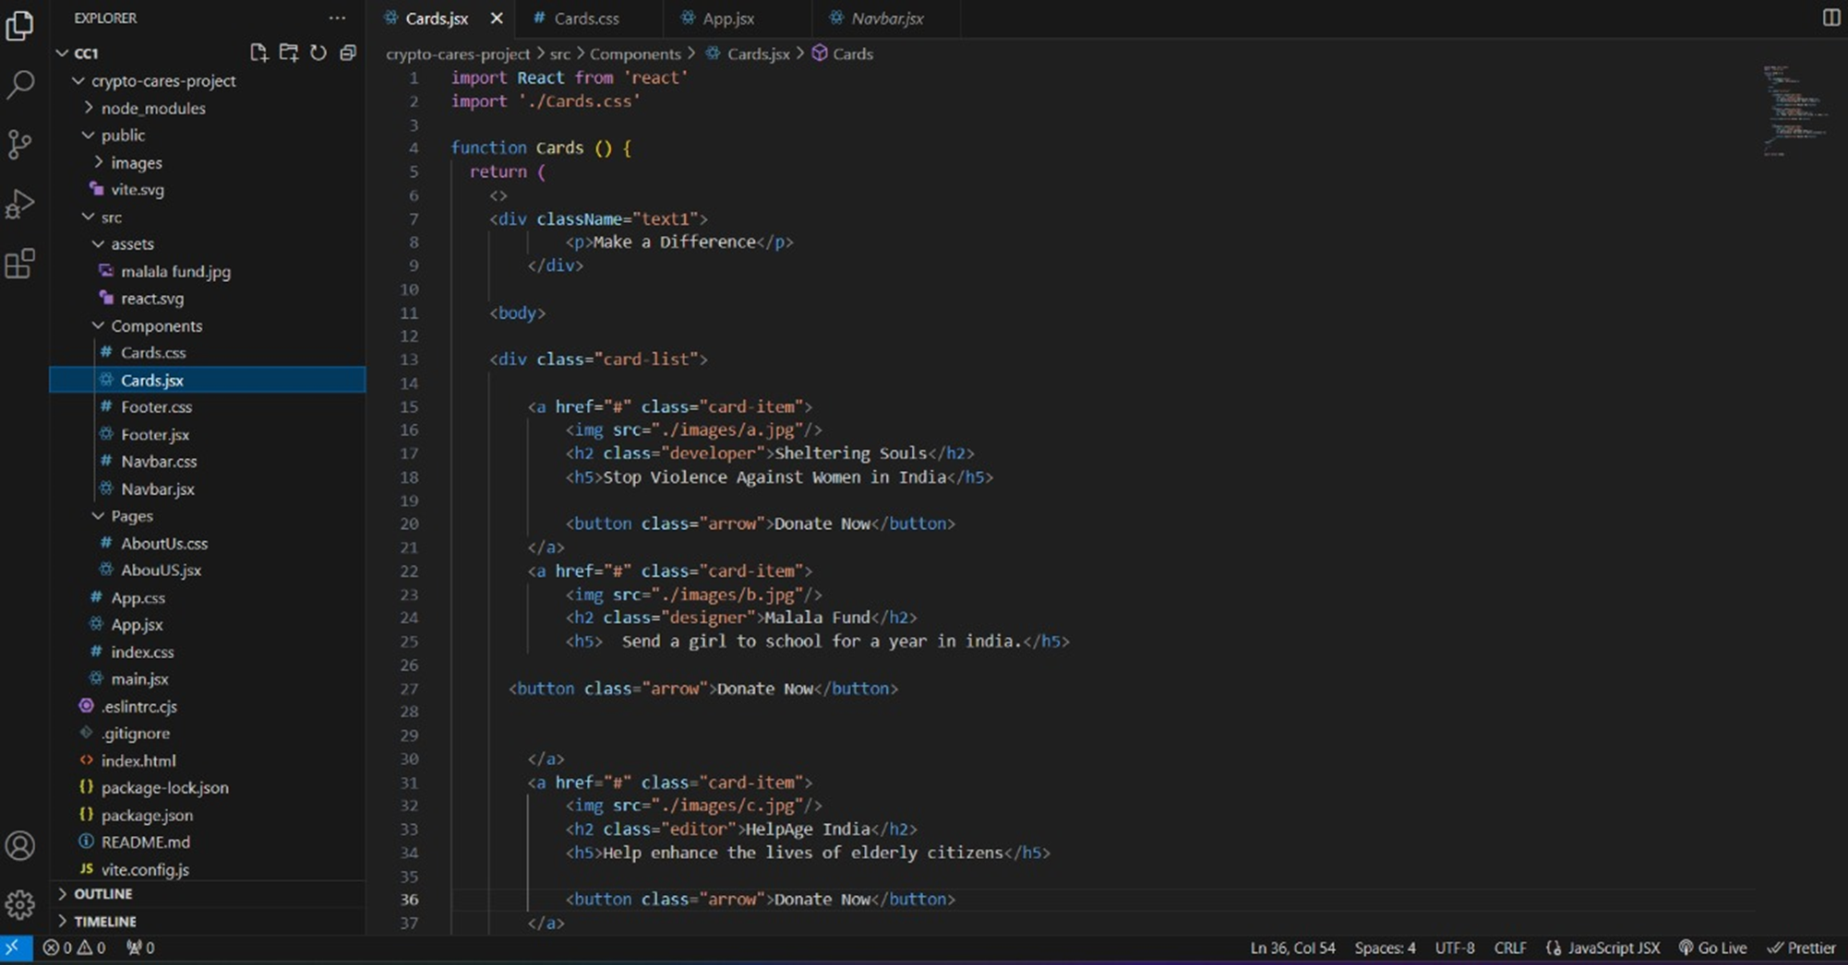

Slide 10
Web3 & SOLIDITY
Web3.js is a JavaScript library that provides an interface for interacting with the Ethereum blockchain. It allows communication with Ethereum nodes, querying information from the blockchain, and sending transactions.
Solidity is a programming language specifically designed for writing smart contracts on the Ethereum platform

Slide 11
working
SOLODITY develops smart contracts using the Solidity programming language. These contracts define the rules and logic of decentralized applications (DApps) that run on the Ethereum blockchain.
Compile the Solidity code into bytecode that can be executed on the Ethereum Virtual Machine (EVM).
Web3.js is used to deploy the compiled smart contract to the Ethereum blockchain. This involves creating a donation to deploy the contract and interacting with Ethereum nodes to include the donation in a block

Slide 12
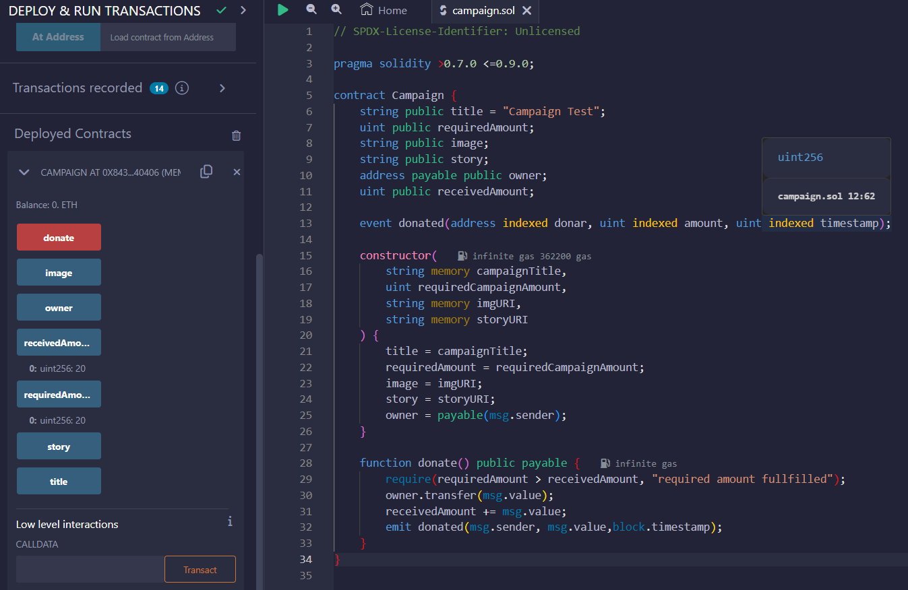

Slide 13
Why CryptoCares ?
Easy GUI
Transparency and Privacy maintained
Donors and charities can track their money, know about their past donations, etc.
Efficient and easy way for charities to raise money and philanthropists to donate money
Blockchain technology provides a decentralised approach, thus removing the middle man
Can be used globally thanks to Blockchain
More safe and secure

Slide 14
THANK YOU
-TEAM DeBlock

