Slide 1
Sanitation Assainissement Eau Potable (SAEP)

Slide 2
S.A.E.P
Accessibility of the platform

Slide 3
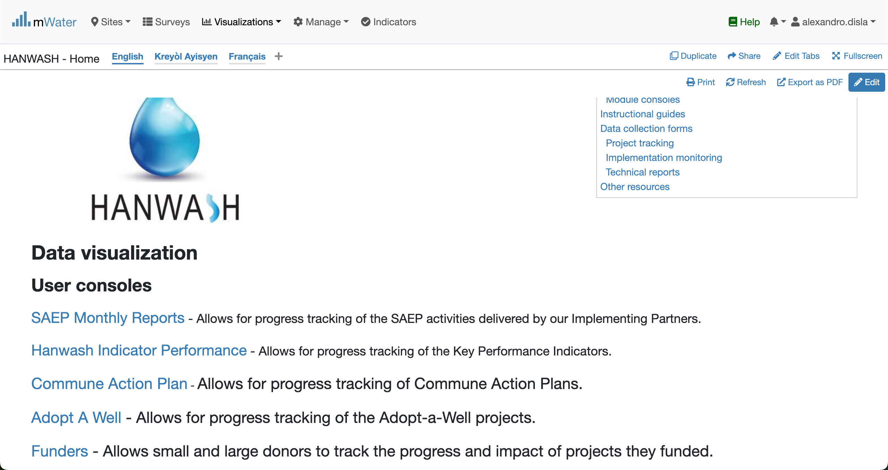
Hanwash HOME
URL LINK : http://go.mwater.co/hanwash

Slide 4
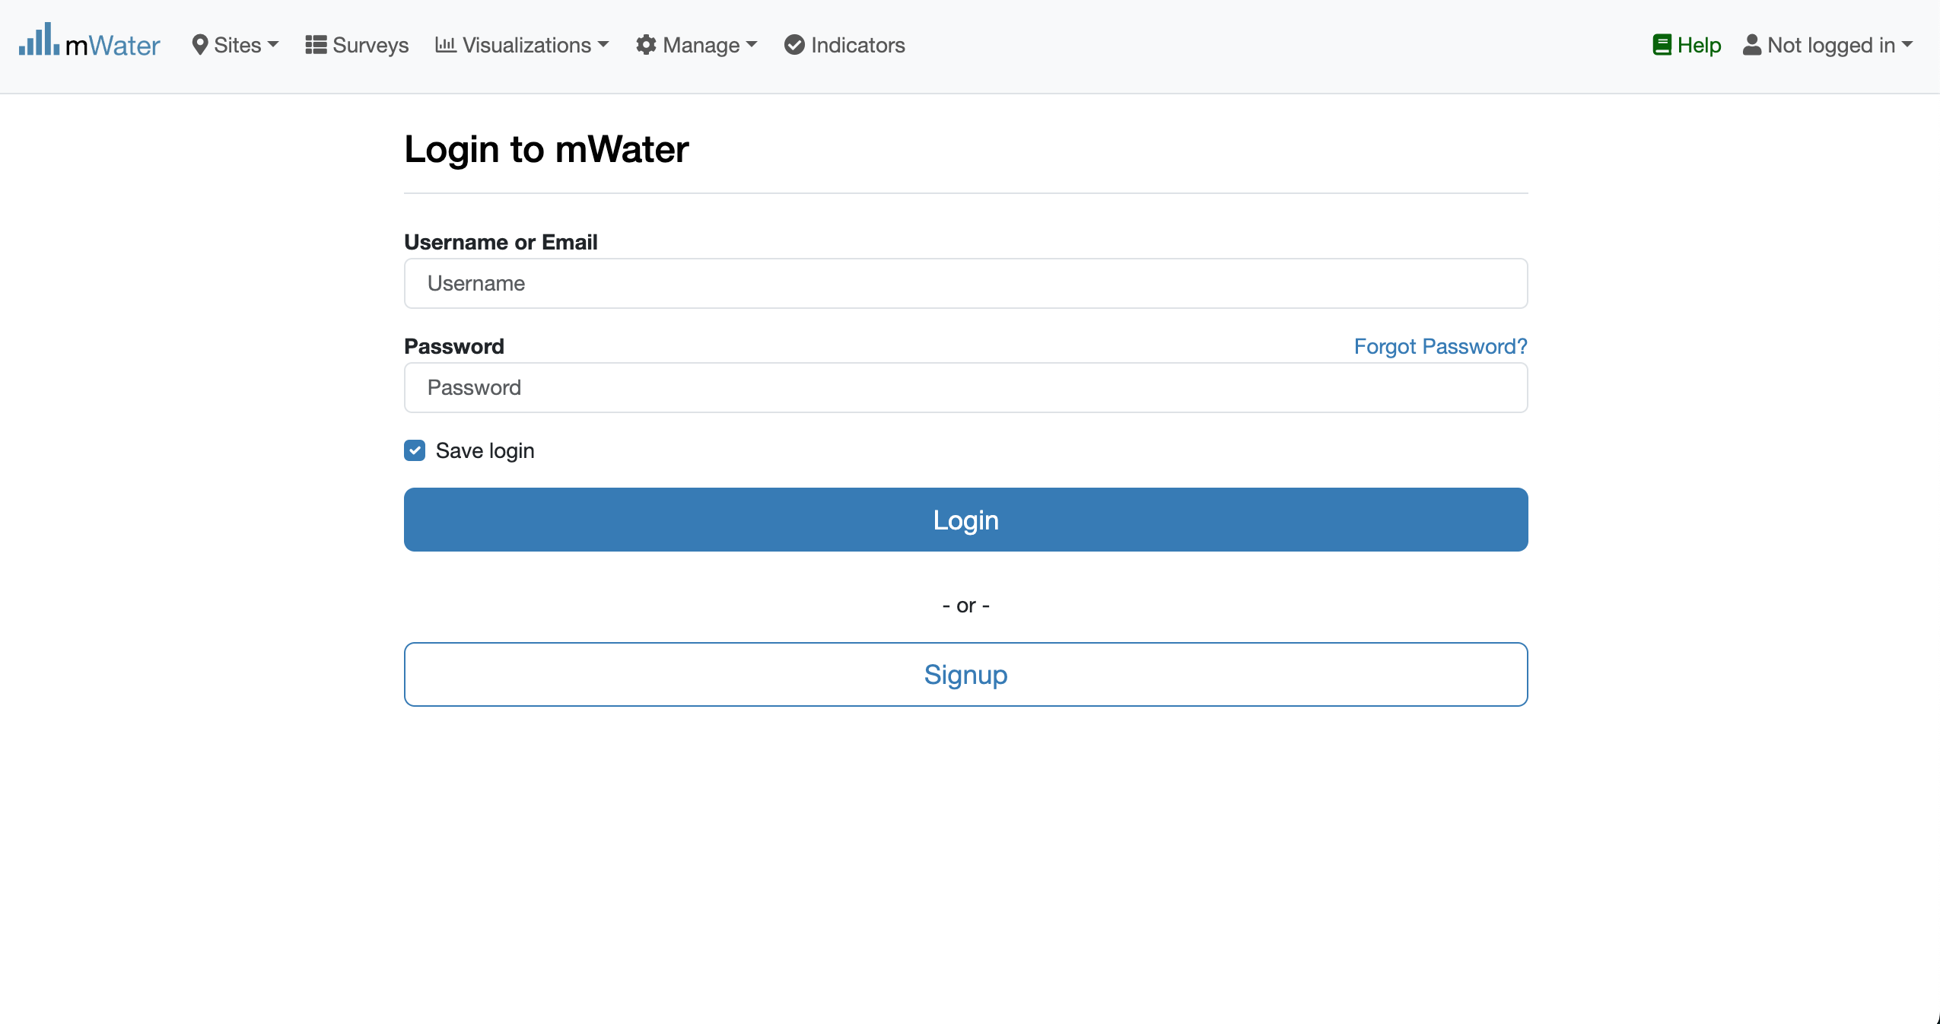
Access The SAEP & Login process
Click on the HIP url link
Log status indicator
Please enter your Credentials

Slide 5

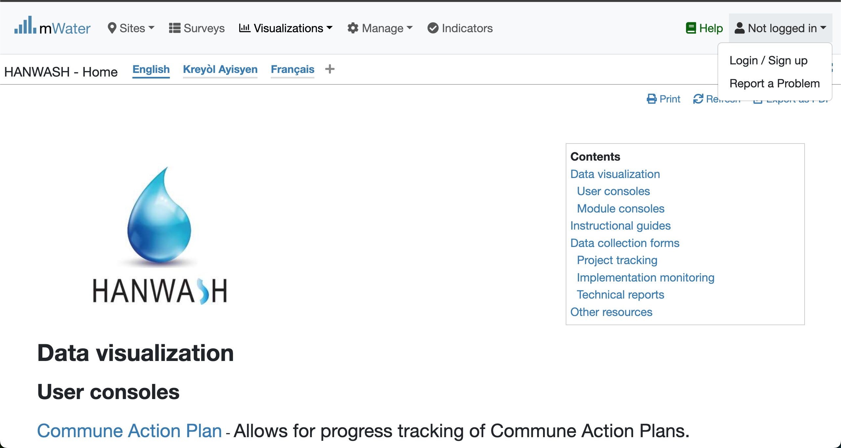


Login Process (2nd scenario)
Click to Login or Signup
Please Click on this selection box
Please enter your Credentials

Slide 6
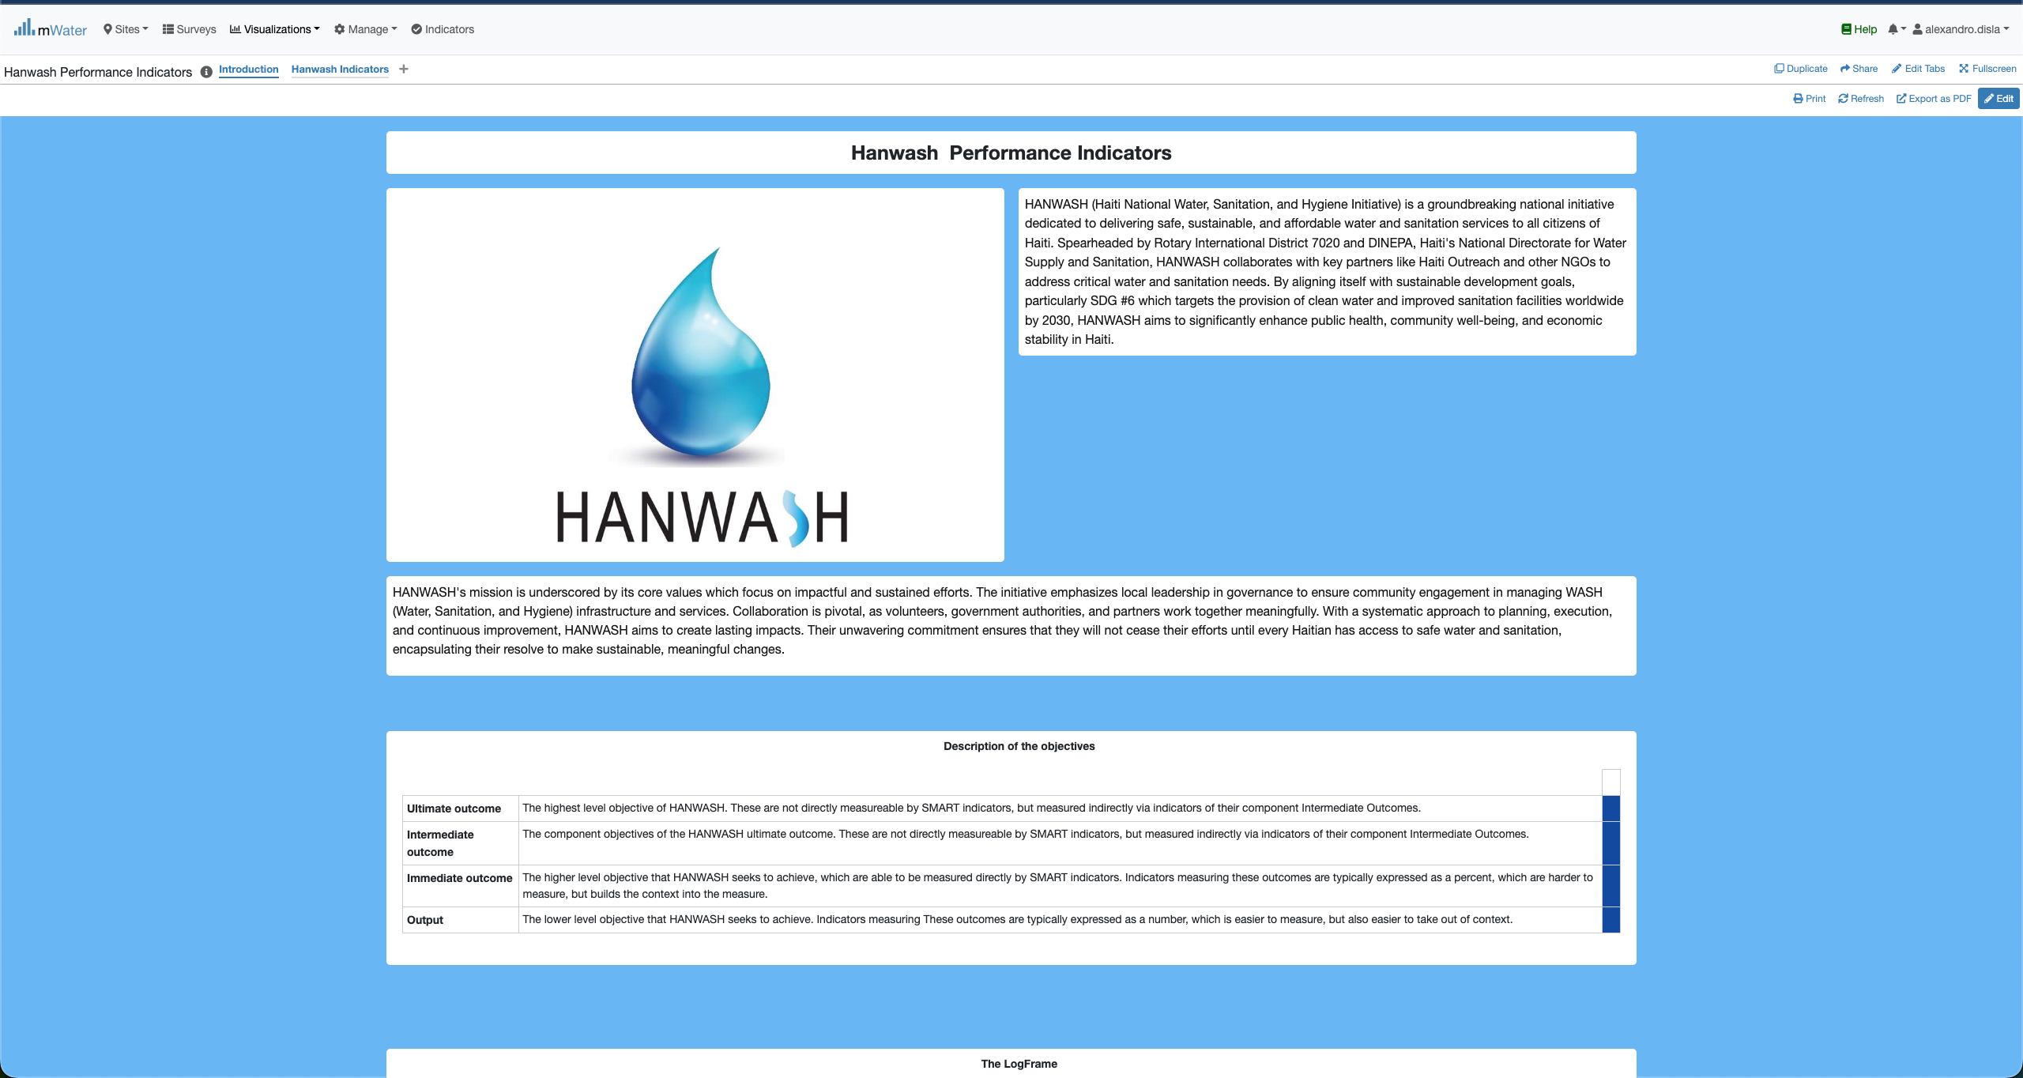
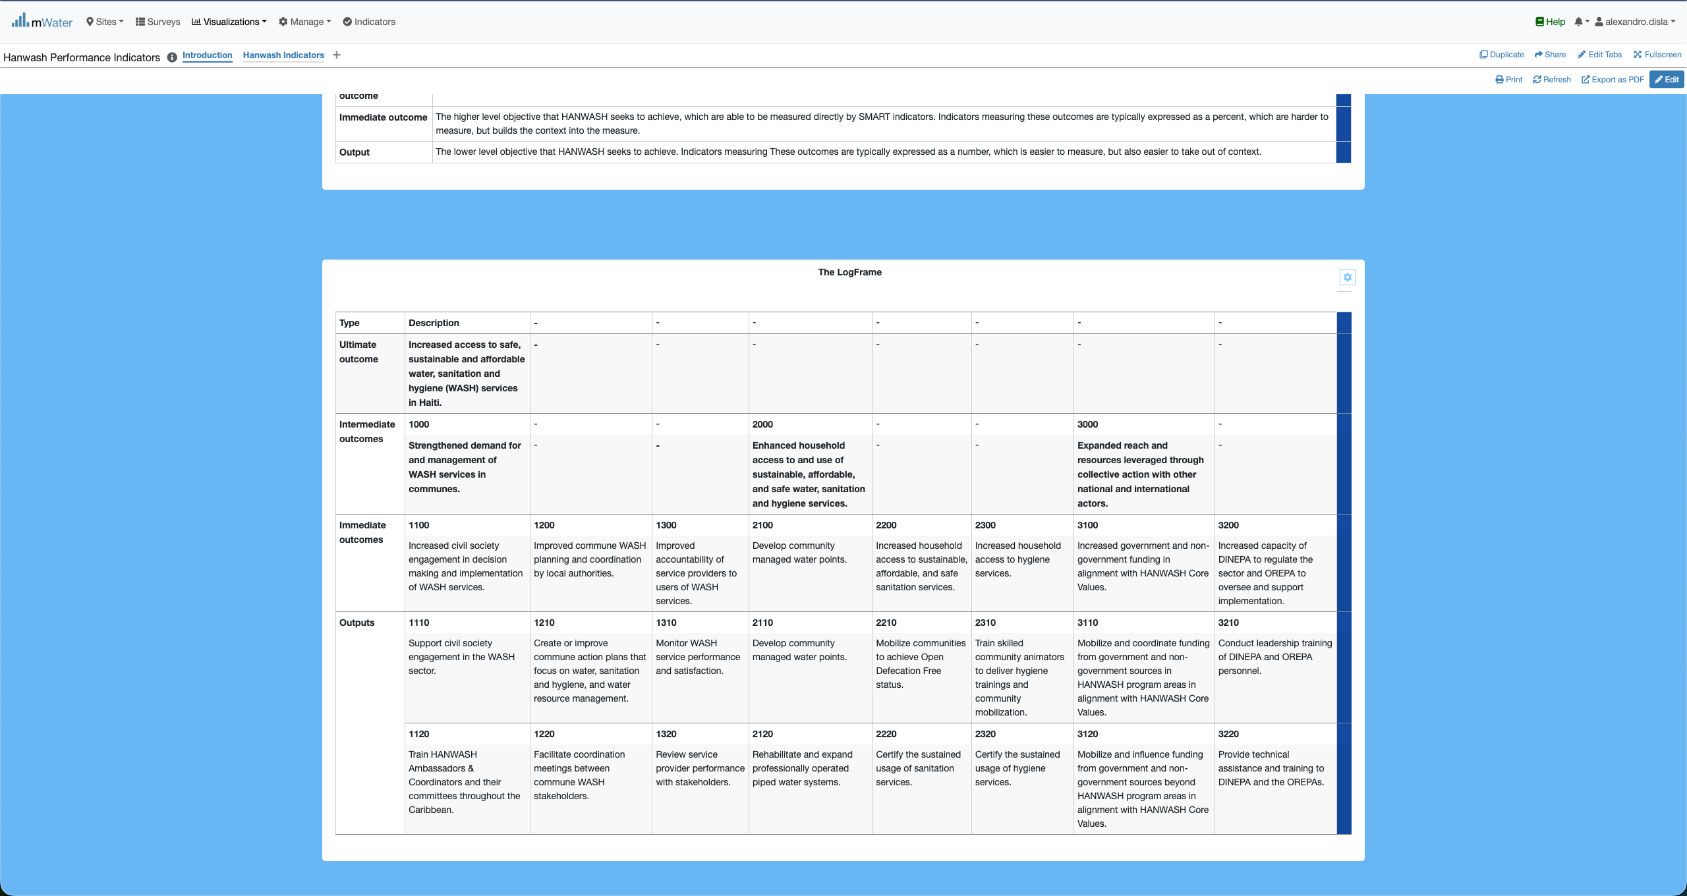
HIP Console overview

Slide 7
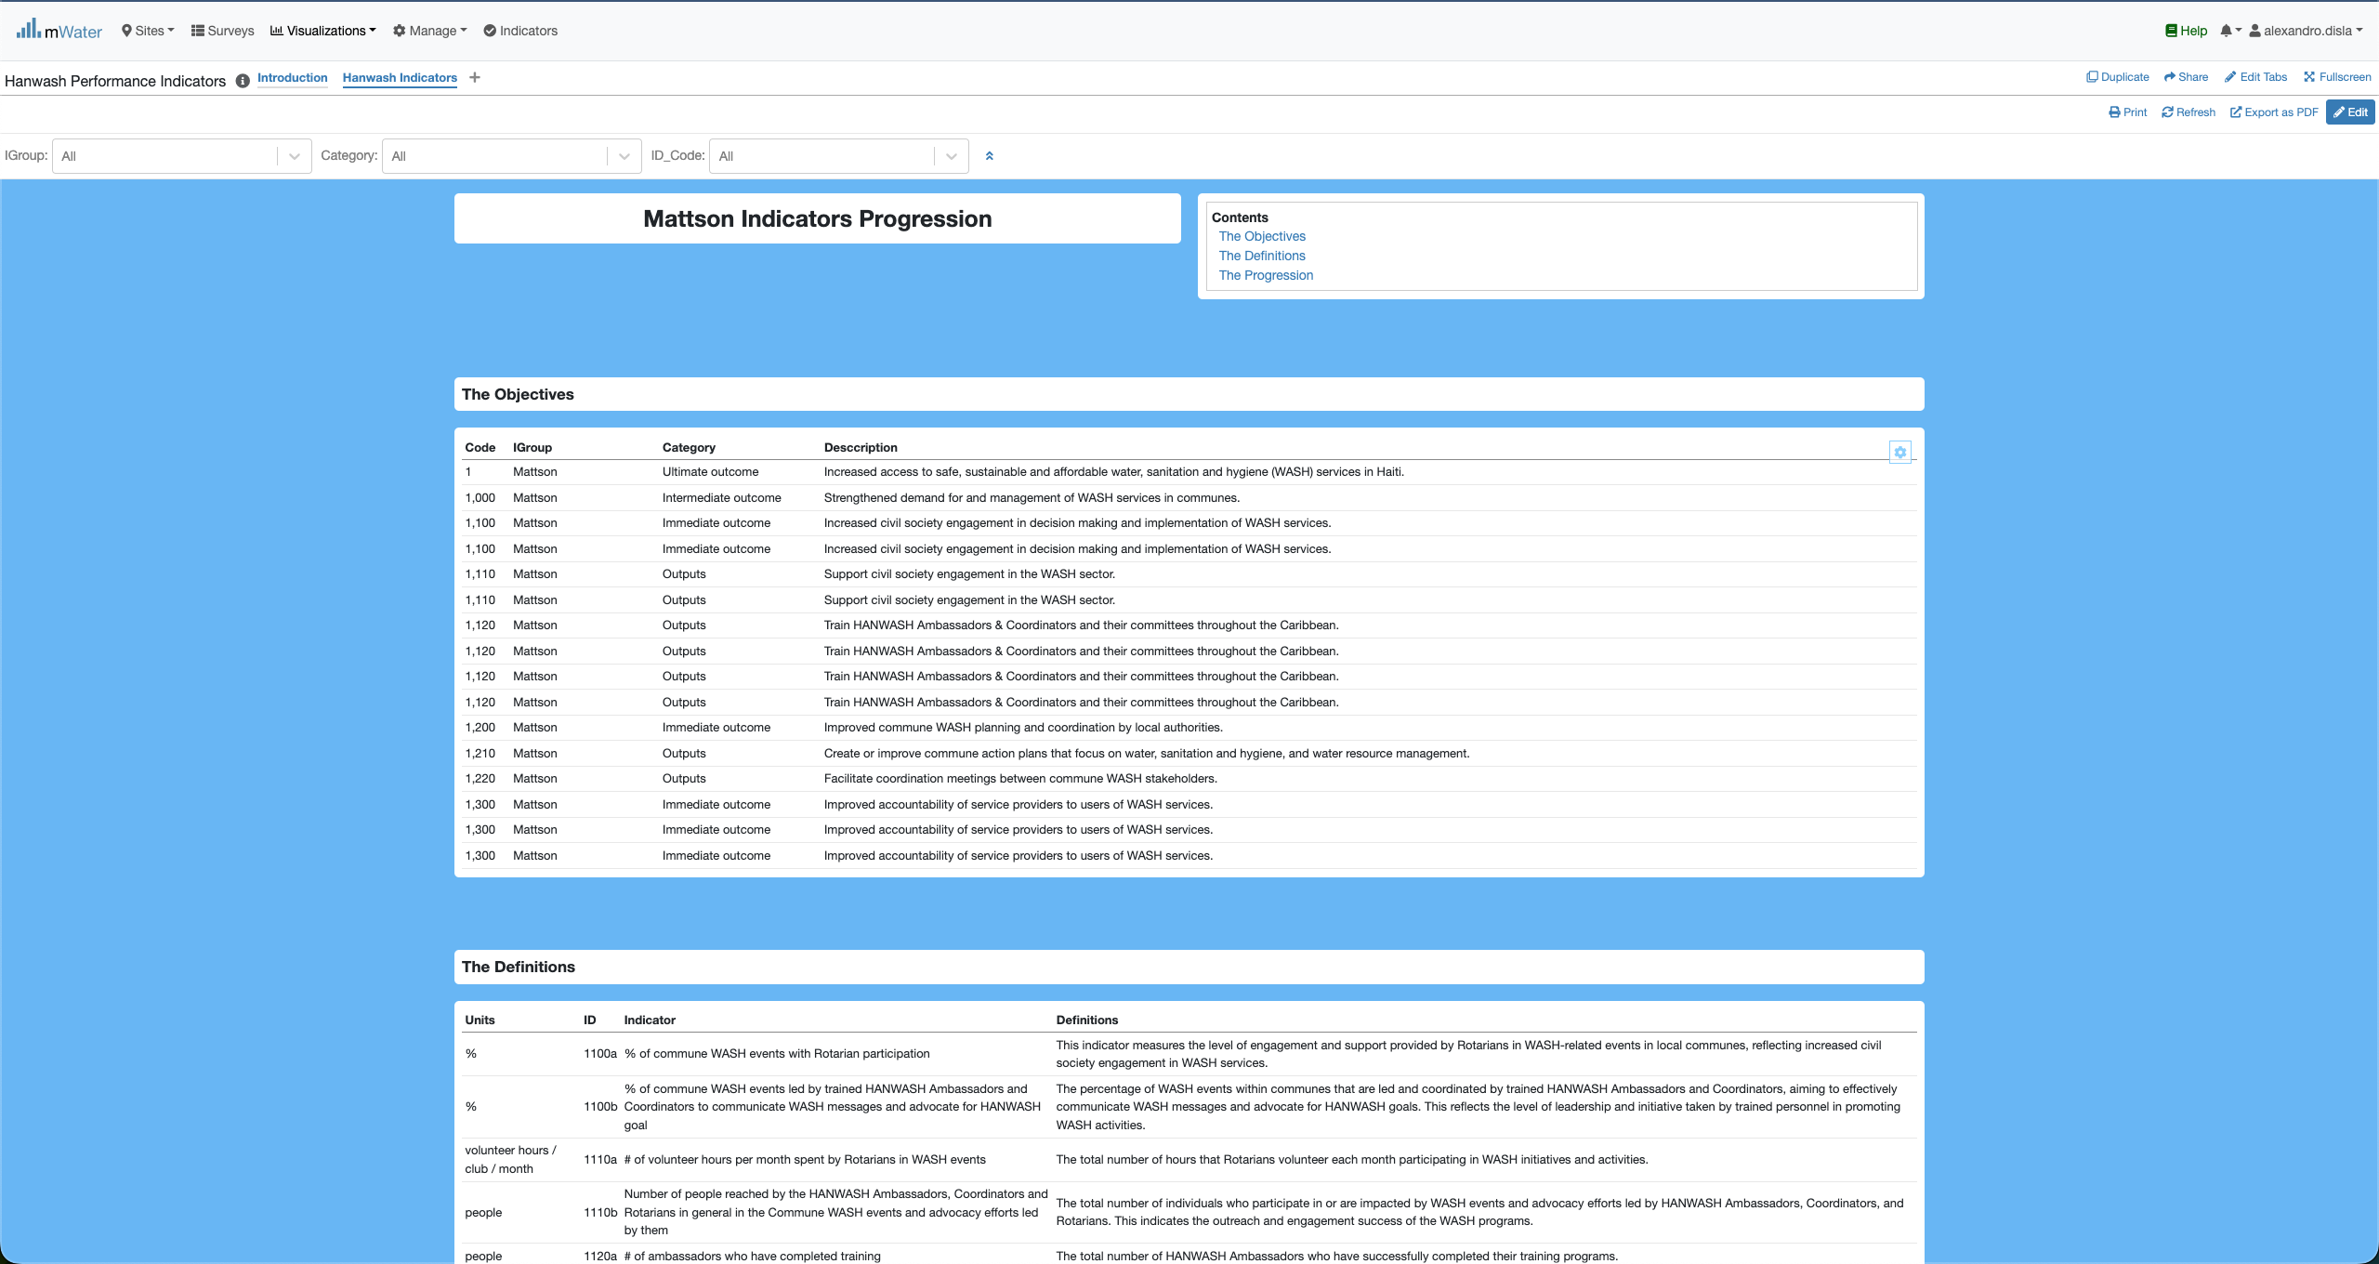
HIP Console overview

Slide 8
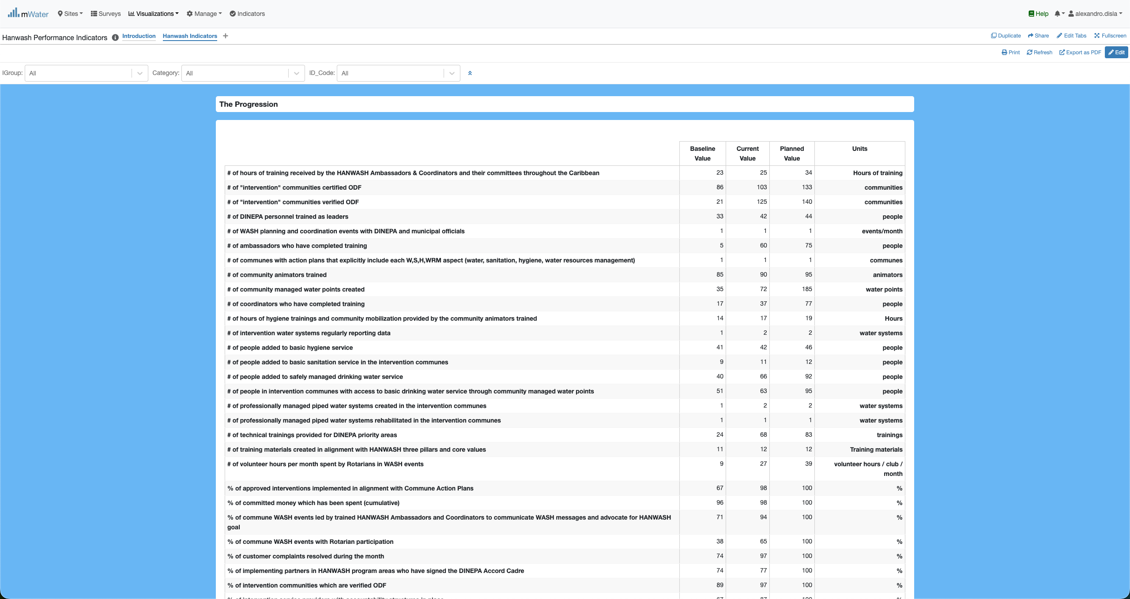
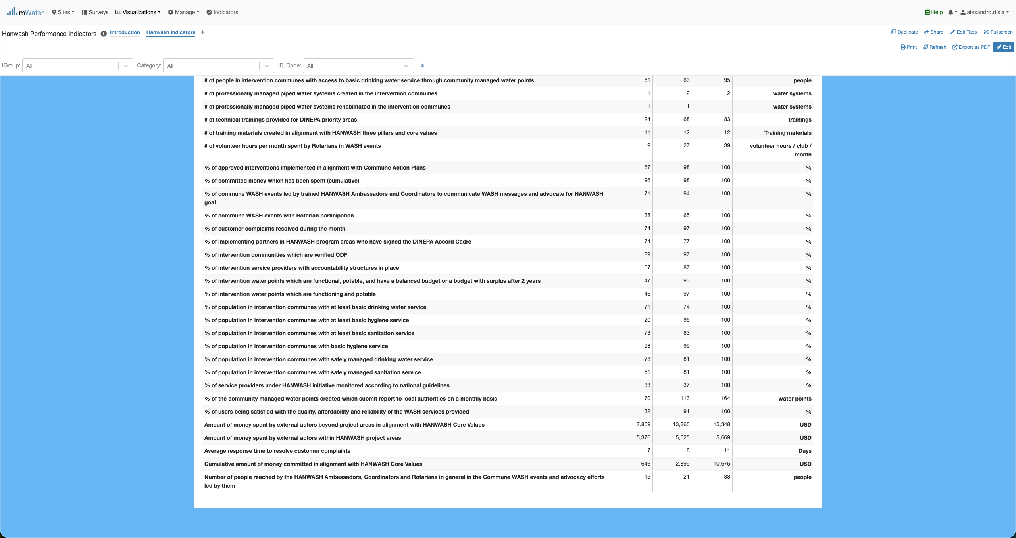
HIP Console overview

Slide 9
Functionalities
Functionalities available in the console

Slide 10
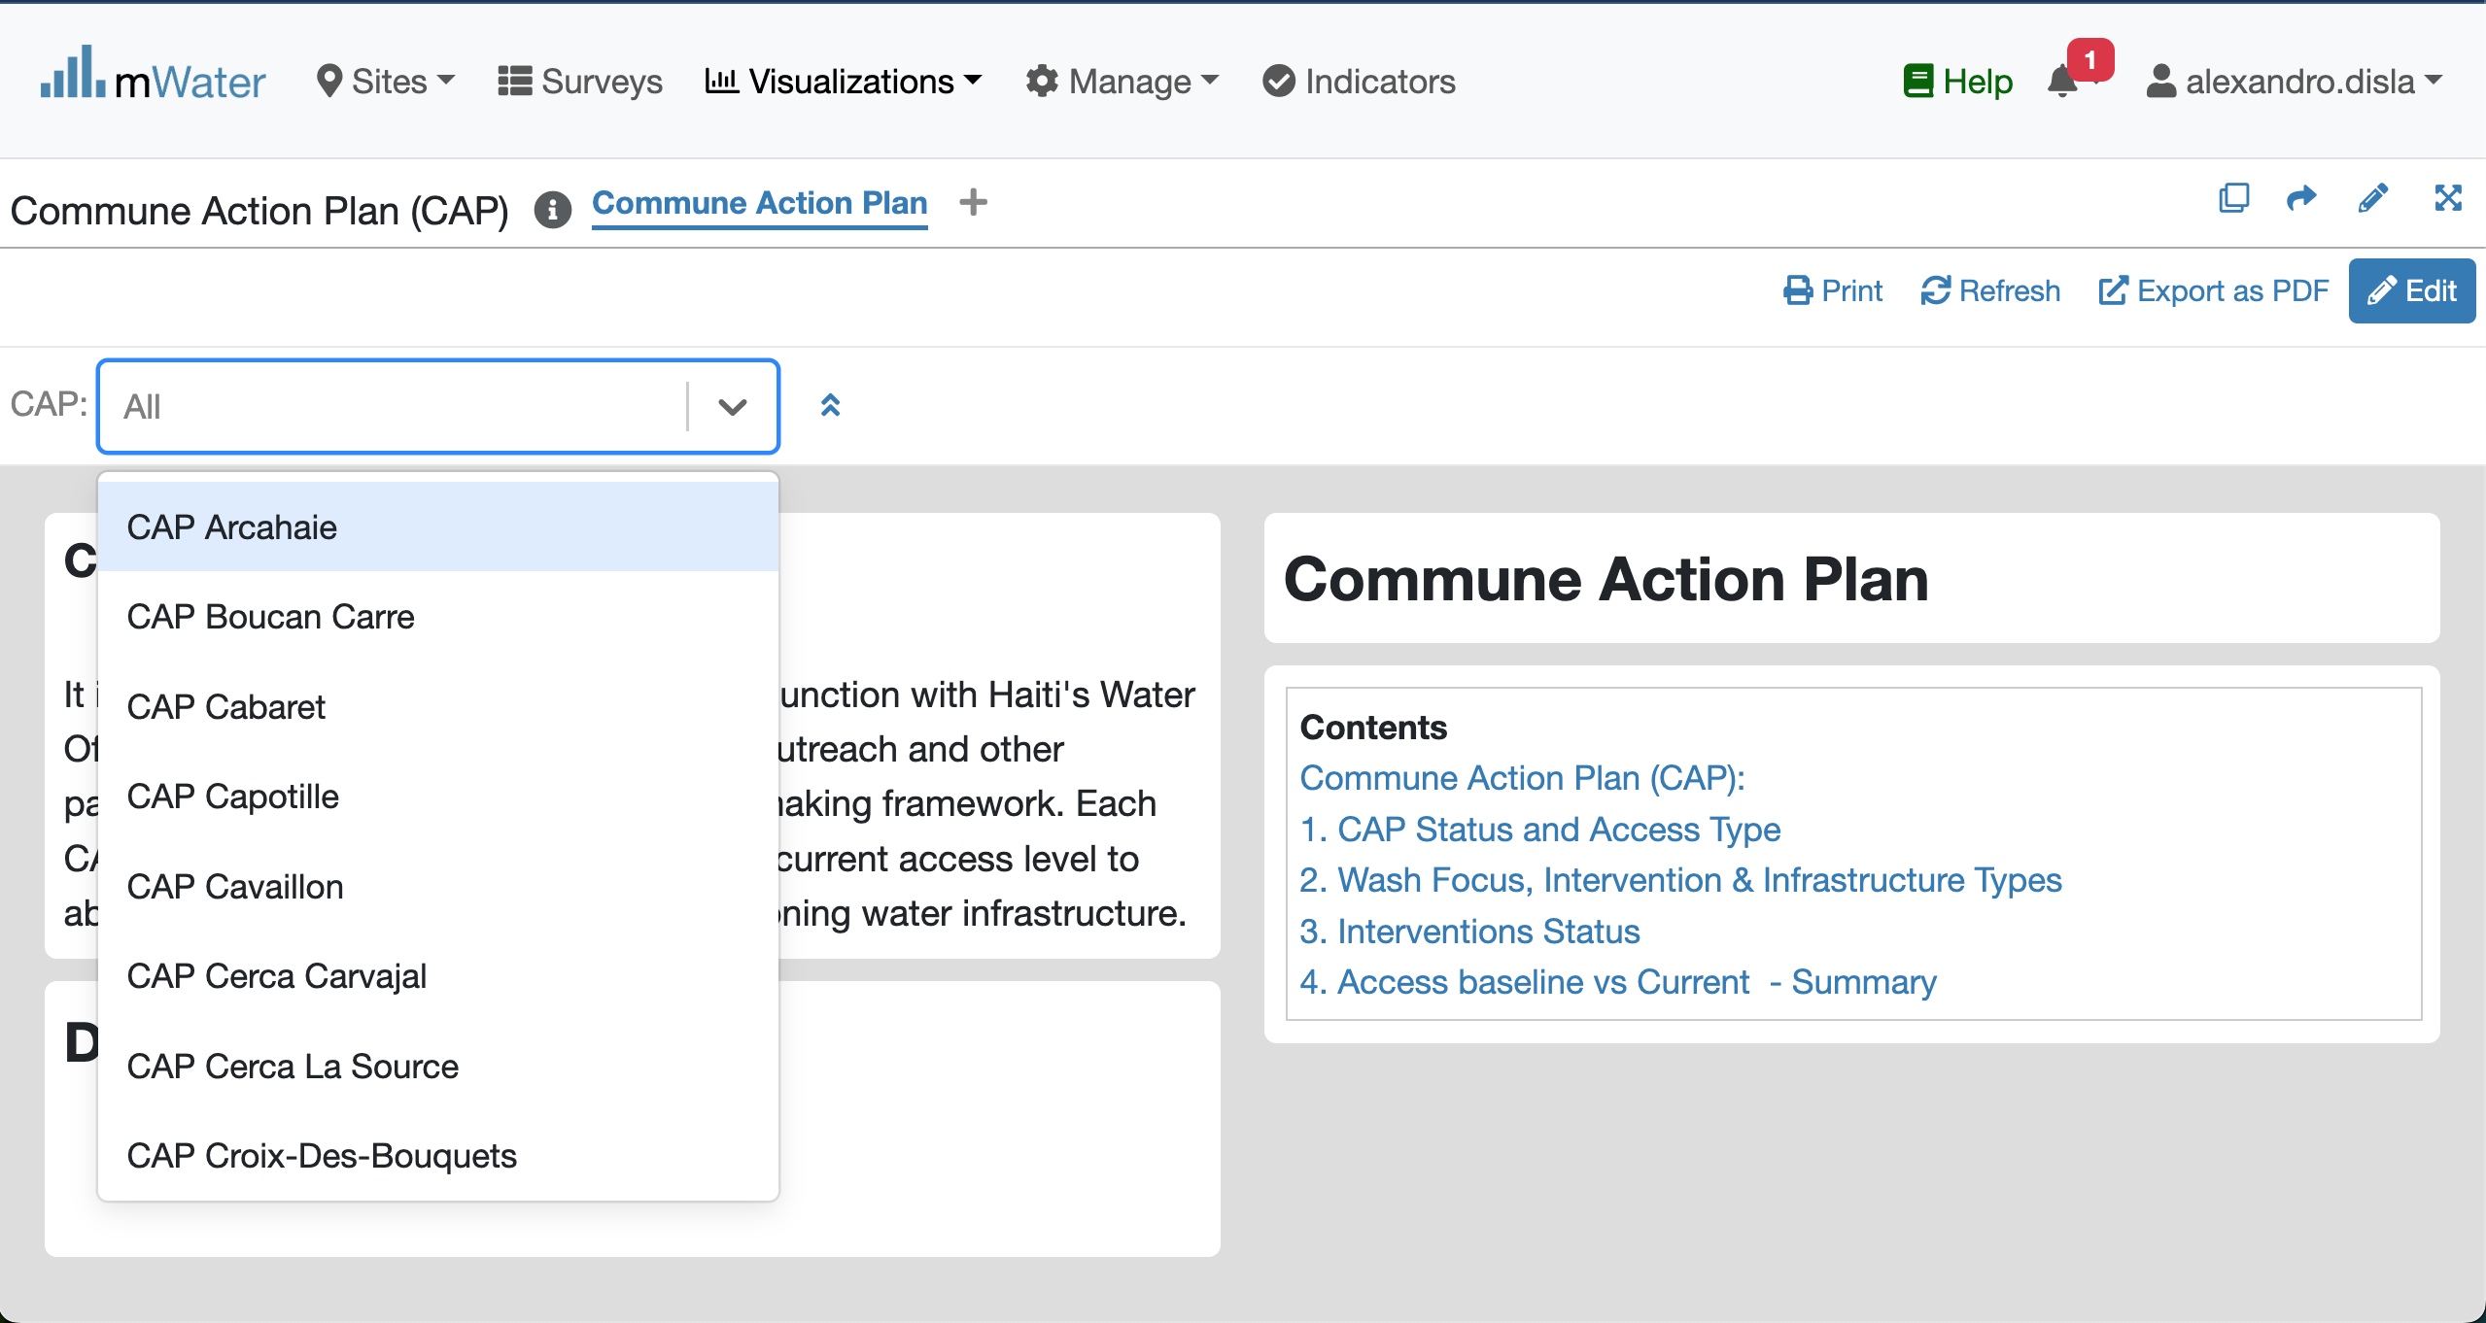
Quick filters
Click to get the dropdown list
Please select one CAP unit

