Slide 1
COMMUNE ACTION PLAN

Slide 2
Table of COntent
1. HANWASH home page
I.a. Access the Commnune Action Plan console
I.b Overview of the Console

Slide 3
Hanwash & CAP
Accessibility of the platform

Slide 4
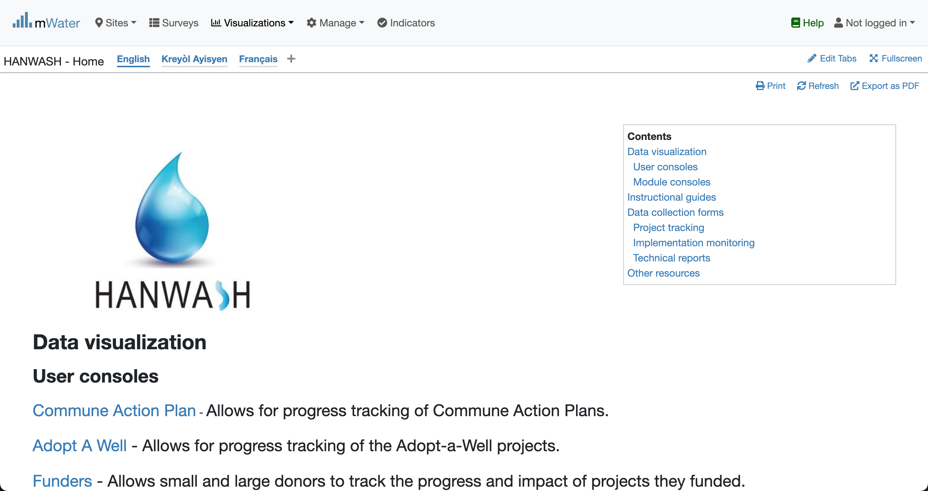
Hanwash HOME
URL LINK : http://go.mwater.co/hanwash

Slide 5
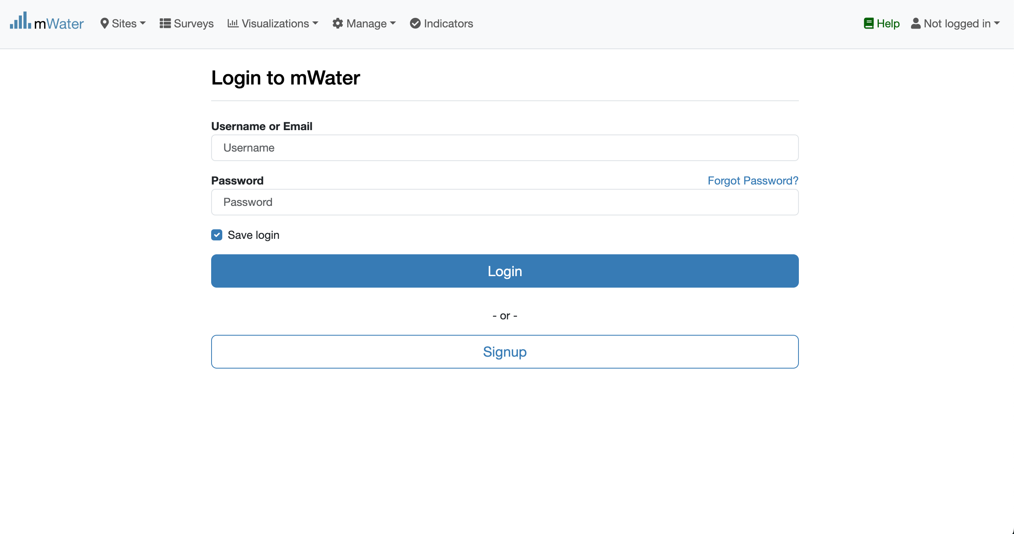

Access The CAP & Login process
Click on the CAP url link
Not Logged in
Please enter your Credentials

Slide 6
CAP Console overview

