Slide 1

Authentication mwater
This user guide will help you with the authentication process on the mWater Plateform

Slide 2
mWater
Platform compatibility: 1. Laptop web browser
II. Mobile mobile
TABLE OF CONTENT: 1. SIGNUP PROCESS
2. LOGIN PROCESS

Slide 3
SIGNUP
What are the steps?
Connection with the mWater plateform
The front page presentation
The signup form
The home page presentation

Slide 4
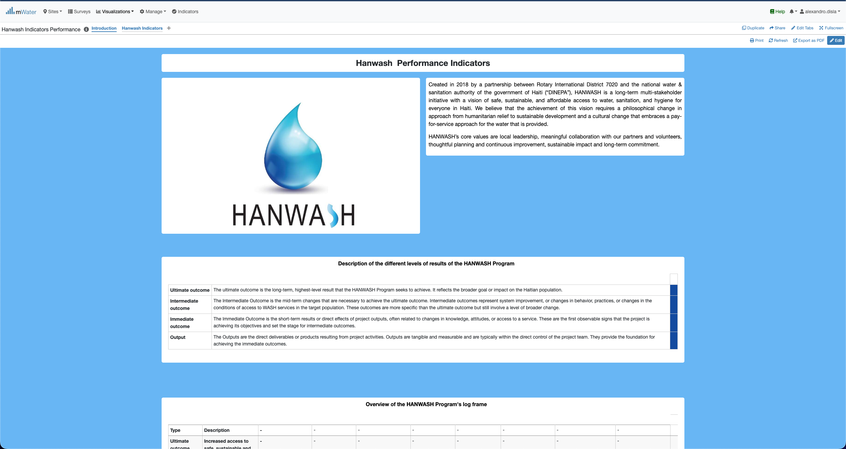
H.P.I Console overview

Slide 5
Login
What are the steps?
Connection with the mWater plateform
The front page presentation
The signup form
The home page presentation

Slide 6
MWATER
CONNECTION LINK: https://www.mwater.co

Slide 7
H.P.I Console overview

