Slide 1
Presentation du Modele
Benzico Pierre & Alexandro Disla

Slide 2
Presentation des Donnees

Slide 3
Source des Donnees
tx.change : Taux de Change Reel
imp: Importation Haitienne
exp: Exportation Haitienne
pib: Produit Interieur Brute Haitienne
pib.usa: Produit Interieur Brute des Etats Unis
ipc: L’indice des prix a la Consommation

Slide 4
Tableau des metadonnees
Variable | Specificite | Periode | Notes
tx.change | HTG/USD | 1960-2022 | une moyenne annuelle sur la base des moyennes mensuelles.
importation | USD constant 2010 | 1988-2022 | n/a
exportation | USD constant 2010 | 1988-2022 | n/a
pib | USD constant 2010 | 1960-2022 | n/a
pib.usa | USD constant 2010 | 1960-2022 | n/a
inflation | (2010 = 100) | 1960-2022 | n/a

Slide 5
Tableau Presentant les Donnees Brutes
Year | tx.change | imp | exp | pib | pib.usa | ipc
1988 | 5.000000 | 745600334 | 499392985 | 11370998251 | 9.288320e+12 | 4.544
1989 | 5.000000 | 657818737 | 549473202 | 11039712814 | 9.629447e+12 | 4.859
1990 | 5.000000 | 834229358 | 551332713 | 11154318590 | 9.811433e+12 | 5.892
1991 | 6.034167 | 704836857 | 496638065 | 11364080540 | 9.800433e+12 | 6.801
1992 | 9.801667 | 626903014 | 374412508 | 10760655486 | 1.014565e+13 | 8.118
1993 | 12.822500 | 925716700 | 457649660 | 10176750469 | 1.042483e+13 | 10.529
1994 | 15.040000 | 757331148 | 303552625 | 8960564746 | 1.084483e+13 | 14.670
1995 | 15.109733 | 1281062678 | 410306598 | 9847455234 | 1.113593e+13 | 18.720
1996 | 15.701150 | 1698392335 | 522320922 | 10255216034 | 1.155604e+13 | 22.574
1997 | 16.654500 | 1820946308 | 596893972 | 10532590290 | 1.206995e+13 | 27.215
1998 | 16.765667 | 1941077488 | 735828883 | 10762394593 | 1.261086e+13 | 28.649
1999 | 16.937892 | 2381827658 | 857126146 | 11054082178 | 1.321548e+13 | 29.509
2000 | 21.170667 | 2580052840 | 266998303 | 11150259244 | 1.375430e+13 | 32.264
2001 | 24.429083 | 2501294679 | 262119450 | 11112041966 | 1.388556e+13 | 36.560
2002 | 29.250483 | 2410003411 | 251250512 | 11228920661 | 1.412105e+13 | 39.131
2003 | 42.366758 | 2664368099 | 524038869 | 11619774656 | 1.451591e+13 | 50.362
2004 | 38.352033 | 2684992998 | 468876283 | 11466642670 | 1.507514e+13 | 60.954
2005 | 40.448550 | 2523553664 | 481325636 | 11818917813 | 1.560024e+13 | 69.471
2006 | 40.408517 | 3004202345 | 350351399 | 12027964993 | 1.603437e+13 | 77.353
2007 | 36.861417 | 2876170061 | 717478448 | 12594064767 | 1.635674e+13 | 82.425
2008 | 39.107592 | 3257532927 | 768662481 | 12928819077 | 1.637673e+13 | 95.021
2009 | 41.197608 | 3452360261 | 838386155 | 13690375514 | 1.595095e+13 | 95.395
2010 | 39.797400 | 4339676816 | 686833397 | 12916662363 | 1.638304e+13 | 100.000
2011 | 40.522822 | 4196125299 | 1580865372 | 13575181393 | 1.663696e+13 | 106.333
2012 | 41.949723 | 3869442762 | 1562010133 | 13643386417 | 1.701639e+13 | 111.669
2013 | 43.462783 | 4314317512 | 1650047860 | 14233433426 | 1.732981e+13 | 116.990
2014 | 45.215981 | 4223512840 | 1744864455 | 14644604938 | 1.772628e+13 | 121.012
2015 | 50.706427 | 4481319846 | 1747466817 | 14849629408 | 1.820602e+13 | 129.158
2016 | 63.335818 | 5098194685 | 1649811070 | 15118774201 | 1.850960e+13 | 144.015
2017 | 64.769680 | 5730757919 | 1658608711 | 15498296457 | 1.892457e+13 | 159.396
2018 | 68.031754 | 6014098931 | 1656636116 | 15756778743 | 1.948197e+13 | 179.291
2019 | 88.814966 | 6298217964 | 1621321956 | 15485274162 | 1.992898e+13 | 212.825
2020 | 93.509807 | 5147018632 | 1006359113 | 14973407577 | 1.937738e+13 | 261.342
2021 | 89.226637 | 5267020634 | 1242453998 | 14704149790 | 2.052946e+13 | 305.356
2022 | 115.630716 | 5526008278 | 1272003003 | 14456828346 | 2.095269e+13 | 409.127
Source: Banque de la republique d’Haiti

Slide 6
Tableau Presentant les Donnees en Logarithme Neperien
Year | tx.change | imp | exp | pib | pib.usa | ipc
1988 | 1.609438 | 20.42970 | 20.02890 | 23.15433 | 29.85978 | 1.513808
1989 | 1.609438 | 20.30444 | 20.12447 | 23.12476 | 29.89585 | 1.580833
1990 | 1.609438 | 20.54202 | 20.12785 | 23.13509 | 29.91457 | 1.773595
1991 | 1.797438 | 20.37348 | 20.02337 | 23.15372 | 29.91345 | 1.917070
1992 | 2.282552 | 20.25630 | 19.74087 | 23.09916 | 29.94807 | 2.094084
1993 | 2.551201 | 20.64608 | 19.94161 | 23.04337 | 29.97521 | 2.354133
1994 | 2.710713 | 20.44531 | 19.53107 | 22.91610 | 30.01471 | 2.685805
1995 | 2.715339 | 20.97096 | 19.83242 | 23.01048 | 30.04120 | 2.929592
1996 | 2.753734 | 21.25295 | 20.07379 | 23.05105 | 30.07823 | 3.116799
1997 | 2.812680 | 21.32262 | 20.20725 | 23.07774 | 30.12174 | 3.303768
1998 | 2.819333 | 21.38651 | 20.41651 | 23.09932 | 30.16558 | 3.355119
1999 | 2.829553 | 21.59113 | 20.56910 | 23.12607 | 30.21241 | 3.384695
2000 | 3.052617 | 21.67108 | 19.40275 | 23.13473 | 30.25237 | 3.473952
2001 | 3.195774 | 21.64007 | 19.38431 | 23.13130 | 30.26187 | 3.598955
2002 | 3.375896 | 21.60289 | 19.34196 | 23.14176 | 30.27869 | 3.666915
2003 | 3.746364 | 21.70323 | 20.07708 | 23.17597 | 30.30627 | 3.919237
2004 | 3.646808 | 21.71094 | 19.96585 | 23.16271 | 30.34407 | 4.110119
2005 | 3.700031 | 21.64893 | 19.99205 | 23.19297 | 30.37831 | 4.240909
2006 | 3.699041 | 21.82328 | 19.67445 | 23.21050 | 30.40576 | 4.348379
2007 | 3.607165 | 21.77973 | 20.39125 | 23.25649 | 30.42566 | 4.411889
2008 | 3.666317 | 21.90424 | 20.46016 | 23.28272 | 30.42688 | 4.554098
2009 | 3.718380 | 21.96232 | 20.54699 | 23.33996 | 30.40054 | 4.558026
2010 | 3.683802 | 22.19107 | 20.34760 | 23.28178 | 30.42727 | 4.605170
2011 | 3.701865 | 22.15743 | 21.18124 | 23.33151 | 30.44265 | 4.666576
2012 | 3.736472 | 22.07638 | 21.16924 | 23.33652 | 30.46520 | 4.715539
2013 | 3.771905 | 22.18520 | 21.22407 | 23.37886 | 30.48345 | 4.762088
2014 | 3.811451 | 22.16393 | 21.27994 | 23.40734 | 30.50607 | 4.795890
2015 | 3.926053 | 22.22318 | 21.28143 | 23.42124 | 30.53277 | 4.861036
2016 | 4.148451 | 22.35215 | 21.22393 | 23.43920 | 30.54931 | 4.969917
2017 | 4.170838 | 22.46911 | 21.22924 | 23.46400 | 30.57148 | 5.071392
2018 | 4.219975 | 22.51737 | 21.22805 | 23.48054 | 30.60051 | 5.189010
2019 | 4.486555 | 22.56353 | 21.20651 | 23.46316 | 30.62320 | 5.360470
2020 | 4.538066 | 22.36168 | 20.72960 | 23.42954 | 30.59513 | 5.565830
2021 | 4.491180 | 22.38473 | 20.94035 | 23.41140 | 30.65288 | 5.721478
2022 | 4.750402 | 22.43273 | 20.96386 | 23.39443 | 30.67329 | 6.014026
Source: Banque de la republique d’Haiti

Slide 7
Analyse Graphiques

Slide 8
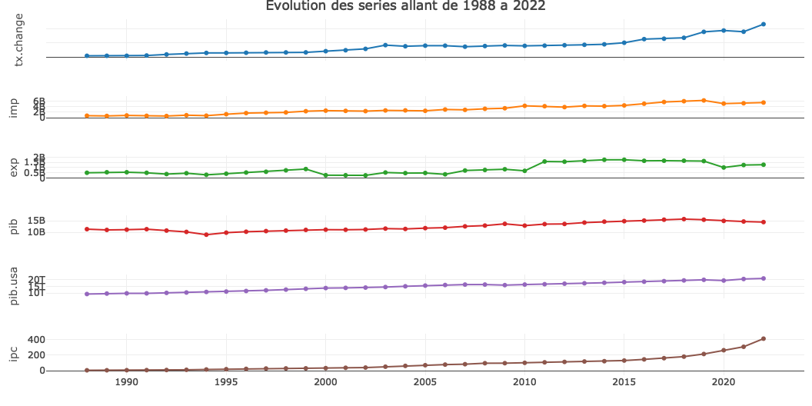
Graphes des donnees Brutes

Slide 9
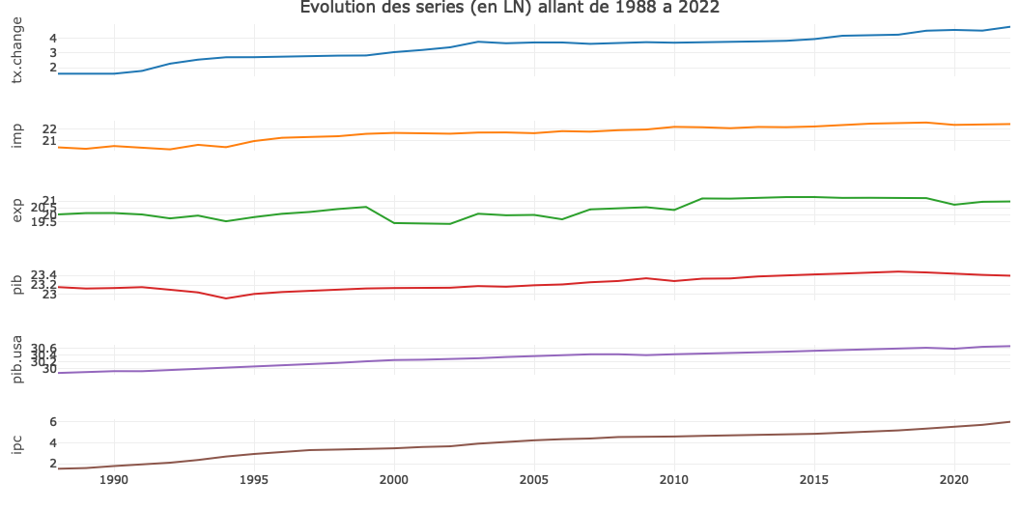
Graphes des donnees en Logarithme Neperien

