Slide 1

P: Modular and Safe Asynchronous Programming
Part 2
Ankush Desai, UC Berkeley
Shaz Qadeer, Microsoft Research

Slide 2
Recap
P program is a collection of state machines.
P provides primitives for modeling non-determinism and performing “unit” testing.
P compiler generates both code for systematic testing and C/C++ code for execution.
P systematic testing engine is able to reproduce hard to find Heisenbugs in asynchronous message passing programs.
Notes:
Let me do a quick recap of the points covered by Shaz.
A P program is a collection of state machines
P provides primitives for modeling nondeterminism in the environment and perform unit testing using test drivers

Slide 3
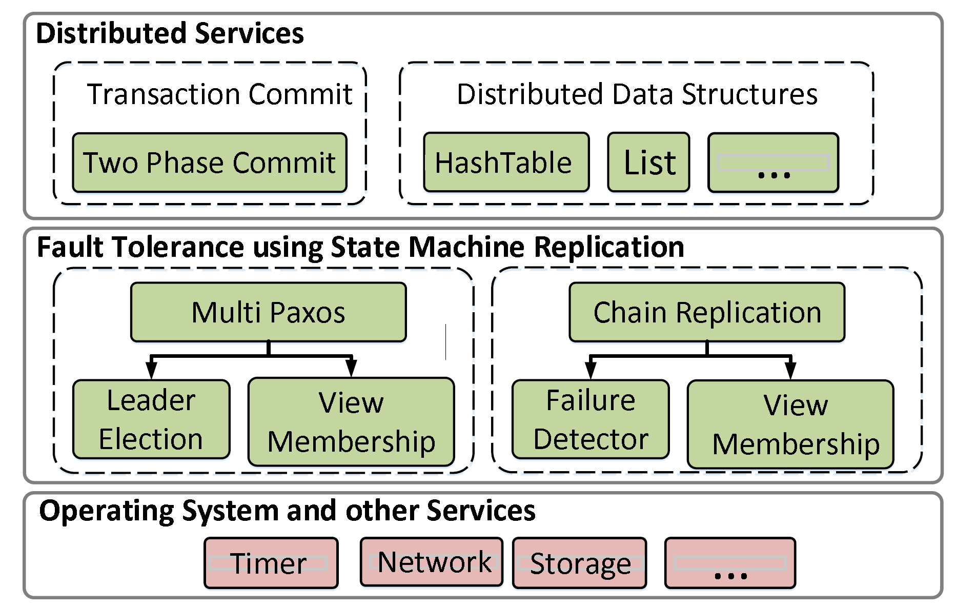
Fault-Tolerant Distributed System
Transaction commit service using Two Phase Commit protocol.
Software stack of a fault-tolerant distributed application
State machine replication is a general method for implementing a fault-tolerant service by replicating logs.
Notes:
We considered the case study of building a fault tolerant distributed system using P.
The figure shows the complete software stack of a fault tolerant distributed system.
We built a transaction commit service that provides transactional guarantees in a distributed setting.
The transaction commit system is built using the two phase commit protocol at the top where a coordinator interacts with participants to provide atomicity guarantee that the transaction is either committed by all the participants or by none.
But the two phase commit protocol is not fault tolerant, failure of any one of the nodes can lead to no progress guarantees.
One way to add fault tolerance is by replicating each of the processes in the 2PC protocol using state machine replication.
There are many ways of implementing SMR, we implemented two protocols (1) multipaxos and (2) chain replication each protocol has different characteristics but they both provide the same guarantee of linearizability
These protocols inturn depend on other subprotocol.
In summary, building a real world distributed system with real-world requirements involves systems that consists of many protocols.

Slide 4
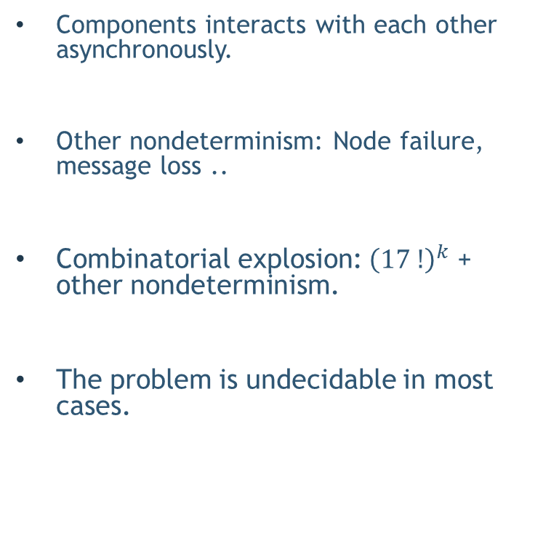
Testing Distributed Systems is Challenging
Components interacts with each other asynchronously.
Other nondeterminism: Node failure, message loss ..
Combinatorial explosion: ${\left(17 !\right)}^{k}$ + other nondeterminism.
The problem is undecidable in most cases.
1 fault tolerant system
4
3
3
3
3
$${worst case total executions :\left(17 !\right)}^{k}$$
Notes:
Testing such distributed systems is challenging and generally prohibitively hard.
Components interact with each other asynchronously by sending messages to each other.
Hence, the programmer has to reason about of possible interleaving's of the program.
Which is really large in general.
For example, for a 1 fault tolerant system (system that can handle one node failure).
There are 4 nodes in the 2 pc protocol, 3 nodes in paxos as it has to maintain a quorum even after a node fails, 3 nodes in ….
Which means that in the worst case there are approx. (17!).. Executions in the system where k is the max depth of any process in the system.
This number is huge even for small depths and getting any meaning coverage is hard.
But this was only because of concurrency, in distribute systems there are other forms of non-determinism. Node failure, message loss, etc. Modeling all this leads to an combinatorial explosion.
The problem is undecidable in most cases because conditions like unbounded buffers and unbounded inputs.

Slide 5
Testing Distributed Systems is Challenging
Exhaustive and random search techniques do not scale.
Inadequate test coverage.
Symbolic execution based approaches also face the path explosion problem.
In practice, bugs are generally found in production or after deployment !
Notes:
The tradition testing approaches like model checking and random testing do not scale because of the combinatorial explosion.
Symbolic execution based approaches may be able to handle unbounded inputs scenarios but still suffer with the problem of path explosion, and in the case of concurrency the interleavings lead to path explosion that are generally really hard to handle using symbolic execution.

Slide 6
Scalable Testing of Distributed Systems
Problem:
Monolithic testing does not scale.
No re-use of the systematic testing effort.
Notes:
To summarize:
The main problem is performing monolithic testing that is “whole system” testing does not scale and fails to provide any coverage guarantees.
The other issue is monolithic testing does not provide any support for re-use testing efforts.
For example: Lets say we testing that the system consisting of … is correct but as the system evolved we would like to replace M with C, in that case one would have to re-test the entire system.

Slide 7
Solution: Divide and Conquer
Two fold:
Test-amplification via abstractions: Test each component in isolation.
Module system based on theory of compositional refinement: Test “whole-system” properties by testing each component in isolation.
Notes:
The solution is fairly obvious, one would like to use a divide and conquer approach.
The solution is two fold:
Test each component in isolation by using abstractions of the other component in its environment. The hope here is that the abstraction of the environment are much more simpler than the actual implementation modules in the environment.
For example, when testing the 2PC protocol, one would like to compose it with a simple single process linearizability abstraction instead of composing it with the entire multi-paxos system.
2) The second part about the solution is after testing each component in isolation one would like to conclude certain properties about the entire system, “like in the case of monolithic testing”.
This can be using a module system based on theory of composition refinement.

Slide 8
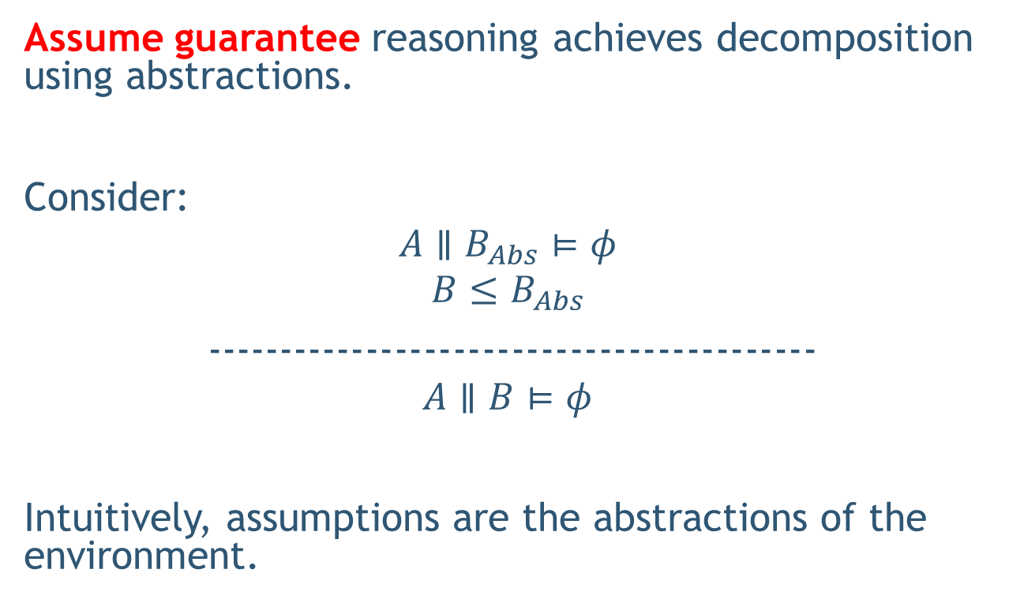
Test Amplification via Abstraction
Assume guarantee reasoning achieves decomposition using abstractions.
Consider:
$$A∥B_{Abs}⊨φ$$
$$B≤B_{Abs}$$
------------------------------------------
$$A∥B⊨φ$$
Intuitively, assumptions are the abstractions of the environment.
Notes:
The idea of using abstraction to simplify the testing problem is a well-known technique and was pioneered by the assume-guarantee literature.
For example: consider the case where we want to prove that A||B satisfies property phi.
One can simplify the problem by first coming up with a good abstraction Babs and then testing the simplified problem that ….
I said good abstraction because it is important that Babs is simpler than B and simplifies A || Babs.
The assumptions about the environment of A are captured by the abstraction and the refinement check basically guarantees that the assumptions hold.

Slide 9
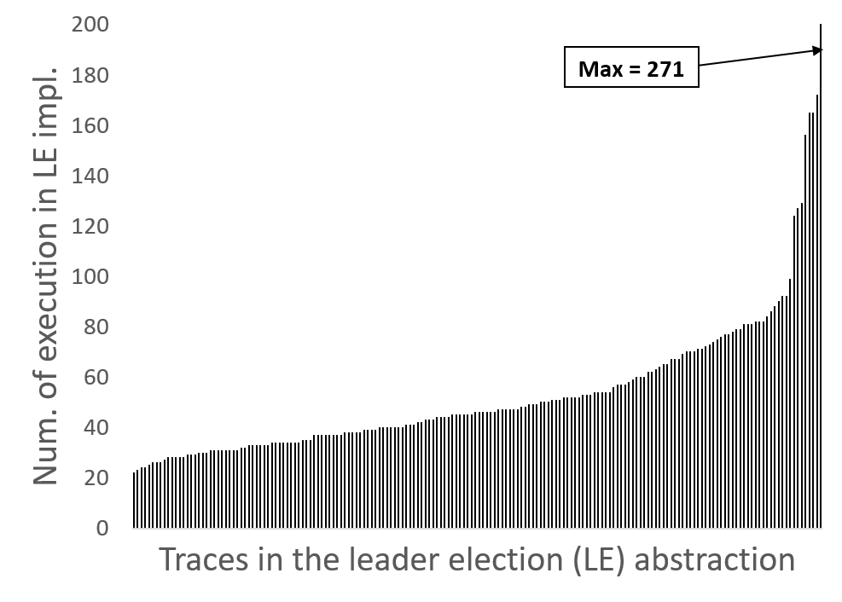


Test-Coverage Amplification
$$MultiPaxos∥ LeaderElection≤Linearizability$$
$$M×L$$
$$MultiPaxos∥ LeaderElectionAbs≤Linearizability$$
$$M×L/271$$
N = 3, K = 50
Linear scale up in test coverage
Notes:
Let me show some results with respect to test coverage amplification using abstractions.
Lets say we want to test that MP || LeaderElection …
Using abstraction one would like to test multipaxos.
To show that this is beneficial we conducted an experiment.
The x axis represents all possible traces in the leader election abstraction. Each point on the x axis a different trace.
The y axis represents number of executions that map to same trace in the abstraction.
The way to interpret this graph is there are 271 executions in the implementation of the LE protocol that map to the same visible trace.
When MultiPaxos is composed with LEImpl there 271 cases when all those executions lead to the same interaction with multipaxos.
Hence when using Abs you get close to linear speed up in test coverage !!

Slide 10
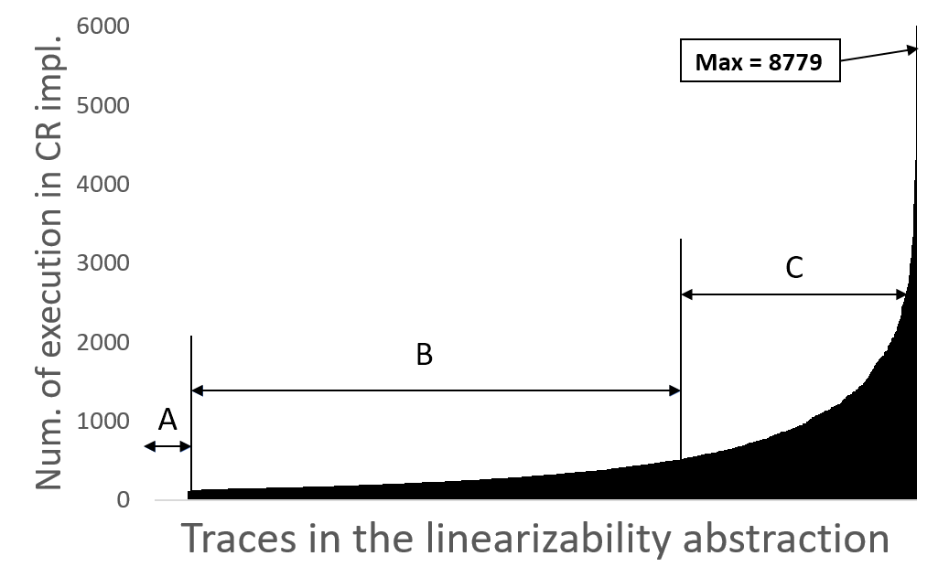
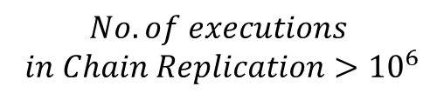
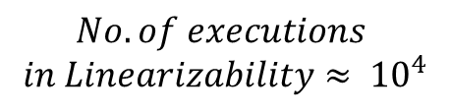
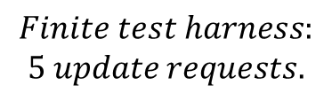

Test-Coverage Amplification
$$ChainReplication≤Linearizability$$
$$Finite test harness:$$
$$5 update requests.$$
$$No. of executions$$
$$in Linearizability≈ {10}^{4}$$
$$No. of executions$$
$$in Chain Replication>{10}^{6}$$
Hard to find executions (or false positives)
Low probability executions
High probability executions
Notes:
Chances of uncovering low probability behavior are higher when using abstraction than when using implementation, alteast it wont be as skewed as here as the number of traces are small.
We can consider the relation ship between the chain replication based SMR and the linearizability abstraction.
For a finite test harness consisting of 5 update requests, we compute all possible traces in .. There are 10^4
We compute the number of traces in CR that map to these execution, there are unbounded number of them but we sample only 10^6 of them.
We found the behavior is highly skewed.
There are some behaviors or traces that are too common, some low and some don’t occur.
Using random search or exhaustive search would normally dwell in tha C region. Using abstraction ……

Slide 11
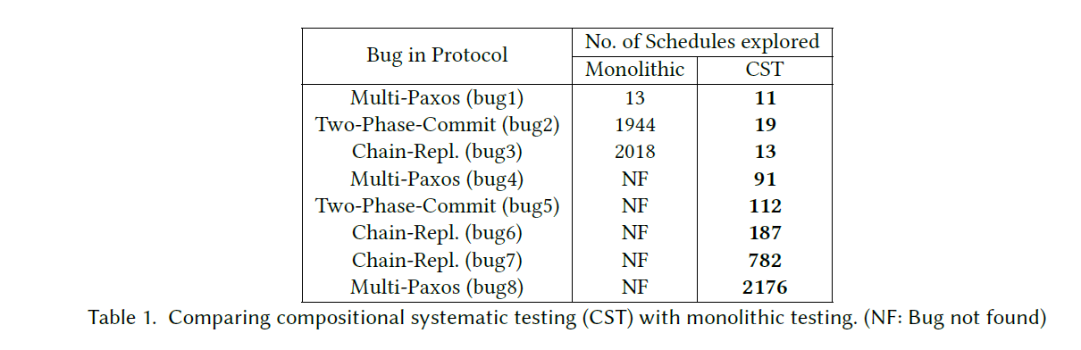
Monolithic vs Compositional
Notes:
There is a huge value of using compositional testing as we uncover more bugs.

Slide 12
Solution: Divide and Conquer
Two fold:
Test-amplification via abstractions: Test each component in isolation.
Module system based on theory compositional refinement: Test “whole-system” properties by testing each component in isolation.

Slide 13
Assume-Guarantee Reasoning
A notion of a module that can be composed with other modules.
The ability to describe a module at multiple levels of abstraction and check that a concrete description refines an abstract description.
The capability to seamlessly substitute, in the environment of a module, any concrete module with its abstraction.
Notes:
There are three technical mechanisms required for introducing assume-guarantee reasoning into a programming framework:

Slide 14
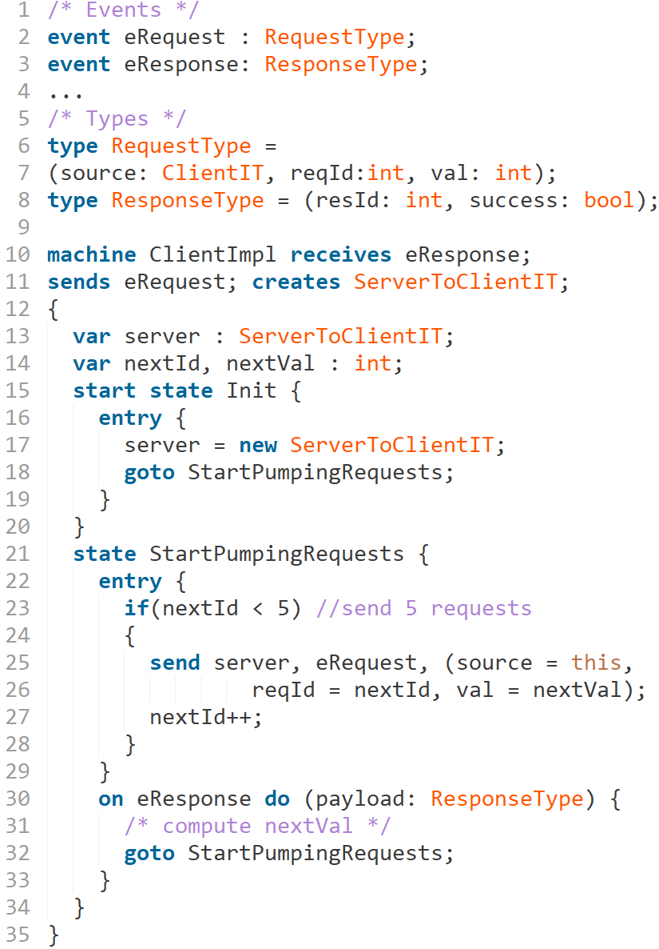
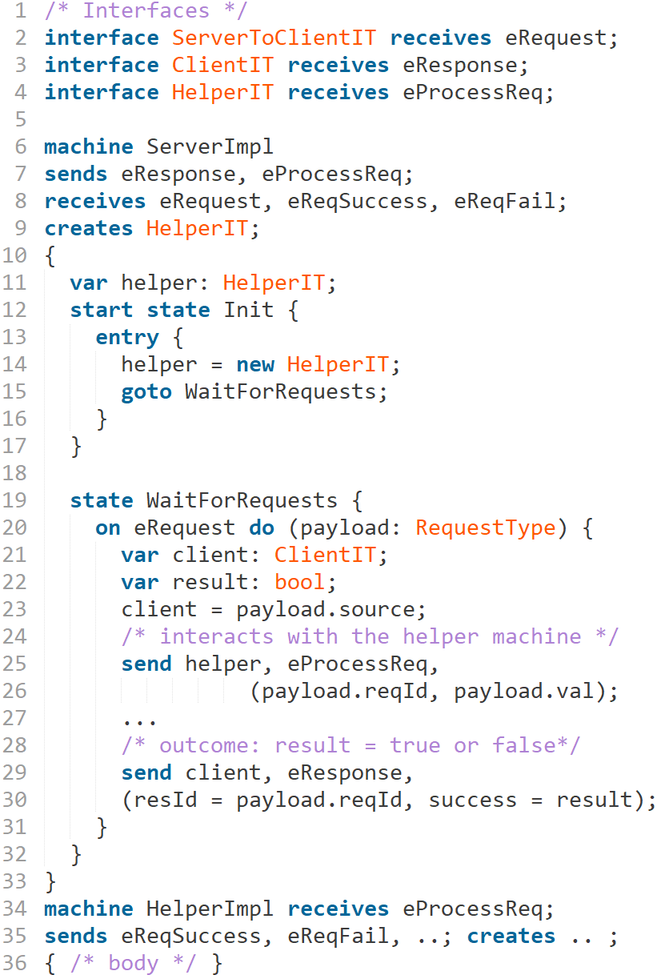
Client Server Application

Slide 15
Substitution
A key feature required for compositional reasoning is substitution, the ability to seamlessly bind the creation statement:
new ServerToClientIT()
to ServerImpl when testing server implementation and to ServerAbs when testing its environment.
Notes:
A key feature for assume guarantee or compositional reasoning is substitution.
That is the ability to substitute an abstract module with its implementation and vice versa.
It basically boils down to the ability to seamlessly bind a create statement like new Iserver() to a …

Slide 16
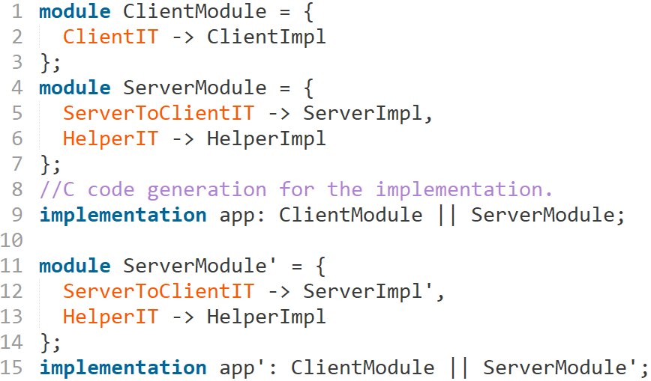
Compositional Programming

Slide 17
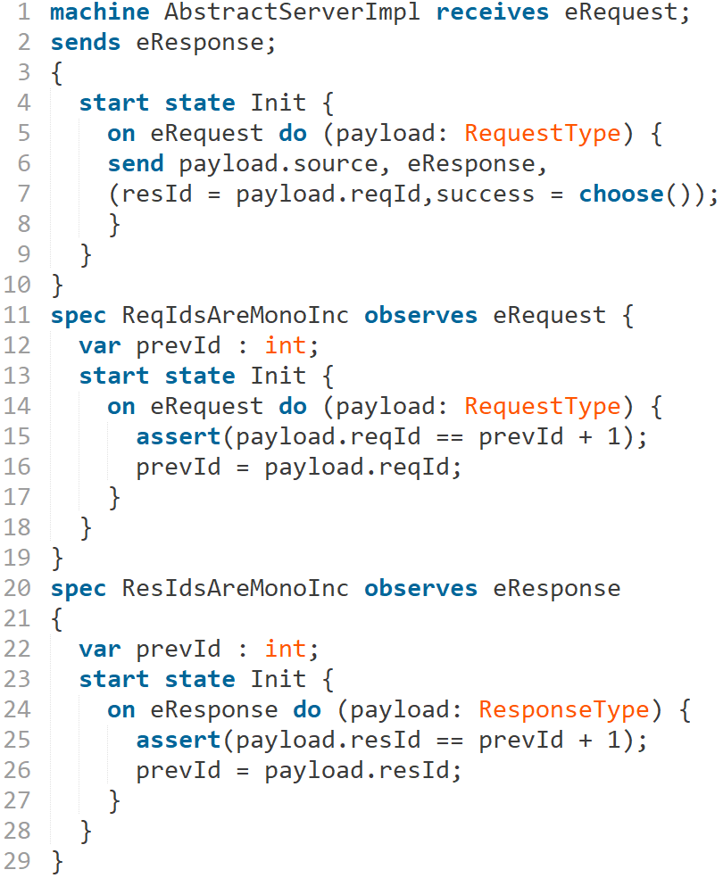
Specifications and Abstractions

Slide 18
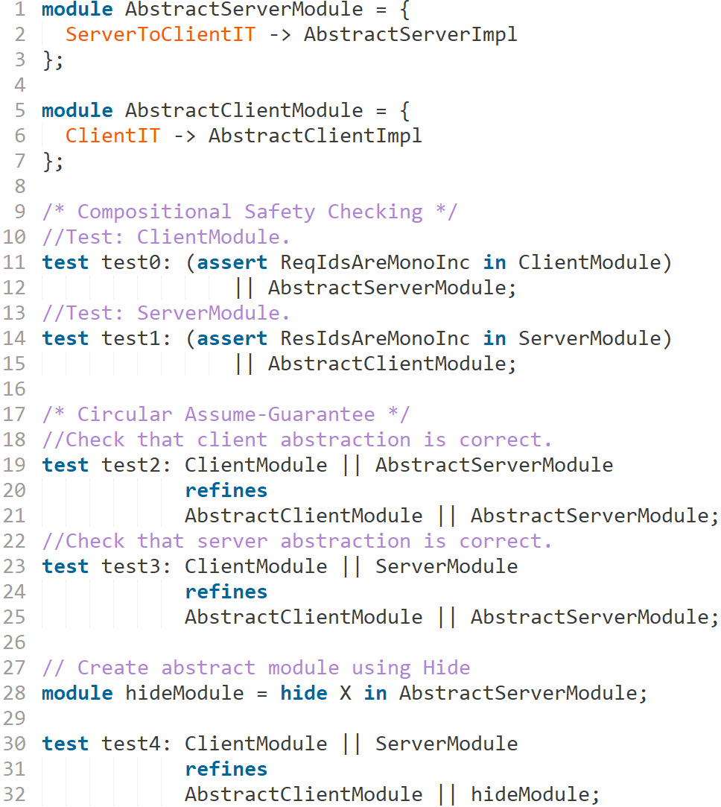
Compositional Testing

Slide 19
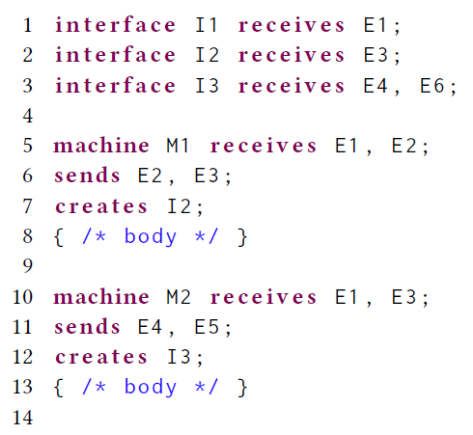
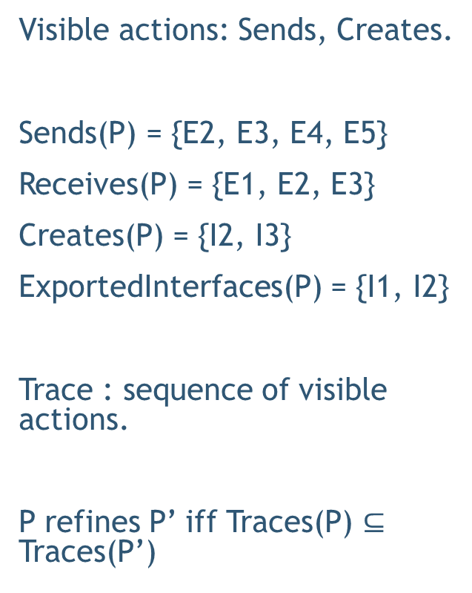

Traces and Refinement
Visible actions: Sends, Creates.
Sends(P) = {E2, E3, E4, E5}
Receives(P) = {E1, E2, E3}
Creates(P) = {I2, I3}
ExportedInterfaces(P) = {I1, I2}
Trace : sequence of visible actions.
P refines P’ iff Traces(P) $⊆$ Traces(P’)
$$module P = \{ I1→M1, I2→M2 \};$$

Slide 20
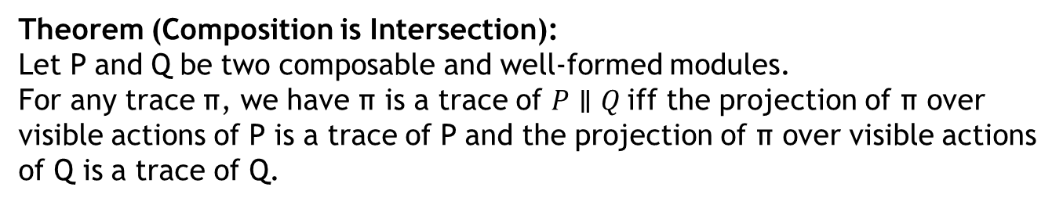


Composition
$P∥Q$: similar to union but requires output actions to be disjoint.
Theorem (Composition is Intersection):
Let P and Q be two composable and well-formed modules.
For any trace π, we have π is a trace of $P∥Q$iff the projection of π over visible actions of P is a trace of P and the projection of π over visible actions of Q is a trace of Q.
Example: $π ≔new I$

Slide 21
Example
Compositional Reasoning and Refinement Checking

Slide 22
Compositional Reasoning of Distributed Systems
Decompose using AG principle into following simpler checks:
Layer 0
Layer 1
Layer 1
$$MultiPaxos∥ LeaderElection∥ .. ≤ MultiPaxosSMR$$
Layer 2

Slide 23
Example
https://github.com/p-org/P/blob/master/Src/Samples/FaultTolerantDistributedSystems/ChainReplication/Test/TestScript.p

Slide 24
Why check refinement ?
Refinement helps ensure that we are not missing behaviors during testing.
Found multiple cases where our abstraction was unsound and could have led to failure in composed system.

