Slide 1
Pyrope
Towards provably correct hardware modeling in Python/HeteroCL
Presenter:
Deyuan (Mike) He, University of Washington
Incoming Ph.D. student @ PrincetonCS

Slide 2



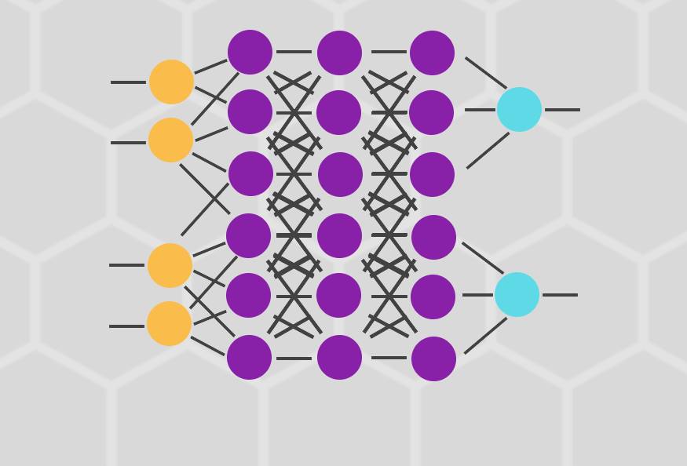

The rise of Domain-specific languages
Halide
This Photo by Unknown Author is licensed under CC BY
This Photo by Unknown Author is licensed under CC BY-NC

Slide 3
Why DSLs?
All problems in computer science can be solved by another level of indirection.
---- David Wheeler
for (int k = 0; k < K; ++k) {
for (int i = 0; i < N; ++i) {
for (int j = 0; j < M; ++j) {
acc[i][j] += x[i][k] * y[j][k];
}
}
}
import heterocl as hcl
def kernel(x, weights, batch,
in_feat, out_feat, dtype=hcl.Int()):
func = hcl.compute(...)
schedule = hcl.create_schedule(..., func)
return hcl.build(schedule, target=...)
Notes:
Use HeteroCL gemm example

Slide 4
The rise of DSLs – the missing part
Halide
Lift the level of abstraction;
but have limited supports for verification

Slide 5
HeteroCL
Decouples algorithms from hardware customizations
Computation
Schedule
Codegen
%1 = load(...)
%2 = load(...)
%3 = compute(...)
...
mov … …
mov … …
call insn …
...
def matmul(x, y, n, m, k):
return hcl.compute(...)
How to formally verify the correctness of the computation?
Based on machine customizations (datatype, memory layout, etc.)
Notes:
Intro to HeteroCL

Slide 6

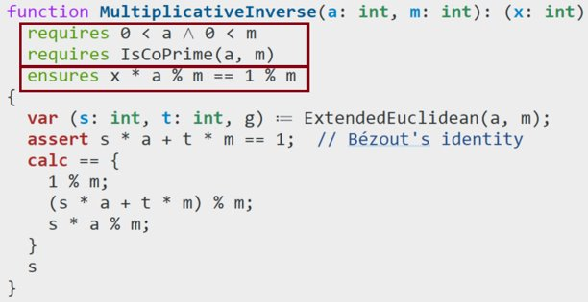
Dafny – A solver-aided language
Developed by Microsoft Research: https://github.com/dafny-lang
Automated verification using Hoare Logic:
ensures the programs meet their specifications
Specifications
Preconditions
Postconditions
Z3 SMT Solver
✔Verified
Implementation
Proof
❌Failure
message
Reference:
Zhenkun Yang, Wen Wang, Jeremy Casas, Pasquale Cocchini, Jin Yang​. Towards A Correct-by-Construction FHE Model​, 2022
Notes:
Dafny:
Proof strategy
Proof takes the most efforts

Slide 7

Example: Heracles FHE Accelerator
redc: ~10 LoC
redc: ~250 LoC
manually encode
models with proofs
Work done by Zhenkun Yang
High-level functional model
Easy to program with but
not verified
High-level functional model
Require more expertise but
verified
Two parallel sources of truth

Slide 8
Design of Pyrope
Goal: Embedded DSL; Bridge high-level modeling with verification
Compile
Proof.
Run
Testing without solver
Q.E.D.

Slide 9
Pyrope – Program Structure
@module(...)
@import_(...)
@include(...)
class MultiMontgomery(Module):
@classmethod
@function_method
def ToNat(cls, xs: seq[UInt]) -> Nat: ...
def LemmaSeqAppend(cls, xs: seq[UInt], x: UInt): ...
@classmethod
@function_method
def FromNat(cls, n: Nat, l: Nat) -> seq[UInt]: ...
@classmethod
@lemma

Slide 10
Pyrope – Frontend Language
Module Decorators
@module()
@import()
@include()
…
Method Decorators
@lemma
@function
@method
@function_method
Proof Utilities
ensures/requires
invariant()
assert_by()
…

Slide 11
Pyrope – Module Decorators
Goals:
Specify module dependencies (includes / imports) and compiled file
Module compiling to
@module('multimontgomery.dfy', abstract=True)
@include('montgomery.dfy',)
@import_(ExtendedGcd,)
class MultiMontgomery(Module): ...
External file to include
Module to import
Module definitions

Slide 12
Pyrope – Module Decorators
Goals:
Specify module dependencies (includes / imports) and compiled file
Parameterize the model
T = TypeVar('T')
@module('parameterized-example.dfy')
@param(lambda args: (T, args[-1]))
class ParameterizedExample(Module): def __init__(self, ty):
super().__init__()
@method
def find_val(cls, xs: seq[T], val: T):
Type placeholder
Concretization
Concrete type assigned

Slide 13
Pyrope – Method Decorators
lemma LemmaREDCDiv (T: nat, R: nat, N: nat, N_prime: nat)
method REDC (R: nat, R_prime: nat, N: nat, N_prime: nat, T: nat)
function method FromNat (n: nat, l: nat) : seq<uint>

Slide 14
Pyrope – Method Decorators
@lemma
def LemmaREDCDiv(cls, T: Nat, R: Nat, N: Nat, N_prime: Nat)
lemma LemmaREDCDiv (T: nat, R: nat, N: nat, N_prime: nat)

Slide 15
Pyrope – Proof Utilities
Goal: enabling Python to express proofs about programs
Specification
Proof
assert_by(…)
assert_expr(…)
invariant(…)
calc(…)
Eq.by(…)
Gt.by(…)
Lt.by(…)
Implies.by(…)
...
requires(…)
ensures(…)
Forall(…)
Exists(…)

Slide 16
Pyrope – Proof Utilities
Specification
requires(…)
ensures(…)
Forall(…)
Exists(…)
Pre/postconditions
Quantification over values / bounds

Slide 17
Pyrope – Proof Utilities
@method
def find_max_in_positive_seq(cls, xs: seq[int]):
requires(len(xs) > 0)
requires(Forall(x > 0 for x in xs))
ensures(Forall(x <= ans for x in xs))
return ans

Slide 18
Pyrope – Proof Utilities
@method
def find_max_in_positive_seq(cls, xs: seq[int]):
requires(len(xs) > 0)
requires(Forall(x > 0 for x in xs))
ans: int = xs[0]
for i in range(1, len(xs)):
if ans < xs[i]:
ans = xs[i]
ensures(Forall(x <= ans for x in xs))
return ans

Slide 19
Pyrope – Proof Utilities
Proof
assert_by(…)
assert_expr(…)
invariant(…)
calc(…)
Eq.by(…)
Gt.by(…)
Lt.by(…)
Implies.by(…)
...
Proof certificates: providing evidence
for the underlying solver

Slide 20
Pyrope – Proof Utilities
@method
def find_max_in_positive_seq(cls, xs: seq[int]):
requires(len(xs) > 0)
requires(Forall(x > 0 for x in xs))
ans: int = xs[0]
for i in range(1, len(xs)):
invariant(1 <= i <= len(xs))
invariant(Forall(xs[j] <= ans for j in range(0, i)))
if ans < xs[i]:
ans = xs[i]
ensures(Forall(x <= ans for x in xs))
return ans

Slide 21
Pyrope – Verification via Dafny
Extremely simple:
@module('examples.dfy', abstract=False)
class Examples(Module):
@classmethod
@method
def find_max_in_positive_seq(cls, xs: seq[int]): …
instance = Examples()
instance.verify()

Slide 22
Demo: Find max in a positive sequence
Notes:
Need to manually maintain the correspondence

Slide 23
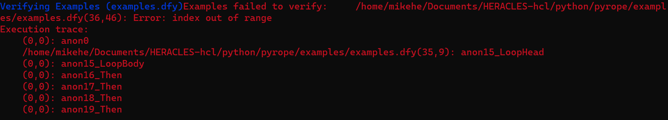
Pyrope – Verification via Dafny
HOWEVER: this is not usually the case
@method
def find_max_in_positive_seq(cls, xs: seq[int]):
requires(len(xs) > 0)
requires(Forall(x > 0 for x in xs))
ans: int = xs[0]
for i in range(1, len(xs)):
invariant(1 <= i <= len(xs))
invariant(Forall(xs[j] <= ans for j in range(0, i)))
if ans < xs[i]:
ans = xs[i]
ensures(Forall(x <= ans for x in xs))
return ans
Unbounded!

Slide 24
Pyrope – Other Features
Assertions by proofs
# m >= 0 and N >= 0 ==> m * N >= 0
assert_by(m * N >= 0, Mul.LemmaMulNonnegative(m, N))

Slide 25
Pyrope – Other Features
Assertions by proofs
Assertions by computations
calc(Eq.by(
(b + k * N) % N,
# forall x, y :: x * y = y * x
By.lemma(Mul.LemmaMulIsCommutativeAuto()),
(N * k + b) % N,
# forall x, m, N :: ((m * N) + x) % N = x % N
By.lemma(DivMod.LemmaModMultiplesVanishAuto()),
b % N))
=

Slide 26
Pyrope – Other Features
Parameterized models (can generate multiple verification targets)
param_instance = ParameterizedExample(ty=Nat)
param_instance.verify()
param_instance = ParameterizedExample(ty=Bv32)
param_instance.verify()

Slide 27
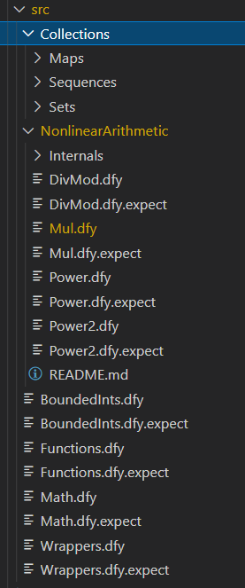
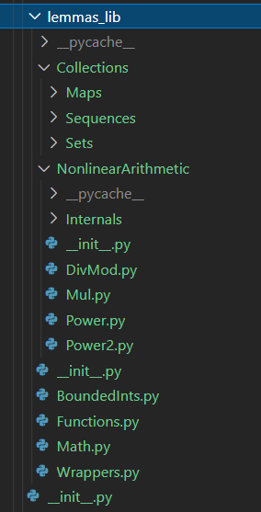
Pyrope – Other Features
Lemma importer (from Dafny proofs)
from lemmas_lib.NonlinearArithmetic import DivMod
from lemmas_lib.NonlinearArithmetic import Mul
...
calc(Eq.by(
(b + k * N) % N,
By.lemma(Mul.LemmaMulIsCommutativeAuto()),
(N * k + b) % N,
By.lemma(DivMod.LemmaModMultiplesVanishAuto()),
b % N))
...
Preserve directory structure
Notes:
Put an example of using the imported lemma

Slide 28

Case Study - Montgomery Reduction Algorithm
Background:
Goal: Given 2 natural numbers $a,b∈[0, N)$ for some $N$, optimize the efficiency for computing $a⋅b \% N$.

Slide 29


Case Study - Montgomery Reduction Algorithm
@method
def REDC(cls, R: Nat, R_prime: Nat, N: Nat, N_prime: Nat, T: Nat): m: Nat = T % R * N_prime % R t: Nat = (T + m * N) // R
# range correction
S: Nat = t - N if t >= N else t
return S
We want to verify $S \% N=TR^{′} \% N$ where
$$R⋅R^{′}≡1 (mod N)$$
Peter Montgomery. “Modular Multiplication Without Trial Division” 1985​
Notes:
See the FHE workshop slide

Slide 30

Case Study - Montgomery Reduction Algorithm
What need to be shown?
@method
def REDC(cls, R: Nat, R_prime: Nat, N: Nat, N_prime: Nat, T: Nat): m: Nat = T % R * N_prime % R t: Nat = (T + m * N) // R
# range correction
S: Nat = t - N if t >= N else t
return S
$T+m⋅N$ is divisible by R
$t<2N$

Slide 31

Case Study - Montgomery Reduction Algorithm
What need to be shown?
@method
def REDC(cls, R: Nat, R_prime: Nat, N: Nat, N_prime: Nat, T: Nat): m: Nat = T % R * N_prime % R t: Nat = (T + m * N) / R
# range correction
S: Nat = t - N if t >= N else t
return S
$$S \% N=TR^{′} \% N$$
✅Proof has been encoded in Pyrope and verified by compiling to Dafny
Notes:
Show the annotated python code of Montgomery
Give Demo here

Slide 32
Demo: Montgomery Reduction Algorithm
Notes:
The Montgomery proofs is encoded from the Dafny proof

Slide 33
Handling HeteroCL Constructs
Possible directions given current status of HeteroCL:
HeteroCL is moving to MLIR: compiling from MLIR to Dafny is feasible
Could refer to the schedule interpreter written by Dr. Steven Lyubomirsky
Challenges:
MLIR support is still WIP; may have many changes
Error reporting will be tricky when dealing with verification failures

Slide 34
What’s next?
Adding HeteroCL support
Heracles FHE accelerator is modeled with HeteroCL
Could help adding verification supports to MLIR
Improve error reporting
Easier to fix when verification failed
Moving towards correct-by-construction modeling with a single source of truth
Modeling in Python/HCL AND proving correctness with Pyrope

Slide 35
Recap
From general-purpose to domain-specific
Problems: verifying the correctness of the program in DSL
Pyrope: attempt to close the gap
Take-away: It’s a good practice to start proving while coding because
It helps understand the implementation better
It exposes issues of the proof infrastructure in early stage
It provides the highest confidence about the implementation correctness
Notes:
Recap, Take-away

Slide 36
Recap
From general-purpose to domain-specific
Problems: verifying the correctness of the program in DSL
Pyrope: attempt to close the gap
Take-away: Easier to maintain when we have a single of source of truth because Specifications, proofs and implementations are closely coupled.
Notes:
Recap, Take-away

Slide 37
Acknowledgement
I would thank all members in the DPRIVE team for supporting my work.
I especially thank Zhenkun Yang and Jeremy Cases for their suggestions and help for improving Pyrope. I greatly appreciate Pasquale Cocchini for ideas on program verification for Python.
I appreciate Jin Yang for providing the opportunity working with the DPRIVE project
Finally, thank you all for your attention.

Slide 38
Q & A

Slide 39
Reference
Zhenkun Yang, Wen Wang, Jeremy Casas, Pasquale Cocchini, Jin Yang​. Towards A Correct-by-Construction FHE Model​, 2022
Yi-Hsiang Lai, Yuze Chi, Yuwei Hu, Jie Wang, Cody Hao Yu, Yuan Zhou, Jason Cong, and Zhiru Zhang. 2019. HeteroCL: A Multi-Paradigm Programming Infrastructure for Software-Defined Reconfigurable Computing. In Proceedings of the 2019 ACM/SIGDA International Symposium on Field-Programmable Gate Arrays (FPGA ’19), Association for Computing Machinery, Seaside, CA, USA, 242–251. DOI:https://doi.org/10.1145/3289602.3293910
Tianqi Chen, Thierry Moreau, Ziheng Jiang, Lianmin Zheng, Eddie Yan, Meghan Cowan, Haichen Shen, Leyuan Wang, Yuwei Hu, Luis Ceze, Carlos Guestrin, and Arvind Krishnamurthy. 2018. TVM: An Automated End-to-End Optimizing Compiler for Deep Learning. arXiv. DOI:https://doi.org/10.48550/ARXIV.1802.04799
Rustan Leino. 2010. Dafny: An Automatic Program Verifier for Functional Correctness. In 16th International Conference, LPAR-16, Dakar, Senegal, Springer Berlin Heidelberg, 348–370. Retrieved from https://www.microsoft.com/en-us/research/publication/dafny-automatic-program-verifier-functional-correctness-2/
Peter L. Montgomery. 1985. Modular Multiplication without Trial Division. Mathematics of Computation 44, 170 (1985), 519–521.

Slide 40

Case Study - Montgomery Reduction Algorithm
Solution V1.0
Apply the Euclidean Division Theorem:
$$a⋅b=q⋅N+r$$
$a⋅b$ could be represented by $q, N$ and $r$
where $q=\left\lfloor \frac{a⋅b}{N}\right\rfloor$ and $r=ab−qN=a⋅b \% N$
Problem: Division is expensive!

Slide 41

Case Study - Montgomery Reduction Algorithm
Solution V2.0: Get rid of the division
Choose an auxiliary variable $R=2^{b}$, let such that $R$ and $N$ are coprime AND $R>N$.
Then let $R′$ be the multiplicative inverse of $R$ modulo $N$
The set $\left\{i⋅R \% N \right| 0≤i<N\}$ is a complete residue system
Change division with $N$ to division with $R$: bit-shifting

Slide 42



Case Study - Montgomery Reduction Algorithm
Solution V2.0
Now we have $R, R^{′},N$ such that
$$\gcd\left(R, N\right)=1$$
$$R⋅R^{′}≡1 (mod N)$$
Define the Montgomery form of a natural number $a<N$ to be $\overline{a}=aR \% N$

Slide 43


Case Study - Montgomery Reduction Algorithm
Solution V2.0
Now we have $R, R^{′},N$ such that
$$\gcd\left(R, N\right)=1$$
$$R⋅R^{′}≡1 (mod N)$$
We hope to compute the product in Montgomery form
($ab⋅R \% N$); however:
$$\overline{a}⋅\overline{b} \% N$$
😫
$$=abR^{2} \% N$$

Slide 44
Case Study - Montgomery Reduction Algorithm
Solution V2.0
Now we have $R, R^{′},N$ such that
$$\gcd\left(R, N\right)=1$$
$$R⋅R^{′}≡1 (mod N)$$
Solution: throw in $R^{′}$
$$\overline{a}\overline{b}⋅R^{′}≡ab⋅R \left(mod N\right)$$
Problem: still need to reduce modulo $N$ to throw in $R′$

Slide 45

Case Study - Montgomery Reduction Algorithm
Solution V2.0
Now we have $R, R^{′},N$ such that
$$\gcd\left(R, N\right)=1$$
$$R⋅R^{′}≡1 (mod N)$$
Montgomery Reduction Algorithm: throw in $R^{′}$ without doing division
Introduce another auxiliary variable $N′$ s.t. $N⋅N^{′}≡−1 (mod R)$

