Slide 1


CSCI6917: Guided Research Methods Summer 2023
Stephen H. Kaisler, D.Sc. (GWU) Jamaladdin Hasanov, Ph.D. (ADA)
Exploring Class Imbalance Solutions: Investigating the Effectiveness of Data Balancing Techniques on Model Performance
Student: Shamil Shukurov

Slide 2
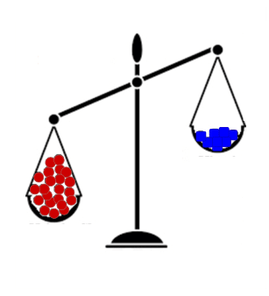
Project Objective
What is class imbalance problem?
Occurs when one class has significantly fewer instances than the other class
Imbalanced datasets can bias models towards the majority
What is balancing?
Techniques used to address class imbalance in datasets and equalize the representation of different classes.
Balancing aims to prevent model bias towards the majority
Purpose of this project is to answer to following questions:
How different balancing techniques affects model performance?
When we need to balance our data?
Do we even need balancing?
How balancing affects generalization capability of model?
Which balancing techniques are effective?
In total, 96 models were built with 5 different balancing techniques and 1 baseline model.

Slide 3
Project Objective
How is it done today?
Basic data balancing techniques (upsampling, downsampling, SMOTE) are commonly used to address class imbalance.
However, the effectiveness of these techniques is often based on trial and error rather than a comprehensive evaluation.
What is new?
Insights on technique effectiveness, class imbalance percentage impact, and overfitting risks.
Who will benefit from the work? Why?
Researchers and practitioners dealing with imbalanced datasets.
Practical guidance for selecting appropriate balancing techniques.
Informed decisions to enhance model performance in real-world applications efficiently.
What is innovative?
Comprehensive Evaluation with Real and Synthetic Datasets
Focus on Class Imbalance Percent
Algorithm Built-in Balancing Advantages tested

Slide 4
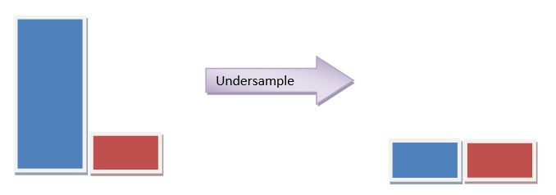
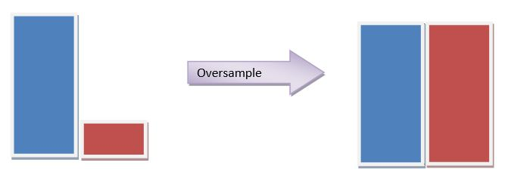
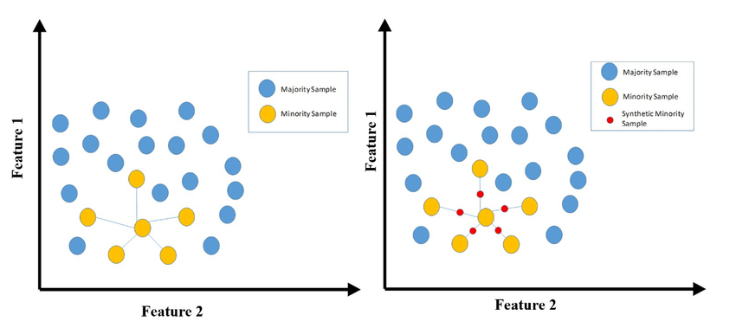
Technical Approach
Collection of Data
Data Preprocessing
Building Baseline Model
Applying Balancing techniques to the data
Upsampling
Downsampling
SMOTE
BalancedBaggingClassifier
Algorithm built-in balancing
Analyze model results:
F1-Score
AUC
Downsample and Upsample
SMOTE

Slide 5
Technical Approach : Data
During the research 13 different imbalanced datasets collected
Dataset_Name | Row_Count | Minority_Class_Percent | Target_Column
Fraud | 284807 | 0.172 | Class
Fraud2 | 250000 | 0.5 | is_fraud
Wine | 6497 | 3.76 | target
Letter-a | 20000 | 3.94 | letter_a
Abalone | 1477 | 4.52 | target
Pendigits | 10992 | 9.59 | is_9
Sick_euthyroid | 2194 | 10.05 | target
Covertype | 581012 | 14.77 | target
Letter-vowel | 20000 | 19.39 | is_vowel
Contraceptive | 1743 | 22.6 | target
Splice-junction | 3186 | 24.07 | target
Adult | 32561 | 24.08 | target
Churn | 7043 | 26.53 | target
Different minority class percentages will show how balancing techniques performs in different degrees of imbalance
Applied preprocessing steps:
Redefining target if needed
Encoding the categorical variables
Correcting type inconsistencies
Imputing missing values if needed

Slide 6
Technical Approach : Data
Problems in collected datasets:
Easier classification problems
Size of datasets
Nature of the data affects metrics
X, y = make_classification(
n_samples=200000,
n_features=10,
n_informative=7,
n_classes=2,
random_state=42,
weights=[0.7,0.3],
hypercube=False,
class_sep=0.01,
flip_y=0.15
)
Additional synthetic data generated:
Class distribution: 30%/70%
By taking samples from this dataset, 5 more datasets generated
Dataset | Minority_Class
Synthetic | 0.3
Synthetic_20 | 0.2
Synthetic_10 | 0.1
Synthetic-5 | 0.05
Synthetic-1 | 0.01
Synthetic-0.5 | 0.005

Slide 7

Technical Approach : Model
LightGBM is a gradient boosting framework that utilizes a tree-based learning algorithm to construct powerful ensemble models. It offers several advantages that make it well-suited for imbalanced classification tasks.
Why LightGBM?
Built-in imbalance technique
Doesn’t need a lot of preprocessing
Popular in practice
Models:
LGBM Baseline
LGBM Upsample
LGBM Downsample
SMOTE LGBM
LGBM Balanced Bagging
LGBM_Imbalance

Slide 8
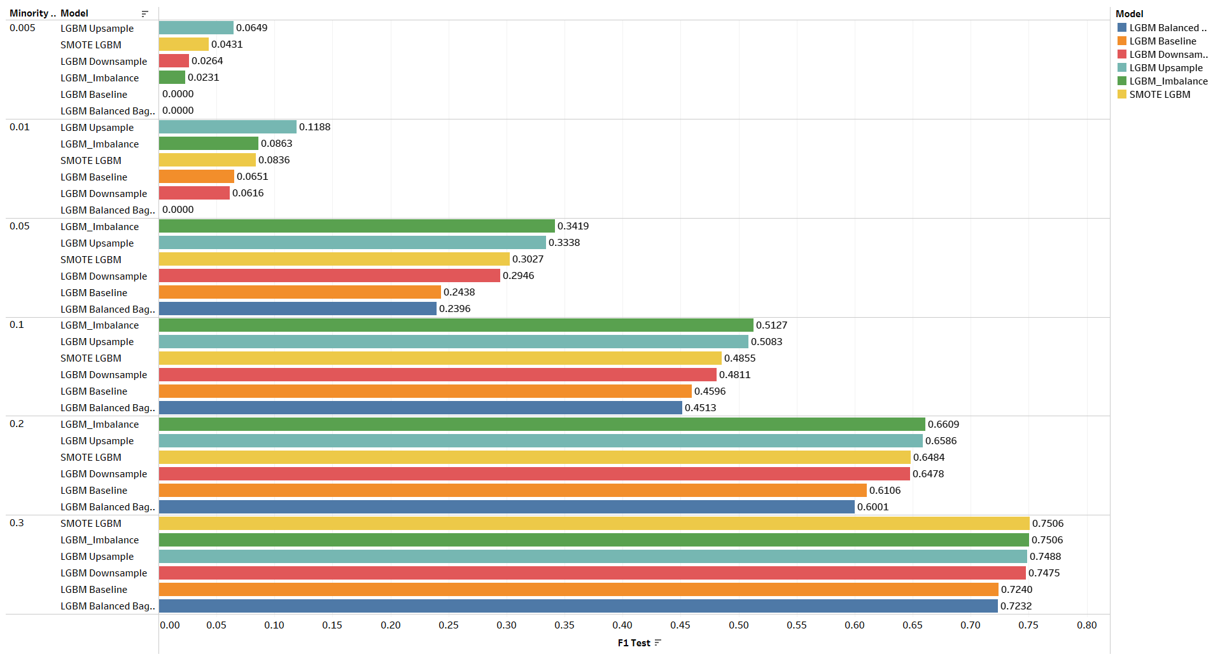
Results : F1-Scores on test data

Slide 9
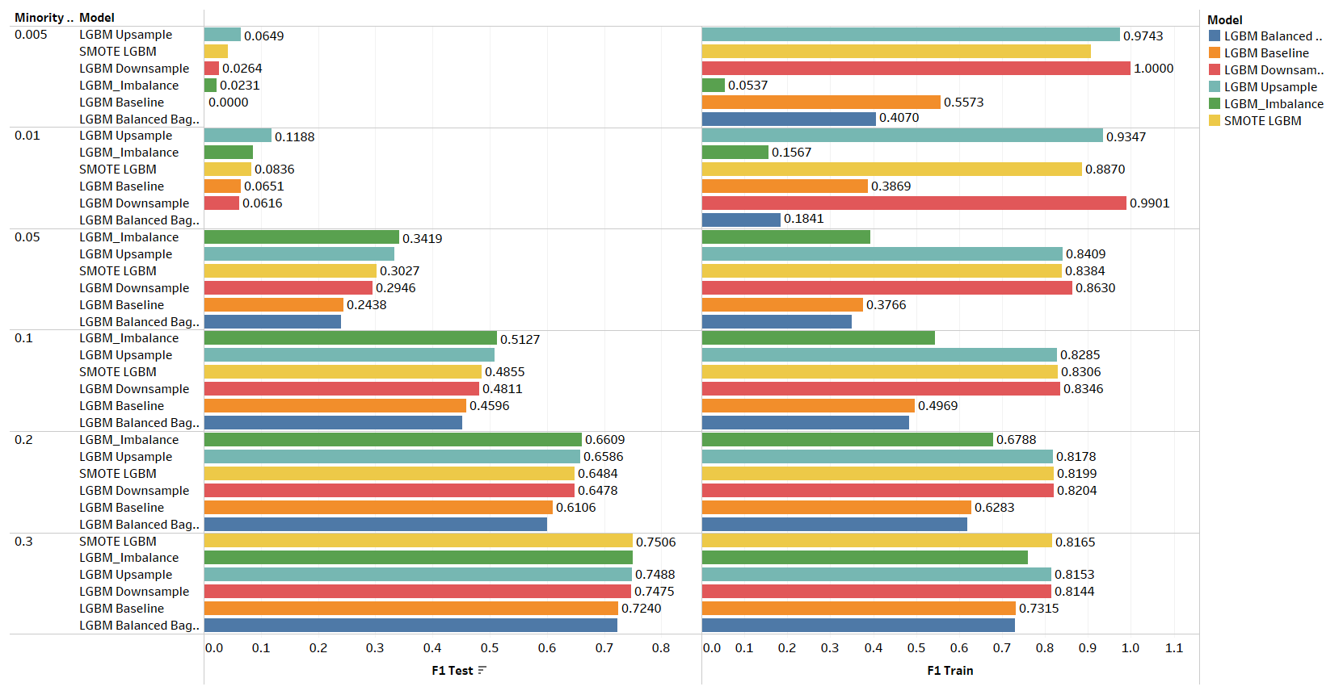
Results : Overfitting

Slide 10
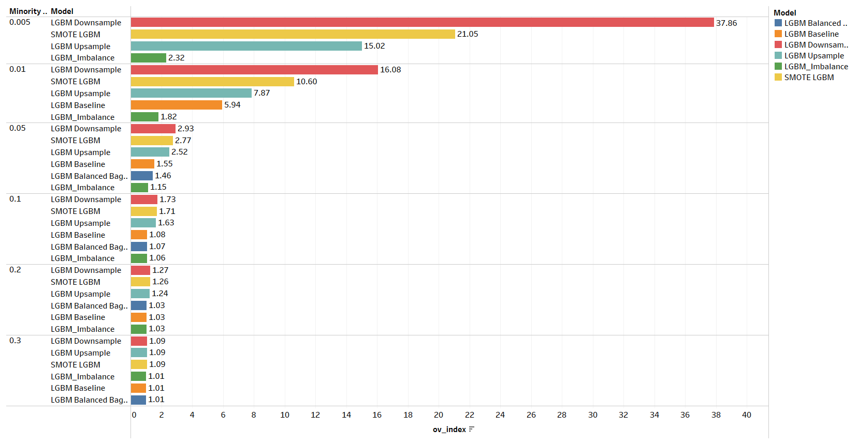
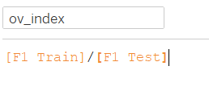
Results : Overfitting

Slide 11
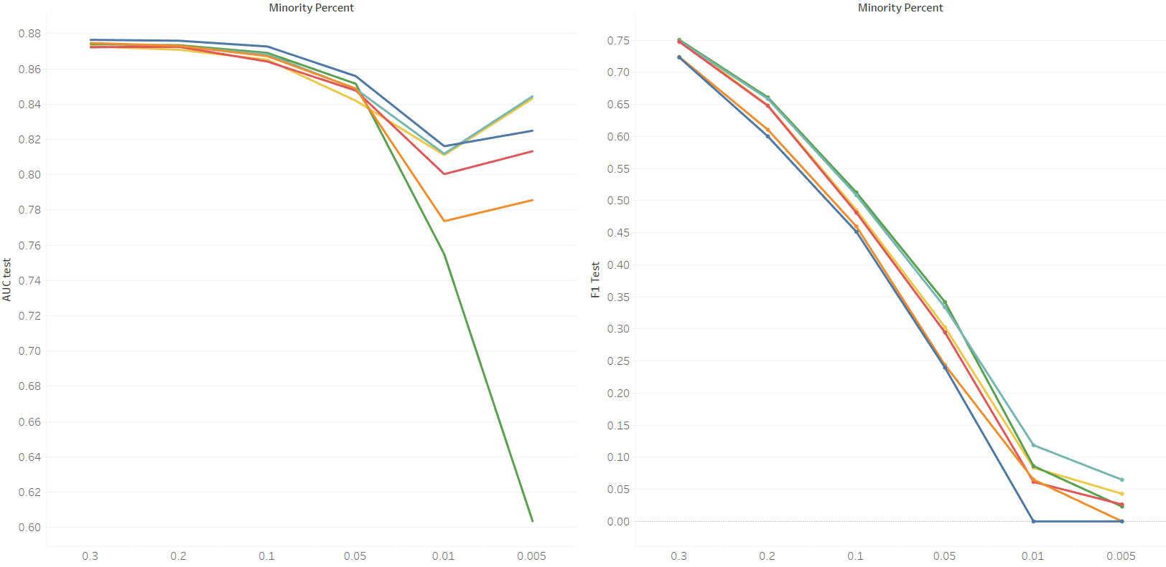
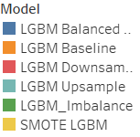
Results
From minority class percent 30% to 10%, the performances of balancing techniques and the baseline model are very close.

Slide 12
Conclusion
When working with imbalanced dataset always build baseline model without any balancing technique
We observed that balancing techniques are not very effective with class imbalance percent > 10%
Some balancing techniques, especially downsampling, SMOTE and upsampling can cause overfitting
LGBM’s built-in balancing generalizes data better than above techniques
Future Work
Extending research with:
More broad datasets
More balancing techniques
Tests on different algorithms
Calibrating models trained on balanced data
Trying other methods to prevent overfitting
Explaining mathematical reasons behind conclusions

Slide 13
Any Questions?

