Slide 1


Course: Guided Research Project Title: Federated Machine Learning Implementation on Image Classification
COMPUTER SCIENCE AND DATA ANALYTICS
Student: Ali Asgarov
Instructors & Supervisors: Dr. Stephen Kaisler, Dr. Jamal Hasanov

Slide 2



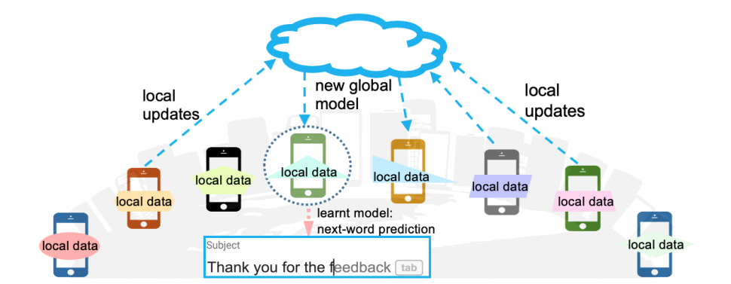




Project Objective
Standard machine learning approaches necessarily require storing training data on a single machine or in datacenter.
Why can’t we just centralize the data all the time ?
Sending the data may be too costly
Self-driving cars generates several TBs of data a day
Wireless devices have limited bandwidth/power
Data may be considered too sensitive
Public awareness and regulations on data privacy
Control of data is advantage in business/research
Federated Learning (FL) – Keep data decentralized.
Collaborative ML model training on decentralized data
Each client’s raw data is stored locally
Parameter aggregation

Slide 3
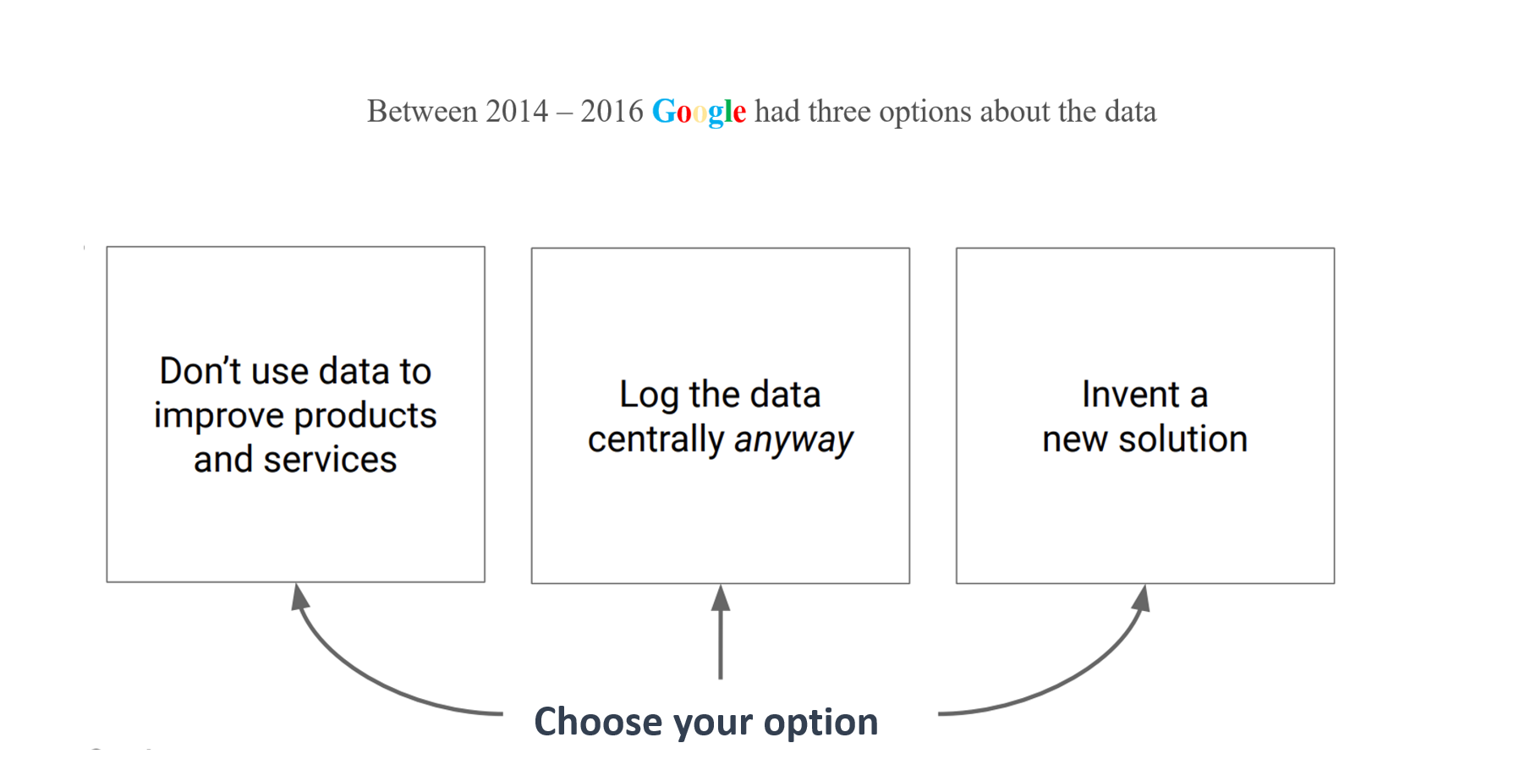

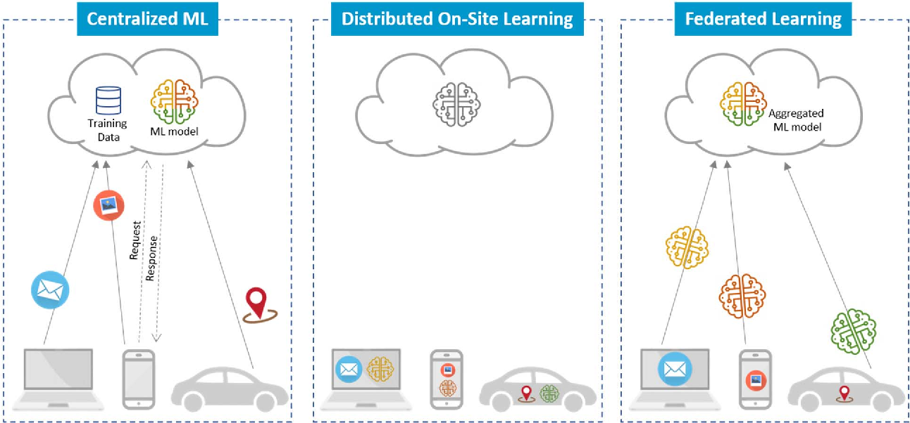
Literature Review
FL is a relatively new type of learning that Google (McMahan) introduced in 2016.
FL is highly multidisciplinary.
Relies on stochastic gradient descent (SGD).
The IID is important to ensure the stochastic gradient is an unbiased.
Convergence guaranteed for IID data.
Centralized ML model.
Usage via API.
Shared data across all nodes
Local data across all nodes
Privacy concerns.
Decentralized model aggregation

Slide 4
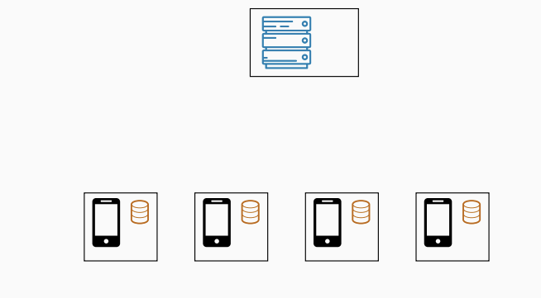
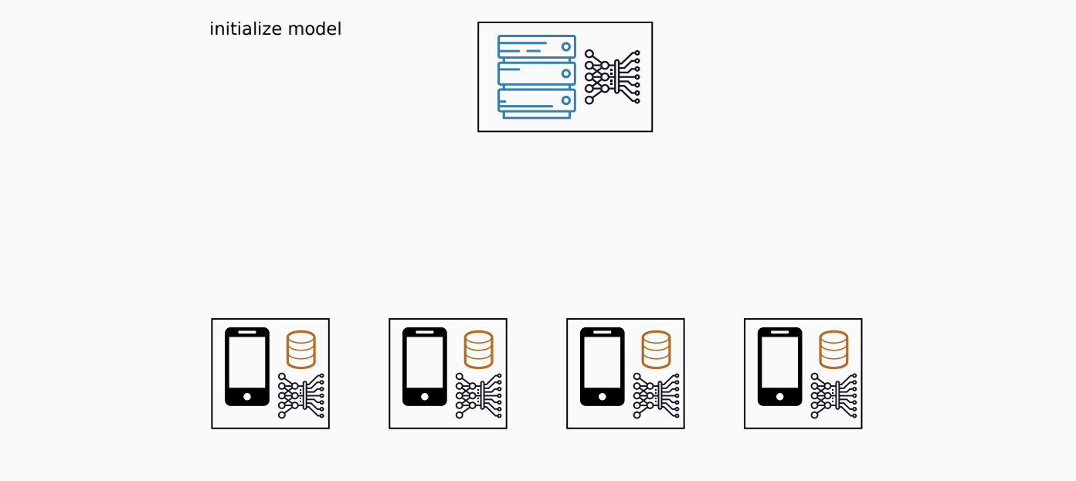
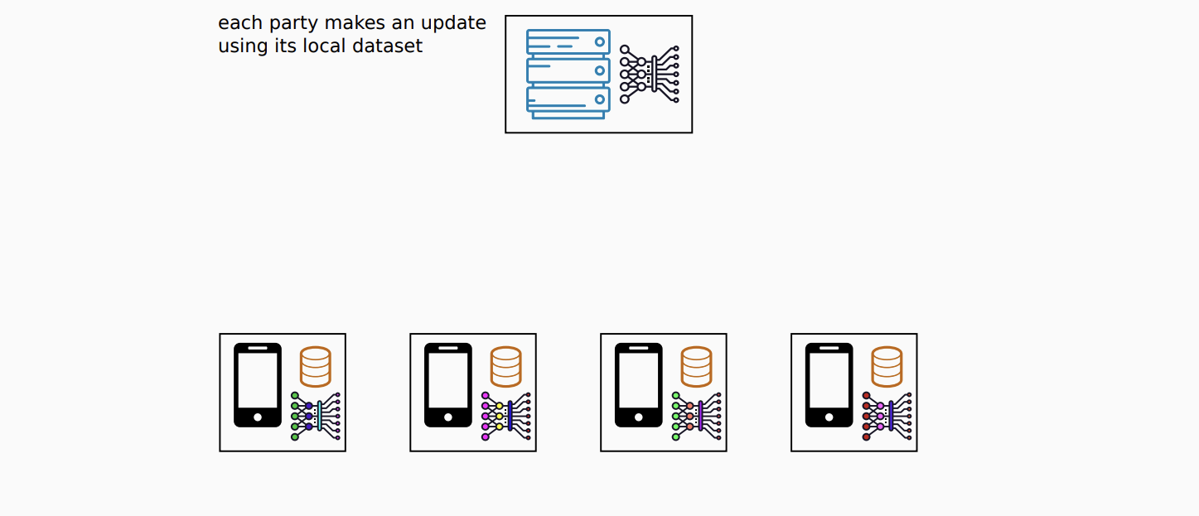
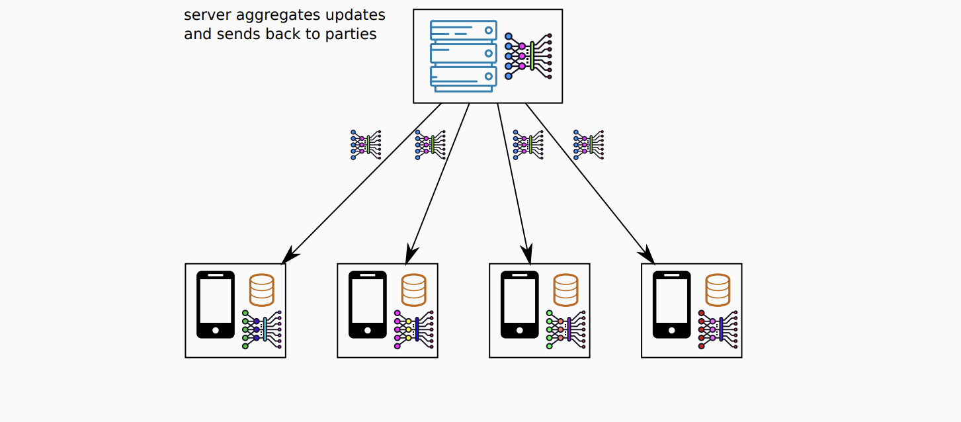
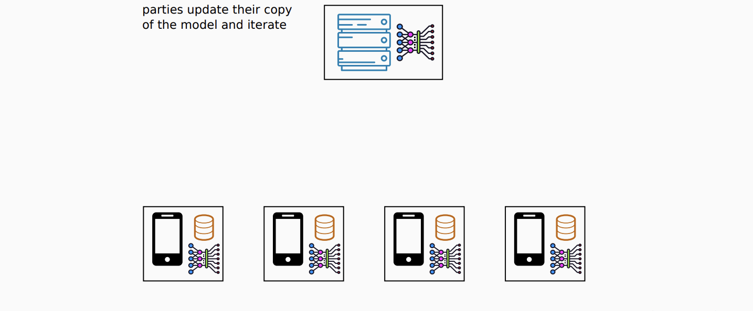
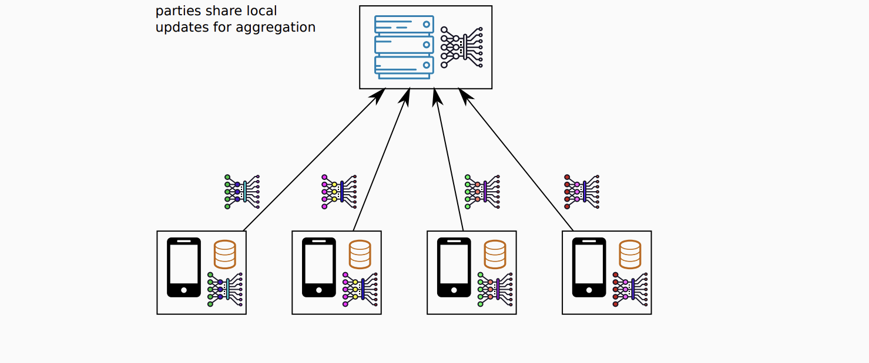
Solution Architecture
Data preparation (IID)
Initialize models
Train local models on the data samples
Averaged weights are sent to the local clients
Local models weights are being averaged
Sharing the model weights to the central model

Slide 5
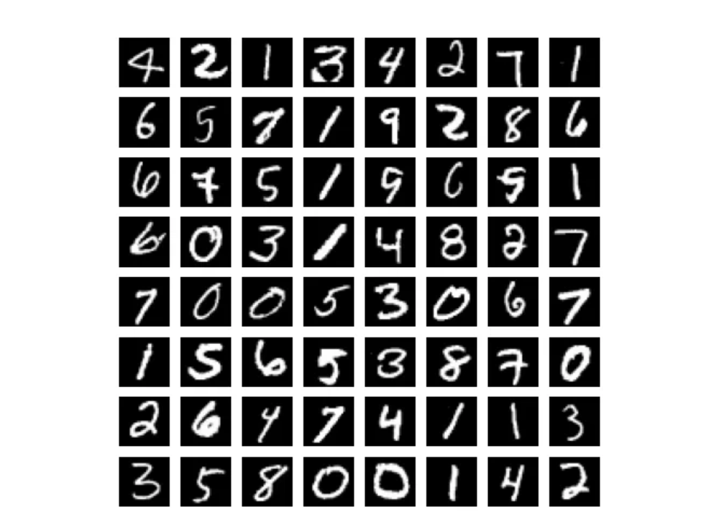
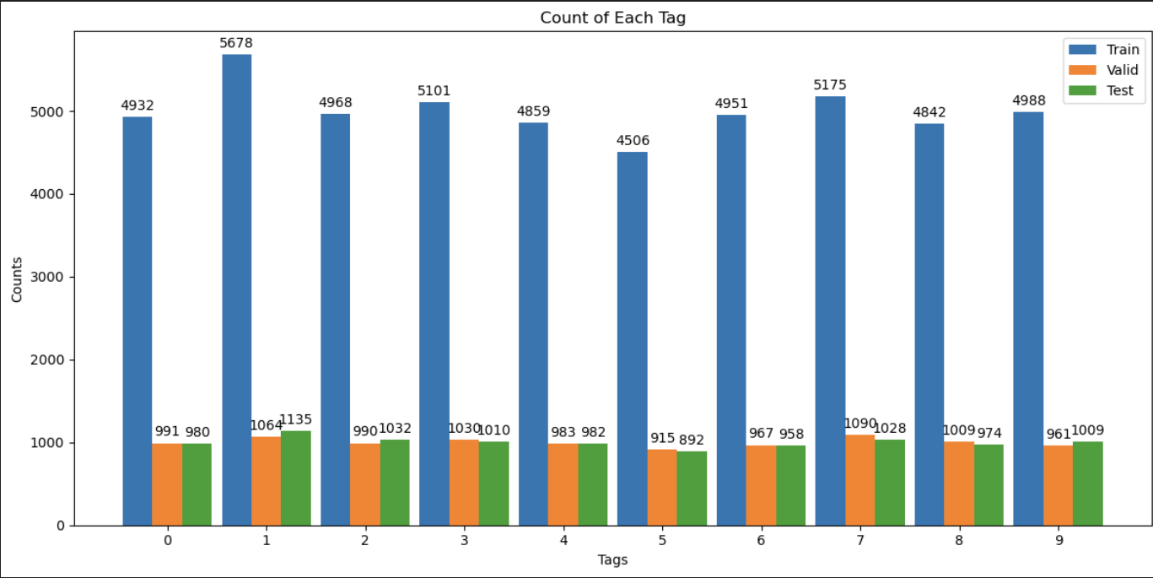



Dataset | Ingestion | Preprocessing
MNIST Dataset - 28 * 28 pixel grayscale images of numbers from 0 to 9.
The MNIST data set does not contain each label equally.
The IID sampling of the training data needed.
To fulfill the IID requirement :
Shuffling data and building dictionary for indexes of labels
Building of client dataset dictionaries with shuffled data
Building of client datasets with previous steps’ dictionaries

Slide 6
Dataset Cleaning
Denoising Autoencoder
The Denoising Autoencoder is an extension of the autoencoder. Just like a standard autoencoder, it's composed of an encoder, that compresses the data into the latent code, extracting the most relevant features, and a decoder, which decompress it and reconstructs the original input. There is only a slight modification: the Denoising Autoencoder takes a noisy image as input and the target for the output layer is the original input without noise.
Heatmap, confusion

Slide 7
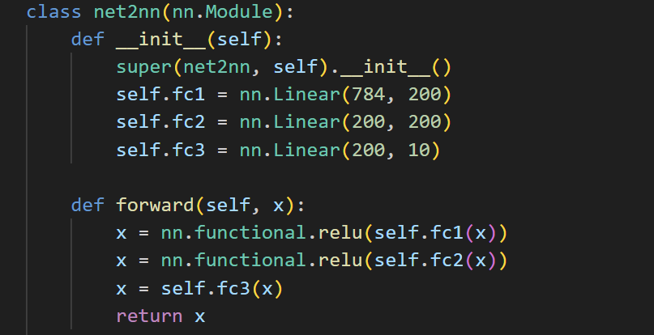
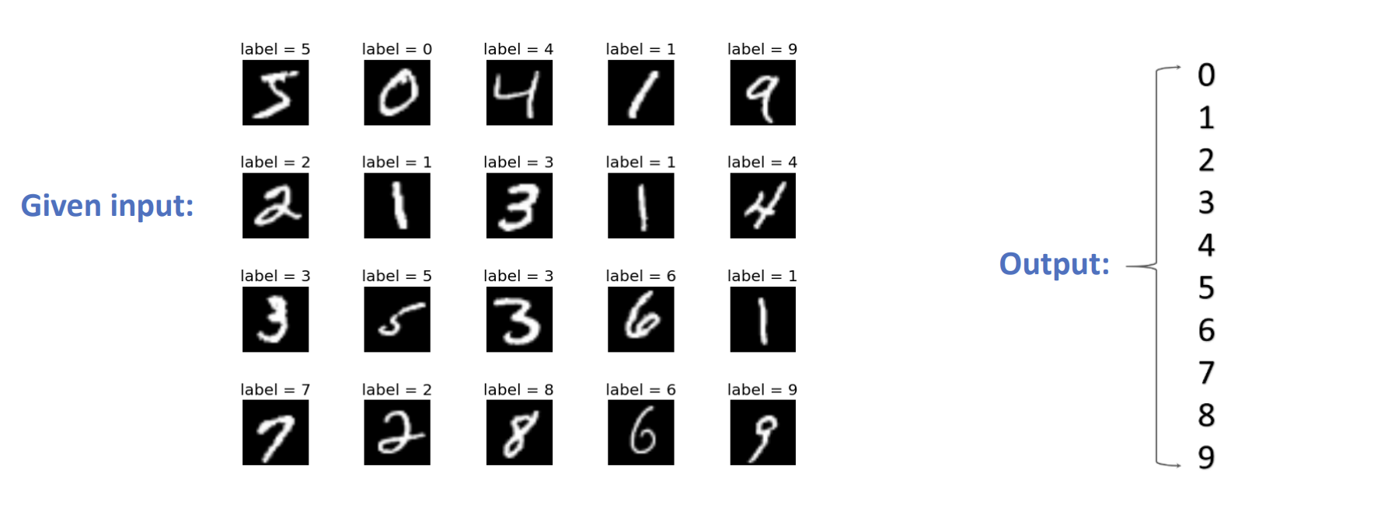
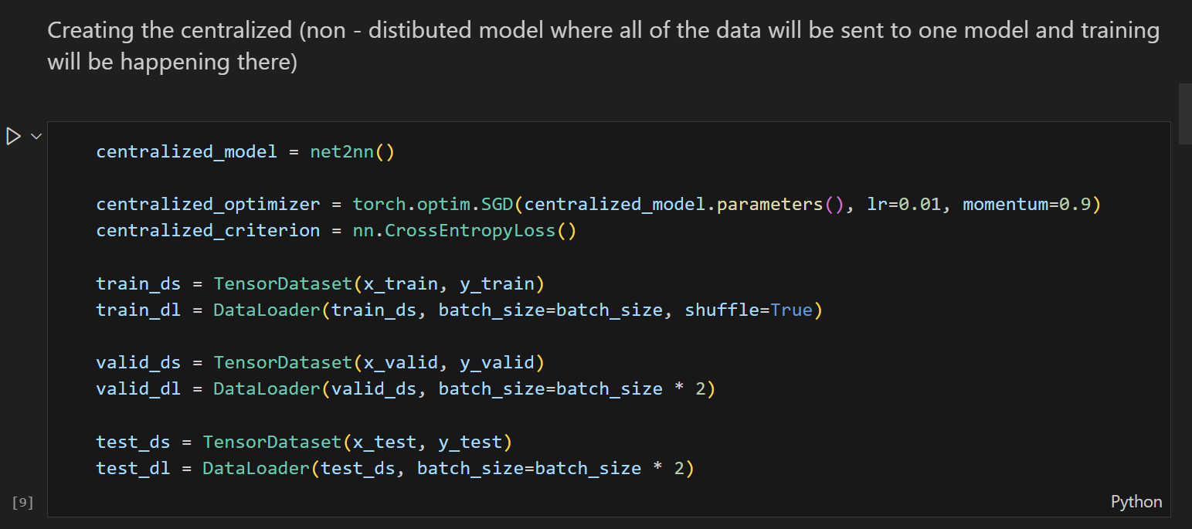
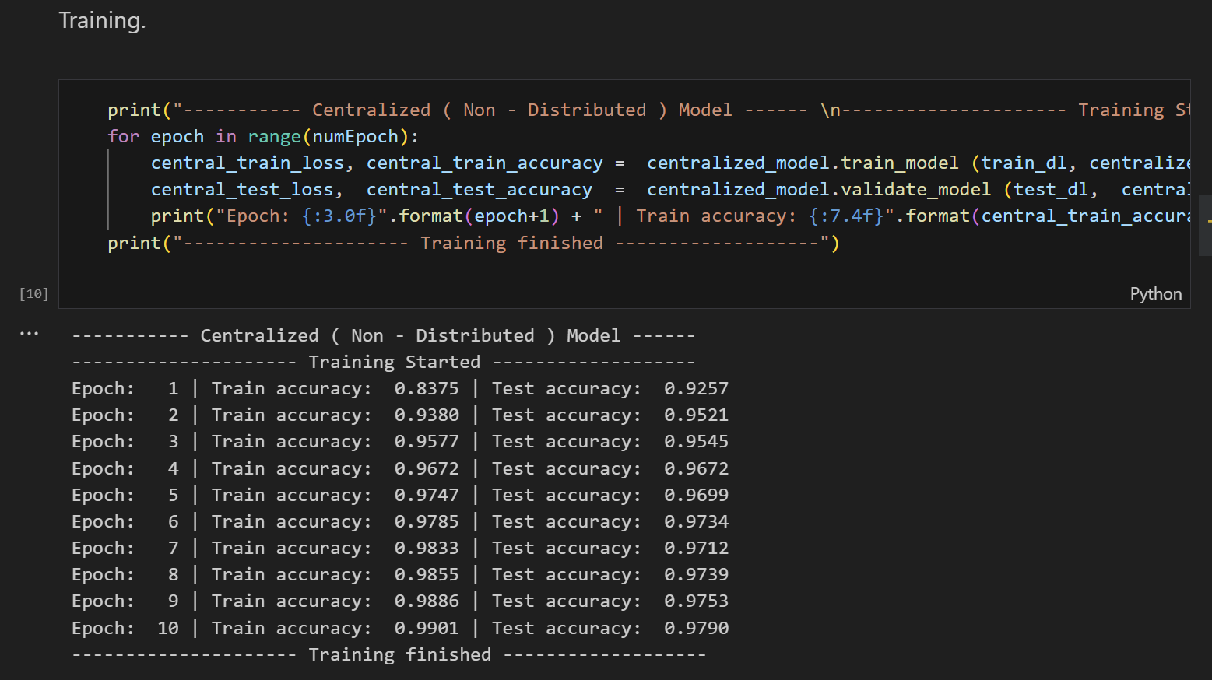
Modelling
Add layers visualization, remove code
A 2-layer model was created for the classification process.

Slide 8
Measurement and Scale
Dependent variable : Accuracy of the main classification model
Independent variables :
Number of Clients
Learning rate
Number of epochs for training
Batch size
Momentum
Designing experiments: I have created a series of experiments where I systematically vary the independent
variables while keeping other factors constant. I have conducted experiments with different numbers of participating clients, varying from 50 to 500, and record the corresponding performance of the federated learning algorithm for each case.

Slide 9
Statistical Analysis

Slide 10
Federated averaging methods
Add code explanation as flow graph
User defined functions for Federated learning in the project:
create_model_optimizer_criterion_dict,
get_averaged_weights,
set_averaged_weights_as_main_model_weights_and_update_main_model,
send_main_model_to_nodes_and_update_model_dict,
start_train_end_node_process,
compare_local_and_merged_model_performance

Slide 11
Conclusion and future scope

Slide 12
References
McMahan, H. B. (2016, February 17). Communication-Efficient Learning of Deep Networks from Decentralized Data. arXiv.org. https://arxiv.org/abs/1602.05629

Slide 13

Thank You

Slide 14
Backup

Slide 15


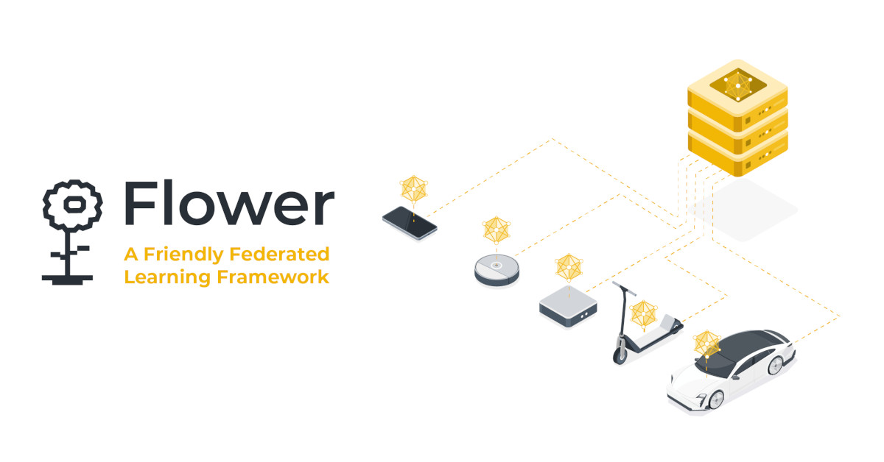

Frameworks Under Development
Several open-source libraries are under development: PySyft, TensorFlow Federated, FATE, Flower, Substra..

Slide 16
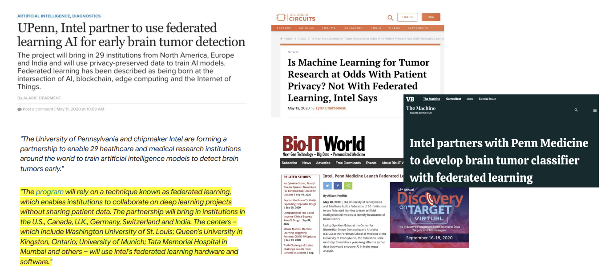
Applications - I

Slide 17
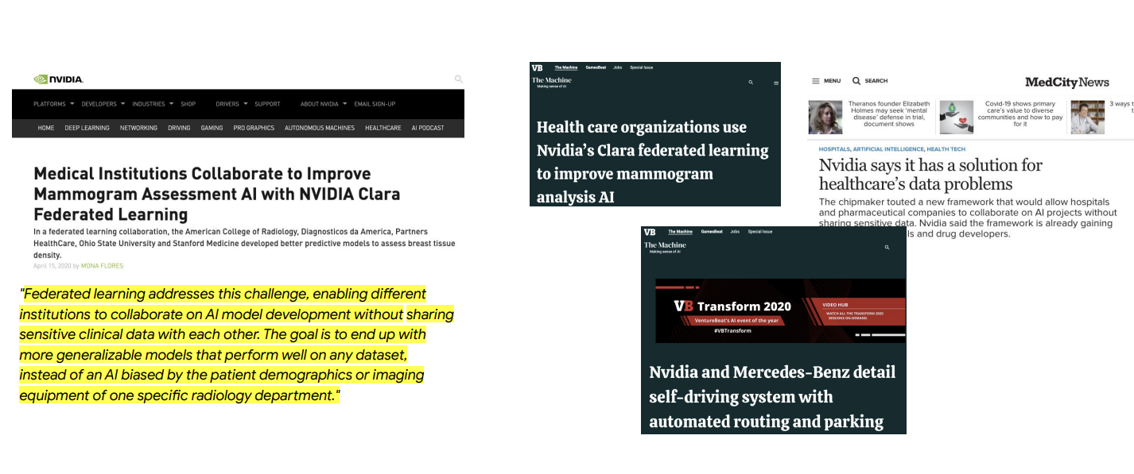
Applications - II

Slide 18
SGD
weight = weight - lr * gradient - momentum * previous_update

Slide 19
Structure
2nd slide George Heilmeier’s Catechism
What are you trying to do? How is it done today, and what are the limits of current practice?
What’s new in your approach and why will it be successful? Who cares? If you are successful, what difference will it make? What are the risks and the payoffs? How much will it cost? How long will it take? What are the midterm and final exams to check for success? Why now?
3rd slide Literature Review
4th slide the general flow of the project
4th slide Dataset - Preprocessing
5th slide Dataset Cleaning
6th slide Statistical Analysis
7th slide Modelling
8th slide Federated Averaging methods
9th slide Measurement and Scale
10th slide Conculsuion and future scope
11th slide Thank you

