Slide 1


Course: Guided Research Project Title: Federated Machine Learning Implementation on Image Classification
COMPUTER SCIENCE AND DATA ANALYTICS
Student: Ali Asgarov
Instructors & Supervisors: Prof. Dr. Stephen Kaisler, Assoc.Prof Jamaladdin Hasanov

Slide 2
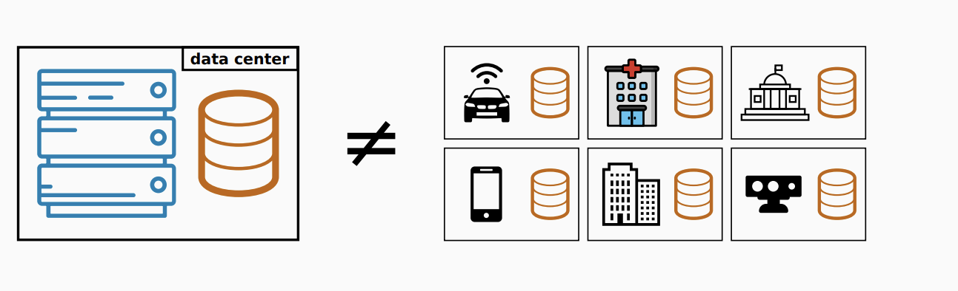





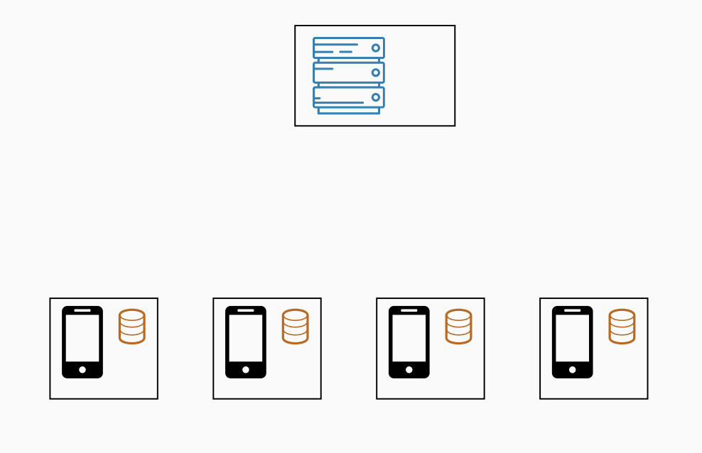
Introduction
Standard machine learning approaches necessarily require storing training data on a single machine or in datacenter.
Why can’t we just centralize the data?
Sending the data may be too costly
Self-driving cars are expected to generate several TBs of data a day
Some wireless devices have limited bandwidth/power
Data may be considered too sensitive
We see a growing public awareness and regulations on data privacy
Keeping control of data can give a competitive advantage in business and research.
Federated Learning (FL) for models is a new concept trained from user interaction from devices.
FL aims to collaboratively train a ML model while keeping the data decentralized.
This goes beyond use of local models in the individual devices to make predictions by bringing model training to the individual devices as well.

Slide 3
Literature Review
FL is a relatively new type of learning that Google introduced in 2016

Slide 4
Solution Architecture
How does it work ?

Slide 5
Dataset Properties | Ingestion | Preprocessing

Slide 6
Dataset Cleaning

Slide 7
Statistical Analysis

Slide 8
Modelling

Slide 9
Federated averaging methods

Slide 10
Measurement and Scale

Slide 11
Conclusion and future scope

Slide 12

Thank You

Slide 13
Backup

Slide 14
Structure
2nd slide George Heilmeier’s Catechism
What are you trying to do? How is it done today, and what are the limits of current practice?
What’s new in your approach and why will it be successful? Who cares? If you are successful, what difference will it make? What are the risks and the payoffs? How much will it cost? How long will it take? What are the midterm and final exams to check for success? Why now?
3rd slide Literature Review
4th slide the general flow of the project
4th slide Dataset - Preprocessing
5th slide Dataset Cleaning
6th slide Statistical Analysis
7th slide Modelling
8th slide Federated Averaging methods
9th slide Measurement and Scale
10th slide Conculsuion and future scope
11th slide Thank you

Slide 15
L1
Reflect on the Heilmeier Catechism
Consider these characteristics:
Is it doable? Inventing a Warp Drive is not doable (insofar as we know currently)
Is it revolutionary? For you: if everything works, who will be most excited or impressed?
Is it feasible? Within resource constraints – time, knowledge, tools, software, hardware, data availability.
Is it interesting? Are you willing to invest the better part of a year in coming up with a solution that works?
Is it an Area You Want to Learn About? Are you willing to be passionate about it?

Slide 16
L1
What? Be qualitative and quantitative
When? What milestones
Where? GWU (Washington, DC), ADA University (Baku, Azerbaijan)
Why? It will be useful to whom because …
Who? The participants are …
How? What technologies or science will you use, tools and methods?
Performance Benchmarks:
What can be measured?
What is the expected time to produce a solution?
What metrics will you use to gauge success?
What are the units/characteristics of the metrics?

Slide 17
L1
Outline of 1-2 Page Project Paper:
Name:
Project Title:
Answer these in Times New Roman, 10-point, Single spacing.
1. What are you going to do?
2. How is it done today? Current Limitations?
3. What is your idea to do something better?
4. Who will benefit from your work? Why?
5. What risks do you anticipate?
6. Out of pocket costs? Complete within 11 weeks?
7. Midterm results?
8. Final Demonstration?

