Slide 1
FOMC SENTIMENT INDEX
Ada Kilic
CSCI 6917
Guided Research
July 2023
Notes:
Cover Slide (name, project title, class # &amp; name, date)

Slide 2
Project Objective
Can the sentiment in the policy statements (press releases) made by the Chair of the Federal Reserve Board (FRB) after each of the he Federal Open Market Committee (FOMC) meetings carry meaningful signal on the financial markets?
This research project aims to build an index that measures the overall sentiments in one of the most important US economic policy institutions, namely the FOMC meeting statements. The objective is that such an index can be used to learn overall sentiment by the policy makers on the economic and market conditions.
Currently, sentiment analysis on FOMC speeches is a novel approach, with no existing research projects in this domain.
The availability of speeches from the year 2000 ensures that there are no immediate limitations in terms of data access.
The proposed sentiment analysis will be beneficial for investigating the relationship between FOMC sentiment and financial market conditions through regressions and other analyses.
The work will benefit anyone seeking insights into financial market conditions and their correlation with FOMC sentiments.
Anticipated risks are minimal, with the main challenge being data cleaning, which may require some time and effort.
The project is feasible within the 11-week timeframe, as sentiment analysis was chosen over topic modeling for quicker completion.
By the midterm, data cleaning and preprocessing will be completed, and preliminary sentiment values may be available.
During the final demonstration, all research results will be presented. An FOMC sentiment index is constructed by averaging sentiment values of each sentence in policy statements.
Notes:
Project Objective(1):
Few bullets on what you tried to do/did
Brief answers to Heilmeier Questions

Slide 3
Technical Approach
1
2
3
4
5
6
DATA COLLECTION
PREPROCESSING
FOMC INDEX CONSTRUCTION
QUALITATIVE & QUANTITATIVE REVIEW
SENTIMENT ANALYSIS & AVERAGING
ANALYSIS & INTERPRETATION OF RESULTS
- The sample of statements for this project covers all the available statements made by the FOMC since 2000.
- The data collected has 202 statements corresponding to the period between January 2000 and June 2023.
- Cleaning and preprocessing text data is an important step before performing
sentiment analysis.
- Tokenization:This process breaks the text into individual words or tokens.
- Read papers that explains and discusses BERT and FinBERT and reviewed a subset of the statements for understanding the context.
- FinBERT is designed to conduct sentiment analysis of Financial text based on pre-trained language models. Results are a numerical score representing the sentiment conveyed in the text.
- FinBERT produces five sentiment values. Three values represent the probabilities that the text is either positive, negative, or neutral.
- FinBERT also calculates a compound score as the positive probability minus the negative probability.
- FinBERT provides trinary sentiment prediction which is based on the highest of the three probabilities.
- I used FinBERT’s compound score to assign a numeric value of sentiment for each sentence in a FOMC statement.
- FinBERT provides us with a sentiment score between -1 and +1 for each sentence in our sample of FOMC statements for a given statement date.
- Results are discussed in future slides.
- I used Consumer Price Index for All Urban Consumers: All Items in U.S. City Average for comparison of my results
Notes:
3. Technical Approach (4) Key steps in research: what did you do
What is innovative about your research (2)
Architecture diagram – key items labeled

Slide 4
Research & Innovation
Conducting sentiment analysis specifically on FOMC speeches as there is no existing research project in this domain.
Creating a historical index of FOMC sentiment based on aggregated sentiment scores
The FOMC index can serve as a tool for assessing the overall sentiment of FOMC members and provide a comprehensive view of sentiment trends over time. This can allow for potentially revealing patterns related to economic conditions and policy decisions.
Investigating the relationship between the FOMC-SI and key economic variables, such as GDP growth and stock market performance, through regression analysis .
Applying sentiment analysis to study the link between FOMC sentiment and financial market conditions.

Slide 5
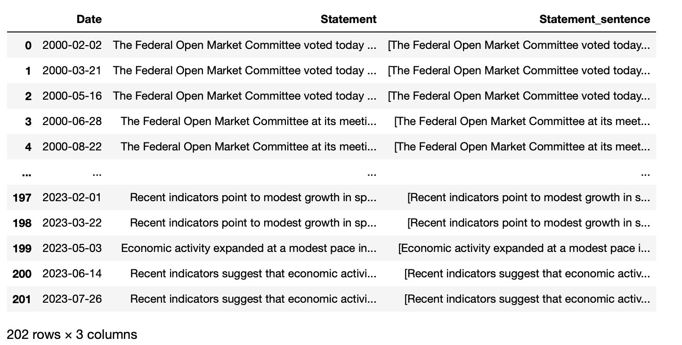
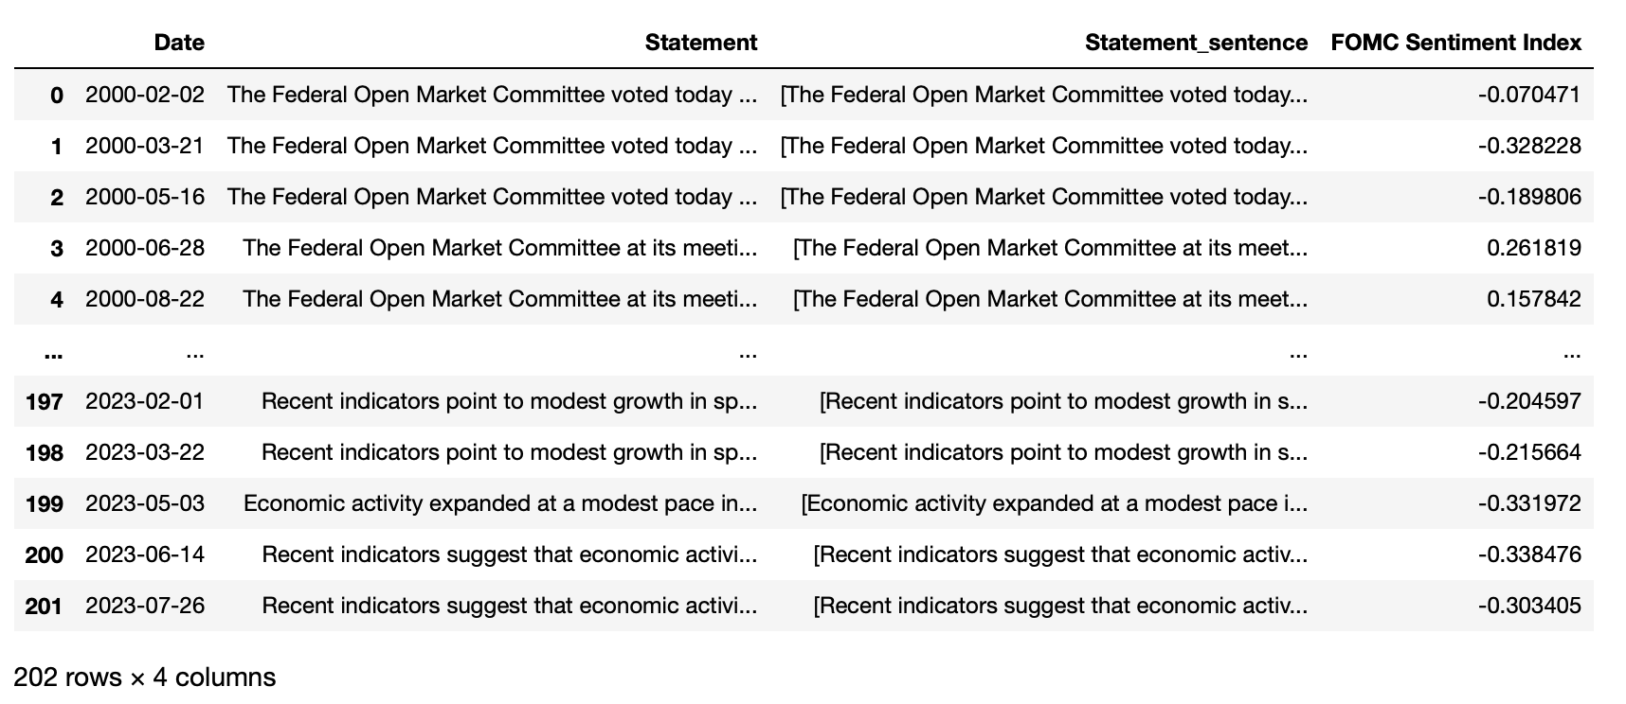
Architecture
Statements to Sentences
Statements to Sentences with FOMC Sentiment Index
mean -0.002320

Slide 6
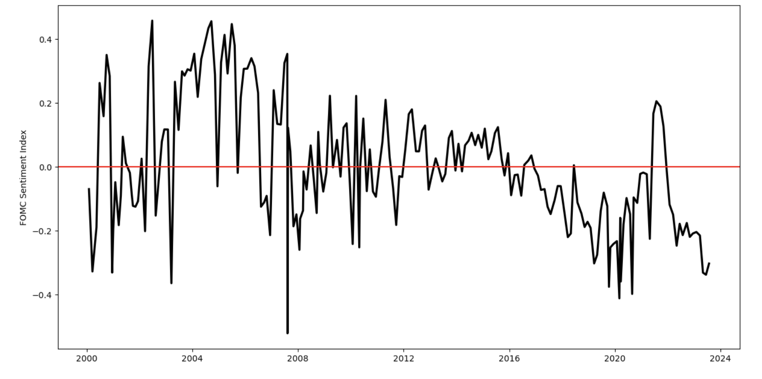
Results - FOMC Sentiment Index
Notes:
4. Results (1)
Show and explain results – how do they show what
you accomplished

Slide 7
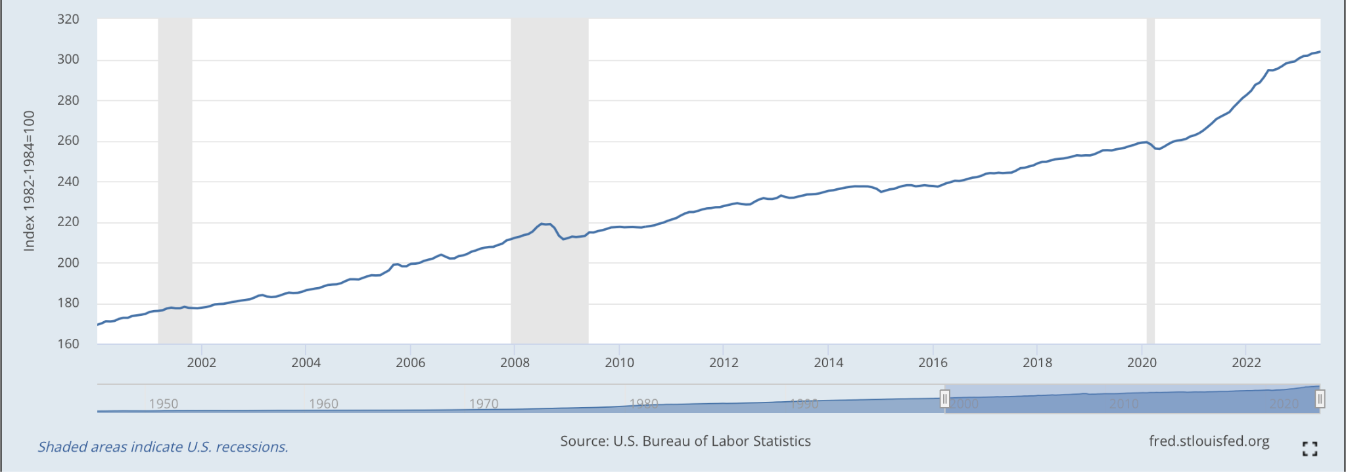
Results - A Comparison to Consumer Price Index for All Urban Consumers: All Items in U.S. City Average
2008
2020
2001

Slide 8
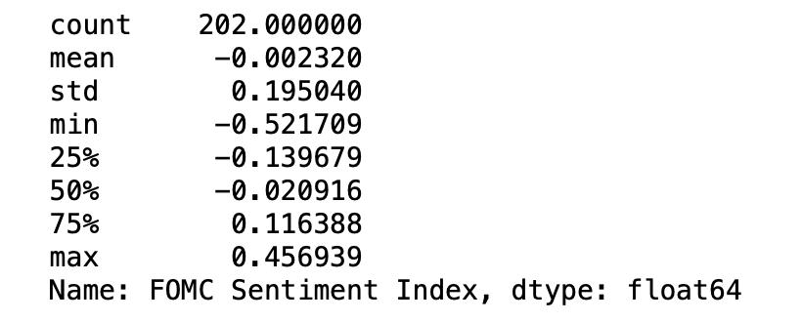
Results - Description of FOMC Sentiment Index

Slide 9
Interpretation and Analysis of Results
Scale Description:
A sentiment index of -1: Extremely positive sentiment.
A sentiment index close to -1: Very positive sentiment.
A sentiment index close to 0: Neutral sentiment.
A sentiment index close to 1: Very negative sentiment.
A sentiment index of 1: Extremely negative sentiment.
FOMC index is -0.002320, it falls very close to neutral sentiment, indicating a nearly balanced or indifferent sentiment in the FOMC speeches.
The sentiment expressed in the speeches is neither overly positive nor negative, but rather neutral with a slightly positive bias.

Slide 10
Results - Index Over Time Linked to Major Economic Events
Notes:
Will add here

Slide 11
Conclusion
I develop a notebook that can be used to implement FinBERT in my data in order to calculate FOMC-SI for each FOMC meeting date. I implemented FinBERT in my data and constructed the FOMC-SI and explored the index over time to link it to some major economic events such as COVID-19 induced recession in 2020 and the Great Financial Crisis during 2007-2008. I used the FOMC-SI to link it to some key economic variables such as economic activity including GDP growth and stock market performance measures via regressions.
Notes:
5. Conclusion (1)

Slide 12
Create a sentiment analysis model trained on more relevant financial text.
Training a domain-specific sentiment analysis model using financial data can potentially lead to more accurate and contextually relevant sentiment predictions for financial documents like FOMC speeches, economic reports, company earnings calls, news articles, and social media posts related to the financial market.
This will allow for a more accurate and contextually meaningful sentiment analysis tool for financial applications.
Future Work

Slide 13
THANK YOU!

